Slide 1
Intro to R – Time Series & Finance Packages
R Workshop
February 25, 2020 Prepared by Jay Cao / TDMDAL
Website: https://tdmdal.github.io/r-tutorial-201920-winter/

Slide 2
What’s Time Series
A series of values obtained at successive times
A series of numerical values
With associated timestamps (or start, end, and frequency if equi-interval)
Typical operations on a time series
lead, lag, difference, rolling window aggregation, etc.
time-aware subsetting
Typical statistics
moving average, returns, etc.
trend, seasonality, stationarity, etc.

Slide 3
How to Store Time Series in R
From what we have seen so far
Vectors (with names as timestamps)
Matrices (with row names as timestamps)
Dataframes/tibbles with a timestamp column
What we really need
Store time series efficiently
More importantly, be able to manipulate time series efficiently
i.e. need associated functions/packages that can efficiently operate on stored time series (lead, lag, smooth, moving average, etc.)

Slide 4
Time Series Specific Data Structures (DS) in R
ts class: a class for equi-spaced time series
what’s a “class”: a data structure with associated operations (methods)
zoo class
can handle regular- and irregular-spaced time series
can use arbitrary classes for the timestamps
xts class
built on zoo with more functions for data processing
uniform handling of R's time-based data classes (zoo, timeSeries, etc.)
Many more
timeSeries class in timeSeries package, etc.
tsibble & tibbletime packages: time-based dataframe/tibble
https://cran.r-project.org/web/views/TimeSeries.html

Slide 5
ts class
A class for equi-spaced time series supported by base R
Data is stored as
a vector or matrix with attributes…
“class”: ts
“tsp” (time series parameters): a numerical vector recording (start, end, freq)
Many functions/packages work well with ts object
ex. forecast package

Slide 6
ts class – how are data stored / 1
> ts_obj <- ts(1:10, frequency = 4, start = c(2017, 2)) # 2nd Quarter of 2017
> ts_obj
Qtr1 Qtr2 Qtr3 Qtr4
2017 1 2 3
2018 4 5 6 7
2019 8 9 10
>
> typeof(ts_obj)
[1] "integer"
>
> class(ts_obj)
[1] "ts"

Slide 7
ts class – how are data stored / 2
> attributes(ts_obj)
$tsp
[1] 2017.25 2019.50 4.00
$class
[1] "ts"

Slide 8
ts class – associated time-aware operations
> cycle(ts_obj)
Qtr1 Qtr2 Qtr3 Qtr4
2017 2 3 4
2018 1 2 3 4
2019 1 2 3
>
> diff(ts_obj, 4)
Qtr1 Qtr2 Qtr3 Qtr4
2018 4 4 4
2019 4 4 4
>
# see notebook for more, and the "forecast" packages intro
> ts_obj
Qtr1 Qtr2 Qtr3 Qtr4
2017 1 2 3
2018 4 5 6 7
2019 8 9 10

Slide 9
xts class
xts extends zoo
zoo can handle regular- and irregular-spaced time series; so does xts
xts can use arbitrary classes for timestamps
Compatible with zoo and other time-series classes in other packages
Many functions/packages work well with xts object
ex. forecast, quantmod, and PerformanceAnalytics

Slide 10
xts class – how are data stored / 1
> x <- matrix(1:6, ncol = 2)
> print(x)
[,1] [,2]
[1,] 1 4
[2,] 2 5
[3,] 3 6
>
> idx <- as.Date(c("2019-01-01", "2019-01-02", "2019-01-05"))
> print(idx)
[1] "2019-01-01" "2019-01-02" "2019-01-05"

Slide 11
xts class – how are data stored / 2
> xts_obj <- xts(x, order.by = idx)
> xts_obj
[,1] [,2]
2019-01-01 1 4
2019-01-02 2 5
2019-01-05 3 6
> typeof(xts_obj)
[1] "integer“
> class(xts_obj)
[1] "xts" "zoo"

Slide 12
xts class – how are data stored / 3
> str(attributes(xts_obj))
List of 3
$ dim : int [1:2] 3 2
$ index: num [1:3] 1.55e+09 1.55e+09 1.55e+09
..- attr(*, "tzone")= chr "UTC"
..- attr(*, "tclass")= chr "Date"
$ class: chr [1:2] "xts" "zoo"

Slide 13
xts class – associated time-aware operations
> # use quantmod package to get data from yahoo finance
> library(quantmod)
> msft <- getSymbols("MSFT",
from = "2018-12-31",
to = "2019-12-31",
auto.assign = FALSE)
>
> # msft_xts is an xts object
> class(msft_xts)
[1] "xts" "zoo"

Slide 14
xts class – associated time-aware operations
> # get data for all Monday in 2019 (time-aware subsetting)
> msft[.indexyear(msft) == (2019 - 1900) & .indexwday(msft) == 1]
MSFT.Open MSFT.High MSFT.Low MSFT.Close MSFT.Volume MSFT.Adjusted
2019-01-07 101.64 103.27 100.98 102.06 35656100 102.06
2019-01-14 101.90 102.87 101.26 102.05 28437100 102.05
2019-01-28 106.26 106.48 104.66 105.08 29476700 105.08
2019-02-04 102.87 105.80 102.77 105.74 31315100 105.74
…
# see notebook for more, and the "PerformanceAnalytics" package intro

Slide 15
Tibble-like Time Series DS & Packages - 1
tidyverts (a toolset consists of three packages)
tsibble: a new time series class (tbl_ts) built on tibble
fable: tidy forecast on top of tissible
feast: Feature Extraction And Statistics for Time Series
tidyquant (package)
integrates resources for collecting and analyzing financial data (xts, quantmod, TTR(Technical Trading Rule) and PerformanceAnalytics)
work with tibble from tidyverse
tibbletime (package)
a time-aware tibble (tbl_time).

Slide 16
Tibble-like Time Series DS & Packages - 2
prophet
time series forecast (from Fastbook) based on addictive model
work directly with tibble from tidyverse

Slide 17
Too Many TS Data Structures!
tsbox
provides conversion between many time series data structures
an attempt to unite time series data structure in R

Slide 18
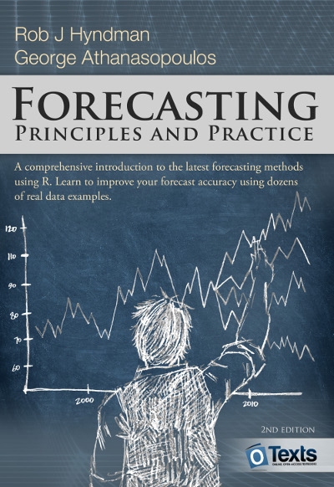
Resources
a Little book of R for Time Series
Forecasting: Principles and Practice
Financial Engineering Analytics: A Practice Manual Using R

