Slide 1
Intro to R – Data wrangling
R Workshop - 2
February 17, 2021 Prepared by Jay Cao / TDMDAL
Website: https://tdmdal.github.io/r-tutorial-201920-winter/

Slide 2
Plan
“Data Scientists spend up to 80% of the time on data cleaning and 20 percent of their time on actual data analysis”
-- ?????
Tidy Data (a way to organize data)
Data manipulation (a continuation)
summarise() and group_by()
_join() datasets
Again, we will focus on basics, underlying principles, and best practices

Slide 3
Tidy Data – Motivation (FANG Revenue Data)
Q1. Is the below table organized well for easy analysis?
Q2. In general, what’s a good way to organize/structure data?
# A tibble: 4 x 6
Ticker `Fiscal Year` Q1 Q2 Q3 Q4
<chr> <int> <dbl> <dbl> <dbl> <dbl>
1 AMZN 2018 51.0 52.9 56.6 72.4
2 FB 2018 12.0 13.2 13.7 16.9
3 GOOG 2018 31.1 32.7 33.7 39.3
4 NFLX 2018 3.70 3.91 4.00 4.19

Slide 4
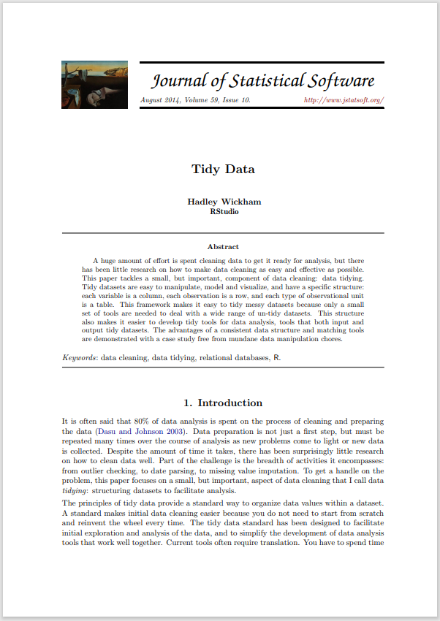
Tidy Data
A (One) way to organize tabular data
Definition
Each variable forms a column.
Each observation, or case, forms a row.
Each type of observational unit forms a table
Why tidy data
A great way to organize data for maintainability
Once in tidy data, it’s easy to use the toolset from tidyverse to manipulate them
http://vita.had.co.nz/papers/tidy-data.html
Notes:
“If you have a consistent data structure, it's easier to learn the tools that work with it because they have an underlying uniformity.”

Slide 5
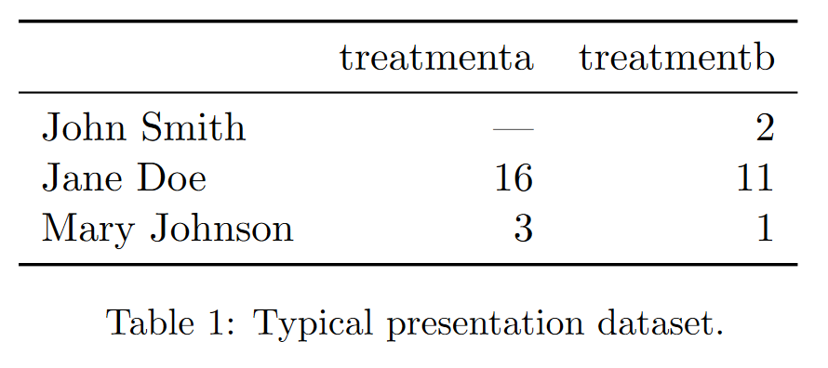
Messy Data – Example 1
http://vita.had.co.nz/papers/tidy-data.html

Slide 6
Messy Data – Example 1
http://vita.had.co.nz/papers/tidy-data.html
Notes:
value as in variable/column name; average results by a and b; average result of all and b; average result by person; in consistency;

Slide 7
Messy Data – Example 1 / Why is it Messy?
Values as column names
Hard to retrieve data and analyze them in a consistent way
how many treatments in total
get average result by person
get average result by treatment
get overall average result
http://vita.had.co.nz/papers/tidy-data.html
Notes:
value as in variable/column name; average results by a and b; average result of all and b; average result by person; in consistency;

Slide 8
Messy Data – Example 1 / Why is it Messy?
Values as column names
Hard to retrieve data and analyze them in a consistent way
how many treatments in total
get average result by person
get average result by treatment
get overall average result
http://vita.had.co.nz/papers/tidy-data.html
Notes:
value as in variable/column name; average results by a and b; average result of all and b; average result by person; in consistency;

Slide 9
Messy Data – Example 1 / Why is it Messy?
Values as column names
Hard to retrieve data and analyze them in a consistent way
how many treatments in total
get average result by person
get average result by treatment
get overall average result
http://vita.had.co.nz/papers/tidy-data.html
Notes:
value as in variable/column name; average results by a and b; average result of all and b; average result by person; in consistency;

Slide 10
Messy Data – Example 1 / Why is it Messy?
Values as column names
Hard to retrieve data and analyze them in a consistent way
how many treatments in total
get average result by person
get average result by treatment
get overall average result
http://vita.had.co.nz/papers/tidy-data.html
Notes:
value as in variable/column name; average results by a and b; average result of all and b; average result by person; in consistency;

Slide 11
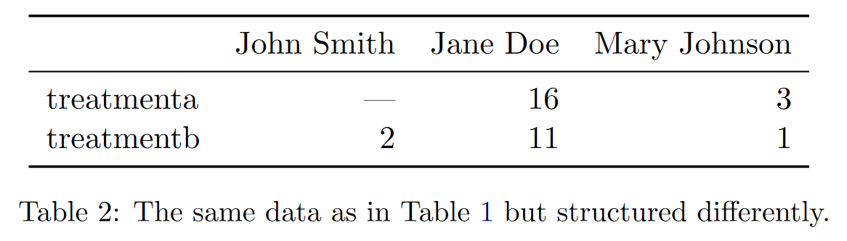
Messy Data – Example 2
http://vita.had.co.nz/papers/tidy-data.html

Slide 12
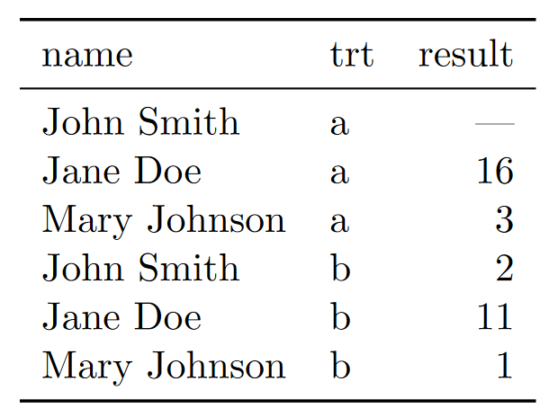
The Tidy Version
http://vita.had.co.nz/papers/tidy-data.html

Slide 13
The Tidy Version – Why is it Tidy
All column-wise operations
how many treatments in total
get average result by person
get average result by treatment
get overall average result
http://vita.had.co.nz/papers/tidy-data.html

Slide 14
Back to the FANG Revenue Data
# A tibble: 4 x 6
Ticker `Fiscal Year` Q1 Q2 Q3 Q4
<chr> <int> <dbl> <dbl> <dbl> <dbl>
1 AMZN 2018 51.0 52.9 56.6 72.4
2 FB 2018 12.0 13.2 13.7 16.9
3 GOOG 2018 31.1 32.7 33.7 39.3
4 NFLX 2018 3.70 3.91 4.00 4.19

Slide 15
From Messy to Tidy (One Example)

Slide 16
pivot_longer()
# A tibble: 3 x 3
name treatmenta treatmentb
<chr> <dbl> <dbl>
1 John Smith NA 2
2 Jane Doe 16 11
3 Mary Johnson 3 1
pivot_longer(df_messy, -name,
names_to = "treatment", values_to = "result")
https://tidyr.tidyverse.org/articles/pivot.html

Slide 17
pivot_longer()
# A tibble: 3 x 3
name treatmenta treatmentb
<chr> <dbl> <dbl>
1 John Smith NA 2
2 Jane Doe 16 11
3 Mary Johnson 3 1
pivot_longer(df_messy, -name,
names_to = "treatment", values_to = "result")
https://tidyr.tidyverse.org/articles/pivot.html

Slide 18
pivot_longer()
# A tibble: 3 x 3
name treatmenta treatmentb
<chr> <dbl> <dbl>
1 John Smith NA 2
2 Jane Doe 16 11
3 Mary Johnson 3 1
pivot_longer(df_messy, -name,
names_to = "treatment", values_to = "result")
https://tidyr.tidyverse.org/articles/pivot.html

Slide 19
pivot_longer()
# A tibble: 3 x 3
name treatmenta treatmentb
<chr> <dbl> <dbl>
1 John Smith NA 2
2 Jane Doe 16 11
3 Mary Johnson 3 1
pivot_longer(df_messy, -name,
names_to = "treatment", values_to = "result")
https://tidyr.tidyverse.org/articles/pivot.html

Slide 20
pivot_longer()
# A tibble: 3 x 3
name treatmenta treatmentb
<chr> <dbl> <dbl>
1 John Smith NA 2
2 Jane Doe 16 11
3 Mary Johnson 3 1
pivot_longer(df_messy, -name,
names_to = "treatment", values_to = "result")
https://tidyr.tidyverse.org/articles/pivot.html

Slide 21
pivot_longer() result
# A tibble: 6 x 3
name treatment result
<chr> <chr> <dbl>
1 John Smith treatmenta NA
2 John Smith treatmentb 2
3 Jane Doe treatmenta 16
4 Jane Doe treatmentb 11
5 Mary Johnson treatmenta 3
6 Mary Johnson treatmentb 1
https://tidyr.tidyverse.org/articles/pivot.html

Slide 22
The inverse transformation: pivot_wider()
name treatment result
<chr> <chr> <dbl>
1 John Smith a NA
2 Jane Doe a 16
3 Mary Johnson a 3
4 John Smith b 2
5 Jane Doe b 11
6 Mary Johnson b 1
pivot_wider(df_tidy,
names_from = treatment, values_from = result)
https://tidyr.tidyverse.org/articles/pivot.html

Slide 23
The inverse transformation: pivot_wider()
name treatment result
<chr> <chr> <dbl>
1 John Smith a NA
2 Jane Doe a 16
3 Mary Johnson a 3
4 John Smith b 2
5 Jane Doe b 11
6 Mary Johnson b 1
pivot_wider(df_tidy,
names_from = treatment, values_from = result)
https://tidyr.tidyverse.org/articles/pivot.html

Slide 24
The inverse transformation: pivot_wider()
name treatment result
<chr> <chr> <dbl>
1 John Smith a NA
2 Jane Doe a 16
3 Mary Johnson a 3
4 John Smith b 2
5 Jane Doe b 11
6 Mary Johnson b 1
pivot_wider(df_tidy,
names_from = treatment, values_from = result)
https://tidyr.tidyverse.org/articles/pivot.html

Slide 25
pivot_wider() result
# A tibble: 3 x 3
name a b
<chr> <dbl> <dbl>
1 John Smith NA 2
2 Jane Doe 16 11
3 Mary Johnson 3 1
https://tidyr.tidyverse.org/articles/pivot.html

Slide 26
Try Yourself: “Tidy up” the FANG revenue data
# A tibble: 16 x 4
Ticker `Fiscal Year` Quarter Revenue
<chr> <int> <chr> <dbl>
1 AMZN 2018 Q1 51.0
2 AMZN 2018 Q2 52.9
3 AMZN 2018 Q3 56.6
4 AMZN 2018 Q4 72.4
5 FB 2018 Q1 12.0
6 FB 2018 Q2 13.2
…
Load the raw “long” data from this URL: https://tdmdal.github.io/r-tutorial-202021-winter/data/fang_2018.csv

Slide 27
Many Ways of Being Messy :(
Messy datasets have 5 common problems (Wickham, 2014)
Column headers are values, not variable names.
Multiple variables are stored in one column.
Variables are stored in both rows and columns.
Multiple types of observational units are stored in the same table.
A single observational unit is stored in multiple tables.
http://vita.had.co.nz/papers/tidy-data.html

Slide 28
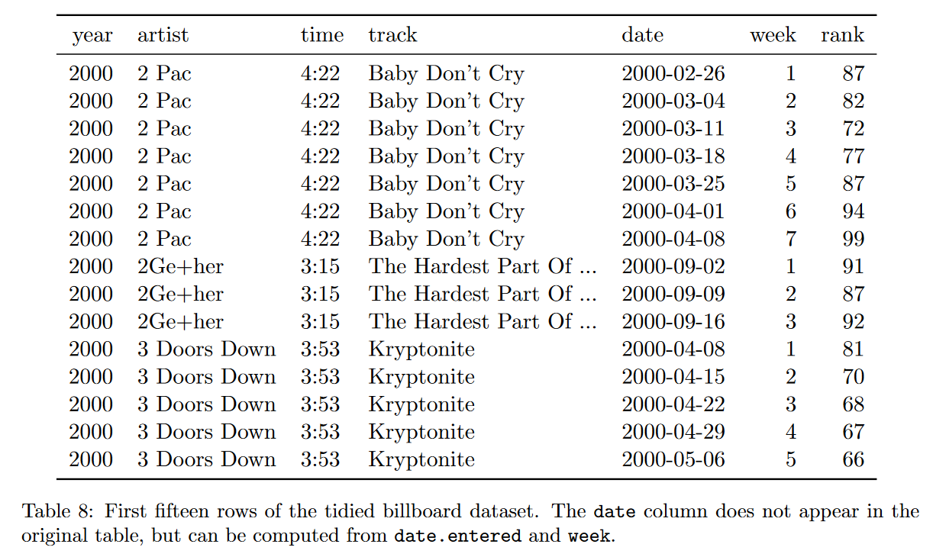
Messy Data – Example 3
http://vita.had.co.nz/papers/tidy-data.html

Slide 29
Messy Data – Example 3
http://vita.had.co.nz/papers/tidy-data.html

Slide 30
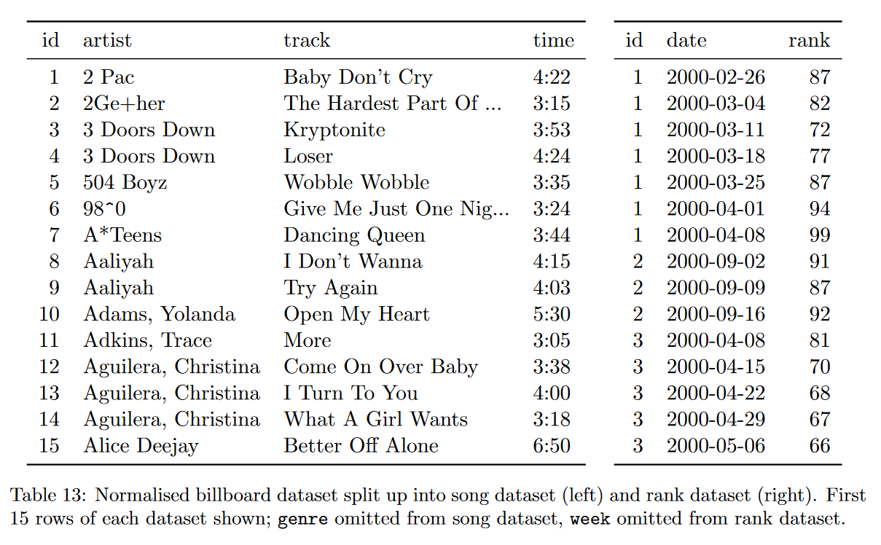
The Tidy Version
http://vita.had.co.nz/papers/tidy-data.html

Slide 31






Tidy Data and Its Eco-system
Tidyverse
“an opinionated collection of R packages designed for data science”
“All packages share an underlying design philosophy, grammar, and data structures.”
Other tools in the eco-system (especially for finance)
tidyquant, a package for quantitative finance
tidyvert, a set of tidy tools for time series
Forecasting: Principles and Practice (3ed), a free book using this toolset

Slide 32
Plan
“Data Scientists spend up to 80% of the time on data cleaning and 20 percent of their time on actual data analysis”
-- ?????
Tidy Data
Data manipulation (a continuation)
summarise() and group_by()
_join() datasets
Again, we will focus on basics, underlying principles, and best practices

Slide 33
Data manipulation: dplyr()
Filter observations: filter()
Select variables: select()
Reorder rows: arrange()
Create new variables: mutate()
Collapse column values to a single summary: summarise()
Group by: group_by()

Slide 34
The Employees Table
> employees %>% select(FirstName, LastName, Country)
# A tibble: 9 x 3
FirstName LastName Country
<chr> <chr> <chr>
1 Nancy Davolio USA
2 Andrew Fuller USA
3 Janet Leverling USA
4 Margaret Peacock USA
5 Steven Buchanan UK
…

Slide 35
Count Number of Employees By Country (1)
> employees %>% select(FirstName, LastName, Country) %>%
group_by(Country)
# A tibble: 9 x 3
# Groups: Country [2]
FirstName LastName Country
<chr> <chr> <chr>
1 Nancy Davolio USA
2 Andrew Fuller USA
3 Janet Leverling USA
…

Slide 36
Count Number of Employees By Country (2)
> employees %>% select(FirstName, LastName, Country) %>%
group_by(Country) %>%
summarise(count = n())
# A tibble: 2 x 2
Country count
<chr> <int>
1 UK 4
2 USA 5

Slide 37
Count Number of Employees By Country (3)
> employees %>% select(FirstName, LastName, Country) %>%
group_by(Country) %>%
summarise(count = n()) %>%
arrange(desc(count))
# A tibble: 2 x 2
Country count
<chr> <int>
1 USA 5
2 UK 4

Slide 38
More on Data Aggregation
summarise() works with many aggregation functions
Aggregation function: n input -> 1 output
e.g. mean(), median(), min(), max(), first(), last(), n_distinct(), …
There are also Windows functions (useful for time series data)
Windows functions: n input -> n output
aggregation variations: cumsum(), cummean(),…
ranking and ordering: rank(), percent_rank(),…
offsets: lead(), lag(),…
https://dplyr.tidyverse.org/reference/summarise.html https://dplyr.tidyverse.org/articles/window-functions.html

Slide 39
Plan
“Data Scientists spend up to 80% of the time on data cleaning and 20 percent of their time on actual data analysis”
-- ?????
Tidy Data
Data manipulation (a continuation)
summarise() and group_by()
_join() datasets
Again, we will focus on basics, underlying principles, and best practices

Slide 40
Motivation: Relation between Datasets/Tables

Slide 41
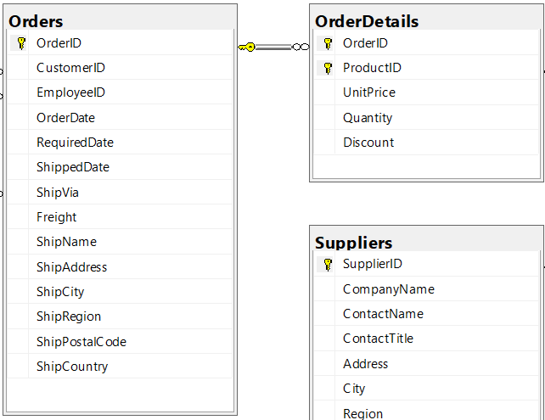
Relation between Datasets/Tables – Zoom In

Slide 42
Relation between Datasets/Tables – Zoom In
Primary key

Slide 43
Relation between datasets/tables – Zoom In
Primary key
Foreign key

Slide 44
Relation between datasets/tables – Zoom In
Primary key
Foreign key
1-to-Many Relationship

Slide 45
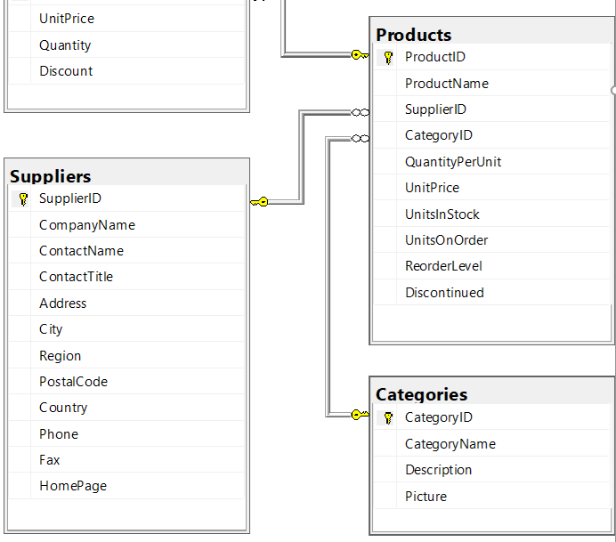
Relation between Tables – Another Example

Slide 46
Join – Inner Join
Table1
Table2
pk | t1c1
1 | a
2 | b
fk | t2c1
1 | c
1 | d
3 | e
Table1
Table2
pk | t1c1 | t2c1
1 | a | c
1 | a | d
inner_join(Table1, Table2, by = c("pk" = "fk"))

Slide 47
Join – Left (Outer) Join
Table1
Table2
pk | t1c1
1 | a
2 | b
fk | t2c1
1 | c
1 | d
3 | e
Table1
Table2
pk | t1c1 | t2c1
1 | a | c
1 | a | d
2 | b | NA
left_join(Table1, Table2, by = c("pk" = "fk"))

Slide 48
Join - Left (Outer) Join With Exclusion
Table1
Table2
pk | t1c1
1 | a
2 | b
fk | t2c1
1 | c
1 | d
3 | e
Table1
Table2
pk | t1c1 | t2c1
2 | b | NA
Table1 %>%
left_join(Table2, by = c("pk" = "fk")) %>%
filter(is.na(t2c1))

Slide 49
More on Join Variations (learn them yourself)
More join variation illustrations in the next few slides
right join, full join, …
Read the “two-table verbs” vignette (in the dplyr package doc)
https://dplyr.tidyverse.org/articles/two-table.html
Read the reference (see the “two table verbs” section)
https://dplyr.tidyverse.org/reference/index.html
For data manipulation tasks in general
reading dplyr related articles are a good start, https://dplyr.tidyverse.org/articles/

Slide 50
Join – Right (Outer) Join*
Table1
Table2
pk | t1c1
1 | a
2 | b
fk | t2c1
1 | c
1 | d
3 | e
Table1
Table2
pk | t1c1 | t2c1
1 | a | c
1 | a | d
3 | NA | e
right_join(Table1, Table2, by = c("pk" = "fk"))
Note: can use left_join as well.

Slide 51
Join - Right (Outer) Join With Exclusion*
Table1
Table2
Table1
Table2
pk | t1c1
1 | a
2 | b
fk | t2c1
1 | c
1 | d
3 | e
pk | t1c1 | t2c1
3 | NA | e
Table1 %>%
right_join(Table2, by = c("pk" = "fk")) %>%
filter(is.na(t1c1))

Slide 52
Join – Full Outer Join
Table1
Table2
pk | t1c1
1 | a
2 | b
fk | t2c1
1 | c
1 | d
3 | e
Table1
Table2
pk | t1c1 | t2c1
1 | a | c
1 | a | d
2 | b | NA
3 | NA | e
full_join(Table1, Table2, by = c("pk" = "fk"))

Slide 53
Join – Full Outer Join With Exclusion
Table1
Table2
pk | t1c1
1 | a
2 | b
fk | t2c1
1 | c
1 | d
3 | e
Table1
Table2
pk | t1c1 | t2c1
2 | b | NA
3 | NA | e
Table1 %>%
full_join(Table2, by = c("pk" = "fk")) %>%
filter(is.na(t1c1) | is.na(t2c1))

