Slide 1
Intro to R – Time Series & Finance Packages
R Workshop - 4
March 3, 2021 Prepared by Jay Cao / TDMDAL
Website: https://tdmdal.github.io/r-tutorial-201920-winter/

Slide 2
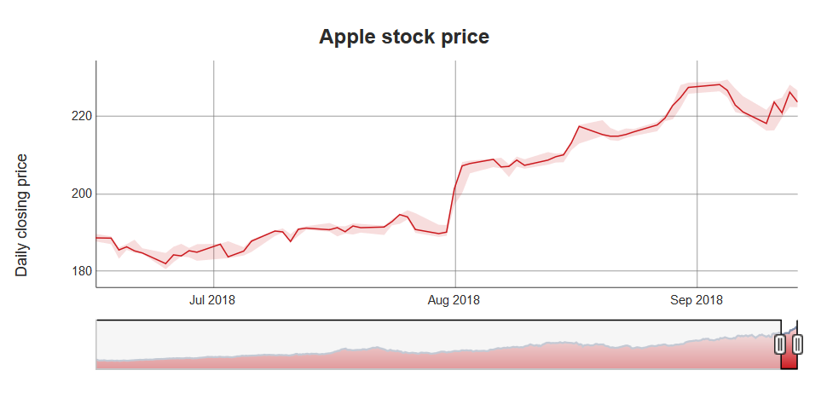
What’s Time Series (TS)
A series of values obtained at successive times
A series of numerical values
With associated timestamps (or start, end, and frequency if equi-interval)
Typical operations on a time series
lead, lag, difference, rolling window aggregation, etc.
time-aware subsetting
Typical statistics
moving average, returns, etc.
trend, seasonality, stationarity, etc.

Slide 3
How to Store Time Series (TS) in R
From what we have seen so far
Vectors (with names as timestamps)
Matrices (with row names as timestamps)
Dataframes/tibbles with a timestamp column
What we really need
Store time series efficiently
More importantly, be able to manipulate time series efficiently
i.e. need associated functions/packages that can efficiently operate on stored time series (lead, lag, smooth, moving average, etc.)

Slide 4
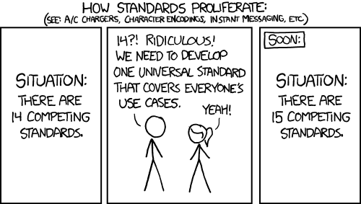
Current Status of R TS Data Structures
A vast number of Time Series Data Structures
Each has associated packages
for TS manipulation
for TS analysis/modeling
https://www.tsbox.help/; https://xkcd.com/927/

Slide 5
Oldies but Goodies
ts class: a class for equi-spaced time series
what’s a “class”: a data structure with associated operations (methods)
zoo class
can handle regular- and irregular-spaced time series
can use arbitrary classes for the timestamps
xts class
built on zoo with more functions for data processing
uniform handling of R's time-based data classes (e.g.zoo, timeSeries, etc.)
Many more
timeSeries class in timeSeries package
tis class from tis package
https://cran.r-project.org/web/views/TimeSeries.html

Slide 6


New Kids in Town
Tibble-like
tsibble from tsibble package: time-based dataframe/tibble
Tibble, but make it “time-aware” whenever needed
Tidyquant takes this approach (e.g. it converts tibble to xts when interfacing with other packages that operates on xts)

Slide 7
Which One Should You Use
Try “New Kids” first
Learn them on your own as they mostly follow the Tidyverse design principle
I will mention a few related TS and finance packages at the end
If “New Kids” can’t do the job, fall back to “Oldies but Goodies”
We will focus on ts and xts and a few related TS and finance packages today

Slide 8
ts class
A class for equi-spaced time series supported by base R
Data is stored as
a vector or matrix with attributes…
“class”: ts
“tsp” (time series parameters): a numerical vector recording (start, end, freq)
Many functions/packages work well with ts object
ex. forecast package

Slide 9
ts class – how are data stored / 1
> ts_obj <- ts(1:10, frequency = 4, start = c(2017, 2)) # 2nd Quarter of 2017
> ts_obj
Qtr1 Qtr2 Qtr3 Qtr4
2017 1 2 3
2018 4 5 6 7
2019 8 9 10
>
> typeof(ts_obj)
[1] "integer"
>
> class(ts_obj)
[1] "ts"

Slide 10
ts class – how are data stored / 2
> attributes(ts_obj)
$tsp
[1] 2017.25 2019.50 4.00
$class
[1] "ts"

Slide 11
ts class – associated time-aware operations
> cycle(ts_obj)
Qtr1 Qtr2 Qtr3 Qtr4
2017 2 3 4
2018 1 2 3 4
2019 1 2 3
>
> diff(ts_obj, 4)
Qtr1 Qtr2 Qtr3 Qtr4
2018 4 4 4
2019 4 4 4
>
# see notebook for more, and the "forecast" packages intro
> ts_obj
Qtr1 Qtr2 Qtr3 Qtr4
2017 1 2 3
2018 4 5 6 7
2019 8 9 10

Slide 12
xts class
xts extends zoo
zoo can handle regular- and irregular-spaced time series; so does xts
xts can use arbitrary classes for timestamps
Compatible with zoo and other time-series classes in other packages
Many functions/packages work well with xts object
ex. forecast, quantmod, and PerformanceAnalytics

Slide 13
xts class – how are data stored / 1
> x <- matrix(1:6, ncol = 2)
> print(x)
[,1] [,2]
[1,] 1 4
[2,] 2 5
[3,] 3 6
>
> idx <- as.Date(c("2019-01-01", "2019-01-02", "2019-01-05"))
> print(idx)
[1] "2019-01-01" "2019-01-02" "2019-01-05"

Slide 14
xts class – how are data stored / 2
> xts_obj <- xts(x, order.by = idx)
> xts_obj
[,1] [,2]
2019-01-01 1 4
2019-01-02 2 5
2019-01-05 3 6
> typeof(xts_obj)
[1] "integer“
> class(xts_obj)
[1] "xts" "zoo"

Slide 15
xts class – how are data stored / 3
> str(attributes(xts_obj))
List of 3
$ dim : int [1:2] 3 2
$ index: num [1:3] 1.55e+09 1.55e+09 1.55e+09
..- attr(*, "tzone")= chr "UTC"
..- attr(*, "tclass")= chr "Date"
$ class: chr [1:2] "xts" "zoo"

Slide 16
xts class – associated time-aware operations
> # use quantmod package to get data from yahoo finance
> library(quantmod)
> msft <- getSymbols("MSFT",
from = "2018-12-31",
to = "2019-12-31",
auto.assign = FALSE)
>
> # msft_xts is an xts object
> class(msft_xts)
[1] "xts" "zoo"

Slide 17
xts class – associated time-aware operations
> # get data for all Monday in 2019 (time-aware subsetting)
> msft[.indexyear(msft) == (2019 - 1900) & .indexwday(msft) == 1]
MSFT.Open MSFT.High MSFT.Low MSFT.Close MSFT.Volume MSFT.Adjusted
2019-01-07 101.64 103.27 100.98 102.06 35656100 102.06
2019-01-14 101.90 102.87 101.26 102.05 28437100 102.05
2019-01-28 106.26 106.48 104.66 105.08 29476700 105.08
2019-02-04 102.87 105.80 102.77 105.74 31315100 105.74
…
# see notebook for more, and the "PerformanceAnalytics" package intro

Slide 18
Tibble-like and Tibble TS DS & Packages - 1
tidyverts (a toolset consists of three packages)
tsibble: a new time series class (tbl_ts) built on tibble
fable: tidy forecast on top of tissible
feast: Feature Extraction And Statistics for Time Series
tidyquant (package)
integrates resources for collecting and analyzing financial data (xts, quantmod, TTR(Technical Trading Rule) and PerformanceAnalytics)
work with tibble from tidyverse

Slide 19
Tibble-like and Tibble TS DS & Packages - 2
prophet
time series forecast (from Fastbook) based on addictive model
work directly with tibble from tidyverse

Slide 20
Too Many TS Data Structures!
tsbox
provides conversion between many time series data structures
an attempt to unite time series data structure in R

Slide 21
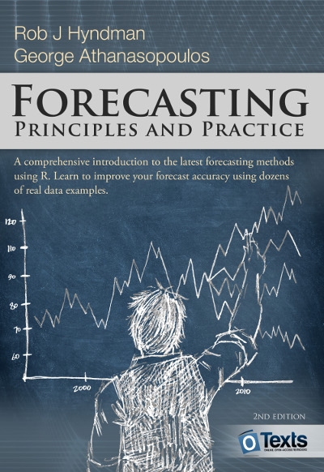
Resources
a Little book of R for Time Series
Forecasting: Principles and Practice (2nd ed)
uses forecast packages
Forecasting: Principles and Practice (3rd ed.)
uses tsibble and fable packages
Financial Engineering Analytics: A Practice Manual Using R

