Slide 1
Intro to R - Visualization
R Workshop - 3
February 24, 2021 Prepared by Jay Cao / TDMDAL
Website: https://tdmdal.github.io/r-tutorial-201920-winter/

Slide 2
R Graphics - Overview
Base plot
Two main plotting systems
lattice
ggplot2
Specialized plots
Plot functions bundled with specific R packages

Slide 3
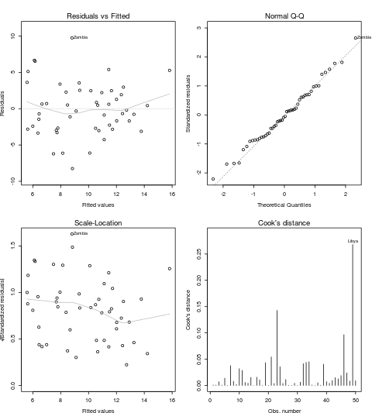
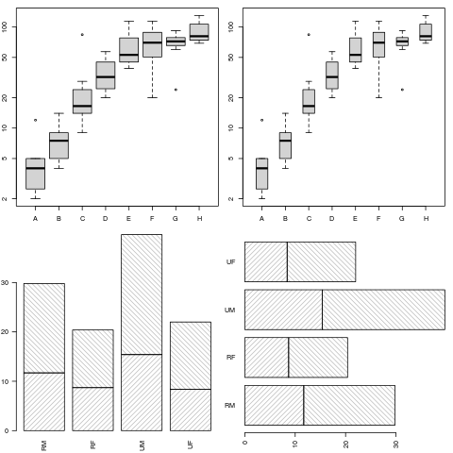
R Graphics – Base plots (examples)
https://www.stat.auckland.ac.nz/~paul/RG3e/chapter2.html

Slide 4
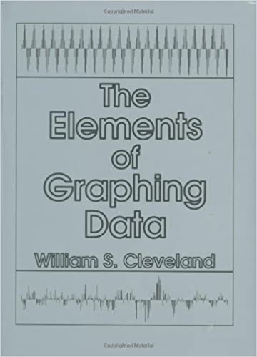
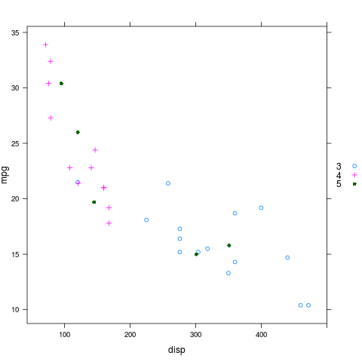
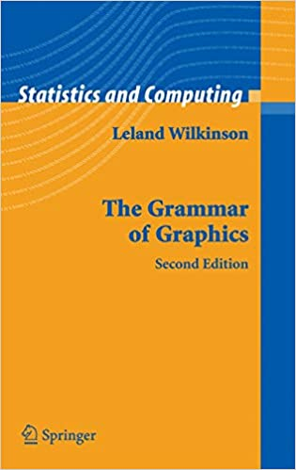
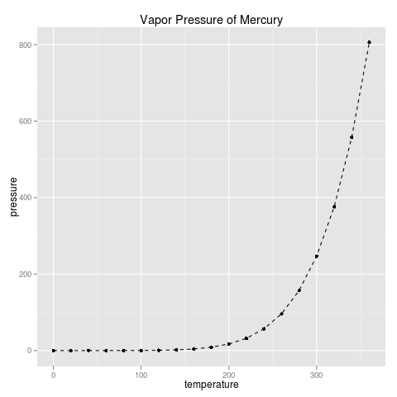
R Graphics – Two Main Plotting Systems
R package: lattice
implements Trellis system by William Cleveland
R package: ggplot2
implements "A Grammar of Graphics" by Leland Wilkinson
Our focus today
https://www.stat.auckland.ac.nz/~paul/RG3e/chapter4.html
https://www.stat.auckland.ac.nz/~paul/RG3e/chapter5.html

Slide 5
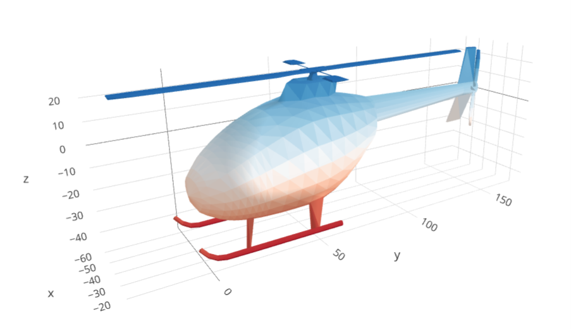
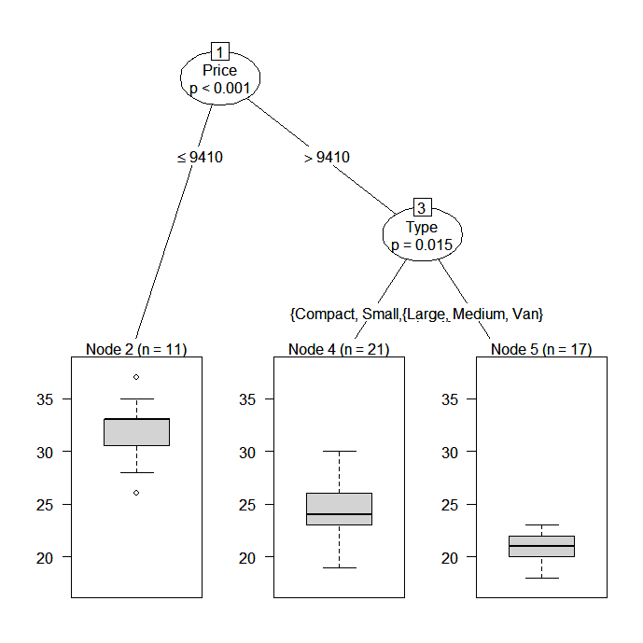
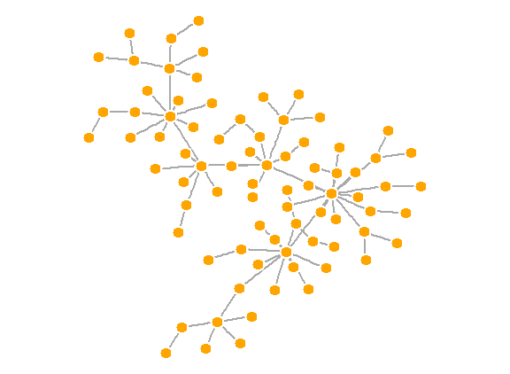
Other - Specialized Plots
Graphic functions provided by specialized packages
Based on R primitive graphical engines like grid (eg. plot() in party, igraph)
Following a plotting system (eg. ggmap, tmap, gganimate, plotly, etc.)
Wrapper of plotting tools in another languages (ex. leaflet, grViz() in DiagrammeR, dygraphs)
3D tri-surface interactive plot using the plotly package
https://plot.ly/r/trisurf/
Decision tree plot using party package
https://www.statmethods.net/advstats/cart.html
Network plot using igraph package
http://kateto.net/networks-r-igraph

Slide 6
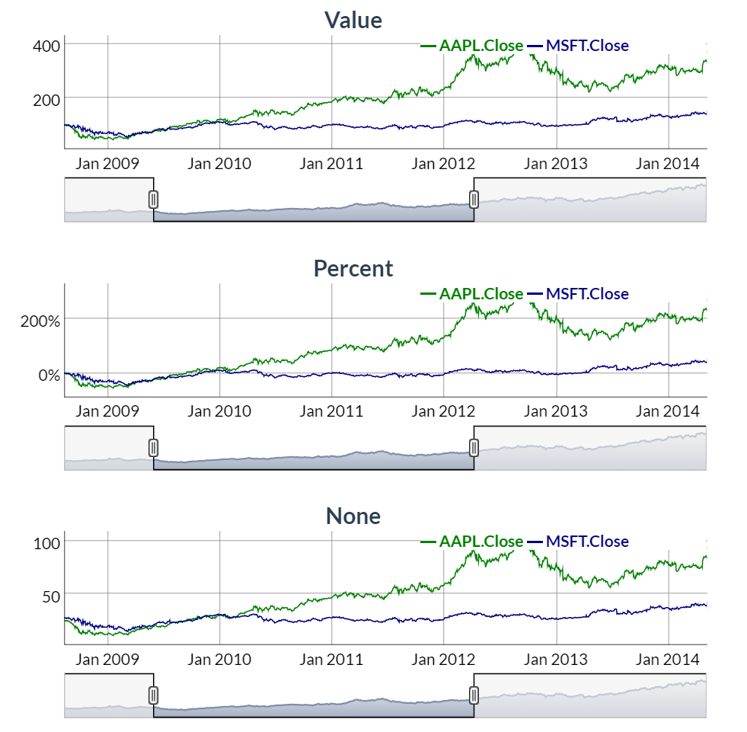
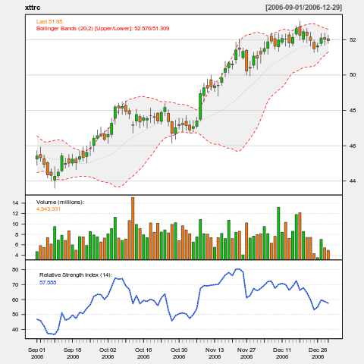
Specialized Plots Highlight - Time Series
https://www.quantmod.com/examples/charting/
https://rstudio.github.io/dygraphs/gallery-straw-broom.html

Slide 7
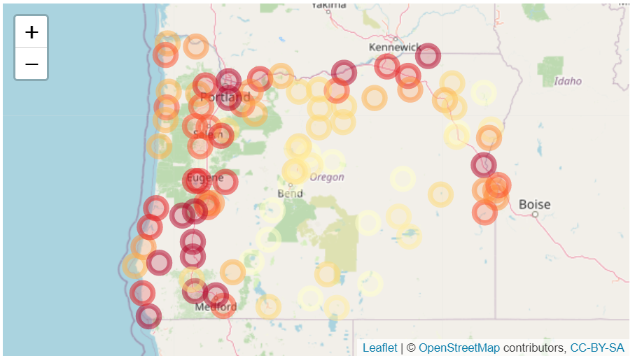
Specialized Plots Highlight - htmlwidgets
R plots that produce interactive web visualizations
See show cases here
My example on the course website

Slide 8
Plan for today
plotting system: ggplot()
stock price series plot using
tidyquant
dygraph

Slide 9
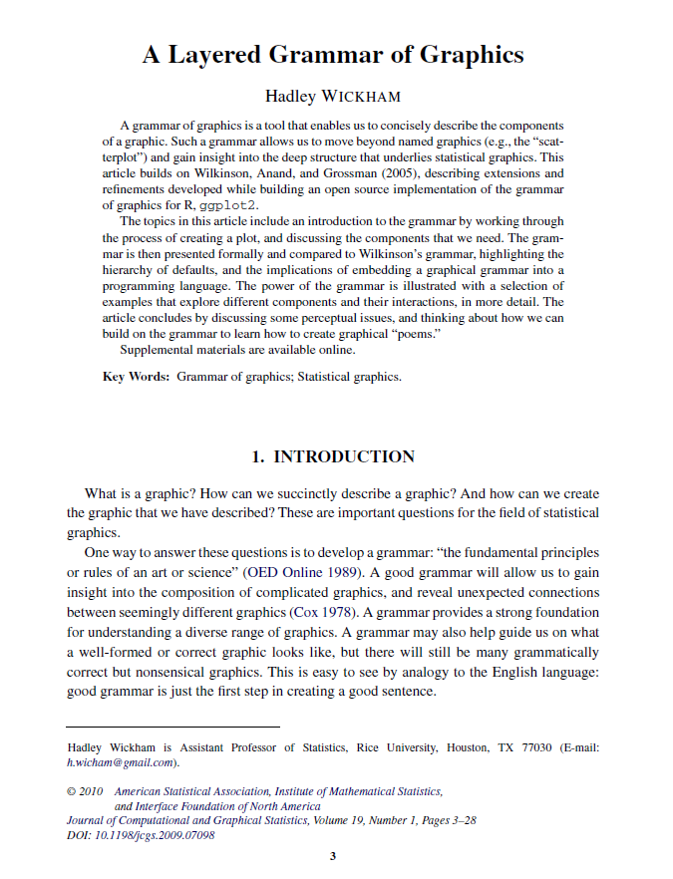
ggplot2
Based on the Grammar of Graphics
Basic idea: you can build any graph from the same components
Data
Coordinate system
Geoms – visual marks that represent data points
A layer-by-layer approach
http://amzn.to/2ef1eWp
http://vita.had.co.nz/papers/layered-grammar.html

Slide 10
ggplot() – “base layer”
p <- ggplot(df, aes(x, y, other_aesthetics))
data
https://ggplot2.tidyverse.org/reference/ggplot.html

Slide 11
ggplot() – “base layer”
mapping: linking variables in the data to aesthetic elements in the plot
p <- ggplot(df, aes(x, y, other_aesthetics))
data
https://ggplot2.tidyverse.org/reference/ggplot.html

Slide 12
ggplot() – “base layer”
mapping: linking variables in the data to aesthetic elements in the plot
p <- ggplot(df, aes(x, y, other_aesthetics))
data
(x, y) coordinates mapping
color-, size-mapping, etc.
https://ggplot2.tidyverse.org/reference/ggplot.html

Slide 13
ggplot() – Add Other Layers
p <- ggplot(df, aes(x, y, other_aesthetics)) +
another_layer +
another_layer +
…
If data and mapping are not specified in the base layer, they must be supplied in each layer added to the plot
mapping: linking variables in the data to aesthetic elements in the plot
data
what to plot : point, line, label, etc. (geom-, scale-functions...)
https://ggplot2.tidyverse.org/reference/ggplot.html

Slide 14
ggplot() – “base layer” / example
country continent year lifeExp pop gdpPercap
<fct> <fct> <int> <dbl> <int> <dbl>
1 Afghanistan Asia 2007 43.8 31889923 975.
2 Albania Europe 2007 76.4 3600523 5937.
3 Algeria Africa 2007 72.3 33333216 6223.
p <- ggplot(df, aes(x = gdpPercap, y = lifeExp))

Slide 15

ggplot() – geom layers (eg. geom_point )
p + geom_point(DATA, MAPPING, STAT, POSITION, …)
layer specific data and mapping
If not specified, inherit from base layer
https://ggplot2.tidyverse.org/reference/geom_point.html

Slide 16
ggplot() – geom layers (eg. geom_point )
p + geom_point(DATA, MAPPING, STAT, POSITION, …)
layer specific data and mapping
If not specified, inherit from base layer
statistical transformation & position adjustment
e.g. position = “jitter"
https://ggplot2.tidyverse.org/reference/geom_point.html

Slide 17
ggplot() – geom layers (eg. geom_point )
other arguments:
e.g. color = "red", alpha = 0.5, etc.
p + geom_point(DATA, MAPPING, STAT, POSITION, …)
layer specific data and mapping
If not specified, inherit from base layer
statistical transformation & position adjustment
e.g. position = “jitter"
https://ggplot2.tidyverse.org/reference/geom_point.html

Slide 18
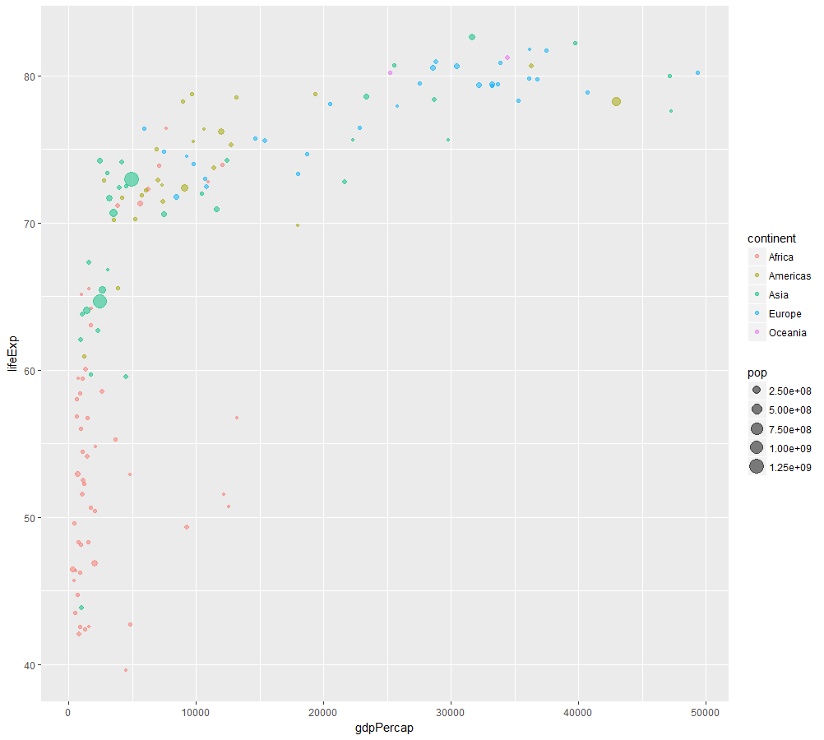
ggplot() – geom_point layer / example
p +
geom_point(aes(size = pop,
color = continent),
alpha = 0.5)

Slide 19
ggplot() – example (diamond data)
## # A tibble: 6 x 10
## carat cut color clarity depth table price x y z
## <dbl> <ord> <ord> <ord> <dbl> <dbl> <int> <dbl> <dbl> <dbl>
## 1 0.23 Ideal E SI2 61.5 55 326 3.95 3.98 2.43
## 2 0.21 Premium E SI1 59.8 61 326 3.89 3.84 2.31
## 3 0.23 Good E VS1 56.9 65 327 4.05 4.07 2.31
## 4 0.290 Premium I VS2 62.4 58 334 4.2 4.23 2.63
## 5 0.31 Good J SI2 63.3 58 335 4.34 4.35 2.75
## 6 0.24 Very Good J VVS2 62.8 57 336 3.94 3.96 2.48

Slide 20
ggplot() – example (layer 1)
ggplot(data = diamonds, aes(carat, price)) +

Slide 21
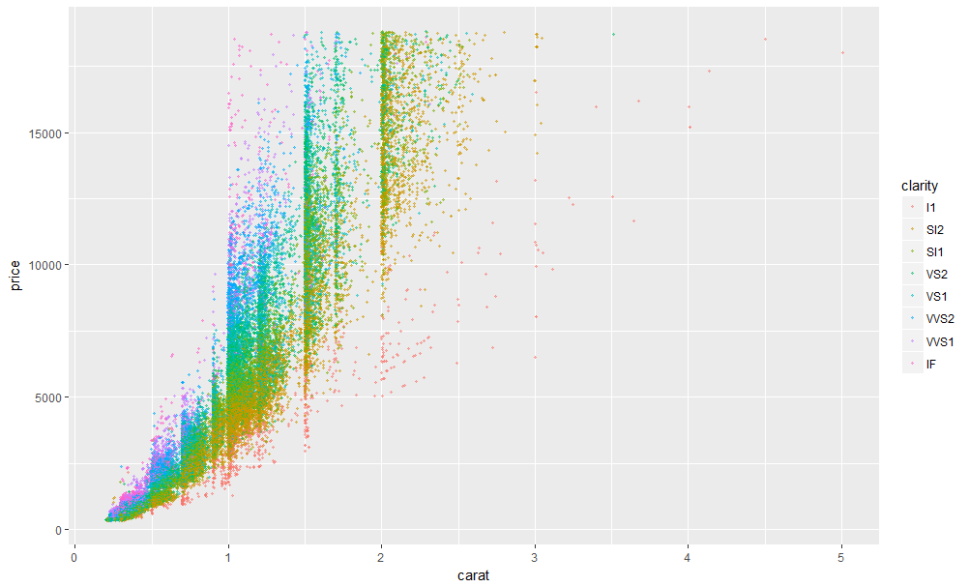
ggplot() – example (layer 2)
ggplot(data = diamonds, aes(carat, price)) +
geom_point(aes(colour = clarity),
position = "jitter",
alpha = 0.5,
size = 0.8) +

Slide 22
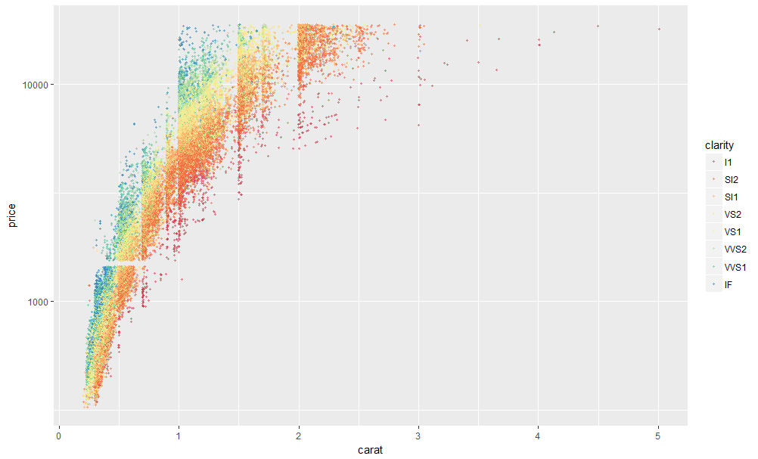
ggplot() – example (layer 3 & layer 4)
ggplot(data = diamonds, aes(carat, price)) +
geom_point(aes(colour = clarity),
position = "jitter",
alpha = 0.5,
size = 0.8) +
scale_y_continuous(trans = "log10") +
scale_color_brewer(palette = "Spectral") +

Slide 23
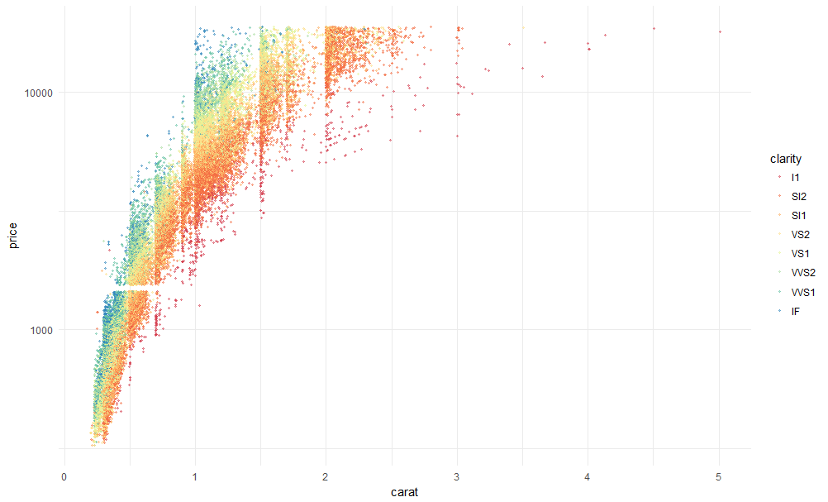
ggplot() – example (layer 5)
ggplot(data = diamonds, aes(carat, price)) +
geom_point(aes(colour = clarity),
position = "jitter",
alpha=0.5,
size = 0.8) +
scale_y_continuous(trans = "log10") +
scale_color_brewer(palette = "Spectral") +
theme_minimal()

Slide 24
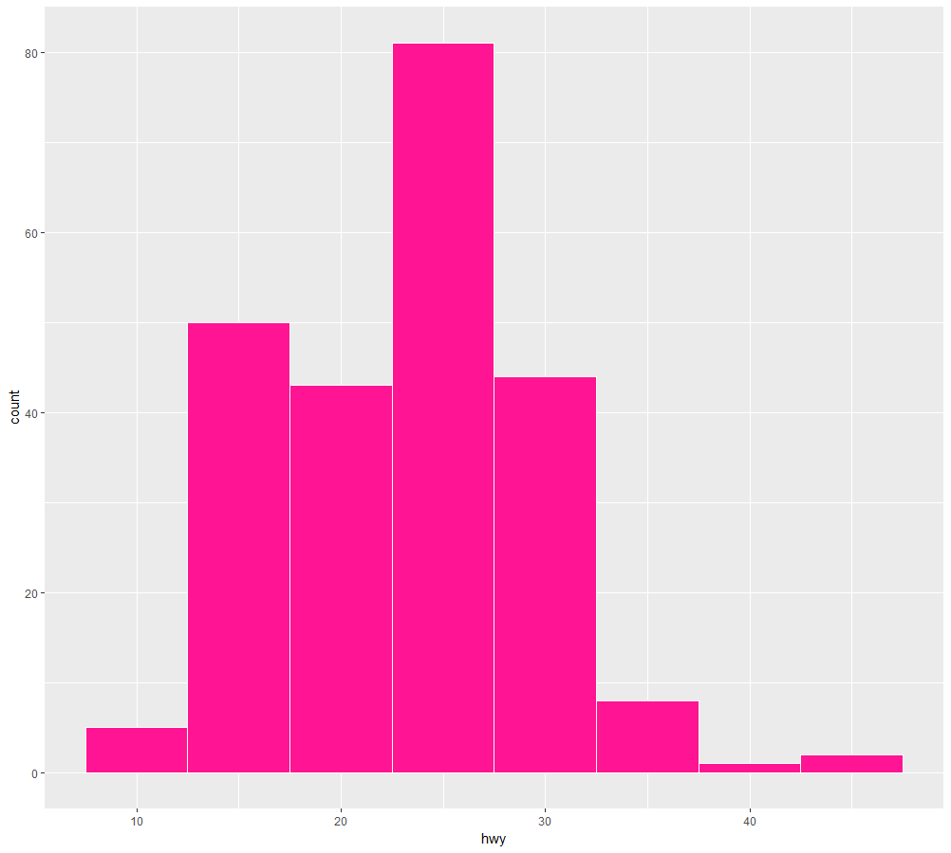
ggplot() – geom_histogram / example
# A tibble: 234 x 11
manufacturer model displ year cyl trans drv cty hwy fl class
<chr> <chr> <dbl> <int> <int> <chr> <chr> <int> <int> <chr> <chr>
1 audi a4 1.80 1999 4 auto(l5) f 18 29 p compact
2 audi a4 1.80 1999 4 manual(m5) f 21 29 p compact
3 audi a4 2.00 2008 4 manual(m6) f 20 31 p compact
ggplot(mpg, aes(x = hwy)) +
geom_histogram(binwidth=5,
color = "white",
fill = "deeppink")
https://ggplot2.tidyverse.org/reference/geom_histogram.html

Slide 25
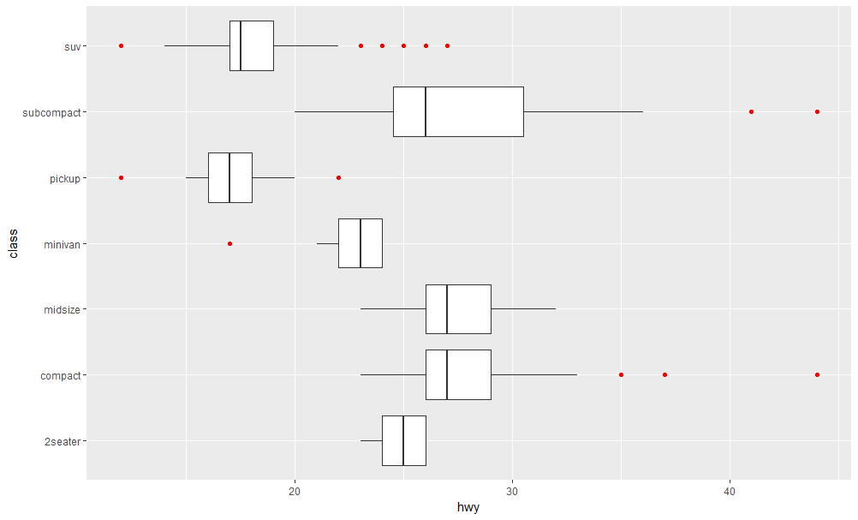
ggplot() – geom_boxplot / example
ggplot(mpg, aes(class, hwy)) +
geom_boxplot(outlier.colour = "red") +
coord_flip()
https://ggplot2.tidyverse.org/reference/geom_boxplot.html

Slide 26
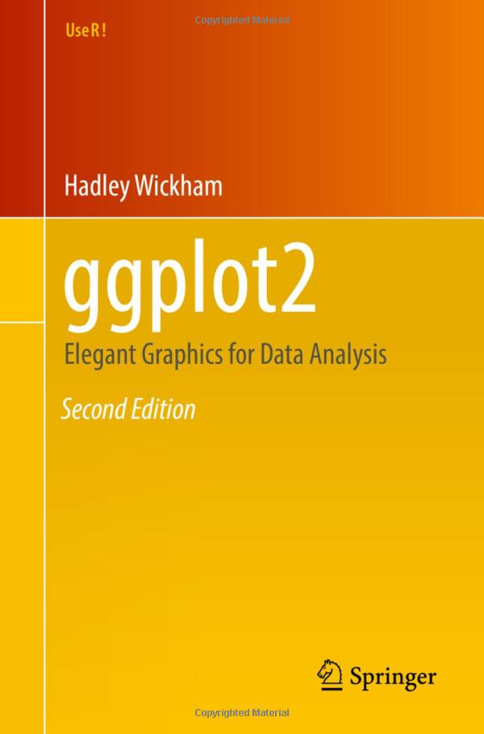
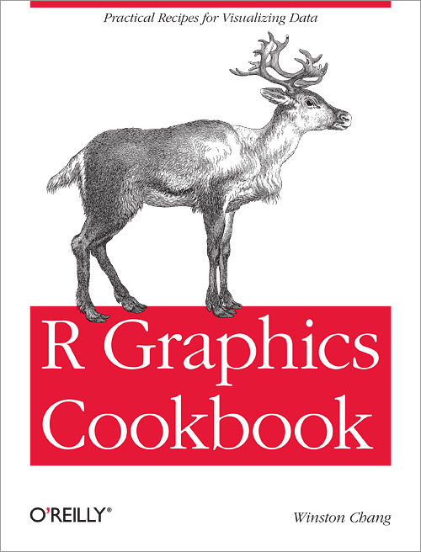
Learning Resources (free)
ggplot2: Elegant Graphics for Data Analysis (3rd ed.; work in progress)
R Graphics Cookbook (2nd ed.)

Slide 27
Plan for today
plotting system: ggplot()
stock price series plot using
tidyquant
dygraph

Slide 28
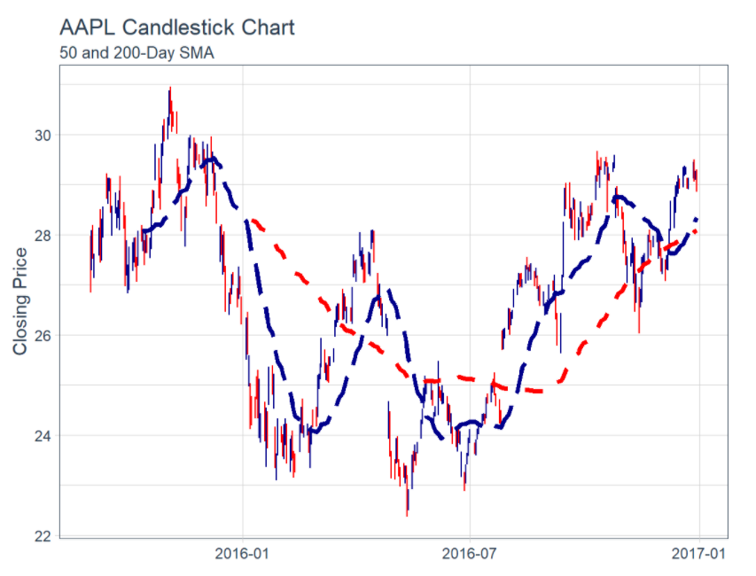
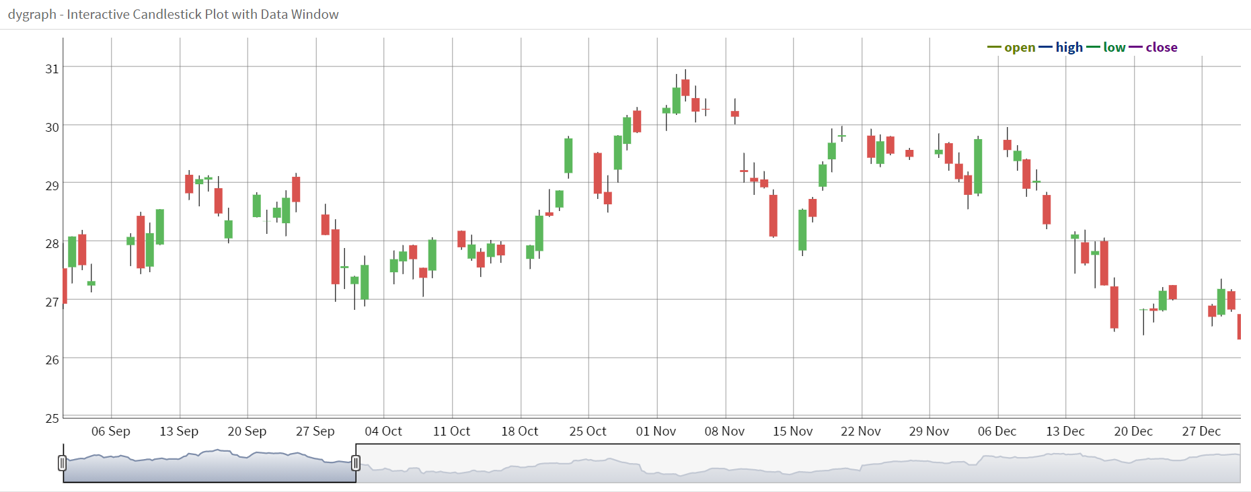
Three examples
Candlestick plot
Candlestick plot with simple moving average
Interactive candlestick plot with data window

