Slide 1
Intro to R
R Workshop for Researchers
November 4, 2019 Prepared by Jay Cao / TDMDAL
Website: https://tdmdal.github.io/r-workshop-students/

Slide 2

What’s R?
A programming language
Free and open source
Extensible with many high-quality user-contributed libraries/packages
Great for statistical analysis, graphics and many other things (ex?)
General purpose languages
- C/C++
- Python
Statistical Analysis Languages/Toolkits
- SPSS
- Stata

Slide 3
What can R do – Statistics & related
Statistics & Econometrics
Regressions
Time series analysis
Bayesian inference
Survival analysis
…
Numerical Mathematics
Optimization
Solver
Differential equations
…
Finance
Portfolio management
Risk management
Option pricing
…
…

Slide 4
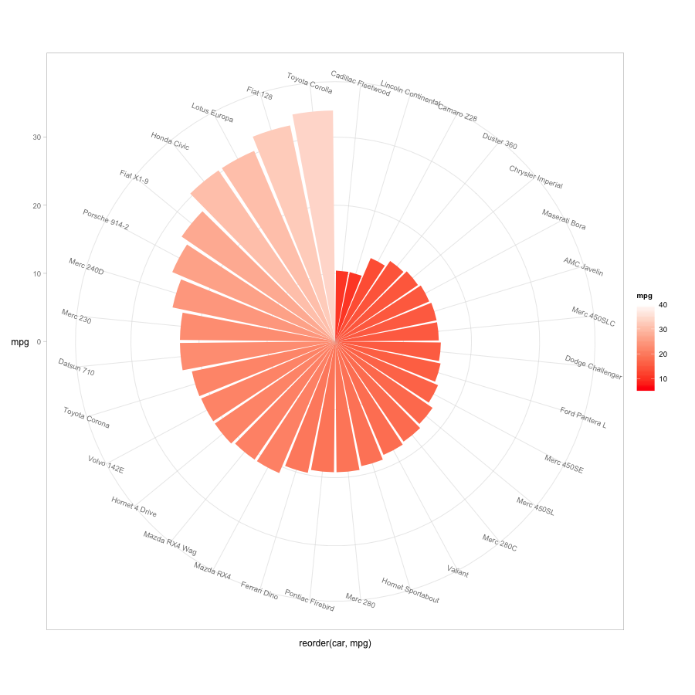
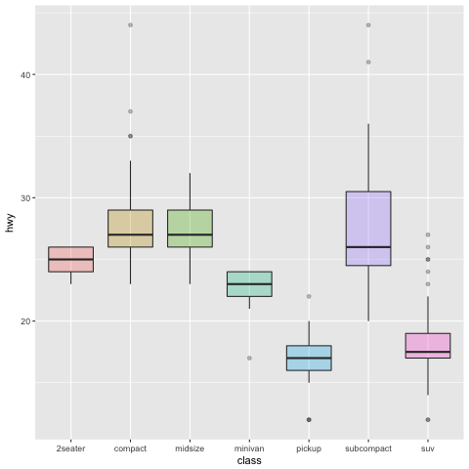
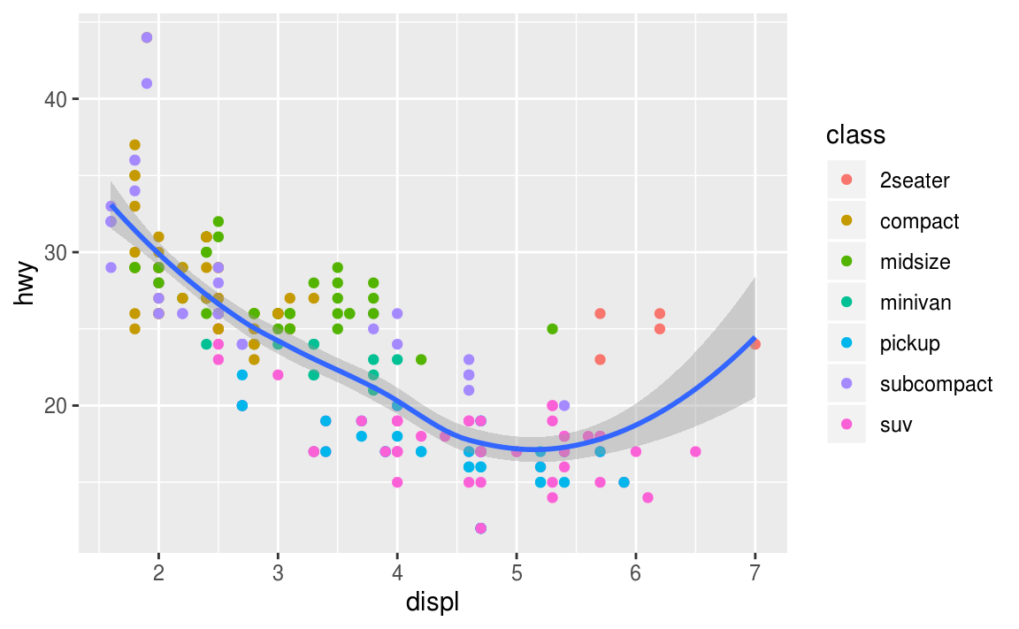
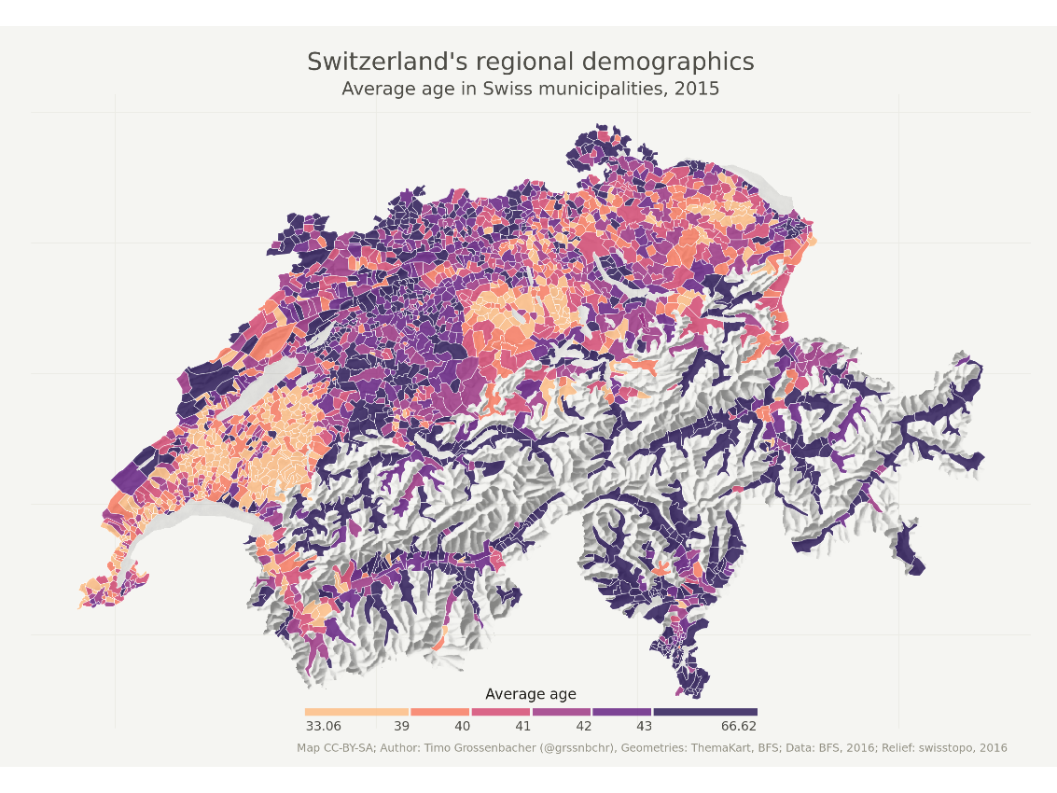
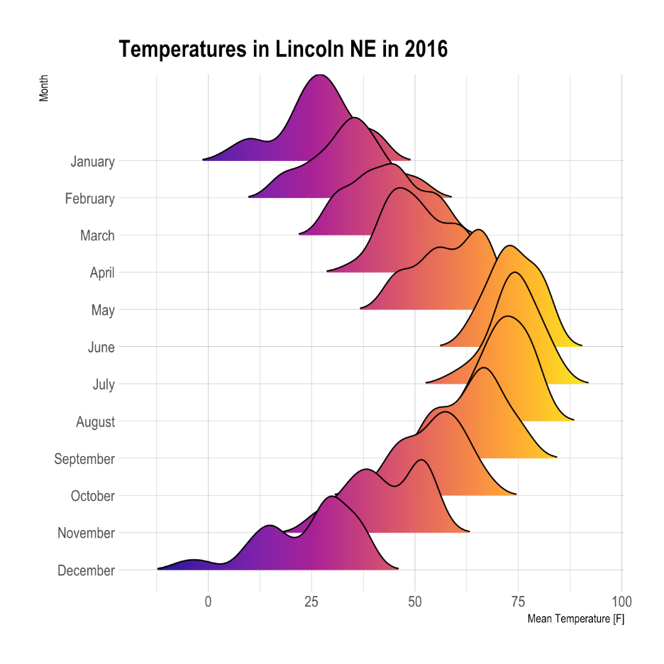
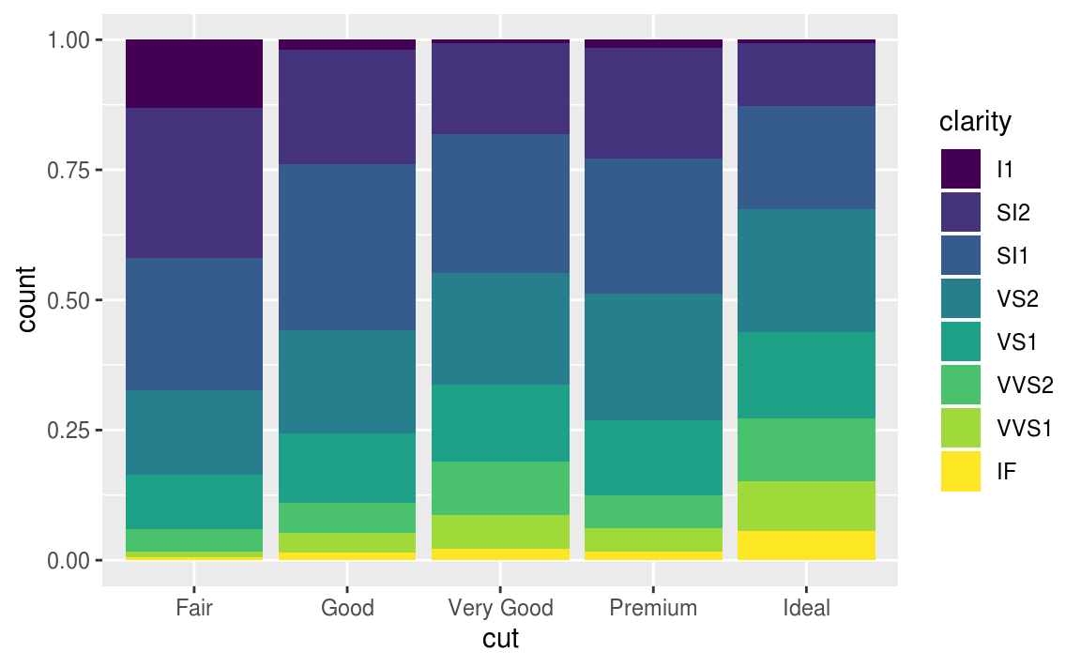
What can R do – Graphics (static ones)
…
https://www.r-graph-gallery.com/
https://timogrossenbacher.ch/2016/12/beautiful-thematic-maps-with-ggplot2-only/;

Slide 5
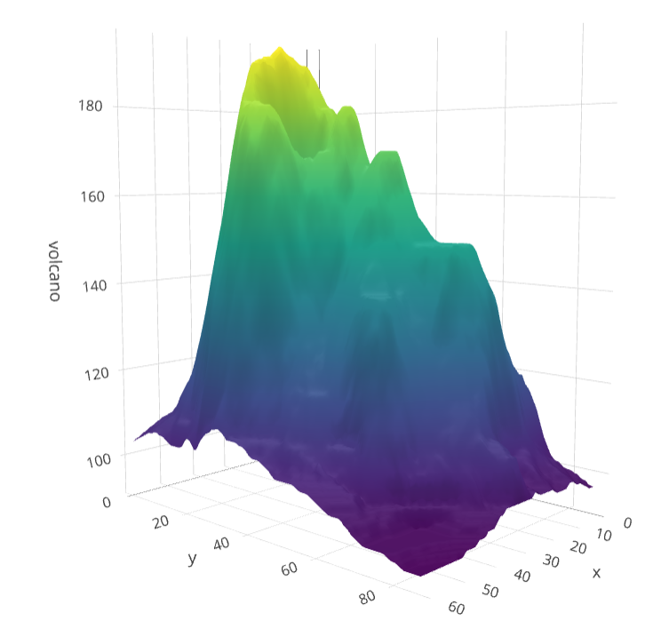
What can R do – Graphics (dynamic ones)
https://plot.ly/r/3d-surface-plots/; https://github.com/thomasp85/gganimate;

Slide 6
What can R do – Others
Machine learning (ex. R interface to Keras: keras)
Natural language processing (ex. tidytext, topicmodels)
Web technology
Web scraping (ex. rvest)
API wrapper (ex. Twitter: rtweet; bigquery: bigrquery; Quandl: Quandl)
Shiny web app (https://shiny.rstudio.com/)
Reporting
R Markdown (write reports, slides, blogs, books, etc. See a gallery here.)
… (see R Task View for more)

Slide 7
What can R do, for you?
Beyond Excel
Automate boring tasks
Prototype ideas
…

Slide 8
Plan for Today (~2 hrs)
Motivation: two examples
A simple regression (housing price and pollution)
Twitter API
Basics of R (quick overview)
Data structure
Programming structure
A typical analysis workflow: extending the regression example
Import and manipulate data
Build models
Report and graph results

Slide 9

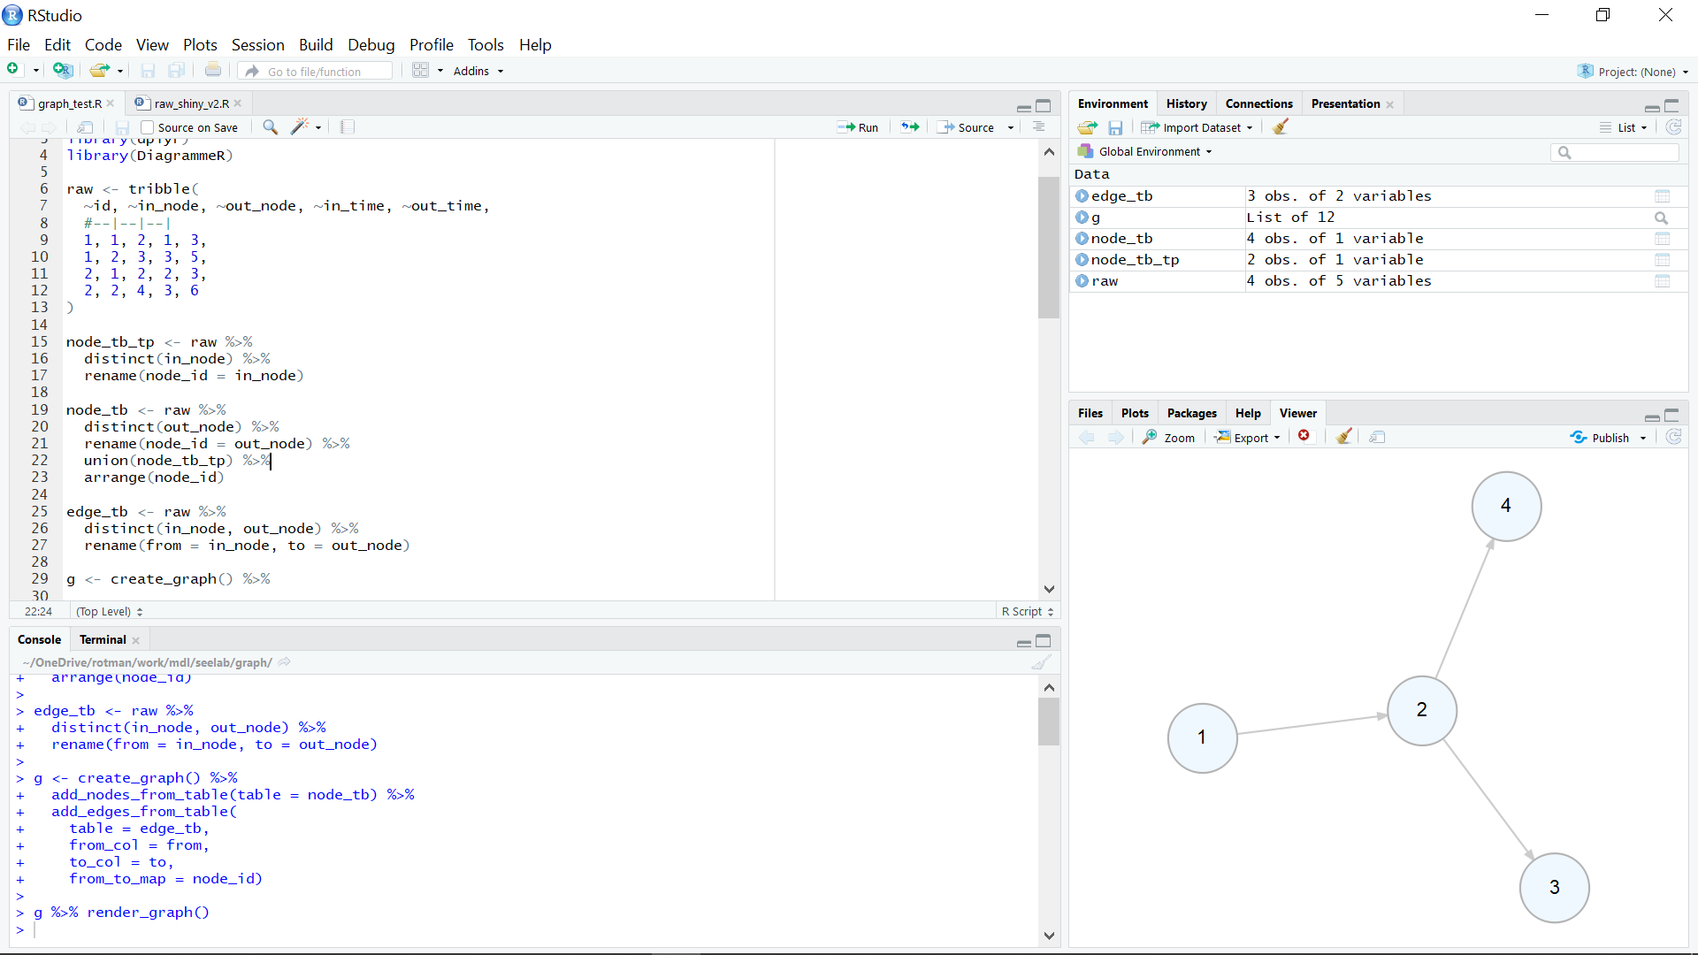
What’s RStudio?

Slide 10

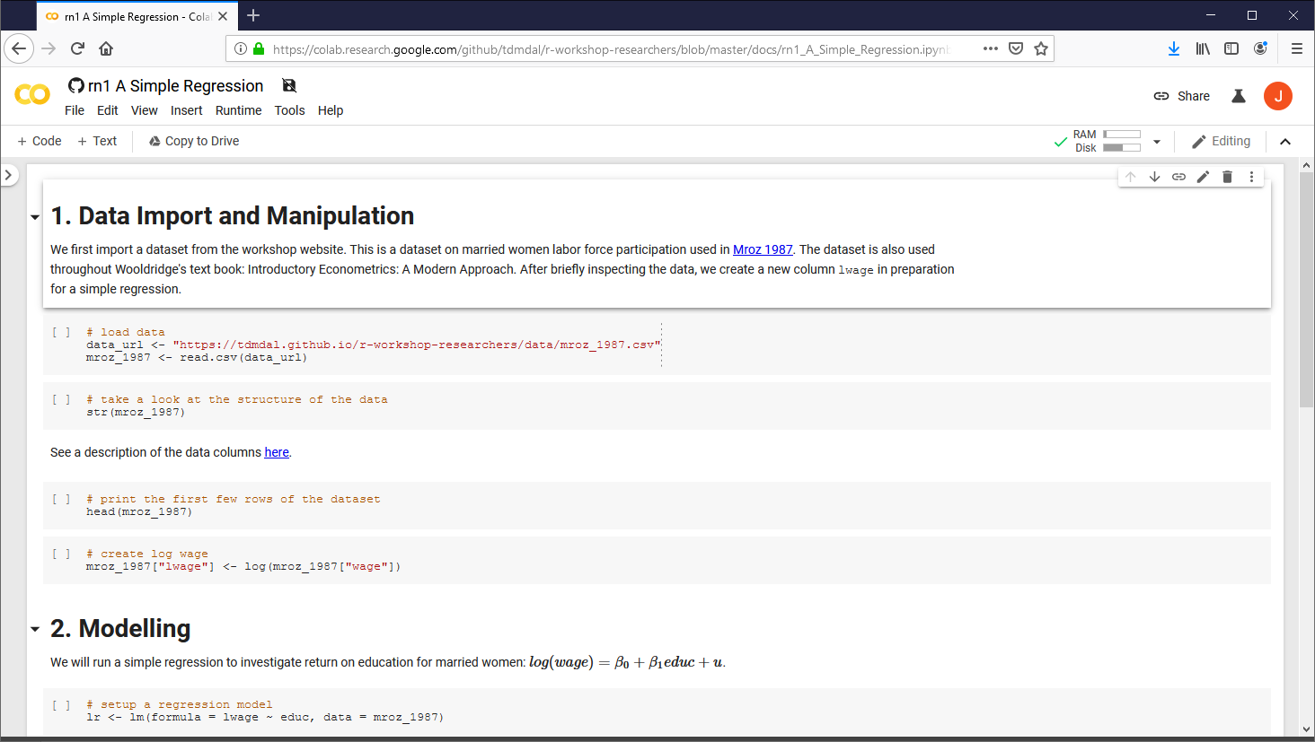
Google Colab

Slide 11
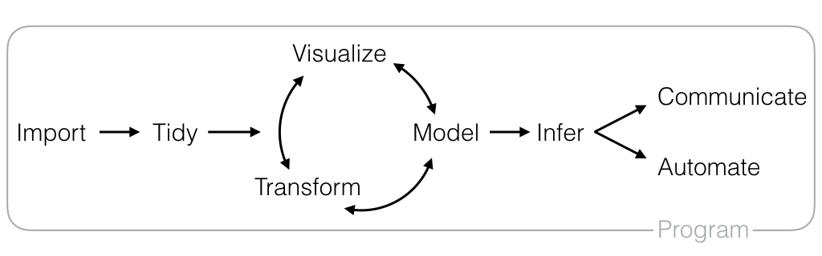
Motivation: two examples
A simple regression
Twitter API
https://github.com/rstudio/RStartHere

Slide 12
R Basics
Data structures
Programming structures

Slide 13
R Data Structure - Overview
 | Homogeneous | Heterogeneous
1-d | Atomic vector | List
2-d | Matrix | Data frame
n-d | Array
http://adv-r.had.co.nz/Data-structures.html

Slide 14
R Data Structure - Overview
 | Homogeneous | Heterogeneous
1-d | Atomic vector | List
2-d | Matrix | Data frame
n-d | Array
http://adv-r.had.co.nz/Data-structures.html

Slide 15
Atomic Vectors
# create R vectors
vec_character <- c("Hello,", "World!")
vec_integer <- c(1L, 2L, 3L)
vec_double <- c(1.1, 2.2, 3.3)
vec_logical <- c(TRUE, TRUE, FALSE)
Hello, | World!
1 | 2 | 3
1.1 | 2.2 | 3.3
TRUE | TRUE | FALSE

Slide 16
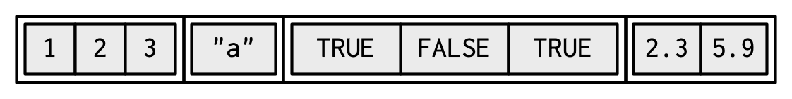
List
# create an R list
l1 <- list(
1:3,
"a",
c(TRUE, FALSE, TRUE),
c(2.3, 5.9)
)
ref. https://adv-r.hadley.nz/vectors-chap.html#list-creating

Slide 17
Data Frame
# create a data frame
df1 <- data.frame(
x = 1:3,
y = letters[1:3],
z = c(1.1, 2.2, 3.3)
)
x | y | z
1 | "a" | 1.1
2 | "b" | 2.2
3 | "c" | 3.3

Slide 18
Data Frame
# create a data frame
df1 <- data.frame(
x = 1:3,
y = letters[1:3],
z = c(1.1, 2.2, 3.3)
)
x | y | z
1 | "a" | 1.1
2 | "b" | 2.2
3 | "c" | 3.3

Slide 19
Data Frame
# create a data frame
df1 <- data.frame(
x = 1:3,
y = letters[1:3],
z = c(1.1, 2.2, 3.3)
)
x | y | z
1 | "a" | 1.1
2 | "b" | 2.2
3 | "c" | 3.3

Slide 20
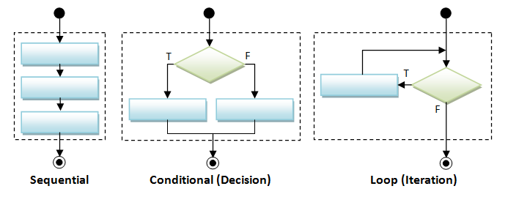
Programming Structure: Control Flows

Slide 21

Sequential
Example: Sum of Squares
$$\sum_{t=1}^{3}{t^{2}}$$
# sum of squares
t <- 1:3
y <- sum(t^2)
print(y)

Slide 22
Conditional (if…else…)
if (cond) {
# run here if cond is TRUE
} else {
# run here if cond is FALSE
}
# y greater than 10?
if (y > 10) {
print("greater than 10")
} else {
print("less or equal to 10")
}

Slide 23
Conditional (if…else if…else…)
if (cond1) {
# run here if cond1 is TRUE
} else if (cond2) {
# run here if cond1 is FALSE but cond2 is TRUE
} else {
# run here if neither cond1 nor cond2 is TRUE
}

Slide 24
Iteration
for (var in seq) {
do something
}
while (cond) {
do something if cond is TRUE
}
# sum of squares
t <- 1:3
y <- 0
for (x in t) {
y <- y + x^2
}
print(y)

Slide 25

Programming Structure: Functions
# sum of squares from 1 to n
ss <- function(n) {
t <- 1:n
sum(t^2)
}
# calling the ss() function
print(ss(2))
print(ss(3))
What’s a function
a logical block of code
input -> output
Why write functions
Reusability
Abstraction
Maintainability
Example: $\sum_{t=1}^{n}{t^{2}}$

Slide 26
Extending the regression example
Manipulate data
Load data
Create new columns
Filter columns and rows
Build models
Multiple regression
IV regression
Report and graph
Build a publication-ready table for regression results

Slide 27
Using R libraries
Install and load an R library
install.packages("library_name")
library(library_name)
CRAN (The Comprehensive R Archive Network)
CRAN Task Views

Slide 28
Many choices, which one to use
Often time, many choices of functions/libraries to do one task
R is open and extensible!
Example: load a csv file to a data frame
Use read.csv() function from the utils library
Use read_csv() function from the readr library
Use fread() function from the data.table library
Use vroom() from the vroom library

Slide 29
Many choices, which one to use
Start with the one most people use
Choose one that is well maintained
check document, github, etc. for last update
Choose one that suits your task

Slide 30
Our Choice: extending the regression example
Manipulate data (tidyverse eco-system)
Load data (read_csv() from the readr)
Create new columns (mutate() from dplyr)
Filter columns and rows (select() and filter() from dplyr)
Build models
Multiple regression (lm() from stats library in R base)
Report and graph
Build a publication-ready table (stargazer() from stargazer library)

Slide 31
Load a CSV file
read_csv() from the readr
read_csv(file)
More about read_csv()
More about readr

Slide 32
Load Data – Many other libraries
readxl for Excel sheets
haven for SPSS, Stata and SAS data
jsonlite for JSON
xml2 for XML
httr for web APIs
rvest for web scraping
DBI for connecting to DataBase engine
…

Slide 33
Data Manipulation: dplyr basics
Filter observations: filter()
Select variables: select()
Reorder rows: arrange()
Create new variables: mutate()
Collapse column values to a single summary: summarise()
Group by: group_by()

Slide 34
Data Manipulation: filter()
filter(my_dataframe, condition1, …)

Slide 35
Data Manipulation: mutate()
mutate(my_dataframe, new_var1 = expression1, …)

Slide 36
Data Manipulation: select()
select(my_dataframe, var1, …)

Slide 37
Data Manipulation: Data Pipe (%>%)
iris_cleaned <- filter(iris, Species == "setosa")
iris_cleaned <- select(iris_cleaned, Sepal.Length)

Slide 38
Data Manipulation: Data Pipe (%>%)
iris_cleaned <- filter(iris, Species == "setosa")
iris_cleaned <- select(iris_cleaned, Sepal.Length)
iris_cleaned <- iris %>%
filter(., Species == "setosa") %>%
select(., Sepal.Length)

Slide 39
Data Manipulation: Data Pipe (%>%)
iris_cleaned <- filter(iris, Species == "setosa")
iris_cleaned <- select(iris_cleaned, Sepal.Length)
iris_cleaned <- iris %>%
filter(Species == "setosa") %>%
select(Sepal.Length)

Slide 40
Data Manipulation: Others
Join two data frames
_join() family in dplyr
Reshape data frames
pivot_longer() and pivot_wider() in tidyr

Slide 41
Regression
Multiple regressions: lm() from stats library in base R
my_model <- lm(y ~ x1 + x2, data)
Multiple regressions with interactive terms
my_model <- lm(y ~ x1 + x2 + I(x1 * x2), data)
Regression result summary: summary()
Ref. https://faculty.chicagobooth.edu/richard.hahn/teaching/FormulaNotation.pdf

Slide 42
Report
Summary table
Summary for lm(): summary(my_model)
publication-ready table: stargazer() from stargazer library
stargazer(my_model1, my_model2, …)
Ref. https://cran.r-project.org/web/packages/stargazer/vignettes/stargazer.pdf

Slide 43
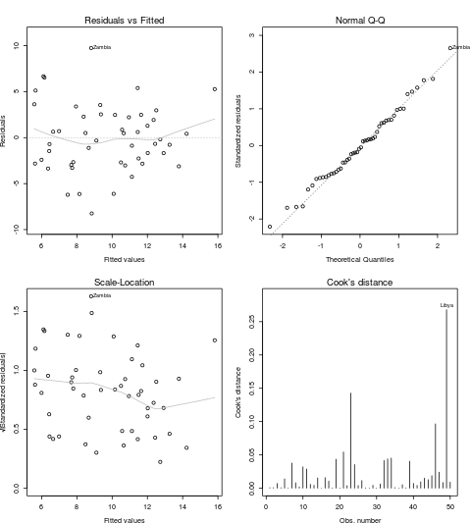
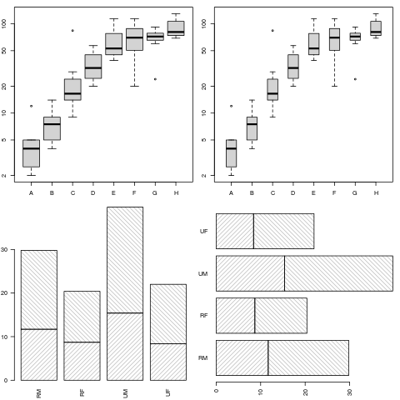
R Graphics – Base plots (examples)
https://www.stat.auckland.ac.nz/~paul/RG3e/chapter2.html

Slide 44
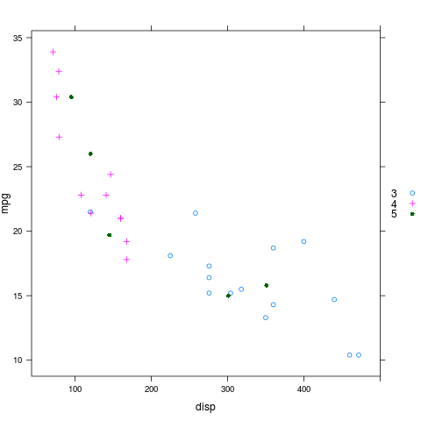
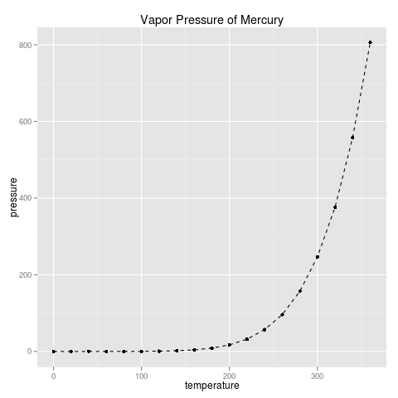
R Graphics – Two Main Plotting Systems
System?
R package: lattice
implements Trellis system by William Cleveland:
R package: ggplot2
implements "A Grammar of Graphics" by Leland Wilkinson
Recommended
https://www.stat.auckland.ac.nz/~paul/RG3e/chapter4.html
https://www.stat.auckland.ac.nz/~paul/RG3e/chapter5.html

Slide 45
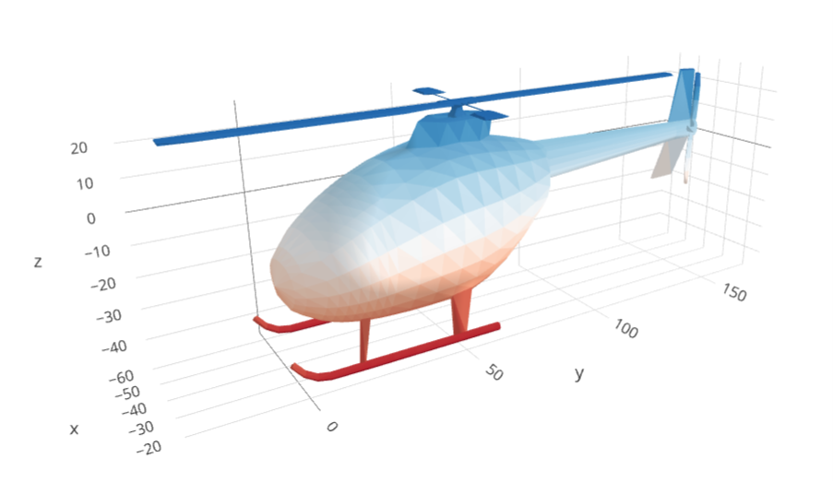
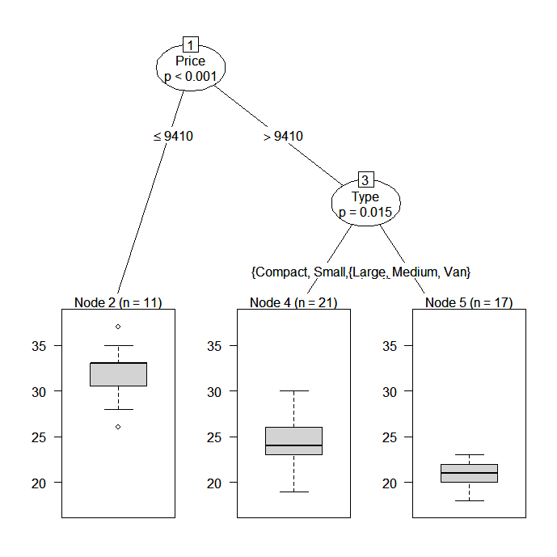
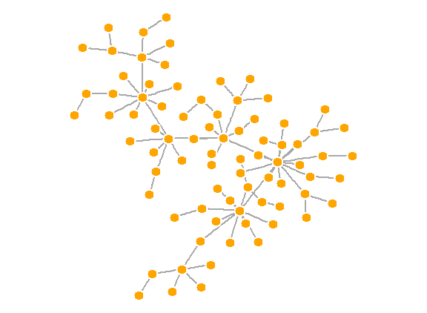
Other Specialized Plots
Graphic functions provided by specialized packages
Based on R primitive graphical engines like grid (eg. plot() in party, igraph)
Following a plotting system (eg. ggmap, tmap, gganimate, plotly, etc.)
Wrapper of plotting tools in another languages (ex. leaflet, grViz() in DiagrammeR)
3D tri-surface interactive plot using the plotly package
https://plot.ly/r/trisurf/
Decision tree plot using party package
https://www.statmethods.net/advstats/cart.html
Network plot using igraph package
http://kateto.net/networks-r-igraph

Slide 46
ggplot2
Based on the Grammar of Graphics
Basic idea: you can build any graph from the same components
Data
Coordinate system
Geoms – visual marks that represent data points
A layer-by-layer approach
Free ggplot2 book: https://ggplot2-book.org/
Paper: A layered grammar of graphics

Slide 47
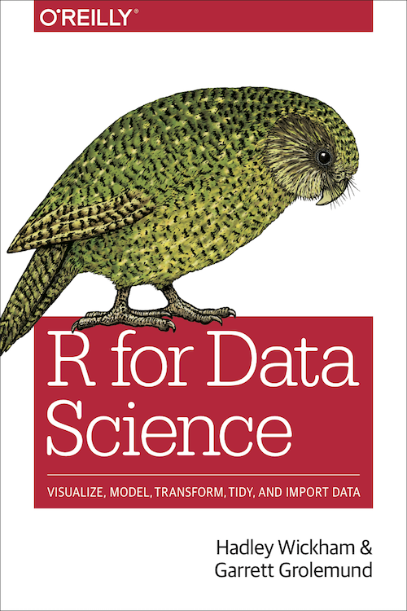
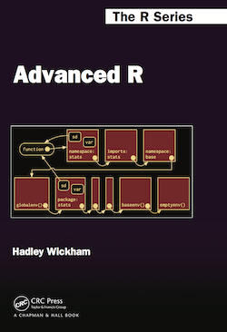
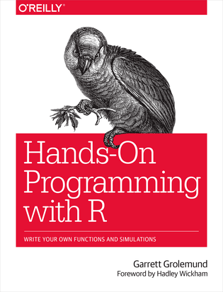
Free Learning Resources - Books
R for Data Science
Advanced R
Hands-On Programming with R
Check bookdown.org often

Slide 48
Free Learning Resources – Video Courses
RStudio Resources Site
LinkedIn Learning (used to be lynda.com)
free for UofT students and Toronto Public Library users
Search R and learn

Slide 49
Free Learning Resources – Others
CRAN Task View
Sample notebooks / reports at http://rpubs.com/
Twitter (a few seeds: #rstat, @hadleywickham, @WeAreRLadies)

