Slide 1
Smarter K8S node provisioning with Karpenter
TiDu Nguyen 2022-03-04

Slide 2


Problem
Task 1
Task 2
Task n

Slide 3

Problem
Containerization
Compute Clusters
Task 1
Task 2
Task n

Slide 4
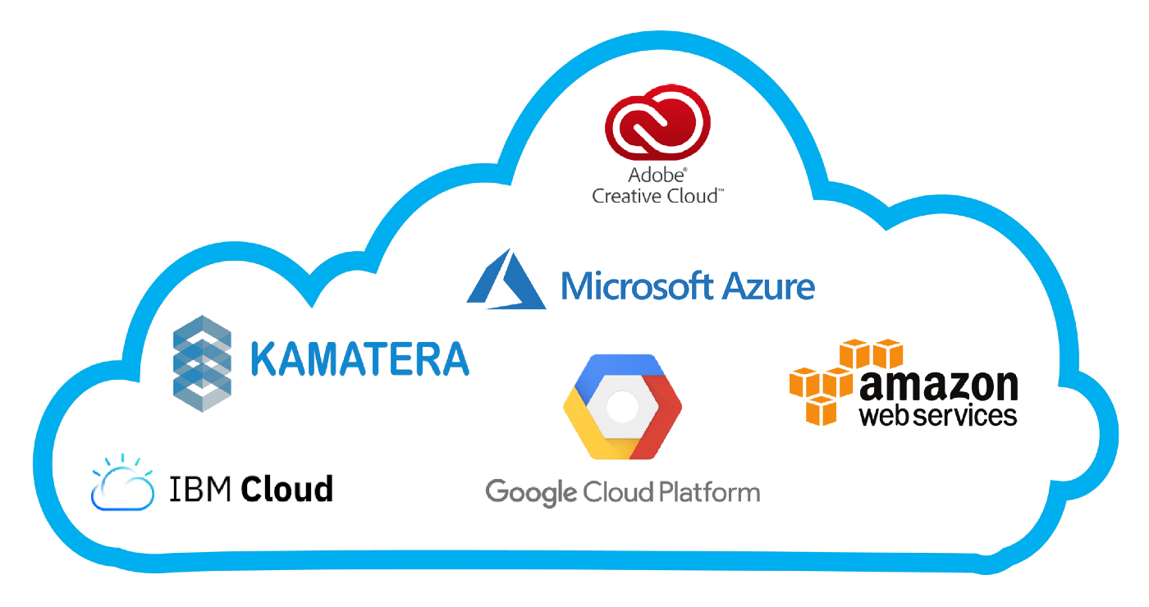



Problem
Containerization
Compute Clusters
Task 1
Task 2
Task n

Slide 5
Problem
Node

Slide 6

Problem
Node

Slide 7
Solution
Manually add nodes
Cluster-autoscaler: add nodes automatically using templates called node groups
Karpenter: add nodes automatically using provisioners

Slide 8



How Karpenter works
I want my node to be:
ARM
at least 2 vCPU
1 nvidia GPU
based in southeast asia
…
Oke, your requirements match the config of provisioner X
Old Node
Hey cloud, give me a new node follows this config I wrote
New node provisioned by ____
Here you are

Slide 9
Karpenter
Provisioners
Pods requests

Slide 10
Demos scenarios
Set up
Node creation
Node migration
Node termination

Slide 11
Node creation
Before provisioner
After provisioner
0 ➝ n pods (1)
n ➝ m pods (2)

Slide 12
Node migration
Subjective: change in requirements
pod requirements (3)
compute (cpu, ram, gpu, etc.)
disk
node requirements (4)
region
ip, subnet, etc.
ec2 types
on-demand/rack/spot intances
update k8s version
update os version
Objective:
resources fragmentation (1 big vm might be better than many small vms) (5)
Node failure

Slide 13
Node termination
Node deleted (5)
Emptiness: no workload except management ones (6)
ttlSecondsAfterEmpty
Node expiry (7)
ttlSecondsUntilExpired
Notice: expiration batch window
At least longer than time it takes to schedule pods onto new nodes

Slide 14
Known issues and limitations
AWS only
Provisioners can only set limits on memory and CPU
Immature:
Bugs
Poorly documented
Breaking changes
Provisioners make many random decisions:
Choose randomly any available EC2 types when not specified clearly (Provisioner API | Karpenter)
Choose randomly any provisioners if a pod matches all of them (Deploying Multiple Provisioners :: EC2 Spot Workshops)
Need experimentations with different configs on AWS to prevent not being able to provision new nodes in productions:
vCPU credits?
Is spot capacity available for the instance type? If yes, how long to get a new node on avg?
Is instance type available in the configured region/zone?
Notes:
Hope in the future karpenter will support other platforms like GCP, Azure and especially on-prem distribution like minikube,/micro-k8s/kind for learning and testing purposes.

Slide 15
Q & A

Slide 16
Thank you

