Slide 1
RECAP
22.02.2016
Fabian Niederberger, Ueli Leber
Agenda
General Information
Recap/lessons learned
Introduction VCS
Program and debug devices
Set up first project/KL25Z
Quiz
Notes:
Hello everybody…

Slide 2




General Information
Source: google image search
Notes:
-interactive course type
-work in teams (2 people each group)
-fullfill 3 testats: recap, lessons learned, and robot maze challenge
-mep with unfair advantages for maze contestants with higher rank ;)

Slide 3


Recaps and lessons learned
Source: google image search
Notes:
-Every course day a recap of the last weeks lesson
Catch the essence of the last weeks day
-a lessons learned sheet created by each student for future course participants

Slide 4




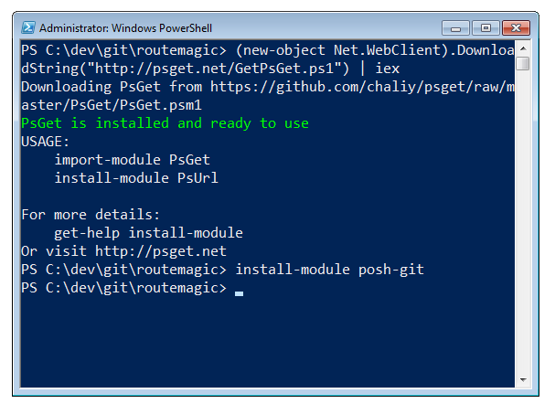

Introduction VCS
Source: google image search
Notes:
-for effective progress in team based code project -> Version Control System
-examples: github, enterprise lab, bitbucket
-to easily control things use a client on your desktop
-examples: github desktop, source-tree, advanced command based shell

Slide 5
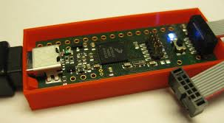

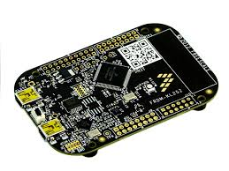
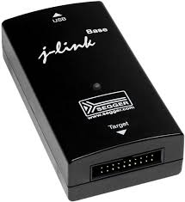

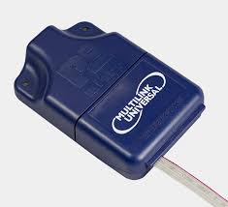
Program and debug devices
Source: mcuoneclipse.com
Source: google image search
Notes:
Developement:
-kinetis design studio / code-warrior (don’t use it, does not support some atmel cores)
-processor expert
Program and debug
-k20 debugger board
-kl25z
-j-linkd
-multilink

Slide 6
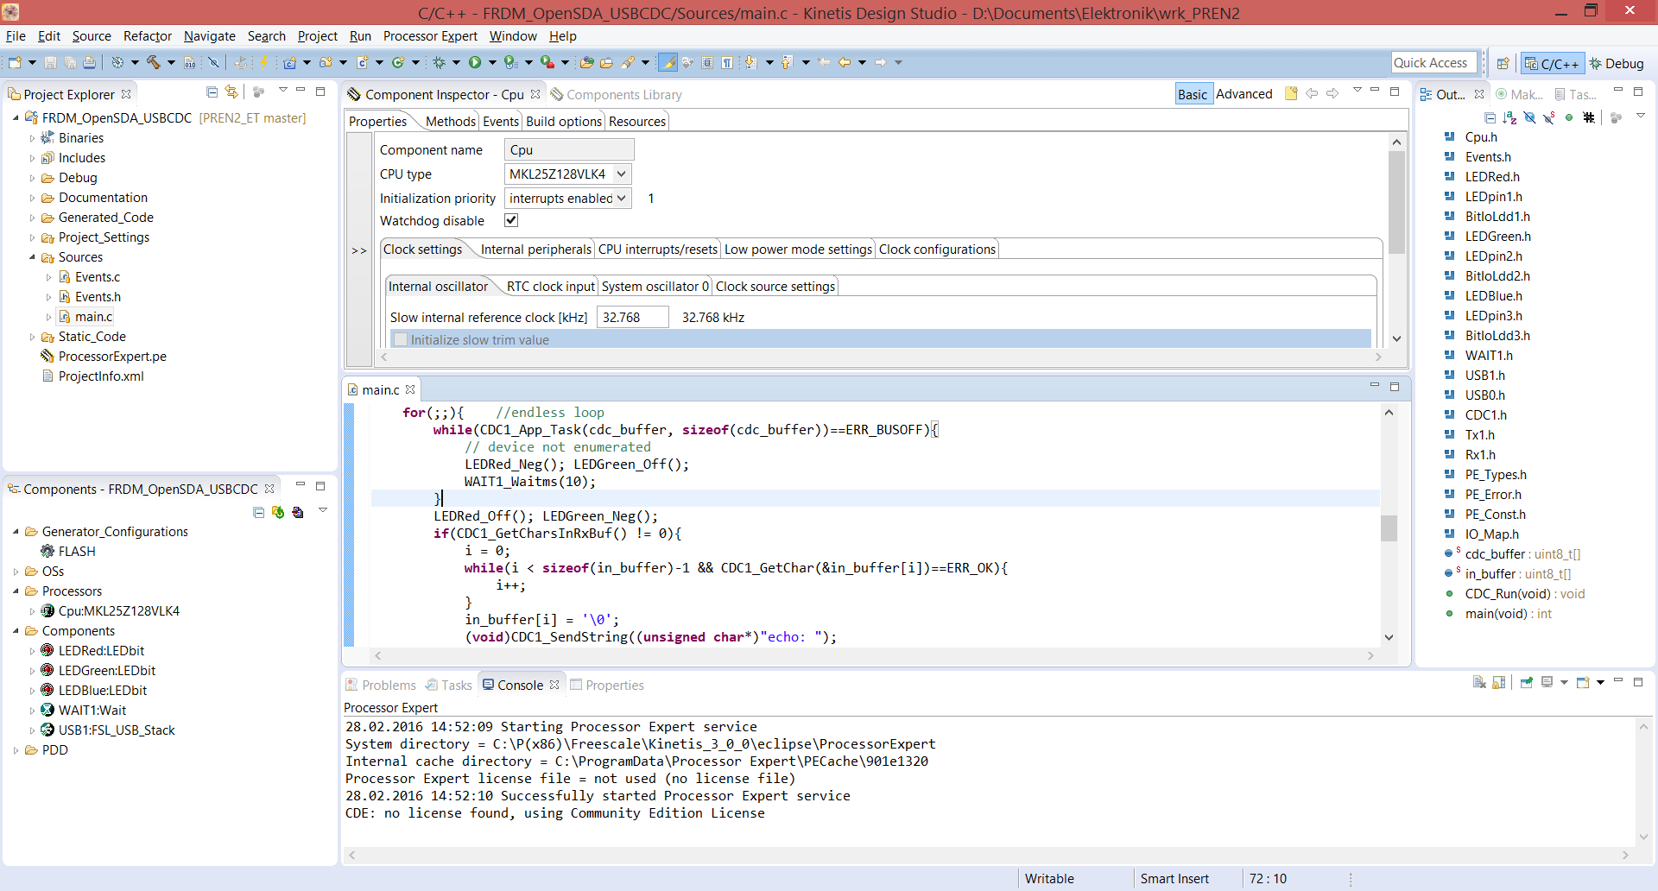
Set up first project/KL25Z
Notes:
Important:
-If KL25Z new, update bootloader with win7 machine
-select core KL25Z128… not board
-activate processor expert
-set project code settings to c90 standard, not c99
-set debugger to openSDA debugger for k20 and KL25Z debugger
-don’t share generated code on git
-check what you commit and comment it aswell as manage your .gitignore file. JUST DON’T FUCK IT UP!!!!!

Slide 7
Quiz (potential MEP questions)
What meaning have the letters VCS?
Version Control System
What are the advantages of a VCS?
Several People can work on same project, Backup and datalog
We are not programing the FRDM Board via KL25Z USB, instead we program via OpenSDA USB. Why?
Because via the KL25Z USB it’s not possible to debug
On brand new FRDM KL25Z boards we update the bootloader. Why?
Because it does not support win8, 10 or mac os
What are the three testats you have to achieve?
Recap, Lessons Learned, solve maze on the robot challenge
Notes:
-Version Control System
-Several People can work on the same project. -Backup with datalog available
-Because via the KL25USB it’s not possible to debug
-Because it’s not compatible with win8.x or later systems
Recap, Lessons Learned, solve the maze with the bot in competition

