Slide 1
RECAP
22.02.2016
Fabian, Ueli
Agenda
General Information
Recap/lessons learned
Introduction VCS
Program and debug devices
Set up first project/KL25Z
Quiz
Notes:
Hello everybody…

Slide 2




General Information
Source: google image search
Notes:
-interactive course type
-work in teams (2 people each group)
-fullfill 3 testats: recap, lessons learned, and robot maze challenge
-mep with unfair advantages for maze contestants with higher rank ;)

Slide 3


Recaps and lessons learned
Source: google image search
Notes:
-Every course day a recap of the last weeks lesson
-a lessons learned sheet created by each student for future course participants

Slide 4




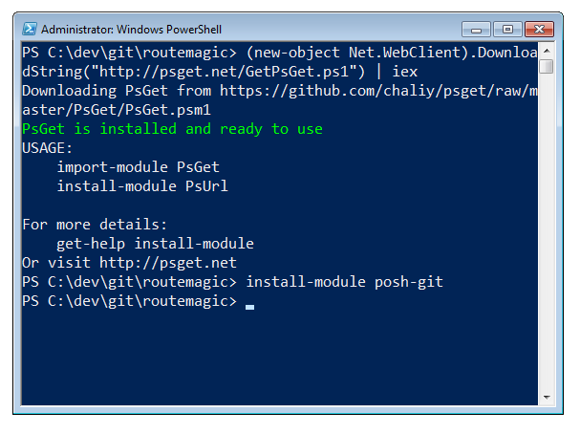

Introduction VCS
Source: google image search
Notes:
-for effective progress in team based code project -> Version Control System
-examples: github, enterprise lab, bitbucket
-to easily control things use a client on your desktop
-examples: github desktop, source-tree, advanced command based shell

Slide 5
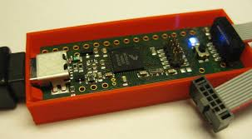

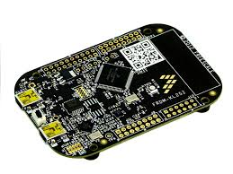
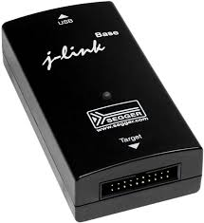

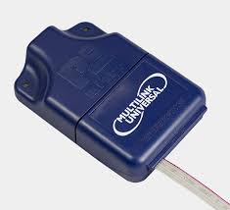
Program and debug devices
Source: mcuoneclipse.com
Source: google image search
Notes:
Developement:
-kinetis design studio / code-warrior (don’t use it, does not support some atmel cores)
-processor expert
Program and debug
-k20 debugger board
-kl25z
-j-linkd
-multilink

Slide 6
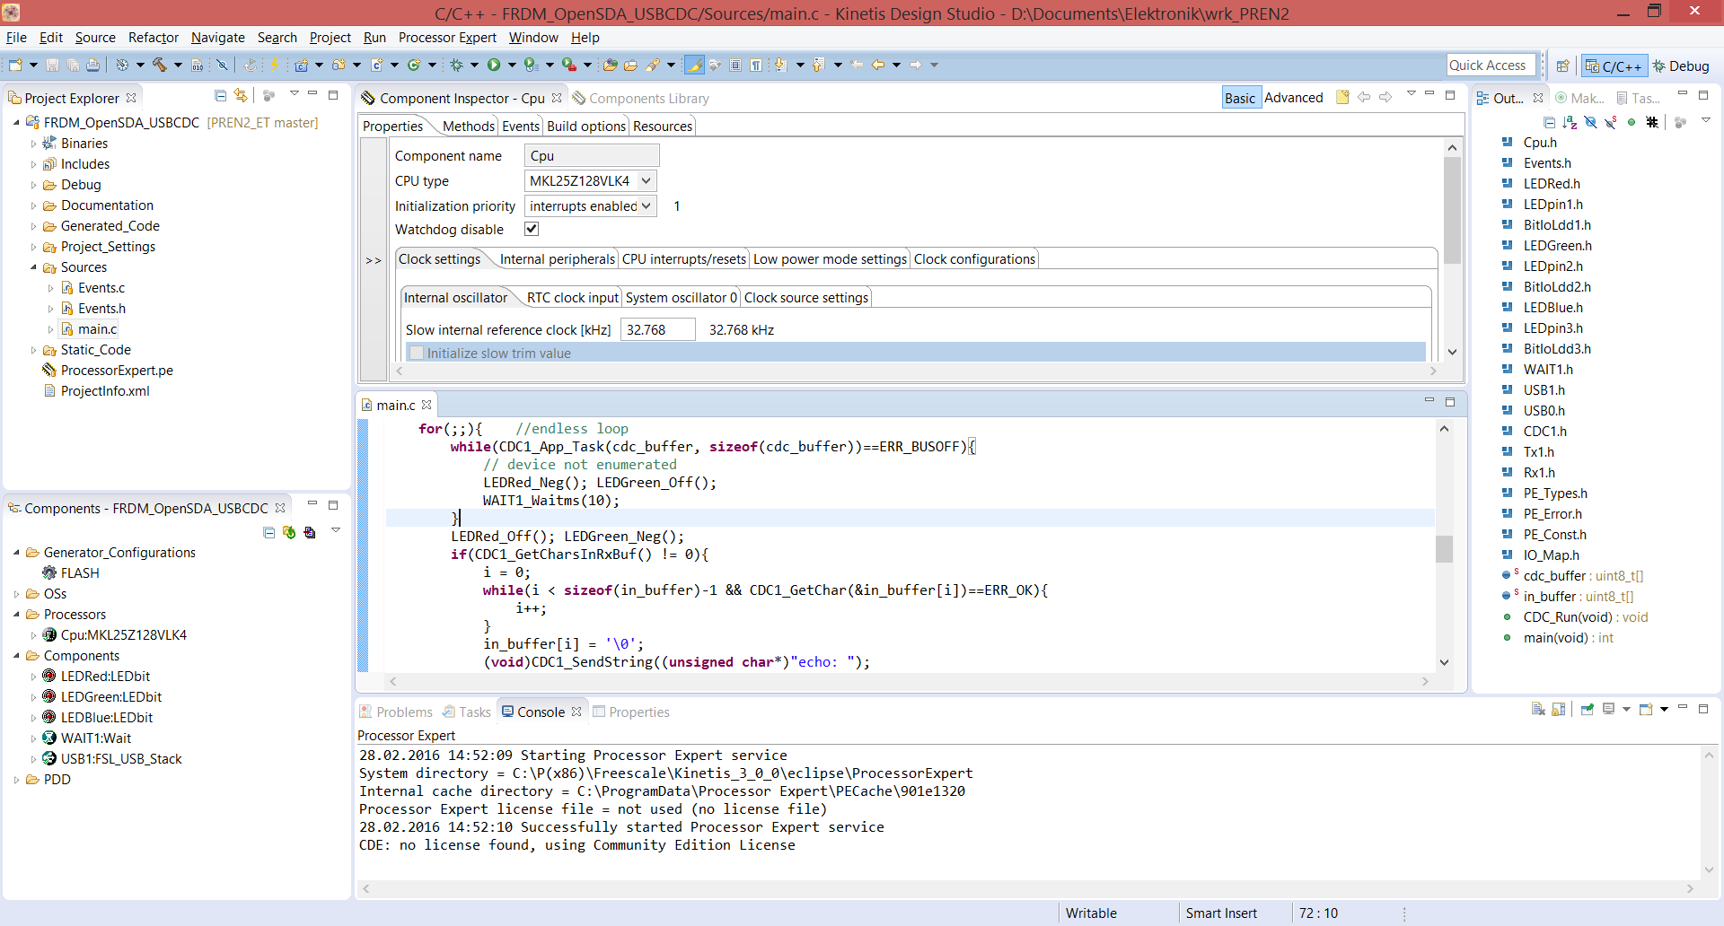
Set up first project/KL25Z
Notes:
Important:
-If KL25Z new, update bootloader with win7 machine
-select core KL25Z128… not board
-activate processor expert
-set project code settings to c90 standard, not c99
-set debugger to openSDA debugger for k20 and KL25Z debugger
-don’t share generated code on git
-check what you commit and comment it aswell as manage your .gitignore file. JUST DON’T FUCK IT UP!!!!!

Slide 7
Quiz (potential MEP questions)

