Slide 1
Data files
Main analysis script
load_parameters_lakename.m
read_odas_print.m
Customized scripts in microstructure folder
Contains parameters required for the analysis, dependent on the instrument type, instrument configuration and field campaign.
Copy of read_odas with printing option
ODAS scripts
Level0/VMPxxx.P
odas_p2mat_print.m
Copy of odas_p2mat with printing option: imports data from .P file.
extract_setupstr.m
analyze_profiles.m
Extract .cfg file from a .P data file.
Load campaign-specific parameters
For each data file:
  Create folder
  Import the .P data file
  Modify config file
  Extract profiles
  Calibrate FP07
  For each profile: run ODAS turbulence analysis (shear)
  Computes corrected conductivity, salinity and density
  For each profile: run Piccolroaz analysis (shear + FP07)
  Save the data
get_config.m
patch_setupstr.m
Create a copy of the .P data file with updated config parameters (shear sensitivities +pressure offset) from specified .cfg file or from specified parameters.
Import the modified .P file.
Patch a .cfg file into a .P data file.
get_profile.m
Extract the profiling indices.
cal_FP07_in_situ_EPFL.m
Modified version of cal_FP07_in_situ: uses temperature from CTD to correct temperature from FP07 and save calibration parameters to .cfg file.
run_calibration_FP07.m
Perform FP07 calibration.
Patch the modified .cfg file to the .P file.
Import the calibrated .P file.
quick_look.m
Runs basic turbulence analysis from shear probes.
compute_rho_salinity.m
Computes corrected conductivity, salinity and density for a given lake.
correct_pressure.m
Computes pressure with respect to atmospheric pressure and depth
resolve_turbulence.m
Computes turbulence estimates from shear probes and FP07 based on Piccolroaz et al. (2021). See details below.
Level2/VMPxxx_.../results_VMPxxx.mat

Slide 2
Input/output data
Details of STEP II.8 – Turbulence analysis (for each profile ind_prof):
Matlab built-in functions
Customized scripts in microstructure folder
ODAS scripts
DATA
(structure generated by odas_p2mat)
param
(structure generated by load_parameters_lakename)
Other arguments (profile index, plot parameters, output folder, etc.)
pres_av.m
mean_grad.m
mean_grad_time.m
Compute mean and standard deviation of a variable in each bin.
Compute the bin-averaged vertical gradient of a variable.
Compute the bin-averaged temporal gradient of a variable.
resolve_turbulence.m
Calculate Thorpe displacements
Create binned quantities
Filter/despike shear and accelerometer data
For each bin, compute bin-averaged diffusivity and viscosity
For each bin, flag acceleration, vibration and inclination
For each bin, perform shear spectral analysis
For each bin, perform temperature spectral analysis
Flag spectral analyses results
Compute vertical eddy diffusivity
Compute Ozmidov length scale
butter.m
detrend.m
Define the filter coefficients for a 1st order Butterworth highpass filter
Keep fluctuations from a signal by removing any linear trend
despike.m
Remove short-duration spikes from a signal (shear and accelerometer)
filter.m
csd_odas.m
Apply the highpass filter on a signal (shear)
Estimate the cross- and auto-spectrum of one or two vectors
SW_Conductivity.m
SW_SpcHeat.m
SW_Viscosity.m
Compute the thermal conductivity from temperature and salinity.
Compute the specific heat from temperature and salinity.
Compute the dynamic viscosity from temperature and salinity.
TKE_dis_spec.m
gradT_dis_spec.m
Perform the shear spectral analysis for turbulence. See details below.
Perform the temperature spectral analysis for turbulence. See details below.
SLOW
(structure corresponding to SLOW{ind_prof} )
FAST
(structure corresponding to FAST{ind_prof} )
BIN
(structure corresponding to BINNED{ind_prof} )

Slide 3
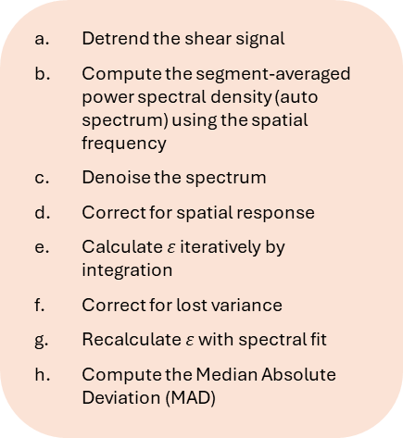
Input/output data
Matlab built-in functions
Details of STEP II.8.F – Shear-derived turbulence (for each bin i):
Customized scripts in microstructure folder
ODAS scripts
pres
(pressure vector in the bin)
x0
(despiked and filtered shear vector/matrix in the bin)
px0
(despiked acceleration vector in the bin)
Other arguments (wavenumbers for integration, FFT parameters, plot options, etc.)
TKE_dis_spec.m
detrend.m
Detrend the shear signal
Compute the segment-averaged power spectral density (auto spectrum) using the spatial frequency
Denoise the spectrum
Correct for spatial response
Calculate $ε$ iteratively by integration
Correct for lost variance
Recalculate $ε$ with spectral fit
Compute the Median Absolute Deviation (MAD)
Keep fluctuations from a signal by removing any linear trend
csd_odas.m
csd_matrix_odas.m
Estimate the cross- and auto-spectrum of one or two vectors (if one shear probe), in spatial or temporal space depending on the frequency put as an argument
Estimate the cross- and auto-spectrum of a matrix (if two shear probes), in spatial or temporal space depending on the frequency put as an argument
clean_shear_spec.m
Remove instrument vibrations (measured by the accelerometers) from the shear spectrum, following the Goodman approach. This function is only used with two shear probes.
eps_S
(bin-averaged TKE dissipation rate)
MAD_S
(Mean Absolute Deviation between observed and empirical spectra)
MADc
(MAD threshold)
fit_flag_S
(acceptance flag)
kL, kU
(wavenumber bounds for integration)

Slide 4
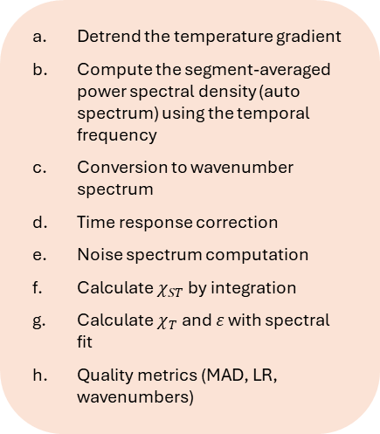
Input/output data
Matlab built-in functions
Details of STEP II.8.G – Temperature-derived turbulence (for each bin i):
Customized scripts in microstructure folder
ODAS scripts
pres
(pressure vector in the bin)
x0
(temperature gradient vector/matrix in the bin)
Other arguments (wavenumbers for integration, FFT parameters, plot options, etc.)
gradT_dis_spec.m
detrend.m
Detrend the temperature gradient
Compute the segment-averaged power spectral density (auto spectrum) using the temporal frequency
Conversion to wavenumber spectrum
Time response correction
Noise spectrum computation
Calculate $χ_{ST}$ by integration
Calculate $χ_{T}$and $ε$ with spectral fit
Quality metrics (MAD, LR, wavenumbers)
Keep fluctuations from a signal by removing any linear trend
csd_odas.m
csd_matrix_odas.m
Estimate the cross- and auto-spectrum of one or two vectors (if one shear probe), in spatial or temporal space depending on the frequency put as an argument
Estimate the cross- and auto-spectrum of a matrix (if two shear probes), in spatial or temporal space depending on the frequency put as an argument
kB
(bin-averaged Batchelor wavenumber from spectral fitting)
eps_T
(bin-averaged TKE dissipation rate from spectral fitting)
Xiv
(bin-averaged temperature dissipation rate from spectral integration)
Xi_ST
(bin-averaged temperature dissipation rate from spectral integration corrected with shear-derived kBS)
Xi_T
(bin-averaged temperature dissipation rate from spectral fitting)
MAD_T
(Mean Absolute Deviation between observed and empirical spectra)
MADc
(MAD threshold)
LR
(likelihood ratio)
fit_flag_T
(acceptance flag)
kL, kU
(wavenumber bounds for integration)
kP
(wavenumber of the theoretical spectrum peak)
krange
(wavenumber range for integration)

Slide 5
Other ODAS functions
read_odas.m
odas_p2mat.m

