Slide 1
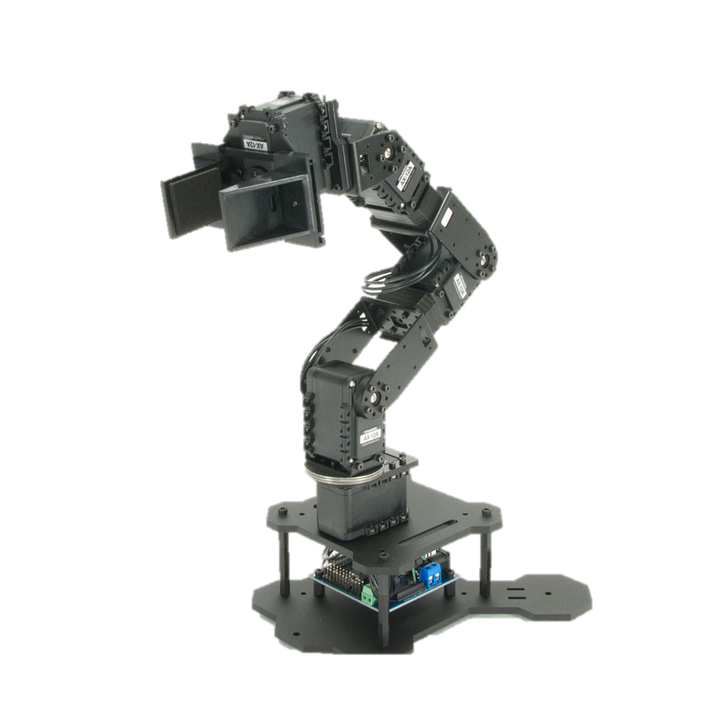
Real-time clock-based data logging subsystem in a 5 DOF robotic arm system
Tál Dominik (RHNFAE) – MI MSc.
Lecturer: Dr. Magyar Attila

Slide 2
Task description
A data logging subsystem shall be designed and developed for the Arbotix-M robocontroller
Log files have to be stored on a microSD card
At least 100ms resolution
Choose the proper hardware elements, design the data structure

Slide 3
Data logging in real-time systems
The ability of the data logger system is that it can collect data in real-time after the logging subsystem is activated, then it will log all the information needed during the monitoring period.
What is data logging?
Process of collecting and recording data from sensor outputs automatically
Logger element is needed
LVC125A chip based microSD card adaptor
Must NOT disturb the observed system’s behaviour

Slide 4
System plan
MicroSD shield
ISP BUS
Arbotix-M
Robocontroller
Servos
TTL Dynamixel 3 pin
Serial
Realtime clock module (DS1302)

Slide 5
requirements
System design and development has been driven by requirements
I have defined two types of requirements:
System requirements
Software requirements
System requirements contain hardware description and some mid level criteria
Software requirements contain the description of SW functionalities and some non-functional details, e.g: Arduino IDE version

Slide 6
Hardware implementation
Arbotix-M Robocontroller has exactly the same input and output pins as and Arduino Uno microcontroller
Pins used by the DS1302 module (left hand side is the microcontroller side):
Digital pin 2: RST
Digital pin 3: DAT
Digital pin 4: CLK
Pins used by the microSD card shield:
Digital pin 10: CS
Digital pin 11: MOSI
Digital pin 12: MISO
Digital pin 13: SCK

Slide 7
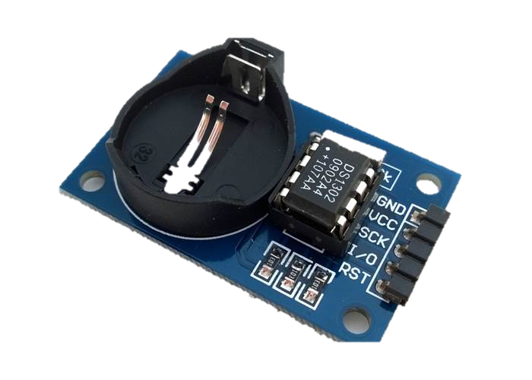
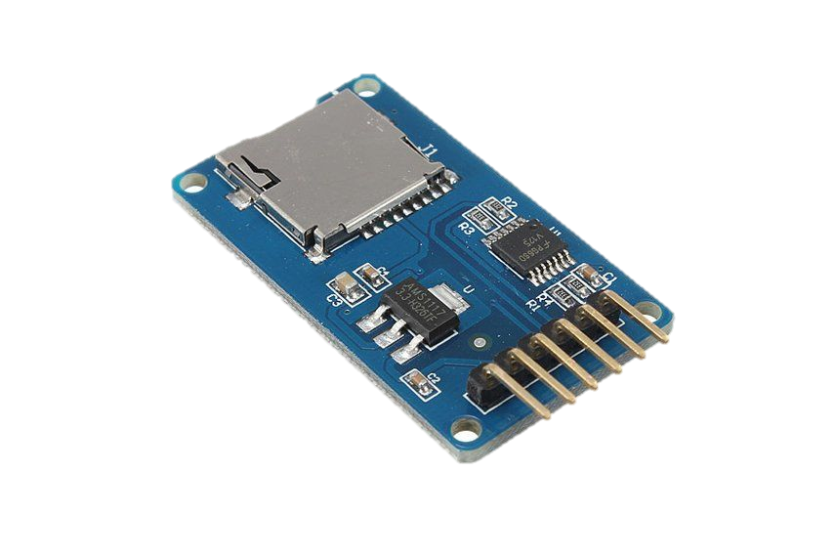
Used hardware elements

Slide 8
Logfile structure
Timestamp needed but DS1302 has only seconds resolution
Solution is to log the loop count since the latest hard reset → Millis() function
Voltage of the battery is monitored and logged
Servo positions one by one
.csv files are saved to the microSD card
They can be easily processed later and data visualisation is much more easier

Slide 9
Software implementation
Component based development
DS1302 and the microSD shield have their own basic functions
High level implementation was needed using the given functions
RTC module: time and date setting, time and date reading
microSD shield: secure file opening and closing, folder handling, reading from file and writing to file

Slide 10
Summary
Good basis has been created for the upcoming thesis
Learnt two important and new devices not just for Arduino
It was challenging to develop from a scratch, write the requirements and implement it
Testing documentation has not been created as planned but unit tests have been executed

Slide 11
Future plans
With the help of the logging function a new movement replay function will be developed into the software
A learning function is planned too when the servos release themselves and the user can record a series of movement by positioning the robotic arm manually
Useful for industrial uses – much easier to record operations
Useful for medical uses – rehabilitation exercises could be recorded and taught to patients
Thank you for your attention!

