Slide 1
Fraud detection from Claim Activities
01/12/2021
Ryan truong

Slide 2
Agenda
Business Issues
Data Review
Model – Model Selection
Key Insights
Next Actions

Slide 3
Business Issues
Fraud Detection Model
Increase number of fraud ?
Data-Driven
Solution ?
Realtime and Scalable ?
Return on investment ?
Support operations?
Notes:
How can we identify bad/fraud customers from their behaviours?
Which data is available internal would help us to identify fraud customers?
What department would benefit from fraud detection models?
How big is the scale for fraud detection model?
Will it can be deployed real-time?
What is the ROI (Return-on-investment) if we develop the model?

Slide 4
Data
Customer Profile
Engagement Profile
Commute Profile
9,888 customers
10,000 data points
20 internal features

Slide 5
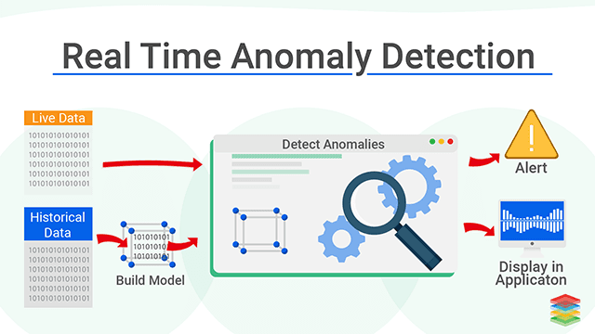
How the Model works
Source: https://www.xenonstack.com/blog/real-time-anomaly-detection

Slide 6
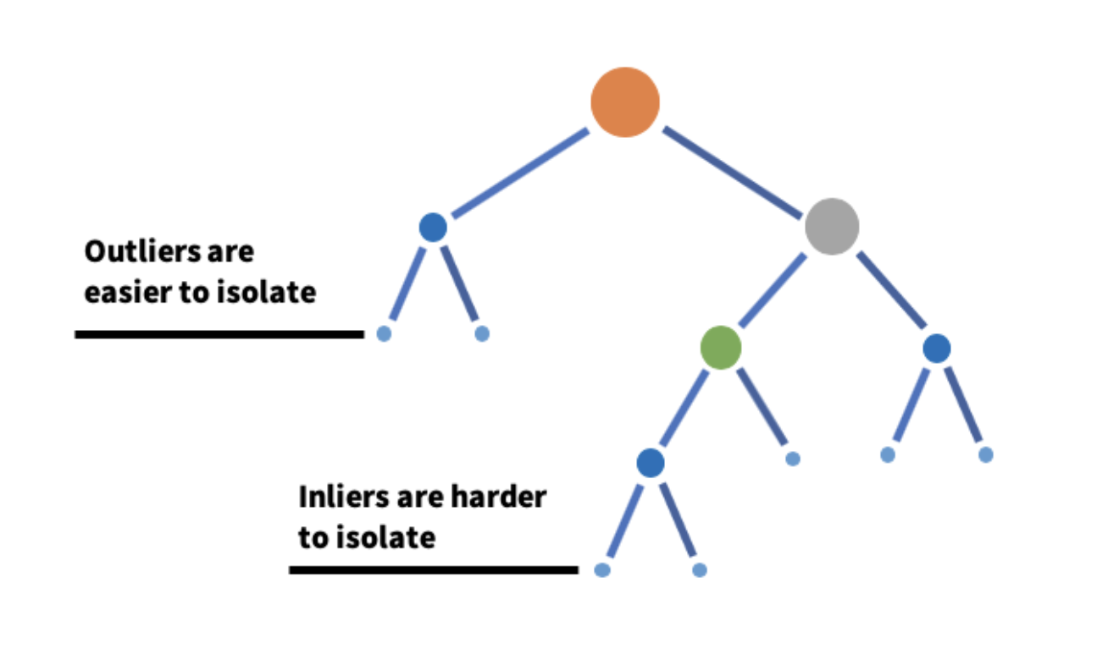
How we built The model
Fraud/ Anomaly: Any data point/observation that deviates significantly from the other observations
ML Model: Isolation Forest (The algorithm ‘isolates’ observations by randomly selecting a feature and then randomly selecting a split value between the maximum and minimum values of the selected feature)
Model Features: Commute Profile & Engagement Profile (Ride, Claim, Offer, Clicks)
Profiling Feature: Customer Profile (Demographic, Account using)
Source: https://www.analyticsvidhya.com/blog/2021/07/anomaly-detection-using-isolation-forest-a-complete-guide/

Slide 7
Key Insights
Importance Variables to detect Fraud:

Slide 8
Fraud Customer Profile
Have duplicate data point
Higher account age ( 322 vs 245)
Higher app download (1.1 vs 1.0)

Slide 9
Next action
Deploy for whole customer base
Make it real-time
Present the profile and indicator to business

