Slide 1
Fraud detection model
01/12/2021
Ryan truong

Slide 2
Agenda
Business Problems
Data Review
Model – Model Selection
Key Findings
Next Actions

Slide 3
Business Problems
Fraud Detection Model
Increase number of fraud ?
Data-Driven
Solution ?
Realtime and Scalable ?
Return on investment ?
Support operations?

Slide 4
Data review
Customer Profile
Engagement Profile
Commute Profile
9,888 customers
10,000 unlabelled data points
20 internal features

Slide 5
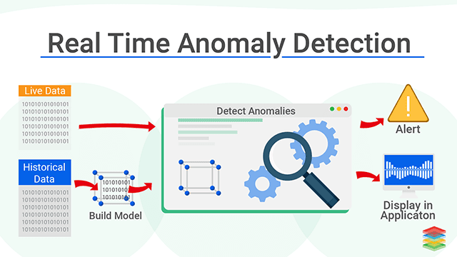
How the Model works
Source: https://www.xenonstack.com/blog/real-time-anomaly-detection

Slide 6
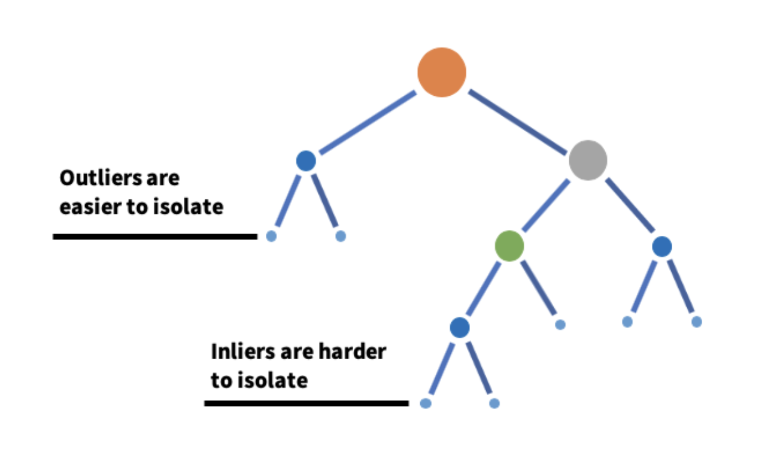
How The model Built
Fraud/ Anomaly definition: Any data point/observation that deviates significantly from the other observations
ML Model: Isolation Forest (The algorithm ‘isolates’ observations by randomly selecting a feature and then randomly selecting a split value between the maximum and minimum values of the selected feature)
Model Features: Commute Profile & Engagement Profile (Ride, Claim, Offer, Clicks)
Profiling Feature: Customer Profile (Demographic, Account)
Source: https://www.analyticsvidhya.com/blog/2021/07/anomaly-detection-using-isolation-forest-a-complete-guide/

Slide 7
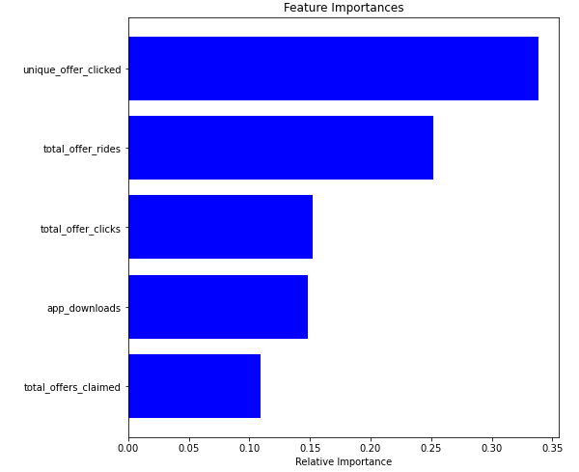
Key Findings
3% or 300 fraud customer detected
The model pointed out the important features and threshold for each feature to identify fraud customer.
“Unique offer click” is a strong indicator for fraud customers. Followed by Total Offer Ride” and “Total Offer Click”
Threshold to detect fraud customers:
Unique offer click from 7 times
Total offer click from 13 times
Total offer ride from 116 times
Total offer claimed from 2 times
Download app from 2 times

Slide 8
Fraud Customer Profile
Essential of a fraud customer profile:
Understand customers al perspective of demographical, engaged and behavioural
Easy to communicate within the business
Help to shape tactics/ strategies to tackle this group of customers
Customer profile:
No difference in age or account last update compared to normal customers
Similar gender distribution but surprisingly, normal group has more percentage in missing.
More likely to have duplicate data point
Higher account age ( 287 vs 245)
Higher app download (1.4 vs 1.0)
Higher offer clicked (18.4vs 5.4)
More offer ride ( 234 vs 63)
More offer claimed (3.95 vs 1.86)

Slide 9
Next actions
Prepare labelled testing and validation data to tune the parameters and validate accuracy of the model.
Deploy for whole customer base
Make it real-time
Present the profiles and indicators to business

