Slide 1







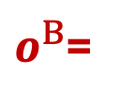

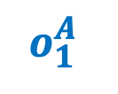




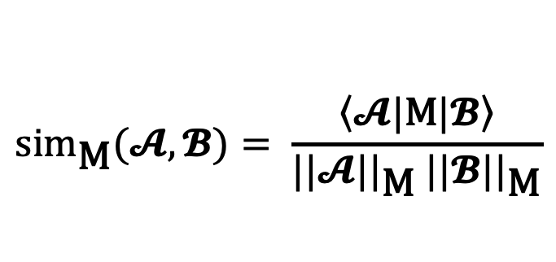
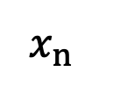
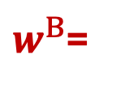
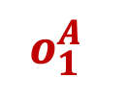

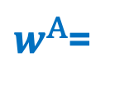




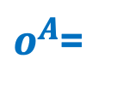


Matrix Similarity
$$𝓐$$
$$𝕭$$
$$w_{1}^{A}$$
$$w_{1}^{B}$$
$$w^{A}$$
Sensitive to weight-space symmetries
Weights of two models
Weights-based vectors
Alignment in weight space
$${sim}_{𝕀}(𝓐,𝓑)= \frac{\left\langle 𝓐|\left.𝓑\right\rangle \right.}{||𝓐|| ||𝓑||}$$
$w^{A}$=
$w^{B}$=
$$w_{M}^{A}$$
$$w_{M}^{B}$$
$$w^{B}$$
Behavioural Similarity
Outputs of two models over many inputs
$$o^{A}$$
Blind to
out-of-distribution effects
Output-based vectors
$$o_{1}^{A}$$
$$o_{1}^{A}$$
Alignment in output space
$${sim}_{𝒟}(𝓐,𝓑)(x)= \frac{\left\langle 𝓐(x)|\left.𝓑(x)\right\rangle \right.}{||𝓐(x)|| ||𝓑(x)||}$$
$$x_{n}$$
$$o_{n}$$
$o^{A}$=
$o^{B}$=
$$o_{N}^{A}$$
$$o_{N}^{A}$$
$$o^{B}$$
Tensor Similarity
Alignment in function space under the metric
Closed-form, data-free invariant to weight-space symmetries
Weights of two models with bilinear architecture
U
Weights-based interaction tensors
$$f^{B}$$
$${sim}_{\text{M}}(𝓐,𝓑)= \frac{\left\langle 𝓐|\text{M}|\left.𝓑\right\rangle \right.}{||𝓐||_{\text{M}} ||𝓑||_{\text{M}}}$$
$T^{A}$=
$T^{B}$=
L
R
$$f^{A}$$

Slide 4



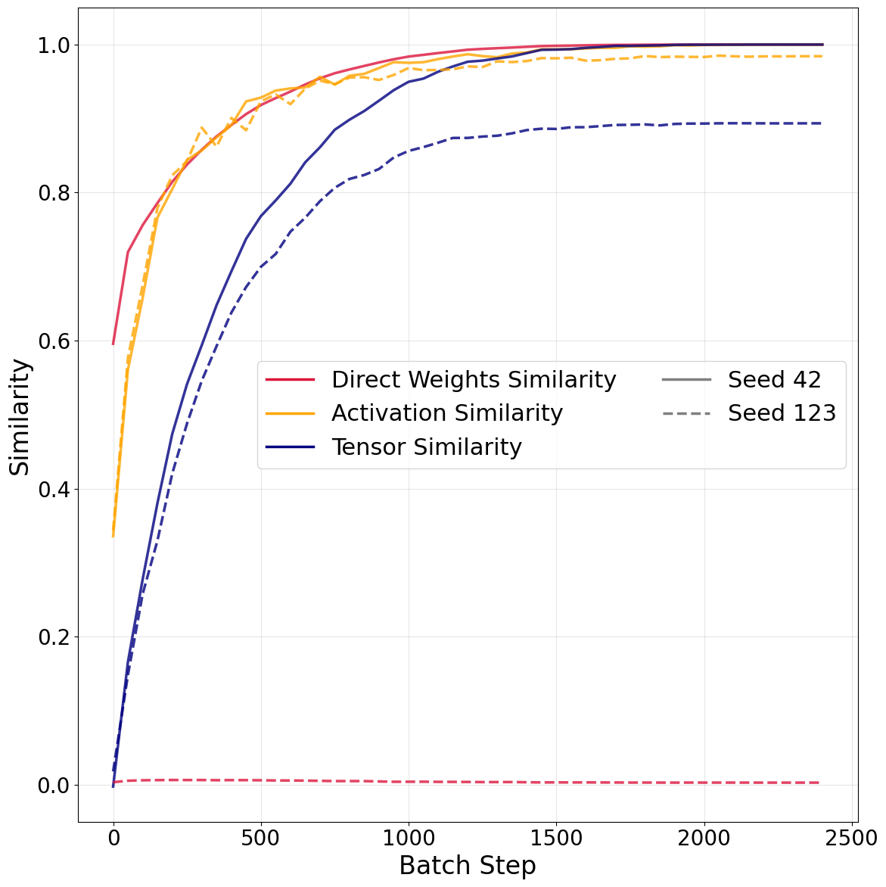

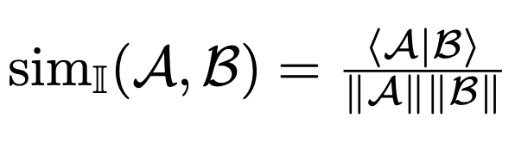





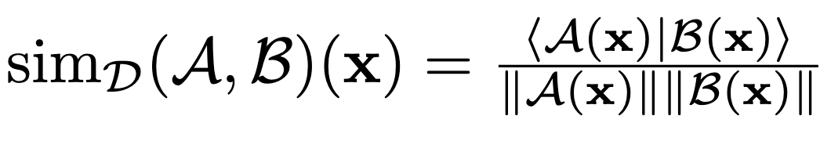










Direct Weights Similarity
θ
$$\text{,}$$
Activation Similarity
$$\text{,}$$
θ
Tensor Similarity
…
$$\text{,}$$
…

Slide 5



Direct Weights Similarity
θ
$$\text{,}$$
Activation Similarity
$$\text{,}$$
θ
Tensor Similarity
…
$$\text{,}$$
…

Slide 6





















Model A
Matrix Similarity
$$w_{1,1}^{A}$$
$$w_{1,1}^{B}$$
Calculate cosine angle
in weight space
$$w^{B}$$
Flatten
weights matrices
$$w^{A} =$$
$$w^{B} =$$
θ
Input
Output
$$w_{L,M}^{A}$$
$$w_{L,M}^{B}$$
$$w^{A}$$
Functional Similarity
$$o_{x_{1},1}^{A}$$
$$o_{x_{1},1}^{B}$$
Calculate cosine angle
in output space
$$o^{B}(x)$$
Flatten
output
matrices
(over N inputs)
$$o^{A}(x) =$$
$$o^{B}(x) =$$
Model B
θ
$$o_{x_{N},M}^{A}$$
$$o_{x_{N},M}^{B}$$
$$o^{A}(x)$$
Tensor Similarity
Input
Output
Calculate
cosine angle
in space of functions of Gaussian input
$$f^{B}$$
Calculate
interaction tensors
$$T^{A} =$$
$$T^{B} =$$
θ
$$f^{A}$$

Slide 7
















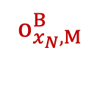
Matrix Similarity
$$w_{1,1}^{A}$$
$$w_{1,1}^{B}$$
Frobenius norm
(angle in weight space)
Uses the
weights
directly
Flatten
weights matrices
$$\text{,}$$
$$w_{L,M}^{A}$$
$$\text{,}$$
$$w_{L,M}^{B}$$
Functional Similarity
$$o_{x_{1},1}^{A}$$
$$o_{x_{1},1}^{B}$$
Frobenius norm
(angle in output space)
Uses the
outputs
$$o_{x_{n},1}^{A}$$
$$o_{x_{n},1}^{B}$$
Flatten
output matrices
$$x_{n}$$
$$x_{n}$$
$$\text{,}$$
$$o_{x_{n},M}^{B}$$
$$o_{x_{N},M}^{A}$$
$$\text{,}$$
$$o_{x_{N},M}^{B}$$
$$o_{x_{n},M}^{A}$$
Tensor Similarity
Uses a bilinear layer
architecture
Calculate
interaction tensors
Tensor similarity
(angle in Gaussian input space)
$$T^{A} =$$
$$T^{B} =$$

Slide 8



$$w_{1,1}^{A}$$
$$w_{1,N}^{A}$$
Input
$$w_{1,N}^{A}$$

Slide 9
Input
Output

Slide 11
Model

Slide 12

Model

Slide 14
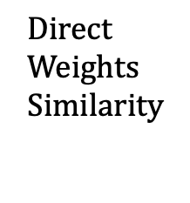
$$\text{Direct} \text{Weights} \text{Similarity}$$
θ
Input x

