Slide 1

Nonlinear and Multiobjective Programming

Slide 2
Nonlinear Programming
Overview
Applications
Theory

Slide 3
Linear Programming Model
ASSUMPTIONS:
Proportionality Assumption
Objective function
Constraints
Additivity Assumption
Objective function
Constraints

Slide 4
What is a nonlinear program?
maximize 3 sin x + xy + y³ - 3z + log z Subject to x² + y² = 1 x + 4z ≥ 2 z ≥ 0
A nonlinear program is permitted to have nonlinear constraints or objectives.
A linear program is a special case of nonlinear programming!

Slide 5
Nonlinear Programs (NLP)
Nonlinear objective function f(x) and/or Nonlinear constraints g_{i}(x).
Today: we will present several types of nonlinear programs.

Slide 6
Unconstrained Facility Location
This is the warehouse location problem with a single warehouse that can be located anywhere in the plane. Distances are “Euclidean.”
y
16
C
(2)
Loc. Dem.
A: (8,2) 19
B: (3,10) 7
C: (8,15) 2
D: (14,13) 5
P: ?
14
D (5)
12
(7)
10
B
8
P ?
6
4
2
A
(19)
0
x
0
2
4
6
8
10
12
14
16

Slide 7
An NLP
Costs proportional to distance; known daily demands
d(P,A) = …
d(P,D) =
minimize 19 d(P,A) + … + 5 d(P,D) subject to: P is unconstrained

Slide 8
Here are the objective values for 55 different locations.

Slide 9
Facility Location. What happens if P must be within a specified region?
y
16
C
(2)
14
D (5)
12
(7)
10
B
8
P ?
6
4
2
A
(19)
0
x
0
2
4
6
8
10
12
14
16

Slide 10
The model
Minimize
+ …+
Subject to x ≥ 7 5 ≤ y ≤ 11 x + y ≤ 24

Slide 11
0-1 integer programs as NLPs
minimize Σ_{j} c_{j} x_{j}
subject to Σ_{j} a_{ij} x_{j} = b_{i} for all i
x_{j} is 0 or 1 for all j
is “nearly” equivalent to
minimize Σ_{j} c_{j} x_{j} + 10⁶ Σ_{j} x_{j} (1- x_{j}).
subject to Σ_{j} a_{ij} x_{j} = b_{i} for all i
0 ≤ x_{j} ≤ 1 for all j

Slide 12
Some comments on nonlinear models
The fact that nonlinear models can model so much is perhaps a bad sign
How can we solve nonlinear programs if we have trouble with integer programs?
Recall, in solving integer programs we use techniques that rely on the integrality.
Fact: some nonlinear models can be solved, and some are WAY too difficult to solve. More on this later.

Slide 13
Regression
Find the best linear fit for estimating the midterm grade from the homework grades

Slide 14
Writing regression as an NLP
Minimize Σ_{j} (r_{j})²
subject to
r₁ = (91x + y) – 89
r₂ = (80x + y) – 97.5
r₃ = (61x + y) – 58.5
…
r₉ = (50x + y) – 67
Minimize Σ_{j} (r_{j})²
subject to
r_{j} = H_{j} x + y – M_{j} for each j
In an optimization framework, one can constrain coefficients.

Slide 15
r² =.082

Slide 16
r² =.29

Slide 17
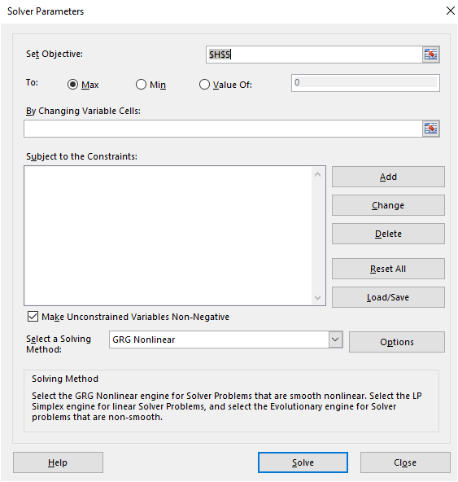
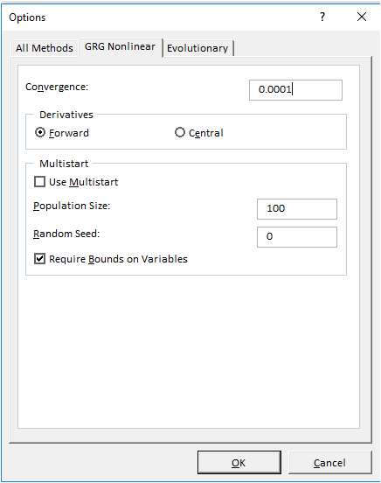
Solving NLP’s by Excel Solver

Slide 18
Solving NLP’s by Excel Solver
It is easy to use the Excel Solver to solve NLPs.
The process is similar to a linear model.
For NLPs having multiple local optimal solutions, the Solver may fail to find the optimal solution because it may pick a local extremum that is not a global extremum.

Slide 19
Summary
Applications of NLP to location problems, regression, and more (portfolio management, etc.)
nonlinear programming is very general and very hard to solve
Special case of convex minimization NLP is easier, because a local minimum is a global minimum

Slide 20
Difficulties of NLP Models
Linear Program:
Nonlinear Programs:

Slide 21
Graphical Analysis of nonlinear programs in two dimensions: An example
Minimize
subject to (x - 8)² + (y - 9)² ≤ 49 x ≥ 2 x ≤ 13 x + y ≤ 24

Slide 22
Where is the optimal solution?
y
Note: the optimal solution is not at a corner point. It is where the isocontour first hits the feasible region.
18
16
14
12
10
8
6
4
2
0
x
0
2
4
6
8
10
12
14
16
18

Slide 23
Minimize
(x-8)² + (y-8)²
Another example:
y
18
16
Then the global unconstrained minimum is also feasible.
14
12
10
The optimal solution is not on the boundary of the feasible region.
8
6
4
2
0
x
0
2
4
6
8
10
12
14
16
18

Slide 24
Local vs. Global Optima
Def’n: Let x be a feasible solution, then
x is a global max if f(x) ≥ f(y) for every feasible y.
x is a local max if f(x) ≥ f(y) for every feasible y sufficiently close to x (i.e., x_{j}-ε ≤ y_{j} ≤ x_{j}+ ε for all j and some small ε).
z
C
max f(x)
s.t. 0 ≤ x ≤ 1
z = f(x)
B
A
0
x
1
There may be several locally optimal solutions.

Slide 25
When is a locally optimal solution also globally optimal?
For minimization problems
The objective function is convex.
The feasible region is convex.

Slide 26
Convexity and Extreme Points
P
We say that a set S is convex, if for every two points x and y in S, and for every real number λ in [0,1], λx + (1-λ)y ε S.
The feasible region of a linear program is convex.
2
4
6
8
10
12
14
We say that an element w ε S is an extreme point (vertex, corner point), if w is not the midpoint of any line segment contained in S.
x
y
W
2
4
6
8
10
12
14
26

Slide 27
On convex feasible regions
If all constraints are linear, then the feasible region is convex

Slide 28
On Convex Feasible Regions
The intersection of convex regions is convex

Slide 29
Recognizing convex sets
Rule of thumb: suppose for all x, y ∈ S the midpoint of x and y is in S. Then S is convex.
It is convex if the entire line segment is always in S.
x
(x+y)/2
y
S

Slide 30
Which are convex?
A
B
C
D
B ∪ C
B ∩ C
B ⊕ C
30

Slide 31
Joining two points on a curve
The line segment joining two points on a curve. Let f( ) be a function, and let g(λy+(1-λ)z)) = λ f(y) + (1- λ)f(z) for 0≤ λ ≤1.
g(y) = f(y)
g(z) = f(z)
g(y/2 + z/2) = f(y)/2 + g(z)/2
f(x)
f(z)
g(x)
f(y)/2 + f(z)/2
f(y)
x
y
(y+z)/2
z

Slide 32
Convex Functions
Convex Functions: f(λ y + (1- λ)z) ≤ λ f(y) + (1- λ)f(z)
for every y and z and for 0≤ λ ≤1.
e.g., λ = 1/2 f(y/2 + z/2) ≤ f(y)/2 + f(z)/2
We say “strict” convexity if sign
is “<” for 0< λ <1.
Line joining any points is above the curve
f(x)
f(z)
f(y)/2 + f(z)/2
f(y)
x
y
(y+z)/2
z

Slide 33
Concave Functions
Concave Functions: f(λ y + (1- λ)z) ≥ λ f(y) + (1- λ)f(z)
for every y and z and for 0 ≤ λ ≤ 1.
e.g., λ = 1/2 f(y/2 + z/2) ≥ f(y)/2 + f(z)/2
We say “strict” concavity if sign
is “<” for 0< λ <1.
Line joining any points is below the curve
f(z)
f(y)/2 + f(z)/2
f(y)
x
y
(y+z)/2
z

Slide 34
More on convex functions
f(x)
x
If f(x) is convex, then f(-x) is convex.
f(-x)
-x

Slide 35
More on convex functions
y
x
If f(x) is convex, then K - f(x) is concave.
y
x

Slide 36
More on convex functions
If f(x) is a twice differentiable function of one variable, and if f”(x) > 0 for all x, then f(x) is convex.
f(x) = x².
f’(x) = 2x, f”(x) = 2
f(x) = - ln(x) for x > 0
f’(x) = -1/x, f”(x) = 1/x²

Slide 37
Even more on convex functions
If f(x) is convex and g(x) is convex, then so is f(x) + g(x)
f(x)+g(x)
f(x)
g(x)

Slide 38
Even more on convex functions
If f(x) is convex and g(x) is convex, then so is max [f(x), g(x)]
max[f(x), g(x)]
f(x)
g(x)

Slide 39
What functions are convex?
f(x) = 4x + 7 all linear functions
f(x) = 4x² – 13 some quadratic functions
f(x) = e^{x}
f(x) = 1/x for x > 0
f(x) = |x|
f(x) = - ln(x) for x > 0

Slide 40
Convex functions vs. convex sets
If y = f(x) is convex, then {(x,y) : f(x) ≤ y} is a convex set
y
f(x)
x

Slide 41
Local Minimum Property
A local min of a convex function on a convex feasible region is also a global min.
Strict convexity implies that the global minimum is unique.
The following NLPs can be solved
Minimization Problems with a convex objective function and linear constraints

Slide 42
Local minimum property
There is a unique local minimum for the function below.
y
f(x)
The local minimum is a global minimum
x

Slide 43
Local Maximum Property
A local max of a concave function on a convex feasible region is also a global max.
Strict concavity implies that the global optimum is unique.
Given this, the following NLPs can be solved
Maximization Problems with a concave objective function and linear constraints

Slide 44
Local maximum property
There is a unique local maximum for the function below.
y
The local maximum is a global maximum
x

Slide 45
More on local optimality
The techniques for nonlinear optimization minimization usually find local optima.
This is useful when a locally optimal solution is a globally optimal solution
It is not so useful in many situations.
Conclusion: if you solve an NLP, try to find out how good the local optimal solutions are.

Slide 46
Finding a local optimal for a single variable NLP
Solving NLP's with One Variable:
max f(θ)
s.t. a ≤ θ ≤ b
Optimal solution is either
a boundary point or
satisfies f ′ (θ∗) = 0 and f ″(θ∗) < 0.
f(θ)
a
θ *
b
θ
f(θ)
f(θ)
a
b
θ
a
θ *
b
θ
θ *

Slide 47
Unimodal Functions
A single variable function f is unimodal if there is at most one local maximum (or at most one local minimum) .

Slide 48
The search finds a local maximum, but not necessarily a global maximum.
13
18
21
26
0
34
16
19

Slide 49
The search finds a local maximum, but not necessarily a global maximum.
13
18
21
26
0
34
16
19

Slide 50
Summary
Convexity important to ensure global optimal solution is reached rather than local optimal solution with various solvers.
Theoretical: the Karush–Kuhn–Tucker (KKT) conditions must be met for the traditional methods to ensure optimal solution is found.
Primal Feasibility
Dual Feasibility
Complementary Slackness

