Slide 1
MSDS 401 Applied Statistics with R
Sync session #1
Dr. Syamala Srinivasan
Northwestern University
School of Professional Studies

Slide 2
Agenda
Course Overview
Review the Course Shell
Assignments/Tests
Quick demo of R

Slide 3
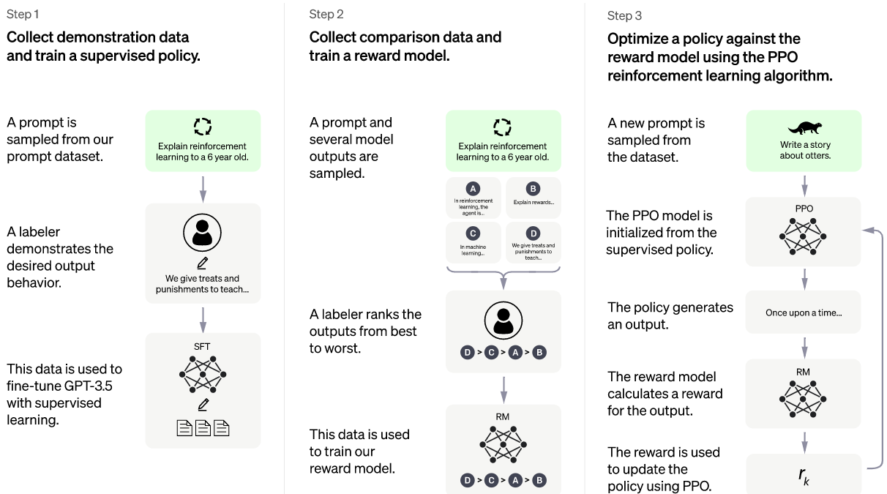
ChatGPT
https://openai.com/blog/chatgpt/

Slide 4
Goal of MSDS 401
R Programming
Applied Statistics
Prepare you for 422 & other courses in the program
Industrial Applications – NOT theory
Better sense when you look at reports in the media
FUN☺

Slide 5
MSDS 401 Course Overview
More than 100 students take this class in a Quarter
All sections use the same ‘core’ content - Core Statistical analysis, but
the course is customized by every faculty
We will use Kabacoff’s book for R and Ken Black’s book for Statistics
Lectures on ‘deep diving’ – 14 Chapter lectures (Panopto) – Dr.
Srinivasan
Lectures on R by former TA Todd Peterson (supplement to the book)
Sync sessions will focus on ‘real life’ problem solving – by integrating the
concepts & R; Cumulative Review
5 sync sessions scheduled (weeks # 1, 3, 5, 7, 9)
Robert Barr will conduct R (Q&A) sessions on 5 Sundays at 12:00 noon CST
Robert Barr will take care of the R Questions
Qualitative learning from peers through DB’s
Overall, it will be a blend of ‘online’ & ‘class room’ experience
Foundational course for the program (15 – 30 hours/week)

Slide 6

What is the problem solving process?
Data Scientist is a ‘business’ problem solver
“Statistical (Analytical) thinking will one day be as necessary for efficient
Citizenship as the ability to read and write.” H.G. Wells
“The formulation of the problem is often
more important than its solution”
Einstein
Problem Formulation
George
Box
Conclusions/
Implementation
$$
Data Quality/
EDA
Yogi Berra
“All models are wrong,
but some are useful”
“You can see a lot by looking”
Analysis/
Modeling
Einstein
“Models should be as simple as possible
but not simpler than necessary”

Slide 7


Business Intelligence/Business Analytics
Prescriptive
8. Optimization (What’s the best that can happen?)
7. Predictive modeling (What will happen next?)
Business Analytics
Predictive
6. Forecasting/extrapolation (What if these trends continue?)
Inferential Statistics
5. Statistical analysis (Why is this happening?)
Competitive Advantage
Bridge
Descriptive Statistics
4. Alerts (What actions are needed? )
Diagnostic
3. Query/drill down (Where exactly is the problem?)
Business Intelligence
Descriptive
2. Ad hoc reports (How many, how often, where?)
1. Standard reports (What happened?)
Sophistication
Competing Analytics book

Slide 8
MSDS 401 Content Overview
EDA – Chap 1 - 3 – Charts & Graphs, Descriptive Statistics Week 1 - 2
Bridge - Foundation – Chap 4 – Probability
Bridge – Chap 5 -7 – Discrete, Continuous, Sampling Distributions Week 3 - 4
Inferences – Chap 8 – 10, 16 – Hypotheses Testing, Confidence Intervals Week 5 - 7
DOE/ANOVA – Chap 11 – Designed Experiments, ‘Causal’ Inference
Predictive Modeling – Chap 12, 13 – Regression Modeling Week 8 - 9

Slide 9
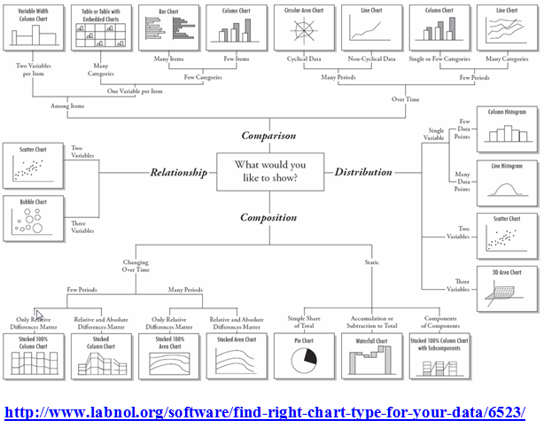
EDA

Slide 10
Canvas Overview

Slide 11
Grading – Total of 500 points
Discussion Board Participation (100 possible points, 10 points for each session –
to get the full grade you need to submit 1 original response (5) +
1 response to other posting (2) +
Reflection Question (3)
Self-Proctored (75 min) (25 possible points)
Tests (100 possible points, 4 quizzes for 25 points each)
2 R Assignments (125 possible points 50 + 75)
2 Data Analysis Assignments + Take Home(150 possible points 50 + 75 + 25)
Qualitative Learning
Concepts
R Programming
Integration
A = 93–100% (465-500 points)
A- = 90–92% (450-464 points)
B+ = 87–89% (435-449 points)
B = 83–86% (415-434 points)
B- = 80–82% (400-414 points)
C+ = 77–79% (385-399 points)
C = 73–76% (365-384 points)
C- = 70–72% (350-64 points)
F = 00–69% (000–349 points)

Slide 12
Tests/Final Exam
4 tests – each will have 10 multiple choice questions – automatically graded
You can take them over a week period – No time constraint
Some are conceptual questions, some require computations using R
Final proctored exam needs to be taken in one shot
Final exam has a duration of 75 + 15 minutes
Multiple choice questions – automatically graded
All questions are ‘conceptual’ – no R is needed
Practice questions are there every week
Practice final exam is posted in Week 10
Take home final exam

Slide 13
Take Home – Final Exam
25 points; Due: Week 10
COVID 19 is an ongoing threat. Data for the outbreak are available here:
https://www.ecdc.europa.eu/en/publications-data/download-todays-data-geographic-distribution-covid-19-cases-worldwide
Descriptive Statistics: Do an Exploratory Data Analysis (EDA) and provide appropriate summary statistics / visualizations to help understand the spread of the disease (incidence) as well as its fatality rate.
Inferential Statistics: Pick 2 countries and compare their incidence and fatality rates using hypothesis testing and confidence interval methods
Correlation: Pick all the countries and evaluate the relationship between incidence rates and fatality rates. Compute the correlation coefficient, if relevant.
Regression: Pick United States. Look at the time series of cases and time series of deaths. Use a regression model to predict the number of cases and the number of deaths for the next 5 days in the future.
Final report: Submit a html file (rmd) with your analysis results and conclusions.

Slide 14
Covid-19 Data/Simulation/Papers
Worldwide covid-19 data: https://www.ecdc.europa.eu/en/publications-data/download-todays-data-geographic-distribution-covid-19-cases-worldwide
John Hopkins dashboard: https://coronavirus.jhu.edu/map.html
3Blue1Brown Simulation: https://www.youtube.com/watch?v=gxAaO2rsdIs
Cohort study: https://www.sciencedirect.com/science/article/pii/S0140673620305663
Abnormal respiratory patterns classifier may contribute to large-scale screening of people infected with COVID-19 in an accurate and unobtrusive manner: auditory way of screening: https://arxiv.org/abs/2002.05534v1

Slide 15
Assignments
R Assignment 1 – Week 3 (50 points)
DA Assignment 1 – Week 5 (50 points)
R Assignment 2 – Week 7 (75 points)
DA Assignment 2 – Week 9 (75 points)

Slide 16
R Markdown
Programming test answers are to be submitted using R markdown
R Markdown Convenient way to prepare report
R markdown templates are prepared for the DA assignments
You just need to add the code into the spaces that are provided
‘Knit’ the file to prepare .html document
Submit the R markdown program and the .html document
Need to download R Studio as well
6 minute Panopto video:
https://northwestern.hosted.panopto.com/Panopto/Pages/
Viewer.aspx?id=099f4232-5267-4064-a414-a86300e9a7e0

Slide 17
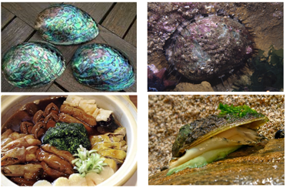
Data Analysis Assignments
Abalone case study
Purpose: develop statistical analysis skills, and practice R programming
Assignment 1: EDA of an observational study (abalone data)
Assignment 2: Model building and development of binary decision rules
You need to develop an ‘optimal’ harvesting strategy

Slide 18
Next steps for this week
Watch Chapter lectures under Week 1
Watch the R video
Read the materials
Post your original responses for the Discussion questions by Thursday night
Get access to R, R studio, R Markdown
Read the Quickstart guide
Attend Robert’s sync session on Sunday

Slide 19
Do not get overwhelmed!
You will feel like ‘drinking from firehose’!
If you have spent 30 minutes on any issue or question, STOP, time to get help!
Robert or I will get back to you within 24 hours
KEY – NEED to be ‘on track’ on daily basis – at least 2 hours/day!
DO NOT FALL BEHIND!
M/Tu: Listen to Lectures; W: Read book/write DB; Th/F/Sa: Assignment/Test;
S: DB responses
My Policy is: No student left behind!
Office hour – By appointment

Slide 20
Agenda
Course Overview
Review the Course Shell
Assignments/Tests
Quick demo of R

Slide 21
R Demo

Slide 22
Questions?

