Slide 1
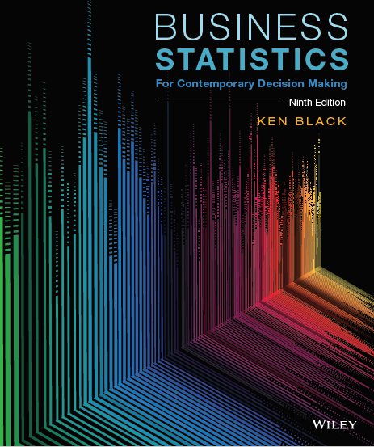
Business Statistics For Contemporary Decision Making 9th Edition
Ken Black
Chapter 1
Introduction
to Statistics

Slide 2
Learning Objectives
List quantitative and graphical examples of statistics within a business context.
Define important statistical terms, including population, sample, and parameter, as they relate to descriptive and inferential statistics.
Explain the difference between variables, measurement, and data.
Compare the four different levels of data: nominal, ordinal, interval, and ratio.
Notes:
2
2

Slide 3
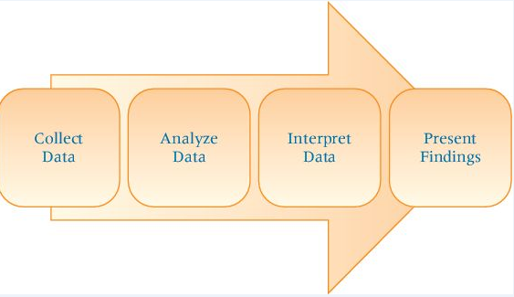
1.1 Basic Statistical Concepts
Statistics is the science of gathering, presenting, analyzing, and interpreting data.
Uses mathematics and probability
Branches of statistics:
Descriptive – graphical or numerical summaries of data
Inferential – making a decision based on data
Notes:
11
8

Slide 4
1.1 Basic Statistical Concepts
Population versus Sample
Population — the whole
a collection of all persons, objects, or items under study
Census — gathering data from the entire population
Sample — gathering data on a subset of the population
Use information about the sample to infer about the population
Notes:
11
8

Slide 5
1.1 Basic Statistical Concepts
Population
Notes:
11
8

Slide 6
1.1 Basic Statistical Concepts
Population and Census Data
Identifier
Color
MPG
RD1
Red
12
RD2
Red
10
RD3
Red
13
RD4
Red
10
RD5
Red
13
BL1
Blue
27
BL2
Blue
24
GR1
Green
35
GR2
Green
35
GY1
Gray
15
GY2
Gray
18
GY3
Gray
17
Avg = 19 mpg
Notes:
11
8

Slide 7
1.1 Basic Statistical Concepts
Sample and Sample Data
Identifier
Color
MPG
RD2
Red
10
RD5
Red
13
GR1
Green
35
GY2
Gray
18
Avg = 19 mpg

Slide 8
1.1 Basic Statistical Concepts
Parameter — descriptive measure of the population
Usually represented by Greek letters
Statistic — descriptive measure of a sample
Usually represented by Roman letters
Notes:
17
14

Slide 9
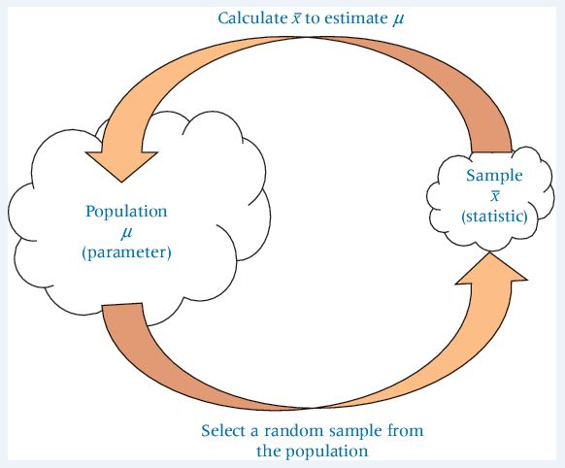
1.1 Basic Statistical Concepts
The inferential process

Slide 10
1.1 Basic Statistical Concepts
A variable is a characteristic of any entity being studied that is capable of taking on different values.
A measurement is when a standard process is used to assign numbers to particular attributes of the variable.
Data are recorded measurements.

Slide 11
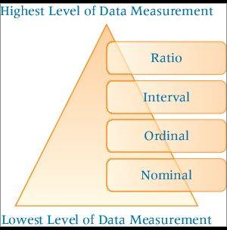
1.2 Data Measurement
Levels of Data Measurement

Slide 12
1.2 Data Measurement
Levels of Data Measurement
Nominal — used only to classify or categorize
No ordering of the cases is implied.
Examples:
Profession (doctor, lawyer…)
Sex (male, female)
Eye color (blue, brown, green…)
Lowest level of measurement
Notes:
21
18

Slide 13
1.2 Data Measurement
Levels of Data Measurement
Ordinal— ranking or ordering
Examples:
Ranking mutual funds by risk
50 most-admired companies
Nominal and ordinal data are nonmetric data or qualitative data because their measurements are imprecise.
Notes:
21
18

Slide 14
1.2 Data Measurement
Levels of Data Measurement
Interval— numerical data in which the distances between consecutive numbers have meaning.
Interval data have equal intervals.
Example:
Fahrenheit temperature scale
The zero point is a matter of convenience or convention.
A temperature of O⁰ does not mean that there is no temperature.
Notes:
21
18

Slide 15
1.2 Data Measurement
Levels of Data Measurement
Ratio— numerical data in which the distances between consecutive numbers have meaning and the zero value represents the absence of the characteristic being studied.
Examples:
Volume
Weight
Kelvin temperature
Highest level of data measurement
Interval and ratio data are called metric or quantitative data.
Notes:
21
18

Slide 16
1.2 Data Measurement
Usage potential among the four units of measurement
Type of data determines the type of statistical analysis that can be performed.
Nominal data is the most limited.
Ratio data is the most broad.
Parametric statistics require interval or ratio data.
Nonparametric statistics can be used with any data, but nominal and ordinal data require nonparametric methods.
Notes:
21
18

Slide 17
Learning Objectives
List quantitative and graphical examples of statistics within a business context.
Define important statistical terms, including population, sample, and parameter, as they relate to descriptive and inferential statistics.
Explain the difference between variables, measurement, and data.
Compare the four different levels of data: nominal, ordinal, interval, and ratio.
Notes:
2
2

