Slide 1

Business Statistics For Contemporary Decision Making 9th Edition
Ken Black
Chapter 2
Charts and Graphs

Slide 2
Learning Objectives
Construct a frequency distribution from a set of data.
Construct different types of quantitative data graphs, including histograms, frequency polygons, ogives, dot plots, and stem-and-leaf plots, in order to interpret the data being graphed.
Construct different types of qualitative data graphs, including pie charts, bar graphs, and Pareto charts, in order to interpret the data being graphed.
Construct a cross-tabulation table and recognize basic trends in two-variable scatter plots of numerical data.
Notes:
2
2

Slide 3
2.1 Frequency Distributions
Ungrouped data
have not been summarized in any way.
are also called raw data.
Example: age in years
Grouped data
logical groupings of data exists.
Example: age ranges (20-29, 30-39, etc.)
have been organized into a frequency distribution.
Notes:
11
8

Slide 4
2.1 Frequency Distributions
Example of Ungrouped Data
2.3
7.0
6.3
11.3
9.6
2.8
7.1
5.6
10.6
9.1
60 years of Canadian unemployment rates
Min = 2.3%
Max = 12%
3.6
5.9
5.4
9.7
8.3
2.4
5.5
7.1
8.8
7.6
2.9
4.7
7.1
7.8
6.8
3.0
3.9
8.0
7.5
7.2
4.6
3.6
8.4
8.1
7.7
4.4
4.1
7.5
10.3
7.6
3.4
4.8
7.5
11.2
7.2
4.6
4.7
7.6
11.4
6.8
6.9
5.9
11.0
10.4
6.3
6.0
6.4
12.0
9.5
6.0
Notes:
11
8

Slide 5
2.1 Frequency Distributions
Frequency Distribution for Canadian unemployment data
Class Interval | Frequency
1-under 3 | 4
3-under 5 | 12
5-under 7 | 13
7-under 9 | 19
9-under 11 | 7
11-under 13 | 5
Notes:
11
8

Slide 6
2.1 Frequency Distributions
Frequency Distribution – summary of data presented in the form of class intervals and frequencies
Vary in shape and design
Constructed according to the individual researcher's preferences
Range is defined as the difference between the largest and smallest numbers.
The range for the Canadian unemployment example is 9.7 (12.0 – 2.3).
Notes:
11
8

Slide 7
2.1 Frequency Distributions
Next step after determining range is to determine how many classes there will be.
Rule of thumb: select between 5 and 15.
Too few classes may be too general to be useful.
Too many classes may not be sufficiently aggregated.
Divide the range by the number of classes.
For the Canadian unemployment example, the researcher chose 6 classes.
9.7/6 = 1.62.
Round up to the nearest whole number (=2).
Must start at or below the lowest observation and end at or above the highest observation.
Notes:
11
8

Slide 8
2.1 Frequency Distributions
Class Midpoint (or Class Mark)
Value halfway across the class interval
Calculated by the average of the two endpoints.
Relative Frequency
Proportion of total frequency in any given class interval
(individual frequency)/(total frequency)
Cumulative Frequency
Running total of frequencies through the classes of a frequency distribution
Notes:
11
8

Slide 9
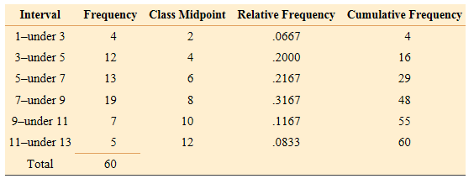
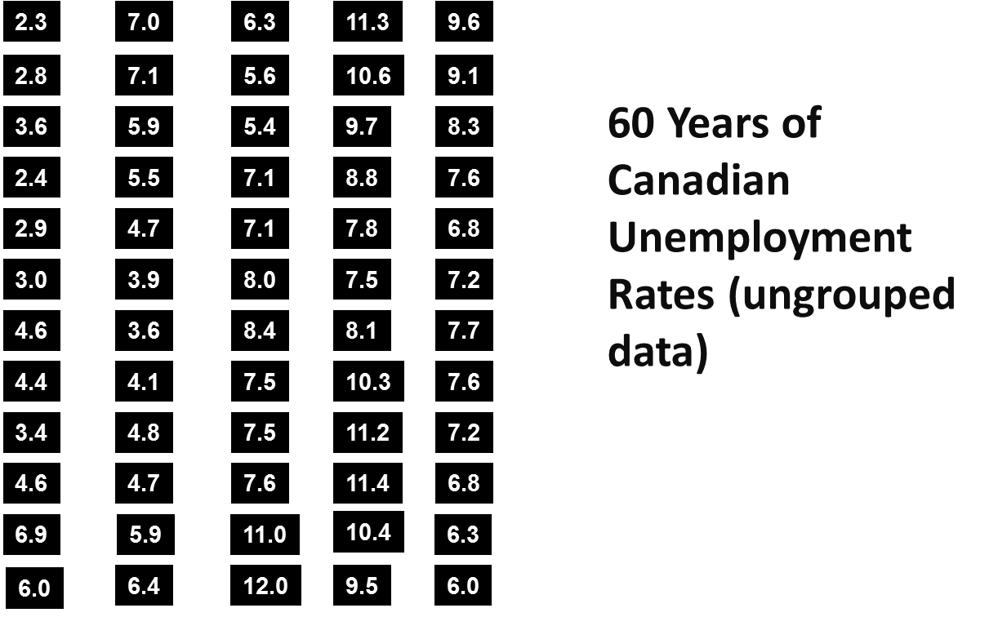
2.1 Frequency Distributions
Table 2.3: Class Midpoints, Relative Frequencies, and Cumulative Frequencies for Unemployment Data
Notes:
11
8

Slide 10
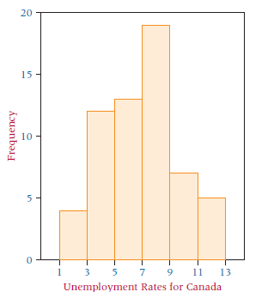
2.2 Quantitative Data Graphs
Histogram — contiguous rectangles that represent the frequency of data in given class intervals.
X-axis has class intervals; Y-axis has frequencies.
Unemployment data histogram
Histograms are useful for getting an initial overview of the distribution of the data.
Note that scale of each axis can change the shape of the histogram
In R, use the hist function
Notes:
17
14

Slide 11
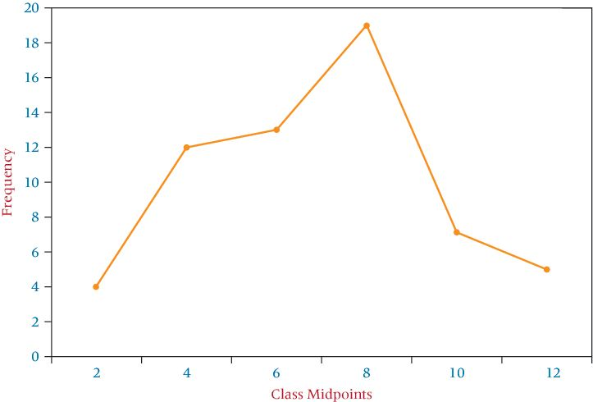
2.2 Quantitative Data Graphs
Frequency Polygon— graphical display of class frequencies
X-axis has class midpoints; Y-axis has frequencies.
A dot is plotted for each class midpoint.
Note that scale of each axis can also change the shape of the frequency polygon.
Notes:
17
14

Slide 12
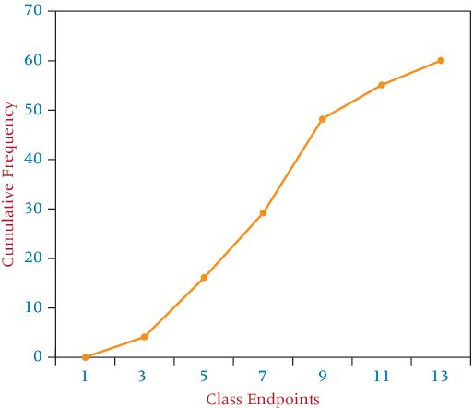
2.2 Quantitative Data Graphs
Ogive— cumulative frequency polygon
X-axis has class endpoints; Y-axis has cumulative frequencies.
A dot is plotted for each class midpoint.
Ogives are most useful when the researcher wants to see running totals.
Steep slopes show sharp increases in frequencies.
Notes:
17
14

Slide 13
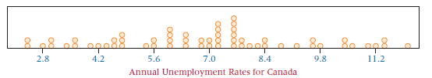
2.2 Quantitative Data Graphs
Dot Plots— each data point is plotted, with identical values stacked vertically
Useful for observing the overall shape of the distribution while observing where there are groupings or gaps in the data.
In the unemployment data, the distribution appears relatively balanced, with a peak towards the center and a few gaps.
Notes:
17
14

Slide 14
2.2 Quantitative Data Graphs
Stem-and-Leaf Plots— digits for each number are grouped into a stem and a leaf.
Stems are the leftmost, higher values.
Leaves are the rightmost, lower values.
Useful for observing whether values are in the upper or lower end of each bracket and seeing the spread of the values.
Retains original data rather than using class midpoints to represent values.
For 2-digit data, left value is the stem; right value is the leaf.
For numbers with more than 2 digits, split is chosen by the researcher’s preference.
Notes:
17
14

Slide 15
2.2 Quantitative Data Graphs
The following tables use scores from an examination on plant safety policy.
Raw Data
Stem
Leaf
86
77
91
60
55
2
3
4
5
6
7
8
9
3
9
7 9
5 6 9
0 7 7 8 8
0 2 4 5 5 6 7 7 8 9
1 1 2 3 3 6 8 9
1 1 2 4 7
76
92
47
88
67
23
59
72
75
83
77
68
82
97
89
81
75
74
39
67
79
83
70
78
91
68
49
56
94
81
Notes:
17
14

Slide 16
2.2 Quantitative Data Graphs
Construction of the safety examination data stem-and-leaf plot:
Raw Data
Stem
Leaf
86
77
91
60
55
2
3
4
5
6
7
8
9
3
9
7 9
5 6 9
0 7 7 8 8
0 2 4 5 5 6 7 7 8 9
1 1 2 3 3 6 8 9
1 1 2 4 7
Stem
76
92
47
88
67
23
59
72
75
83
77
68
82
97
89
Leaf
81
75
74
39
67
Stem
79
83
70
78
91
68
49
56
Leaf
94
81
Notes:
17
14

Slide 17
2.3 Qualitative Data Graphs
Pie Chart— circular depiction of the data where the area of the whole pie represents 100% of the data and slices of the pie represent percentage breakdown of the sublevels.
Shows relative magnitudes of the sublevels of the data.
Constructed by determining the proportion of the sublevel to the whole.
The following table shows the capacity of the top five U.S. petroleum refiners, in 1,000 barrels per day.
Company | Capacity
Exxon Mobil | 5,589
Valero Energy | 2,777
Chevron | 2,540
ConocoPhillips | 2,514
Marathon Oil | 1,714
Totals | 15,134
Notes:
17
14

Slide 18
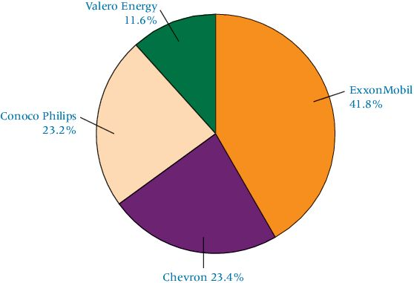
2.3 Qualitative Data Graphs
Company | Capacity | Proportion | Degrees
Exxon Mobil | 5,589 | 0.3693 | 132.95
Valero Energy | 2,777 | 0.1835 | 66.06
Chevron | 2,540 | 0.1678 | 60.41
ConocoPhillips | 2,514 | 0.1661 | 59.79
Marathon Oil | 1,714 | 0.1133 | 40.79
Totals | 15,134 | 1.0000 | 360.00
Proportion is each figure divided by the total.
Multiply each proportion by 360 degrees to get the angle for each slice of the pie.
Notes:
17
14

Slide 19
2.3 Qualitative Data Graphs
Bar Graph or Chart— 2 or more categories on one axis, bars for each category on the other axis.
Horizontal bar graphs are usually called bar charts.
Vertical bar graphs are usually called column charts.
The following table shows spending on back-to-college shopping by an average student:
Category | Amount ($)
Electronics | $211.89
Clothing | 134.40
Furnishings | 90.90
Supplies | 68.47
Misc. | 93.72
Notes:
17
14

Slide 20
2.3 Qualitative Data Graphs
Pareto Chart— vertical bar chart tallying number or type of defects ranked in order of occurrence.
The following table shows the type of defect found in electric motors, showing the frequency of types of defects.
Type | Frequency
Poor wiring | 40%
Short in the coil | 30%
Defective plug | 25%
Cessation of bearings | 5%
Pareto charts often include an ogive to show cumulative frequency.
Notes:
17
14

Slide 21
2.4 Charts and Graphs for Two Variables
Cross Tabulation— two-dimensional table that displays the frequency count for two variables simultaneously.
Data shows responses from a survey of banker satisfaction with their jobs. 1-5 represent levels of satisfaction, from least to greatest satisfaction.
Banker | Level of Satisfaction | Age
1 | 4 | 53
2 | 3 | 37
3 | 1 | 24
4 | 2 | 28
5 | 4 | 46
6 | 5 | 62
7 | 3 | 41
8 | 3 | 32
9 | 4 | 29
.
.
.
177 | 3 | 51
Level of Satisfaction | Age Category
 |  | <30 | 30-50 | 50> | Total
 | 1 | 7 | 3 | 0 | 10
 | 2 | 19 | 14 | 3 | 36
 | 3 | 28 | 17 | 12 | 57
 | 4 | 11 | 22 | 16 | 49
 | 5 | 2 | 9 | 14 | 25
 | Total | 67 | 65 | 45 | 177
Notes:
17
14

Slide 22
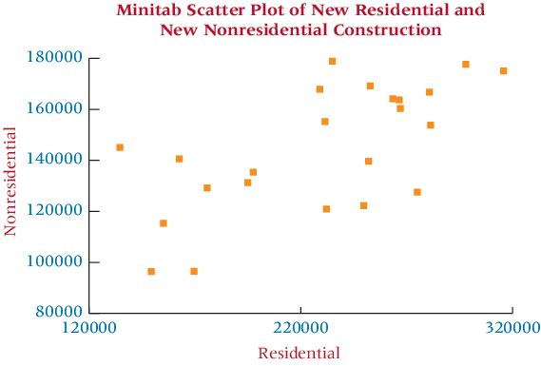
2.4 Charts and Graphs for Two Variables
Scatter Plot— two-dimensional graph plot of pairs of points from two numerical variables.
Useful for examining possible relationships between variables.
Scatter plot below shows values of new residential and nonresidential buildings in the U.S. for 35 years.
Data shows a mixed relationship.
Both types of construction might be expected to rise or fall at the same time, but data does not confirm that.
ggplot in R
Notes:
17
14

Slide 23
Learning Objectives
Construct a frequency distribution from a set of data.
Construct different types of quantitative data graphs, including histograms, frequency polygons, ogives, dot plots, and stem-and-leaf plots, in order to interpret the data being graphed.
Construct different types of qualitative data graphs, including pie charts, bar graphs, and Pareto charts, in order to interpret the data being graphed.
Construct a cross-tabulation table and recognize basic trends in two-variable scatter plots of numerical data.
Notes:
2
2

