Slide 1
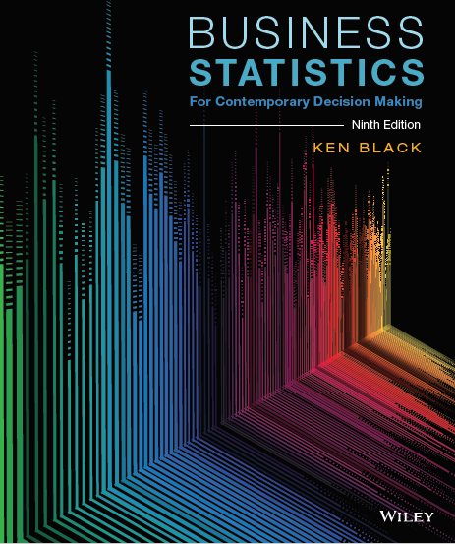
Business Statistics For Contemporary Decision Making 9th Edition
Ken Black
Chapter 3
Descriptive Statistics

Slide 2
Learning Objectives
Apply various measures of central tendency-including the mean, median, and mode-to a set of ungrouped data.
Apply various measures of variability- including the range, interquartile range, mean absolute deviation, variance, and standard deviation (using the empirical rule and Chebyshev’s theorem)- to a set of ungrouped data.
Compute the mean, median, mode, standard deviation, and variance of grouped data.
Describe a data distribution statistically and graphically using skewness, kurtosis, and box-and-whisker plots.
Use computer packages to compute various measures of central tendency, variation, and shape on a set of data, as well as to describe the data distribution graphically.
Notes:
2
2

Slide 3
3.1 Measures of Central Tendency: Ungrouped Data
Measures of central tendency yield information about the center or middle of group of numbers.
Mode: the most frequently occurring value in a data set
Applicable to all levels of data measurement
Sometimes, no mode exists, or there is more than one mode (bimodal, or multimodal).
Often used with nominal data (e.g., determining most common sizes of footwear).
Notes:
11
8

Slide 4
3.1 Measures of Central Tendency: Ungrouped Data
Median: the middle value of an ordered array of numbers.
Array values in order.
Median is the center number, or with an even number of observations, the average of the middle two terms.
Not affected by extreme values, so often preferable to the mean when the data includes some unusually large or small observations (e.g., income in the U.S., house prices in a given area).
Disadvantage is that it does not include all of the information in the data.
Data measurement level must at least be ordinal.
Notes:
11
8

Slide 5
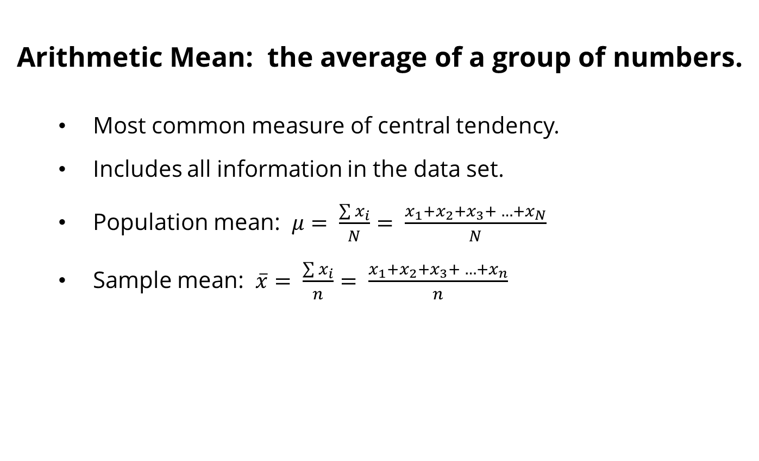
3.1 Measures of Central Tendency: Ungrouped Data
Arithmetic Mean: the average of a group of numbers.
Most common measure of central tendency.
Includes all information in the data set.
Population mean: $μ= \frac{\sum{x_{i}}}{N}= \frac{x_{1}+x_{2}+x_{3}+ …+x_{N}}{N}$
Sample mean: $\overline{x}= \frac{\sum{x_{i}}}{n}= \frac{x_{1}+x_{2}+x_{3}+ …+x_{n}}{n}$
Notes:
11
8

Slide 6
3.1 Measures of Central Tendency: Ungrouped Data
Example: Calculate the mean, median, and mode for the size of top 13 shopping centers in the UK.
Shopping Centre | Size (1000 m²)
MetroCentre | 190.0
Trafford Centre | 180.9
Westfield Stratford City | 175.0
Bluewater | 155.7
Liverpool One | 154.0
Westfield London | 149.5
Intu Merry Hill | 140.8
Manchester Arndale | 139.4
Meadowhall | 139.4
Lakeside | 133.8
St. David’s | 130.1
Bullring | 127.1
Eldon Square | 125.4
Notes:
11
8

Slide 7
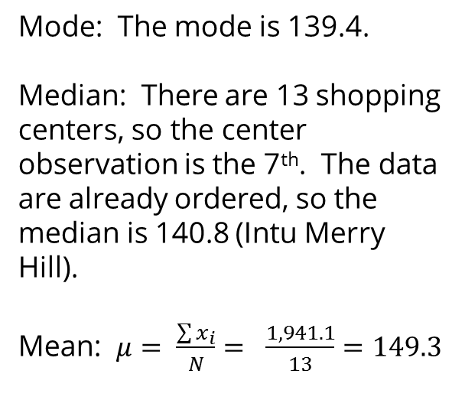
3.1 Measures of Central Tendency: Ungrouped Data
Solution:
Shopping Centre | Size (1000 m²)
MetroCentre | 190.0
Trafford Centre | 180.9
Westfield Stratford City | 175.0
Bluewater | 155.7
Liverpool One | 154.0
Westfield London | 149.5
Intu Merry Hill | 140.8
Manchester Arndale | 139.4
Meadowhall | 139.4
Lakeside | 133.8
St. David’s | 130.1
Bullring | 127.1
Eldon Square | 125.4
Mode: The mode is 139.4.
Median: There are 13 shopping centers, so the center observation is the 7th. The data are already ordered, so the median is 140.8 (Intu Merry Hill).
Mean: $μ= \frac{\sum{x_{i}}}{N}= \frac{1,941.1}{13}=149.3$
Notes:
11
8

Slide 8
3.1 Measures of Central Tendency: Ungrouped Data
Percentiles: measures of central tendency that divide a group of data into 100 parts.
At least n% of the data lie at or below the n^{th} percentile, and at most (100 - n)% of the data lie above the n^{th} percentile
Example: 90th percentile indicates that at 90% of the data are equal to or less than it, and 10% of the data lie above it
To calculate the P^{th} percentile,
Order the data
Calculate i = (P/100)N
Determine the percentile
If i is a whole number, then use the average of the i^{th} and (i+1)^{th} ordered observation
Otherwise, round i up to the next highest whole number
Notes:
11
8

Slide 9
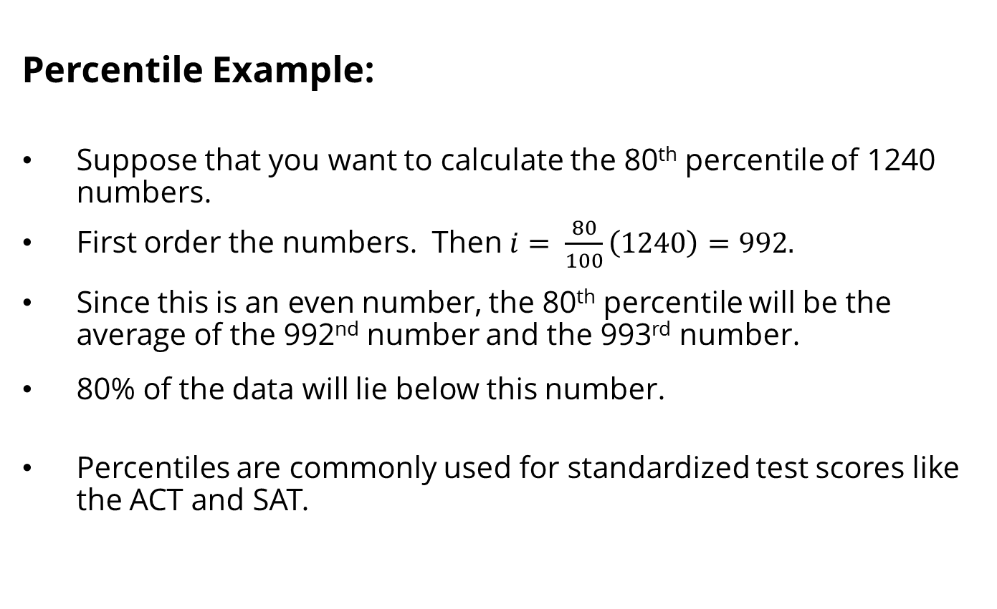
3.1 Measures of Central Tendency: Ungrouped Data
Percentile Example:
Suppose that you want to calculate the 80th percentile of 1240 numbers.
First order the numbers. Then $i= \frac{80}{100}\left(1240\right)=992.$
Since this is an even number, the 80th percentile will be the average of the 992nd number and the 993rd number.
80% of the data will lie below this number.
Percentiles are commonly used for standardized test scores like the ACT and SAT.
Notes:
11
8

Slide 10
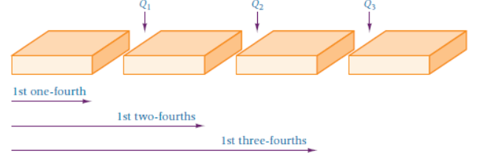
3.1 Measures of Central Tendency: Ungrouped Data
Quartiles: measures of central tendency that divide a group of data into four subgroups.
25% of the data set is below the first quartile
50% of the data set is below the second quartile
75% of the data set is below the third quartile
100% of the data set is below the fourth quartile
To calculate quartiles, find the 25th, 50th, and 75th percentiles.
Notes:
11
8

Slide 11
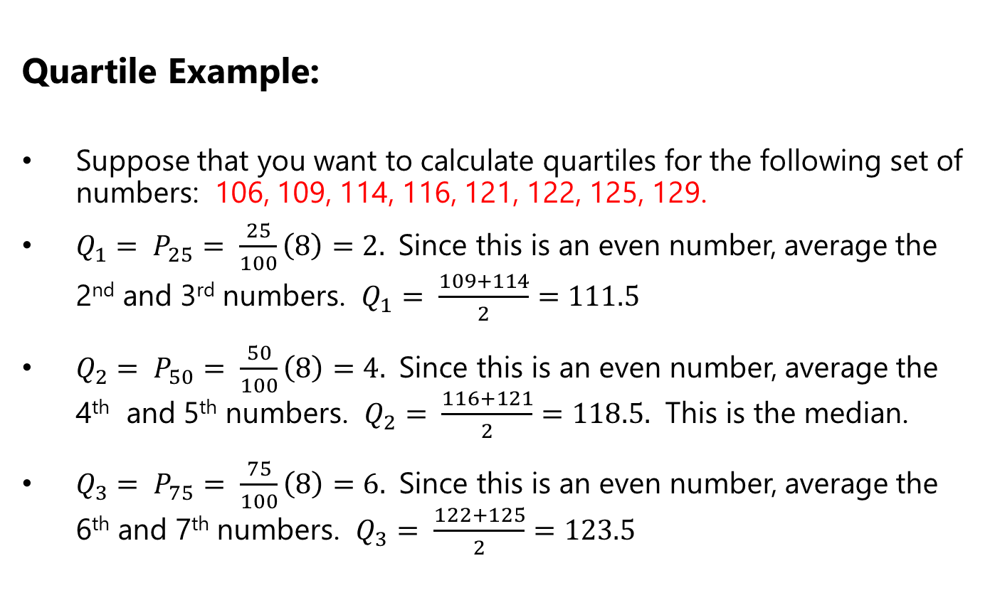
3.1 Measures of Central Tendency: Ungrouped Data
Quartile Example:
Suppose that you want to calculate quartiles for the following set of numbers: 106, 109, 114, 116, 121, 122, 125, 129.
$Q_{1}= P_{25}= \frac{25}{100}\left(8\right)=2.$Since this is an even number, average the 2nd and 3rd numbers. $Q_{1}= \frac{109+114}{2}=111.5$
$Q_{2}= P_{50}= \frac{50}{100}\left(8\right)=4.$Since this is an even number, average the 4th and 5th numbers. $Q_{2}= \frac{116+121}{2}=118.5.$ This is the median.
$Q_{3}= P_{75}= \frac{75}{100}\left(8\right)=6.$Since this is an even number, average the 6th and 7th numbers. $Q_{3}= \frac{122+125}{2}=123.5$
Notes:
11
8

Slide 12
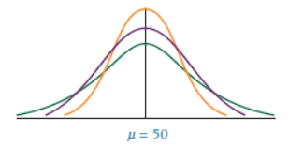
3.2 Measures of Variability: Ungrouped Data
Measures of variability describe the spread or dispersion of a set of data.
Distributions may have the same mean but different variability.
Notes:
11
8

Slide 13
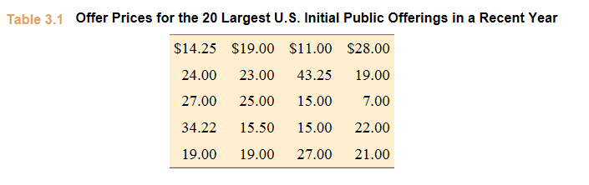
3.2 Measures of Variability: Ungrouped Data
Range: the difference between the largest and the smallest values in a set of data
Advantage – easy to compute
Disadvantage – is affected by extreme values
Range=$43.25-$7.00=$36.25
Notes:
11
8

Slide 14
3.2 Measures of Variability: Ungrouped Data
Country | Exports ($ billion)
Canada | 312.4
Mexico | 240.2
China | 123.7
Japan | 66.8
United Kingdom | 53.8
Germany | 49.4
South Korea | 44.5
Netherlands | 43.1
Brazil | 42.4
Hong Kong | 40.9
Belgium | 34.8
France | 31.3
Singapore | 30.2
Taiwan | 26.7
Switzerland | 22.2
Interquartile range: range of values between the first and third quartile
Range of the “middle half”; middle 50%
Useful when researchers are interested in the middle 50%, and not the extremes
The following data indicate the top 15 trading partners of the United States in exports in 2014, according to the U.S. Census Bureau.
Notes:
11
8

Slide 15
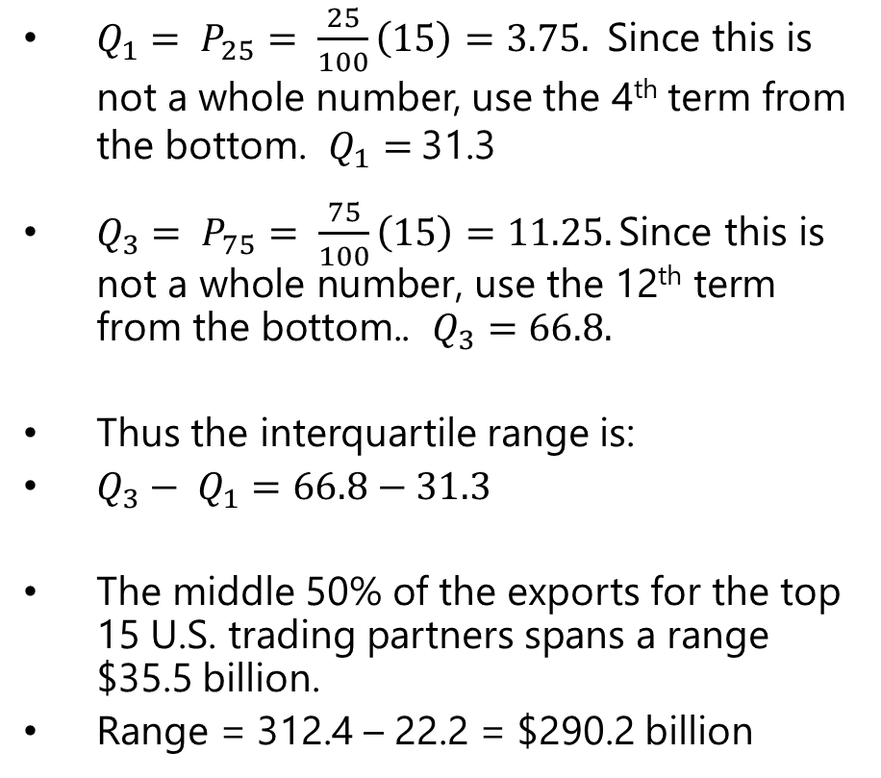
3.2 Measures of Variability: Ungrouped Data
Country | Exports ($ billion)
Canada | 312.4
Mexico | 240.2
China | 123.7
Japan | 66.8
United Kingdom | 53.8
Germany | 49.4
South Korea | 44.5
Netherlands | 43.1
Brazil | 42.4
Hong Kong | 40.9
Belgium | 34.8
France | 31.3
Singapore | 30.2
Taiwan | 26.7
Switzerland | 22.2
$Q_{1}= P_{25}= \frac{25}{100}\left(15\right)=3.75.$Since this is not a whole number, use the 4th term from the bottom. $Q_{1}=$31.3
$Q_{3}= P_{75}= \frac{75}{100}\left(15\right)=11.25. \text{Since} \text{this} \text{is} \text{not} \text{a} \text{whole} \text{number}\text{, }\text{use} \text{the}\text{ 12}\text{th} \text{term} \text{from} \text{the} \text{bottom}\text{.}$. $Q_{3}=66.8.$
Thus the interquartile range is:
$Q_{3}− Q_{1}=66.8−31.3$
The middle 50% of the exports for the top 15 U.S. trading partners spans a range $35.5 billion.
Range = 312.4 – 22.2 = $290.2 billion
Notes:
11
8

Slide 16
3.2 Measures of Variability: Ungrouped Data
Mean Absolute Deviation, Variance, and Standard Deviation
Measures of variability used with at least interval-level data.
Suppose that a company has the following data from five weeks of computer production (machines per week):
5, 9, 16, 17, 18
The owner could calculate the mean of the data, which is 13.
But there is significant variability from week to week.
X | X-μ
5 | -8
9 | -4
16 | 3
17 | 4
18 | 5
Subtracting the mean from each observation gives the deviation from the mean.
But the sum of the deviations will always add up to zero.
0
Notes:
11
8

Slide 17
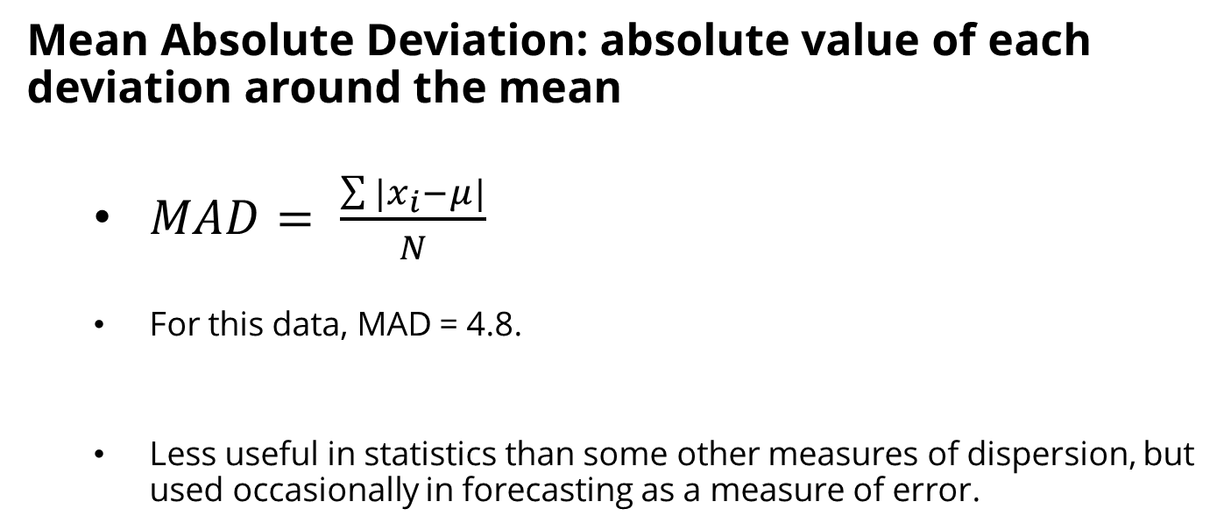
3.2 Measures of Variability: Ungrouped Data
Mean Absolute Deviation: absolute value of each deviation around the mean
$MAD= \frac{\sum{|x_{i}−μ|}}{N}$
For this data, MAD = 4.8.
Less useful in statistics than some other measures of dispersion, but used occasionally in forecasting as a measure of error.
X | X-μ | |X-μ|
5 | -8 | 8
9 | -4 | 4
16 | 3 | 3
17 | 4 | 4
18 | 5 | 5
0 24
Notes:
11
8

Slide 18
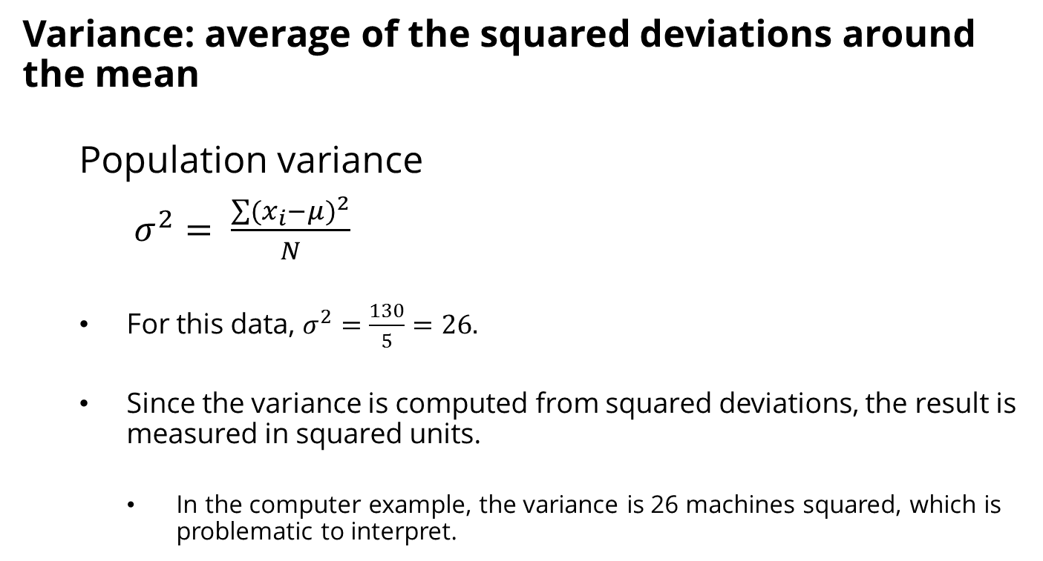
3.2 Measures of Variability: Ungrouped Data
Variance: average of the squared deviations around the mean
Population variance
$σ^{2}= \frac{\sum{{(x_{i}−μ)}^{2}}}{N}$
For this data, $σ^{2}=\frac{130}{5}=26.$
Since the variance is computed from squared deviations, the result is measured in squared units.
In the computer example, the variance is 26 machines squared, which is problematic to interpret.
X | X-μ | (X-μ)²
5 | -8 | 64
9 | -4 | 16
16 | 3 | 9
17 | 4 | 16
18 | 5 | 25
Total | 0 | 130
Notes:
11
8

Slide 19
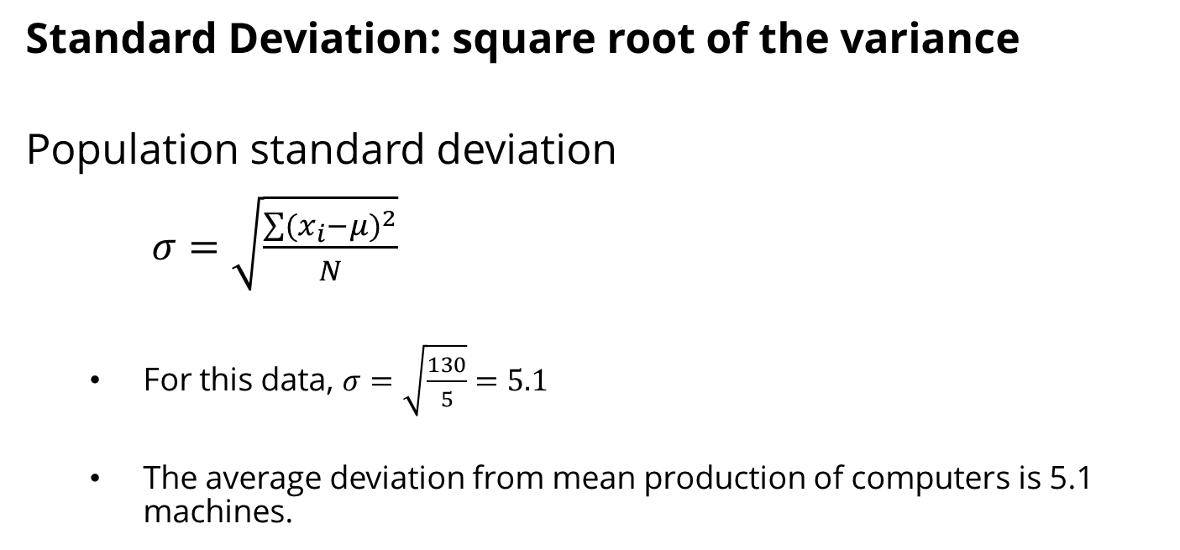
3.2 Measures of Variability: Ungrouped Data
Standard Deviation: square root of the variance
Population standard deviation
$σ=\sqrt{\frac{\sum{{(x_{i}−μ)}^{2}}}{N}}$
For this data, $σ=\sqrt{\frac{130}{5}}=5.1$
The average deviation from mean production of computers is 5.1 machines.
X | X-μ | (X-μ)²
5 | -8 | 64
9 | -4 | 16
16 | 3 | 9
17 | 4 | 16
18 | 5 | 25
Total | 0 | 130
Notes:
11
8

Slide 20
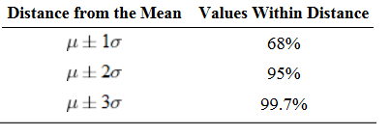
3.2 Measures of Variability: Ungrouped Data
The Empirical Rule
If a set of data is normally distributed, approximately 68% of values will lie within 1 standard deviation of the mean, 95% are within 2 standard deviations, and 99.7% are within 3 standard deviations.
Data must be normally distributed.
Since this is common for many things, the empirical rule is widely used.
Notes:
11
8

Slide 21
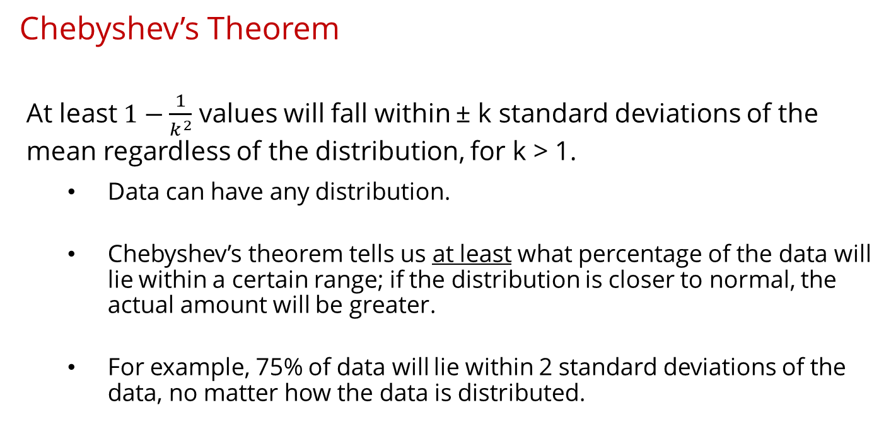
3.2 Measures of Variability: Ungrouped Data
Chebyshev’s Theorem
At least $1−\frac{1}{k^{2}}$ values will fall within ± k standard deviations of the mean regardless of the distribution, for k > 1.
Data can have any distribution.
Chebyshev’s theorem tells us at least what percentage of the data will lie within a certain range; if the distribution is closer to normal, the actual amount will be greater.
For example, 75% of data will lie within 2 standard deviations of the data, no matter how the data is distributed.
Notes:
11
8

Slide 22
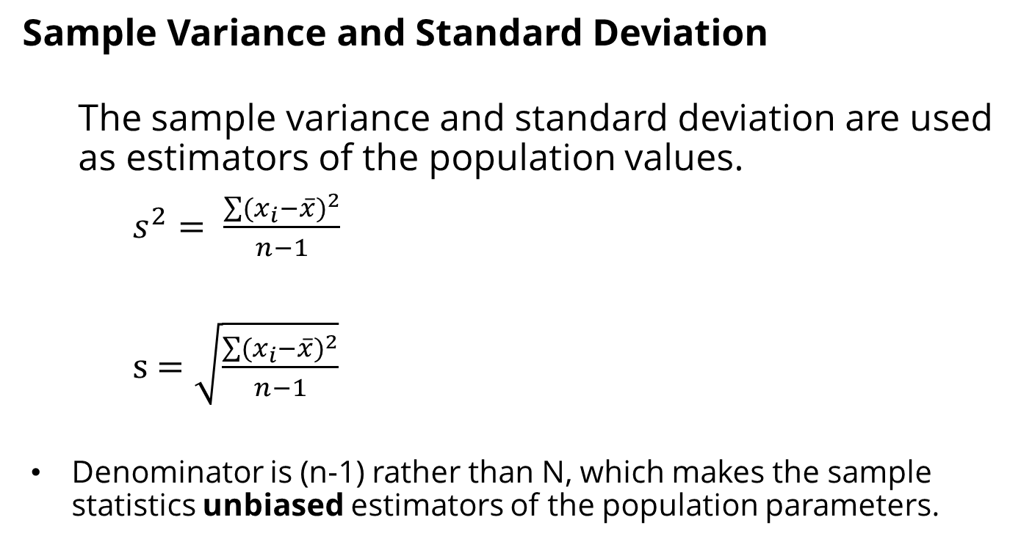
3.2 Measures of Variability: Ungrouped Data
Sample Variance and Standard Deviation
The sample variance and standard deviation are used as estimators of the population values.
$s^{2}= \frac{\sum{{(x_{i}−\overline{x})}^{2}}}{n−1}$
s $=\sqrt{\frac{\sum{{(x_{i}−\overline{x})}^{2}}}{n−1}}$
Denominator is (n-1) rather than N, which makes the sample statistics unbiased estimators of the population parameters.
Notes:
11
8

Slide 23
3.2 Measures of Variability: Ungrouped Data
Example: Partners in Accounting Firms
A researcher takes a sample of six of the largest accounting firms in the U.S., and wants to find the sample variance and standard deviation.
Firm | Number of Partners
Deloitte & Touche | 3030
Ernst & Young | 2700
Pricewaterhouse Cooper | 2691
KPMG | 1813
RSM McGladrey | 644
Grant Thornton | 529
Notes:
11
8

Slide 24
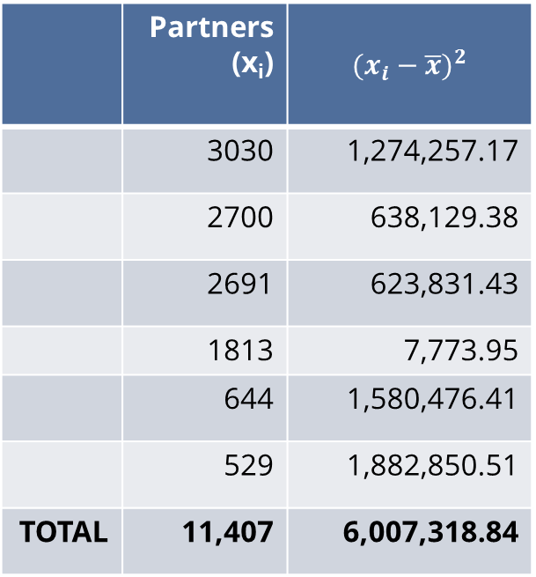

3.2 Measures of Variability: Ungrouped Data
Example: Partners in Accounting Firms
$$\overline{x}=\frac{11,407}{6}=1,901.17$$
$$s^{2}= \frac{\sum{{(x_{i}−\overline{x})}^{2}}}{n−1}$$
$$= \frac{6,007,318.84}{6−1}$$
$$=1,201,463.77$$
s $=\sqrt{\frac{\sum{{(x_{i}−\overline{x})}^{2}}}{n−1}}$
$$=\sqrt{1,201,463.77 }$$
$$=1,096.11$$
 | Partners (x_{i}) | $${(x_{i}−\overline{x})}^{2}$$
 | 3030 | 1,274,257.17
 | 2700 | 638,129.38
 | 2691 | 623,831.43
 | 1813 | 7,773.95
 | 644 | 1,580,476.41
 | 529 | 1,882,850.51
TOTAL | 11,407 | 6,007,318.84
Notes:
11
8

Slide 25
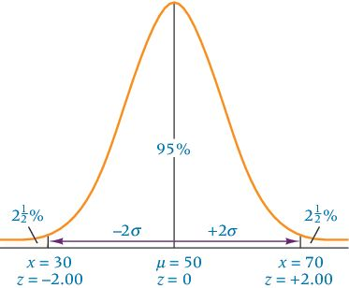
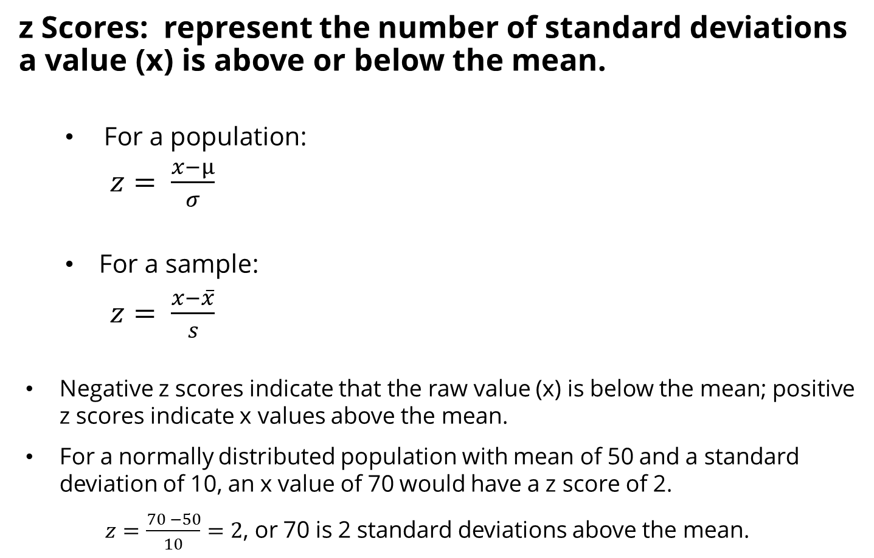
3.2 Measures of Variability: Ungrouped Data
z Scores: represent the number of standard deviations a value (x) is above or below the mean.
For a population:
$z= \frac{x−μ}{σ}$
For a sample:
$z= \frac{x−\overline{x}}{s}$
Negative z scores indicate that the raw value (x) is below the mean; positive z scores indicate x values above the mean.
For a normally distributed population with mean of 50 and a standard deviation of 10, an x value of 70 would have a z score of 2.
$z=\frac{70 −50}{10}=2$, or 70 is 2 standard deviations above the mean.
Notes:
11
8

Slide 26
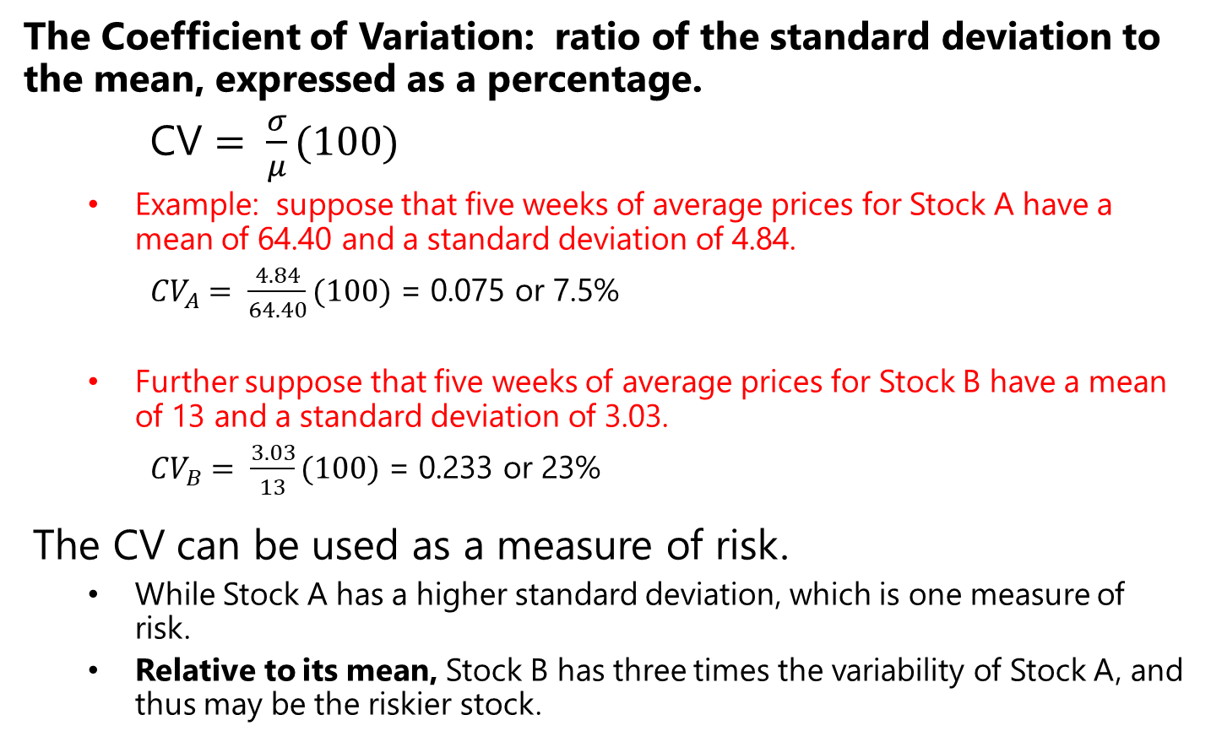
3.2 Measures of Variability: Ungrouped Data
The Coefficient of Variation: ratio of the standard deviation to the mean, expressed as a percentage.
CV $= \frac{σ}{μ}(100)$
Example: suppose that five weeks of average prices for Stock A have a mean of 64.40 and a standard deviation of 4.84.
${CV}_{A}= \frac{4.84}{64.40}(100)$ = 0.075 or 7.5%
Further suppose that five weeks of average prices for Stock B have a mean of 13 and a standard deviation of 3.03.
${CV}_{B}= \frac{3.03}{13}(100)$ = 0.233 or 23%
The CV can be used as a measure of risk.
While Stock A has a higher standard deviation, which is one measure of risk.
Relative to its mean, Stock B has three times the variability of Stock A, and thus may be the riskier stock.
Notes:
11
8

Slide 27
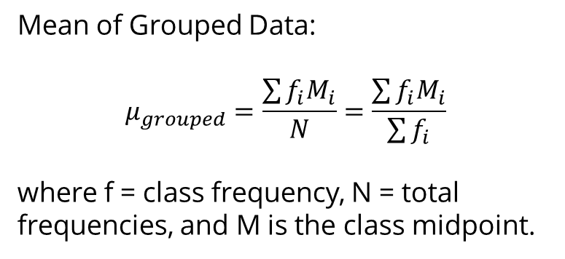
3.3 Measures of Central Tendency and Variability: Grouped Data
Data may already be grouped by class, and thus specific values are unknown.
Use midpoint of class interval to represent all values in the class.
Table shows the frequency distribution of unemployment rates in Canada, used earlier in the chapter.
Class Interval | Frequency | Cumulative Frequency
1-under 3 | 4 | 4
3-under 5 | 12 | 16
5-under 7 | 13 | 29
7-under 9 | 19 | 48
9-under 11 | 7 | 55
11-under 13 | 5 | 60
60
Mean of Grouped Data:
$$μ_{grouped}=\frac{\sum{f_{i}M_{i}}}{N}=\frac{\sum{f_{i}M_{i}}}{\sum{f_{i}}}$$
where f = class frequency, N = total frequencies, and M is the class midpoint.
Notes:
11
8

Slide 28
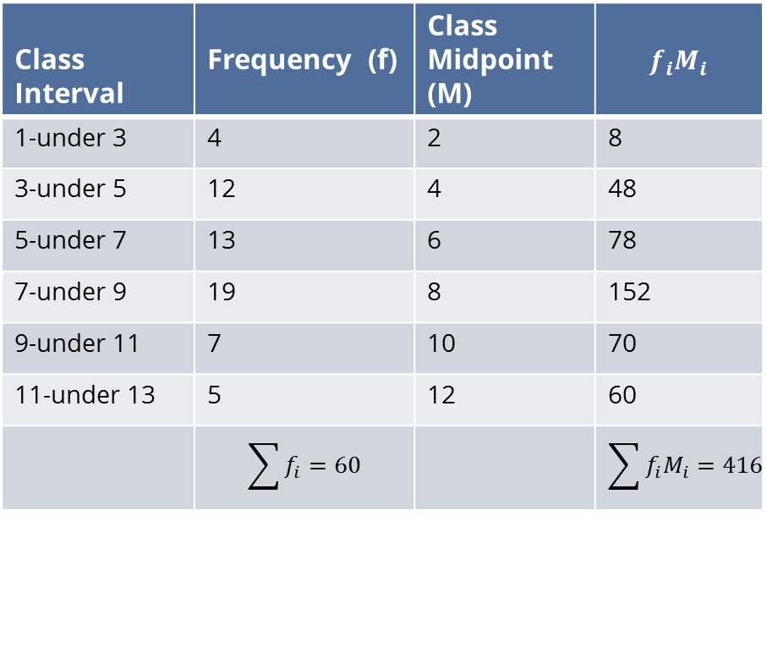
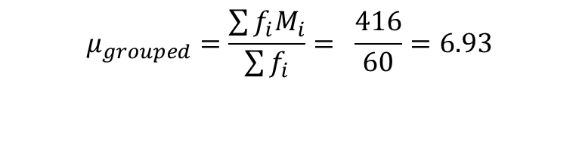
3.3 Measures of Central Tendency and Variability: Grouped Data
Class Interval | Frequency (f) | Class Midpoint (M) | $$f_{i}M_{i}$$
1-under 3 | 4 | 2 | 8
3-under 5 | 12 | 4 | 48
5-under 7 | 13 | 6 | 78
7-under 9 | 19 | 8 | 152
9-under 11 | 7 | 10 | 70
11-under 13 | 5 | 12 | 60
 | $$\sum{f_{i}=60}$$ |  | $$\sum{f_{i}M_{i}=416}$$
$$μ_{grouped}=\frac{\sum{f_{i}M_{i}}}{\sum{f_{i}}}= \frac{416}{60}=6.93$$
Notes:
11
8

Slide 29

3.3 Measures of Central Tendency and Variability: Grouped Data
Median of Grouped Data:
$$Median=L+\frac{\frac{N}{2} −cf_{P}}{f_{med}}(W)$$
where L =lower limit of the median class interval,
cf_{P} is the cumulative total of frequencies up to but not including the median class,
f_{med} is the frequency of the median class,
W is the width of the median class interval,
N is the total number of frequencies.
Class Interval | Frequency | Cumulative Frequency
1-under 3 | 4 | 4
3-under 5 | 12 | 16
5-under 7 | 13 | 29
7-under 9 | 19 | 48
9-under 11 | 7 | 55
11-under 13 | 5 | 60
Notes:
11
8

Slide 30

3.3 Measures of Central Tendency and Variability: Grouped Data
$$Median=L+\frac{\frac{N}{2} −cf_{P}}{f_{med}}(W)$$
Since there are 60 values, N/2 = 30.
The median is the 30th term, and falls in the (7-under 9) class, the median class interval.
There are 29 observations below.
The class width is 2.
The frequency of the median class interval is 19.
$$Median=7+\frac{\frac{60}{2} −29}{19}\left(2\right)=7.105$$
Class Interval | Frequency | Cumulative Frequency
1-under 3 | 4 | 4
3-under 5 | 12 | 16
5-under 7 | 13 | 29
7-under 9 | 19 | 48
9-under 11 | 7 | 55
11-under 13 | 5 | 60
Notes:
11
8

Slide 31
3.3 Measures of Central Tendency and Variability: Grouped Data
Class Interval | Frequency | Cumulative Frequency
1-under 3 | 4 | 4
3-under 5 | 12 | 16
5-under 7 | 13 | 29
7-under 9 | 19 | 48
9-under 11 | 7 | 55
11-under 13 | 5 | 60
The mode of grouped data is the class midpoint of the modal class (the class interval with the greatest frequency.
For the Canadian unemployment data, the modal class is 7-under .
The mode is the midpoint of that class, 8.
Notes:
11
8

Slide 32
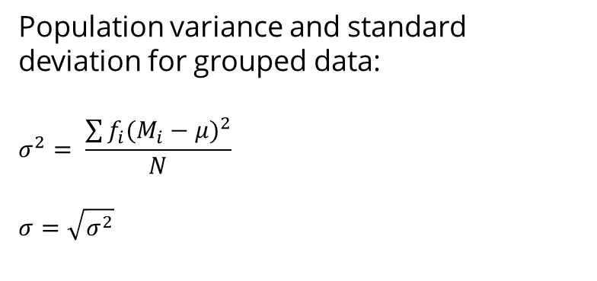
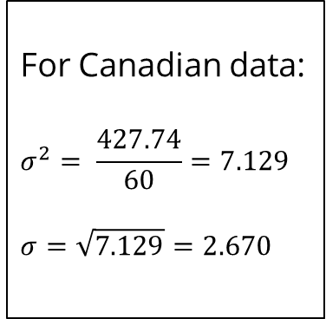
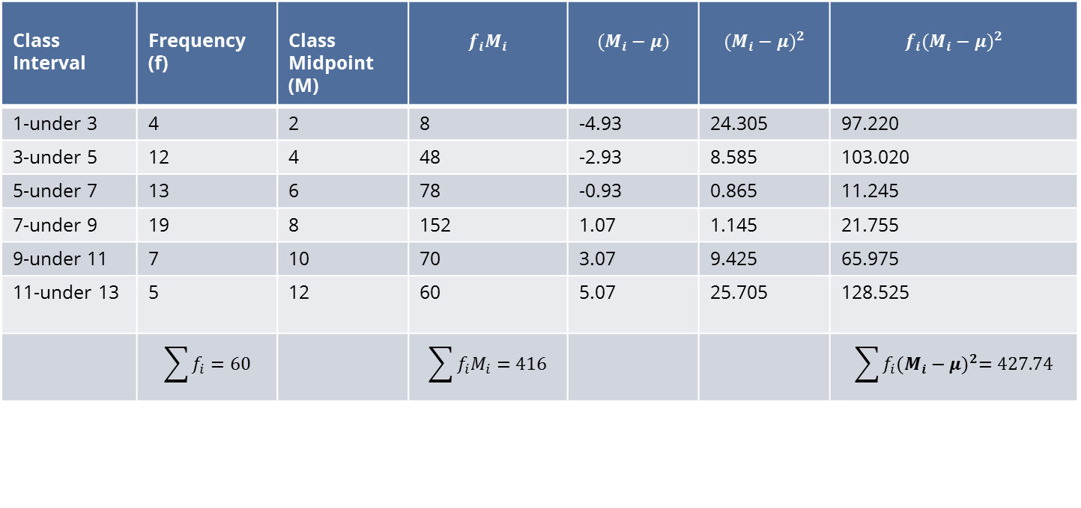
3.3 Measures of Central Tendency and Variability: Grouped Data
Class Interval | Frequency (f) | Class Midpoint (M) | $$f_{i}M_{i}$$ | $$(M_{i}−μ)$$ | $${(M_{i}−μ)}^{2}$$ | $$f_{i}{(M_{i}−μ)}^{2}$$
1-under 3 | 4 | 2 | 8 | -4.93 | 24.305 | 97.220
3-under 5 | 12 | 4 | 48 | -2.93 | 8.585 | 103.020
5-under 7 | 13 | 6 | 78 | -0.93 | 0.865 | 11.245
7-under 9 | 19 | 8 | 152 | 1.07 | 1.145 | 21.755
9-under 11 | 7 | 10 | 70 | 3.07 | 9.425 | 65.975
11-under 13 | 5 | 12 | 60 | 5.07 | 25.705 | 128.525
 | $$\sum{f_{i}=60}$$ |  | $$\sum{f_{i}M_{i}=416}$$ |  |  | $$\sum{f_{i}{(M_{i}−μ)}^{2}=427.74}$$
Population variance and standard deviation for grouped data:
$$σ^{2}= \frac{\sum{f_{i}{(M_{i}−μ)}^{2}}}{N}$$
$$σ=\sqrt{σ^{2}}$$
For Canadian data:
$$σ^{2}= \frac{427.74}{60}=7.129$$
$$σ=\sqrt{7.129}=2.670$$
Notes:
11
8

Slide 33
3.4 Measures of Shape
Measures of shape are tools that can be used to describe the shape of a distribution of data.
Skewness is when a distribution is asymmetrical or lacks symmetry.
Skewed portion is the long, thin part of the curve.
Skewed left, or negatively skewed.
Skewed right, or positively skewed.
Notes:
11
8

Slide 34
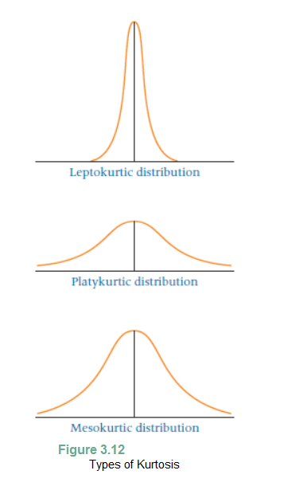
3.4 Measures of Shape
Kurtosis describes the peakedness of the distribution.
Normal
Notes:
11
8

Slide 35
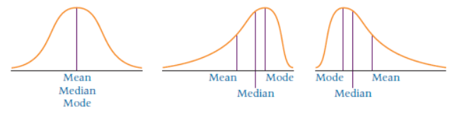
3.4 Measures of Shape
The relationship of the mean, median, and the mode relate to skew.
Symmetric: mean, median, and mode are equal.
Negatively skewed: Mean is less than the median, which is less than the mode.
Positively skewed: Mode is less than the median, which is less than the mean.
Symmetric Negative Skew Positive Skew
Notes:
11
8

Slide 36
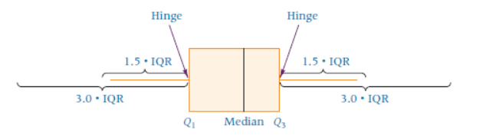
3.4 Measures of Shape
A box-and-whisker plot is a diagram that utilizes the upper and lower quartiles along with the median and the two most extreme values to depict a distribution graphically.
Sometimes called the 5-number summary.
A box is drawn around the median with the upper and lower quartiles as the box endpoints (hinges).
The interquartile range is used to construct the inner fences, ±1.5 (IQR).
If data fall outside the inner fences, outer fences are constructed, ± 3.0 (IQR).
A whisker (line segment) is drawn from the lower hinges of the box outward to the smallest data value.
A second whisker is drawn to the largest data value.
Notes:
11
8

Slide 37
3.4 Measures of Shape
Box-and-whisker plots, continued.
One use of box-and-whisker plots is to find outliers.
Data values that fall outside the mainstream of values are called outliers.
Sometimes merely extremes of the data.
Sometimes due to measurement or recording error.
Sometimes so unusual that they should not be considered with the rest of the data.
Values that are outside the inner fences but inside the outer fences are mild outliers.
Values that fall outside the outer fences are extreme outliers.
Another is to determine if the distribution is skewed.
The position of the median in the box gives information about the skew of the middle 50% of the data.
If the median is to the left, the middle 50% is skewed right.
If the median is to the right, the middle 50% is skewed left.
The length of the whiskers shows the skew of the outer values
Notes:
11
8

Slide 38
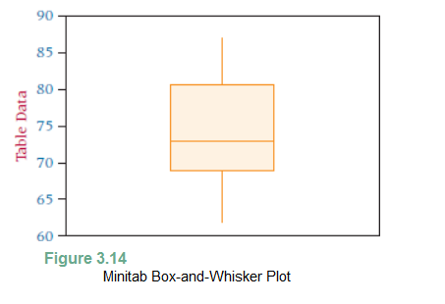
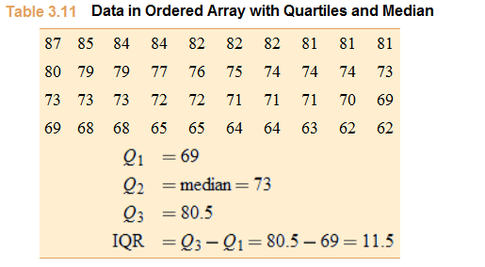

3.4 Measures of Shape
Example:
The median of the data is closer to the lower (or left) hinge, so the data is skewed right.
No numbers are outside the inner fences.
$Q_{1}−1.5\left(IQR\right)=69 −1.5\left(11.5\right)=5$1.75
$Q_{3}−1.5\left(IQR\right)=83+1.5\left(11.5\right)=97.75$
The lowest value is 62, and the highest value is 87, the endpoints of the whiskers.
n = 40
97.75
51.75
boxplot function in R
Notes:
11
8

Slide 39
3.5 Descriptive Statistics on the Computer
Both Excel and Minitab yield descriptive statistics.
Excel output for the Computer Production problem
Minitab output for the same problem
boxplot function in R
boxplot.stats function in R
Notes:
11
8

Slide 40
3.5 Descriptive Statistics on the Computer
R has several functions for computing summary statistics:
summary(dataframe)
quants <- c(0.001, 0.01, 0.5, 0.99, 0.999)
summary <- apply(df$C1, 2, quantile, probs=quants, na.rm= TRUE)
Notes:
11
8

Slide 41
Learning Objectives
Apply various measures of central tendency-including the mean, median, and mode-to a set of ungrouped data.
Apply various measures of variability- including the range, interquartile range, mean absolute deviation, variance, and standard deviation (using the empirical rule and Chebyshev’s theorem)- to a set of ungrouped data.
Compute the mean, median, mode, standard deviation, and variance of grouped data.
Describe a data distribution statistically and graphically using skewness, kurtosis, and box-and-whisker plots.
Use computer packages to compute various measures of central tendency, variation, and shape on a set of data, as well as to describe the data distribution graphically.
Notes:
2
2

