Slide 1
Memory safety in programming languages
Tom Peters, May 23, 2019
Notes:
Rather than starting with slides I'm going to show some code:
Argv
"Parallel" vectors
Use-after-free. Due to presence of aliasing in language
Stack smashing

Slide 2
Roughly 3 categories of memory bugs
Spatial -- out-of-bounds access
Heap-buffer overflow
Stack buffer overflow
Temporal
Use-after-free
Stack use after return
Stack use after scope
Data races - two concurrent accesses to a memory location, one of which is a write.
Notes:
These are not the only ones -- UMRs are also a problem

Slide 3
How do we deal with memory unsafety in C++?
Best practices, code review
Compiler warnings
Static analysis
Dynamic analysis

Slide 4
Static analysis
Analysis of program (either source or binary) in non-runtime environment.
Industrial tools ($):
Klocwork
Codesonar
Free tools:
Clang-check
Visual studio static analyizer
CppCheck

Slide 5
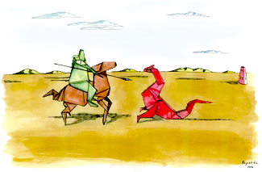
Dynamic analysis
Catching bugs as they happen at runtime (mostly linux only).
Valgrind suite, in particular memcheck
Google Sanitizers, in particular AddressSanitizer
Notes:
Demo: run valgrind on earlier examples
How does it work?
Introduce sanitizers

Slide 6
Comparison of memcheck, AddressSantizer
Asan wins:
Speed
Instrumentation of globals, better stack instrumentation, use after return, container overflow
Memcheck wins:
Also checks (bitwise) validity
Inline assembly, jitted code, external libs handled
Requires no compilation, linking changes.
Able to run alongside CUDA libraries.
Notes:
There is a sanitizer for UMRs, memsan, but almost no one except Google uses it, because it requires instrumenting all libraries
ASAN is available on Clang and GCC, and AFAIK they're not available on Windows
I would be thrilled, in fact I'd offer a reward, to anyone who can instrument our OpenVINO build with ASAN

Slide 7
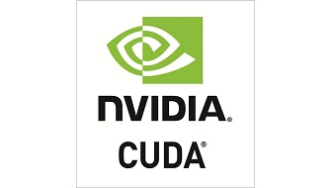
Aside #1: cuda-memcheck
CUDA C/C++ are memory unsafe
NVIDIA toolkit comes with cuda-memcheck, much like Valgrind's memcheck, but for CUDA code

Slide 8
Aside #2: Data race detection
Dynamic tools for data race detection:
Helgrind, a Valgrind tool.
ThreadSanitizer, from Google/LLVM

Slide 9
Practical recommendations for memory safety
Use a combination of static and dynamic analysis.
How should you take advantage of dynamic analysis?
Run them as necessary, much like debuggers.
Keep on during development, or on "canary" releases.
Run them on your unit tests, eg periodic memory checks.
This is particularly easy for valgrind and cmake: ctest -T memcheck
For sanitizers, it requires multiple rebuilds (no two sanitizers which require shadow memory can be run simultaneously)
Run instrumented fuzz tests.

Slide 10

But it's not proof of safety
Eg, Google Chome:
Large scale fuzzing
Google developers
Can't find all the bugs.

Slide 11





Other approaches
Most safe languages use a combination of runtime bounds checking and garbage collection.
Notes:
DEMO examples in java.
We just can't have a use-after-free in java. There's no way to end the lifetime of an object and maintain a reference to it.

Slide 12
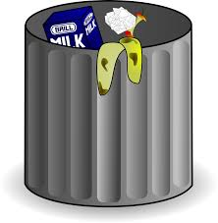
Garbage collection
Java
C#

Slide 13


Is there another way?
Enter: Rust
Notes:
Until quite recently, we had to choose between memory safety and speed. It's true that GC'd languages have made remarkable progress on performance, but the fact is they (at the very least) require more memory, are often slower than native languages, and have nondeterministic lifetimes (which makes them a nonstarter on real time or embedded systems).
Rust is a systems programming language with an emphasis on both performance AND safety. Backed by LLVM (which clang uses), performance is comparable to C or C++, but it is memory safe by default.
Let's look at some examples in rust.

Slide 14
Conclusion
Different approaches to memory safety:
Memory unsafe: C, C++, Fortran -- require discipline knowledge and tools.
Runtime GC: Java, C#, Haskell -- memory safe by default, but must pay cost of GC.
Rust -- memory safe (by default), no GC.

