Slide 1
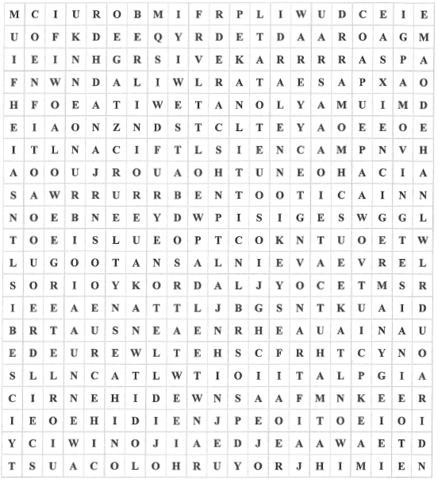
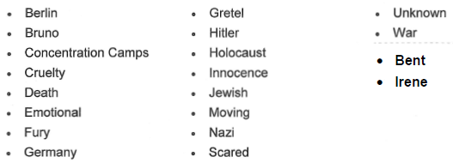
A task to get you back into programming. Here is a 21x21 word search, I “borrowed” from the history dept.
Version 1 program should -
Read in the data from the given CSV files.
Search for the words below.
Words can be in the rows forward → and reversed ←.
Words can be in the columns both up ↑ and down ↓.
Results should be output to the screen in a readable format.
Version 2 program should -
Words can be in the diagonals ↖ ↗ ↘ ↙
Version 3 program should -
Handle word grids that are not square.
Y12 CS Introduction Task #1

