Slide 1
Live traffic update
Pota
Trần Duy Quang
Hoàng Anh Tú

Slide 2
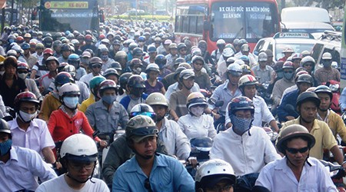

Which way should I choose?

Slide 3


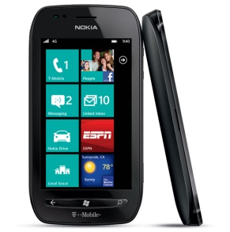
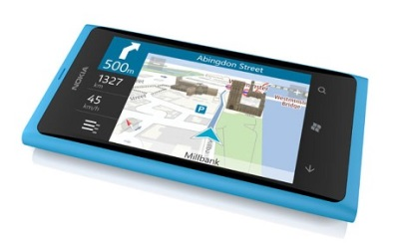

Solution
Web service
Traffic status
Traffic status

Slide 4
Business model
Freemium
Software as a service

Slide 5

Freemium
Free + Advertisement

Slide 6

VoH traffic program
67%
Radio listeners
79%
Interested by drivers
95%
Suitable for traffic
Source: giaothongvantai.com.vn

Slide 7
VoH problem
High cost
Low responsiveness

Slide 8


Other location-based services
No real-time traffic information

Slide 9

B2B – Software as a service
For
Other location-based services
Radio stations

Slide 10
Microworker’s Payment
Effectiveness
Activeness

Slide 11
Demo
Microworker sends traffic status
User checks traffic status
Web query

Slide 12
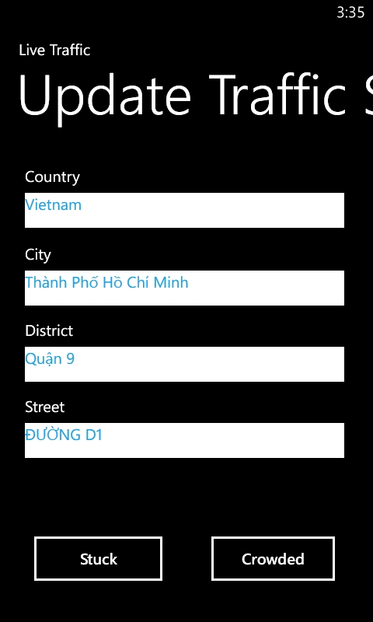
Update traffic info
Mindset: Quick
Auto detect location address
Faster
Less Cost
More Accuracy

Slide 13
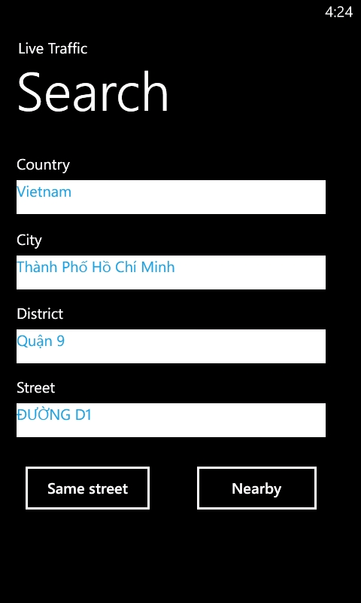
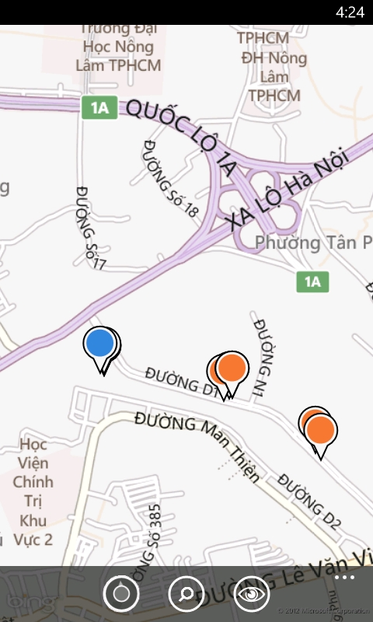
Check traffic status

Slide 14
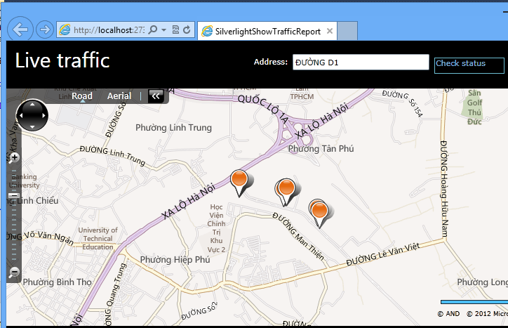
Web

Slide 15
Future work
Live time traffic status service: API, location-based application
Path finding

