Slide 1
Live traffic update
Pota
Trần Duy Quang
Hoàng Anh Tú

Slide 2
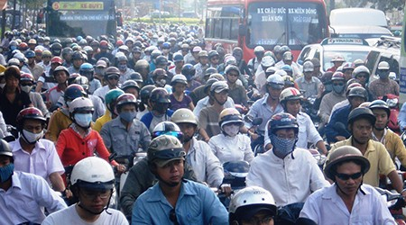

Which way should I choose?

Slide 3
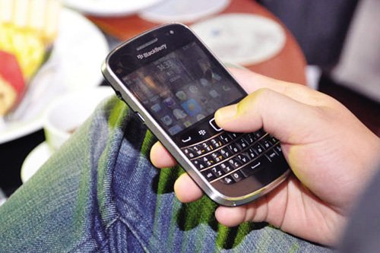


Live traffic update

Slide 4


Query situation ahead

Slide 5
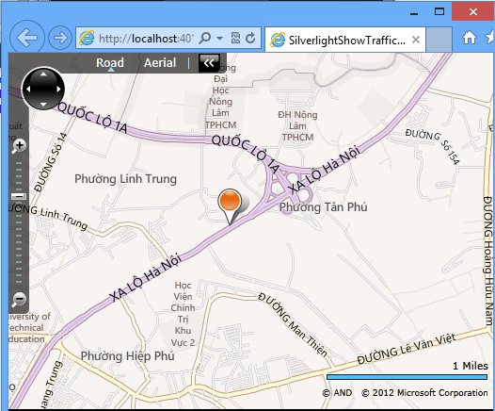
Web

Slide 6
Demo
Microworker sends traffic status
User checks traffic status
Web query

Slide 7
Business model
Worker: Paid on Effectiveness and Usefulness
Advertisement
SaaS

