Slide 1
深度学习原理与应用
深度学习
汤达荣
2024/10/6
tdr1991@outlook.com

Slide 2
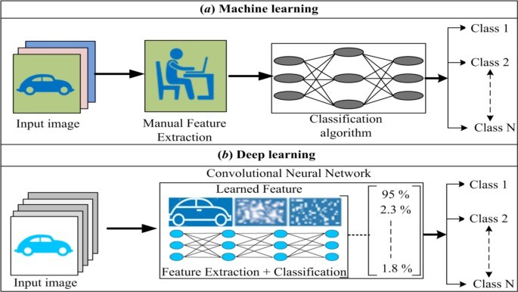
经典机器学习 vs 深度学习
经典机器学习 vs 深度学习
Source: Bhatt, Chandradeep, et al. "The state of the art of deep learning models in medical science and their challenges." Multimedia Systems 27.4 (2021): 599-613.

Slide 3
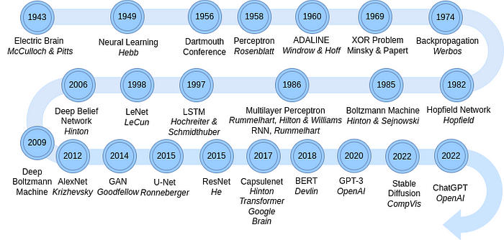
A Brief History of Neural Nets
https://pub.towardsai.net/a-brief-history-of-neural-nets-472107bc2c9c

Slide 4
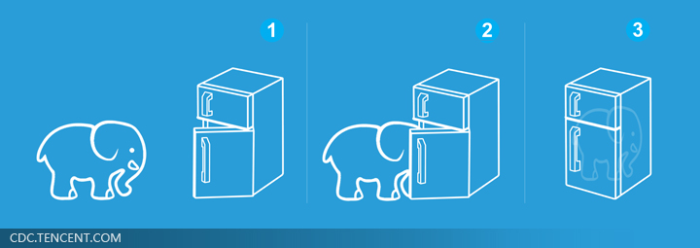
Three Steps for Deep Learning
Step 1: define a set of function
Step 2: goodness of function
Step 3: pick the best function
Neural
Network
Deep Learning is so simple ……
Notes:
http://www.twword.com/wiki/%E8%85%A6%E6%88%B6%E7%A9%B4
http://ukenglish.pixnet.net/blog/post/105691160-%E3%80%90%E5%8F%B0%E5%8D%97%E5%B8%82%E5%AD%B8%E8%8B%B1%E8%AA%9E%EF%BC%8C%E5%84%AA%E9%85%B7%E8%8B%B1%E8%AA%9E%E6%96%87%E7%90%86%E5%85%AC%E5%91%8A%E3%80%91%E6%9C%AC%E4%B8%AD%E5%BF%83
http://onepiece1234567890.blogspot.tw/2013/12/blog-post_8.html

Slide 5
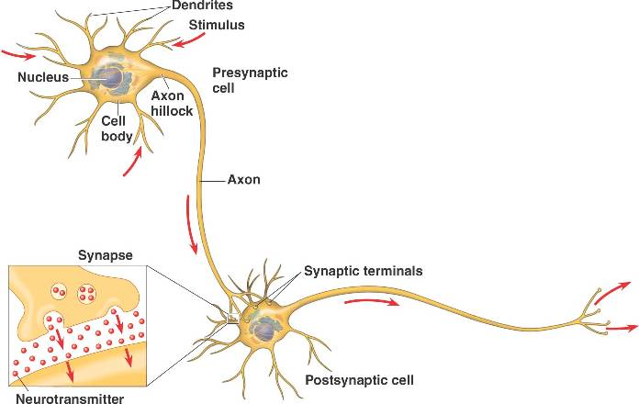
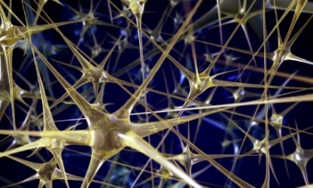
Neural Network
“Neuron”
Neural Network
Different connection leads to different network structures
Network parameter $θ$: all the weights and biases in the “neurons”
Notes:
瞬間潮了起來

Slide 6
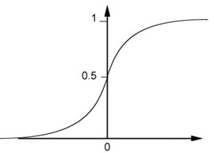
Fully Connect Feedforward Network
1
4
0.98
1
-2
1
-1
-2
0.12
-1
1
0
Sigmoid Function
Notes:
Ignore +

Slide 7
Fully Connect Feedforward Network
1
4
0.98
2
0.86
3
0.62
1
-2
-1
-1
1
0
-2
-1
-2
0.12
-2
0.11
-1
0.83
-1
1
-1
4
0
0
2

Slide 8
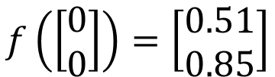
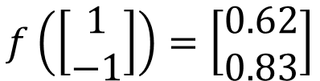
Fully Connect Feedforward Network
1
0.73
2
0.72
3
0.51
0
-2
-1
-1
1
0
-2
-1
0.5
-2
0.12
-1
0.85
0
1
-1
4
0
0
2
This is a function.
$$f\left(\left[\begin{matrix}1 \\ −1\end{matrix}\right]\right)=\left[\begin{matrix}0.62 \\ 0.83\end{matrix}\right]$$
$$f\left(\left[\begin{matrix}0 \\ 0\end{matrix}\right]\right)=\left[\begin{matrix}0.51 \\ 0.85\end{matrix}\right]$$
Input vector, output vector
Given network structure, define a function set
Notes:
For example, if we modify “1” to “2”, then we have another function

Slide 9
Fully Connect Feedforward Network
neuron
Input
Layer 1
Layer 2
Layer L
Output
……
y₁
……
y₂
……
……
……
……
……
……
y_{M}
Input Layer
Output Layer
Hidden Layers
Notes:
You can connect the neurons by other ways you like ☺
How many layer is deep?
CNN just another way to connect the neuros.
You can always connect the neurons in your own way.
“+” is ignored
Each dimension corresponds to a digit (10 dimension is needed)

Slide 10
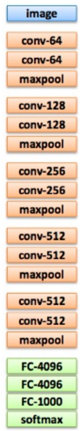
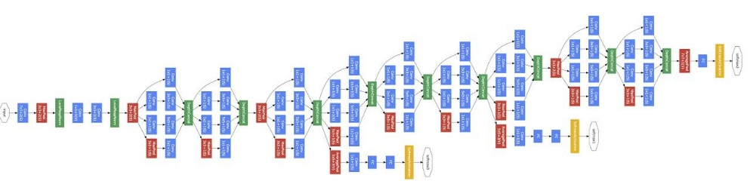
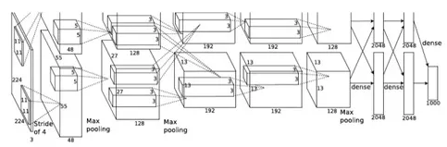
Deep = Many hidden layers
22 layers
http://cs231n.stanford.edu/slides/winter1516_lecture8.pdf
19 layers
8 layers
6.7%
7.3%
16.4%
AlexNet (2012)
VGG (2014)
GoogleNet (2014)

Slide 11

Deep = Many hidden layers
152 layers
101 layers
Special
structure
Ref: https://www.youtube.com/watch?v=dxB6299gpvI
3.57%
7.3%
6.7%
16.4%
AlexNet (2012)
VGG
(2014)
GoogleNet
(2014)
Residual Net
(2015)
Taipei
101
Notes:
169層

Slide 12
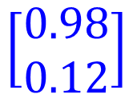


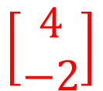

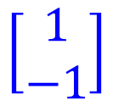

Matrix Operation
1
4
0.98
1
-2
1
-1
-2
0.12
-1
1
0
$$\left[\begin{matrix}1 & −2 \\ −1 & 1\end{matrix}\right]$$
$$\left[\begin{matrix}1 \\ −1\end{matrix}\right]$$
$$\left[\begin{matrix}1 \\ 0\end{matrix}\right]$$
$$=$$
$$\left[\begin{matrix}0.98 \\ 0.12\end{matrix}\right]$$
$$σ\left( \right)$$
$$+$$
$$\left[\begin{matrix}4 \\ −2\end{matrix}\right]$$
Notes:
Make sure you know how to do it
author: Adam Coates, Baidu, Inc.
Deep Learning (hopefully faster)
http://videolectures.net/deeplearning2015_coates_deep_learning/

Slide 13



Neural Network
……
y₁
W¹
W²
W^{L}
……
y₂
b¹
b²
b^{L}
……
……
……
……
……
x
a¹
a²
y
……
y_{M}
W¹
x
b¹
+
$$σ\left( \right)$$
a¹
b²
W²
+
$$σ\left( \right)$$
W^{L}
b^{L}
a^{L-1}
+
$$σ\left( \right)$$
Notes:
Draw it?

Slide 14


Neural Network
……
y₁
W¹
W²
W^{L}
……
y₂
b¹
b²
b^{L}
……
……
……
……
……
x
a¹
a²
y
……
y_{M}
y
x
Using parallel computing techniques to speed up matrix operation
$$=f\left( \right)$$
W^{L}
…
W²
W¹
x
b¹
b²
…
b^{L}
+
+
+
$$σ\left( \right)$$
$$=σ\left( \right)$$
$$σ\left( \right)$$
Notes:
Draw it?

Slide 15
Output Layer as Multi-Class Classifier
Feature extractor replacing feature engineering
……
y₁
……
y₂
Softmax
……
……
……
……
……
……
y_{M}
Input Layer
Output Layer
= Multi-class Classifier
Hidden Layers

Slide 16
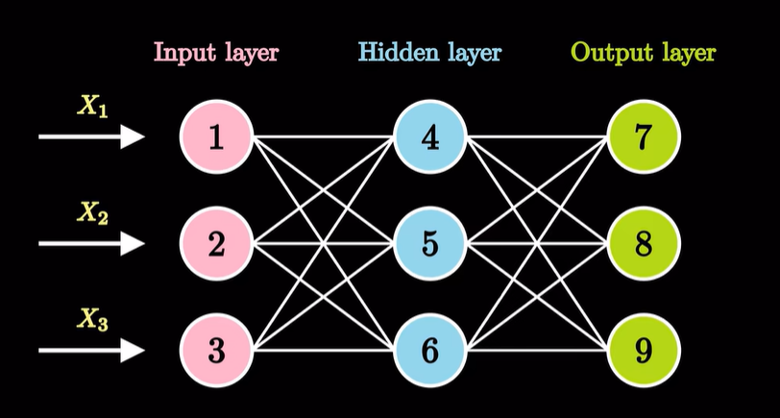
神经网络计算可视化
https://www.bilibili.com/video/BV1zV4y1R7B4/?vd_source=89d0bbc7a0e62ff88842d9bd62600f69

Slide 17
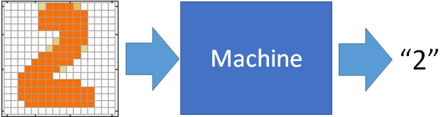
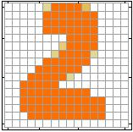
Example Application
Input
Output
y₁
is 1
0.1
y₂
is 2
0.7
The image is “2”
……
……
……
y₁₀
0.2
is 0
16 x 16 = 256
Ink → 1
No ink → 0
Each dimension represents the confidence of a digit.
Notes:
The same for even more complex tasks.

Slide 18
Example Application
Handwriting Digit Recognition
y₁
is 1
Machine
y₂
is 2
Neural
Network
“2”
……
……
……
y₁₀
is 0
What is needed is a function ……
Input:
256-dim vector
output:
10-dim vector
Notes:
The same approach for other cases

Slide 19
Example Application
Input
Layer 1
Layer 2
Layer L
Output
……
y₁
is 1
……
A function set containing the candidates for
Handwriting Digit Recognition
y₂
is 2
“2”
……
……
……
……
……
……
……
y₁₀
is 0
Input Layer
Output Layer
Hidden Layers
You need to decide the network structure to let a good function in your function set.
Notes:
CNN just another way to connect the neuros.
You can always connect the neurons in your own way.
“+” is ignored
Each dimension corresponds to a digit (10 dimension is needed)

Slide 20
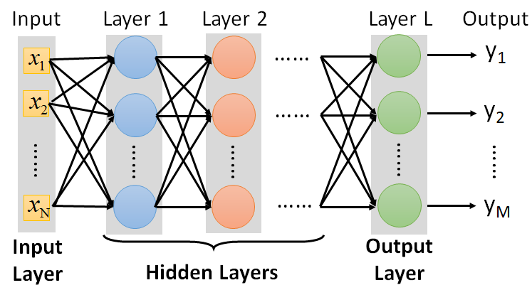
FAQ
Q: How many layers? How many neurons for each layer?
Q: Can the structure be automatically determined?
E.g. Evolutionary Artificial Neural Networks
Q: Can we design the network structure?
Trial and Error
+
Intuition
Convolutional Neural Network (CNN)

Slide 21
Three Steps for Deep Learning
Step 1: define a set of function
Step 2: goodness of function
Step 3: pick the best function
Neural
Network
Deep Learning is so simple ……
Notes:
http://www.twword.com/wiki/%E8%85%A6%E6%88%B6%E7%A9%B4
http://ukenglish.pixnet.net/blog/post/105691160-%E3%80%90%E5%8F%B0%E5%8D%97%E5%B8%82%E5%AD%B8%E8%8B%B1%E8%AA%9E%EF%BC%8C%E5%84%AA%E9%85%B7%E8%8B%B1%E8%AA%9E%E6%96%87%E7%90%86%E5%85%AC%E5%91%8A%E3%80%91%E6%9C%AC%E4%B8%AD%E5%BF%83
http://onepiece1234567890.blogspot.tw/2013/12/blog-post_8.html

Slide 22




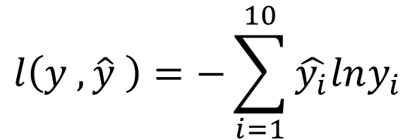


Loss for an Example
target
“1”
……
y₁
$${\hat{y}}_{1}$$
1
……
0
Given a set of parameters
y₂
$${\hat{y}}_{2}$$
Softmax
……
……
……
……
Cross
Entropy
……
……
……
y₁₀
0
$${\hat{y}}_{10}$$
$$y$$
$$\hat{y}$$
$$l\left(y ,\hat{y} \right)=−\sum_{i=1}^{10}{\hat{y_{i}}lny_{i}}$$
Notes:
https://www.youtube.com/watch?v=XWTfgehRxzU
You can never tind this in the textbook!
With softmax, the summation of all the ouputs would be one.
Can be considered as probability if you want ……

Slide 23





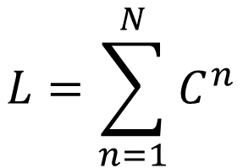
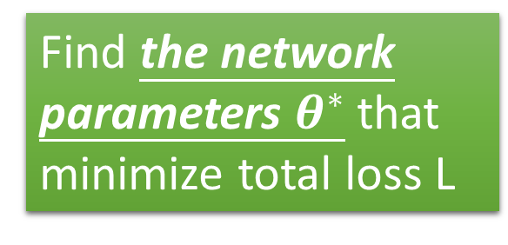







Total Loss
Total Loss:
$$L=\sum_{n=1}^{N}{l^{n}}$$
For all training data …
x¹
NN
y¹
$${\hat{y}}^{1}$$
$$l^{1}$$
NN
Find a function in function set that minimizes total loss L
x²
y²
$${\hat{y}}^{2}$$
$$l^{2}$$
x³
NN
y³
$${\hat{y}}^{3}$$
$$l^{3}$$
……
……
……
……
Find the network parameters $θ^{∗}$ that minimize total loss L
x^{N}
NN
y^{N}
$${\hat{y}}^{N}$$
$$l^{N}$$
Notes:
Randomly picked one
Two approaches update the parameters towards the same direction, but stochastic is faster!
Better!

Slide 24
Three Steps for Deep Learning
Step 1: define a set of function
Step 2: goodness of function
Step 3: pick the best function
Neural
Network
Deep Learning is so simple ……
Notes:
http://www.twword.com/wiki/%E8%85%A6%E6%88%B6%E7%A9%B4
http://ukenglish.pixnet.net/blog/post/105691160-%E3%80%90%E5%8F%B0%E5%8D%97%E5%B8%82%E5%AD%B8%E8%8B%B1%E8%AA%9E%EF%BC%8C%E5%84%AA%E9%85%B7%E8%8B%B1%E8%AA%9E%E6%96%87%E7%90%86%E5%85%AC%E5%91%8A%E3%80%91%E6%9C%AC%E4%B8%AD%E5%BF%83
http://onepiece1234567890.blogspot.tw/2013/12/blog-post_8.html

Slide 25
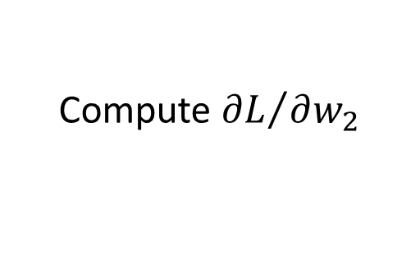
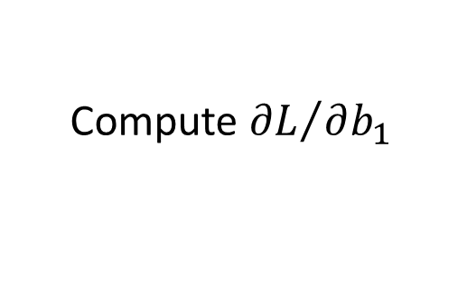
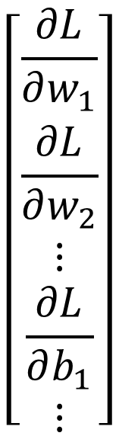
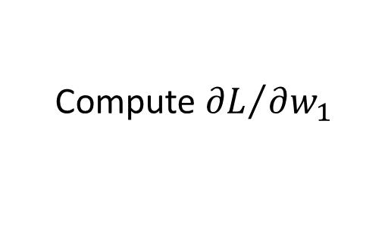





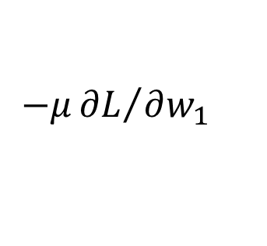
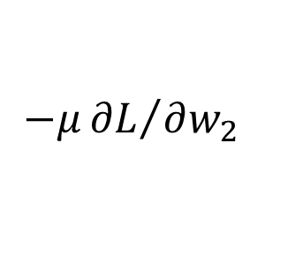
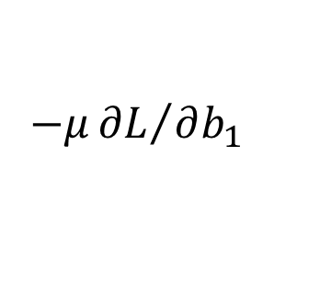
Gradient Descent
$$θ$$
Compute ${∂L}/{∂w_{1}}$
$$\left[\begin{aligned}\frac{∂L}{∂w_{1}} \\ \frac{∂L}{∂w_{2}} \\ ⋮ \\ \frac{∂L}{∂b_{1}} \\ ⋮\end{aligned}\right]$$
$$w_{1}$$
0.2
0.15
$$−μ{∂L}/{∂w_{1}}$$
Compute ${∂L}/{∂w_{2}}$
$$w_{2}$$
-0.1
0.05
$$∇L=$$
$$−μ{∂L}/{∂w_{2}}$$
……
Compute ${∂L}/{∂b_{1}}$
$$b_{1}$$
0.3
0.2
$$−μ{∂L}/{∂b_{1}}$$
……
gradient

Slide 26
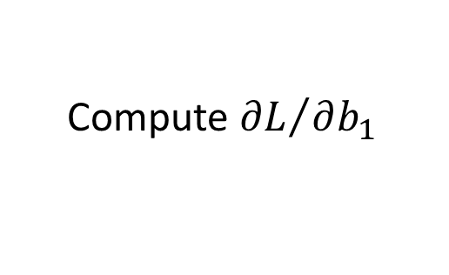
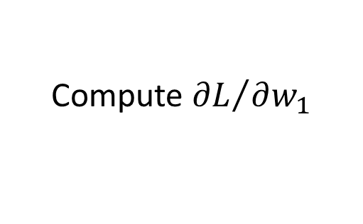
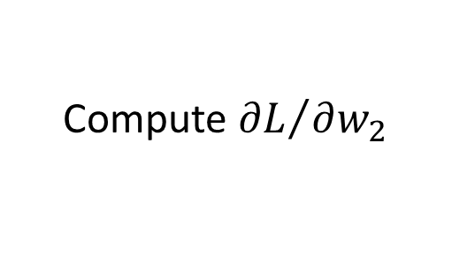
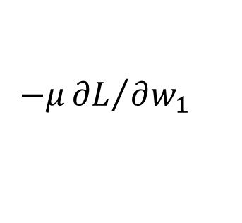
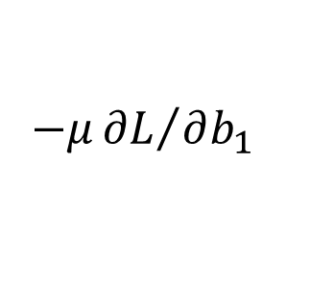
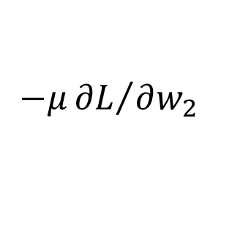
Gradient Descent
$$θ$$
Compute ${∂L}/{∂w_{1}}$
Compute ${∂L}/{∂w_{1}}$
$$w_{1}$$
0.2
0.15
0.09
$$−μ{∂L}/{∂w_{1}}$$
$$−μ{∂L}/{∂w_{1}}$$
……
Compute ${∂L}/{∂w_{2}}$
Compute ${∂L}/{∂w_{2}}$
$$w_{2}$$
-0.1
0.05
0.15
$$−μ{∂L}/{∂w_{2}}$$
$$−μ{∂L}/{∂w_{2}}$$
……
……
Compute ${∂L}/{∂b_{1}}$
Compute ${∂L}/{∂b_{1}}$
$$b_{1}$$
0.3
0.2
0.10
$$−μ{∂L}/{∂b_{1}}$$
$$−μ{∂L}/{∂b_{1}}$$
……
……

Slide 27


Gradient Descent
This is the “learning” of machines in deep learning ……
Even alpha go using this approach.
People image ……
Actually …..
I hope you are not too disappointed :p
Notes:
Congugate gradient

Slide 28








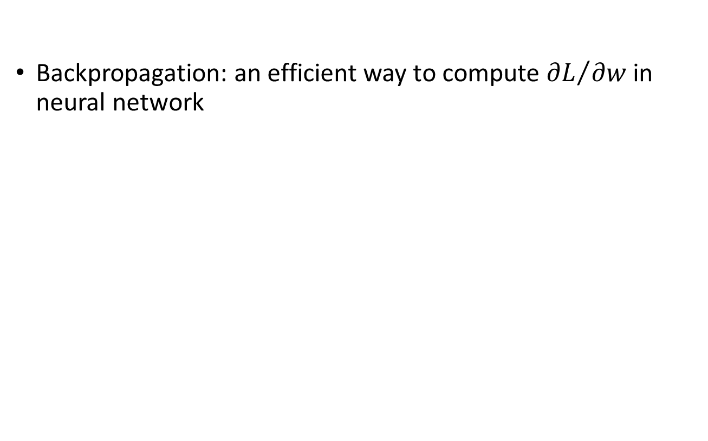
Backpropagation
Backpropagation: an efficient way to compute ${∂L}/{∂w}$ in neural network
libdnn
台大周伯威
同學開發
Ref: http://speech.ee.ntu.edu.tw/~tlkagk/courses/MLDS_2015_2/Lecture/DNN%20backprop.ecm.mp4/index.html
Notes:
amazon-dsstne

Slide 29
Three Steps for Deep Learning
Step 1: define a set of function
Step 2: goodness of function
Step 3: pick the best function
Neural
Network
Deep Learning is so simple ……
Notes:
http://www.twword.com/wiki/%E8%85%A6%E6%88%B6%E7%A9%B4
http://ukenglish.pixnet.net/blog/post/105691160-%E3%80%90%E5%8F%B0%E5%8D%97%E5%B8%82%E5%AD%B8%E8%8B%B1%E8%AA%9E%EF%BC%8C%E5%84%AA%E9%85%B7%E8%8B%B1%E8%AA%9E%E6%96%87%E7%90%86%E5%85%AC%E5%91%8A%E3%80%91%E6%9C%AC%E4%B8%AD%E5%BF%83
http://onepiece1234567890.blogspot.tw/2013/12/blog-post_8.html

