Slide 1
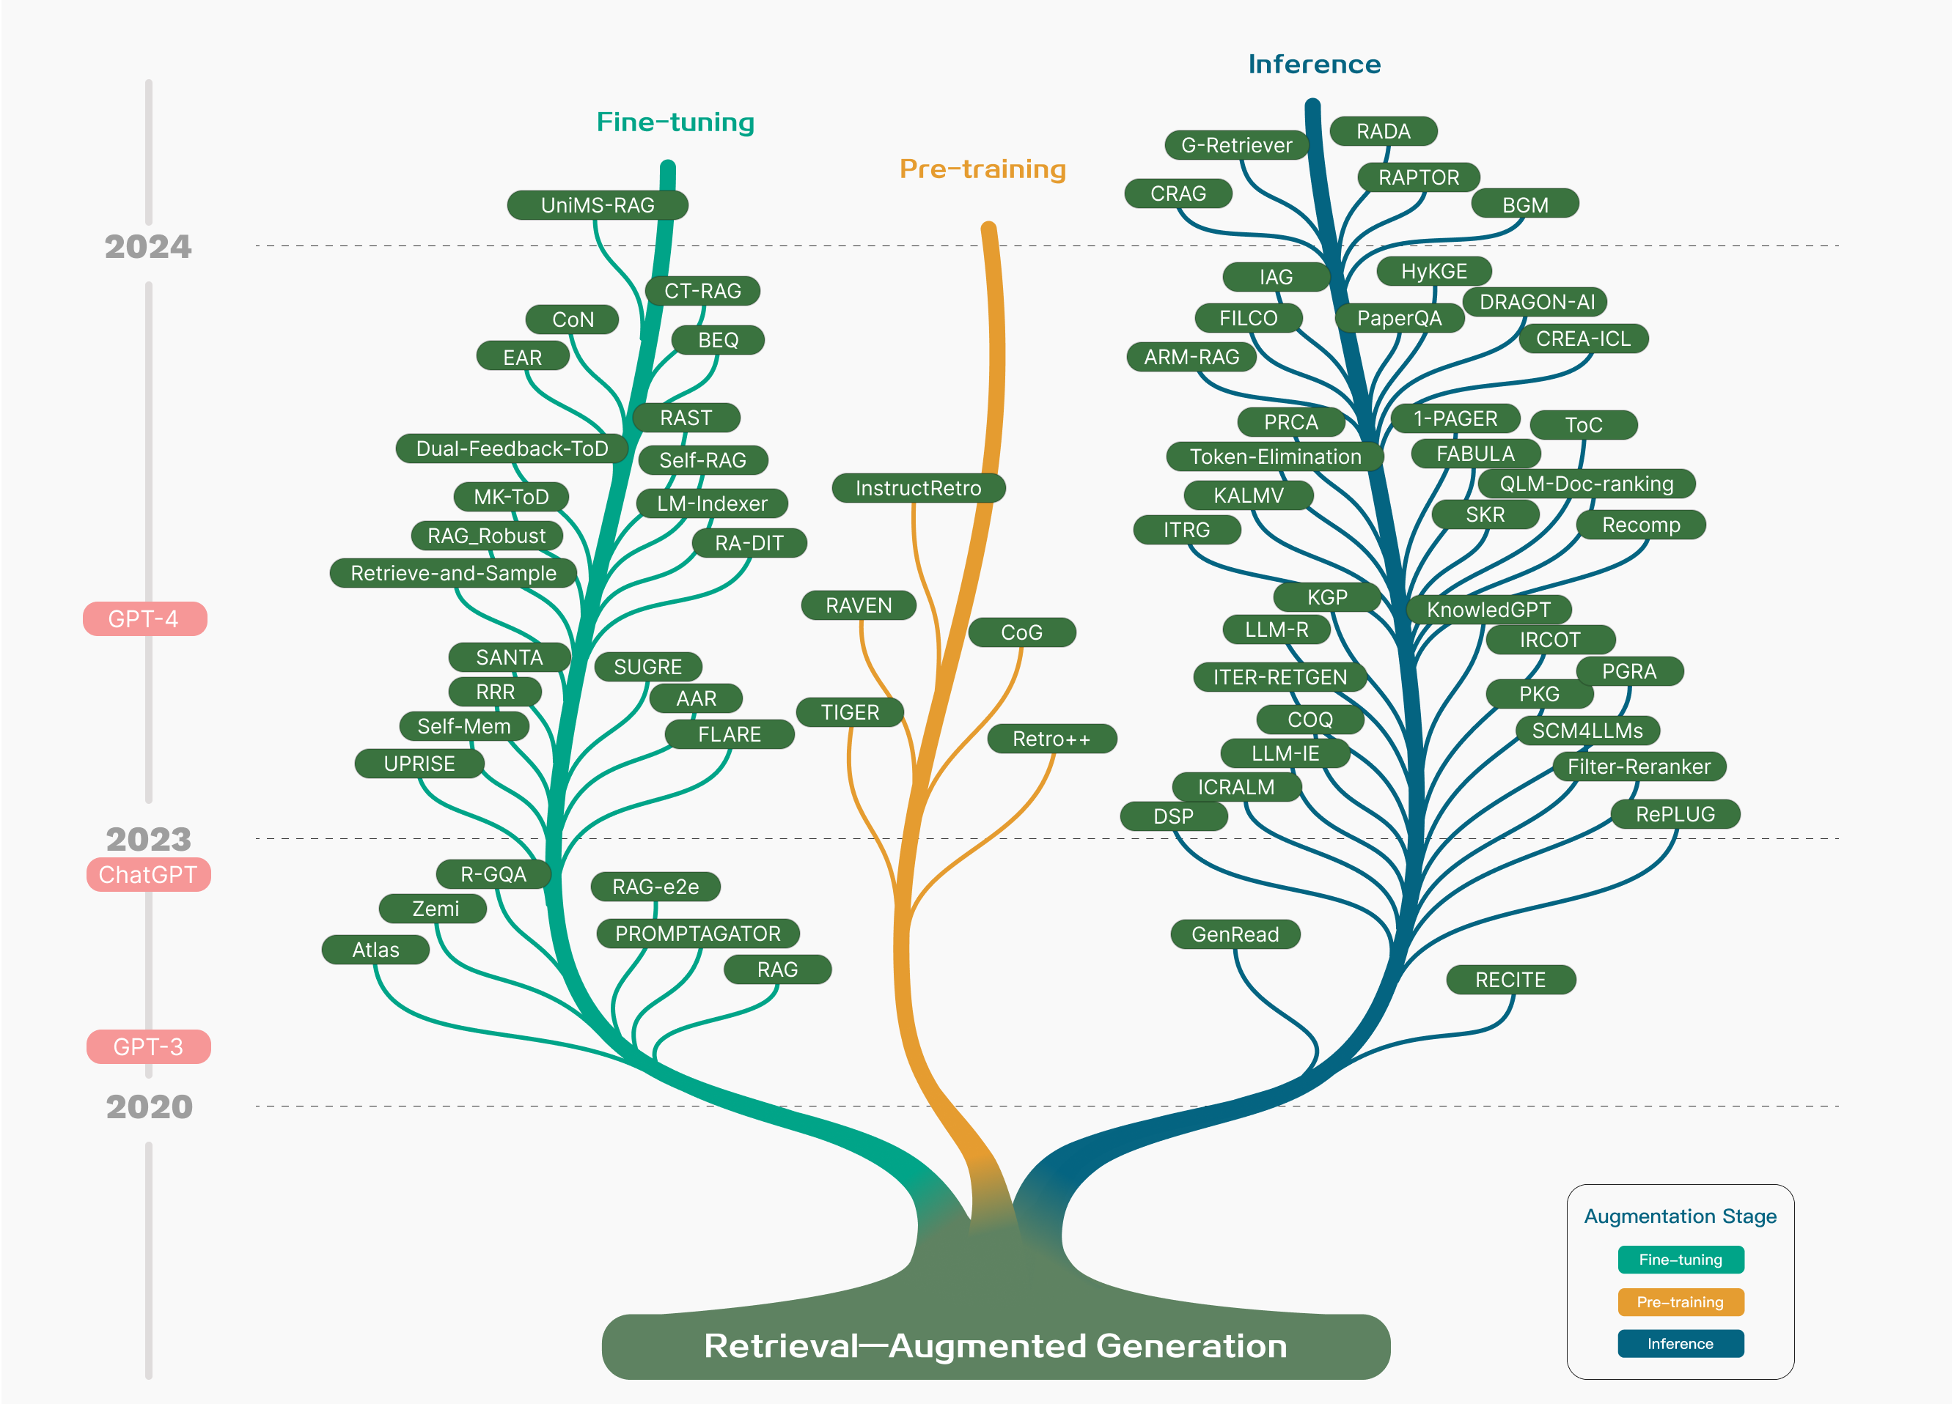
https://arxiv.org/html/2312.10997
https://www.53ai.com/news/qianyanjishu/326.html

Slide 2
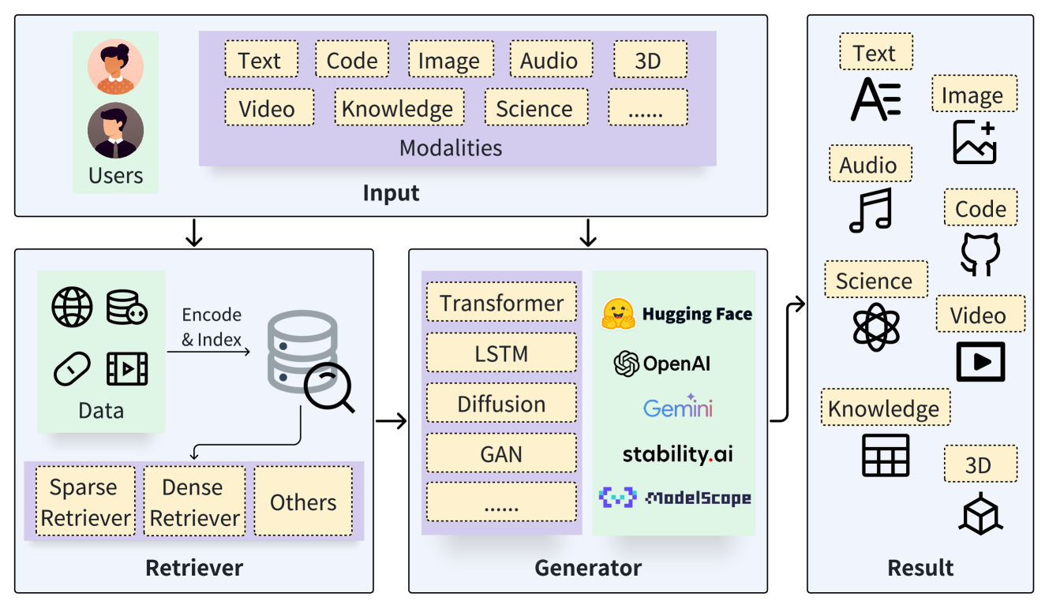
https://arxiv.org/html/2402.19473v6

Slide 3
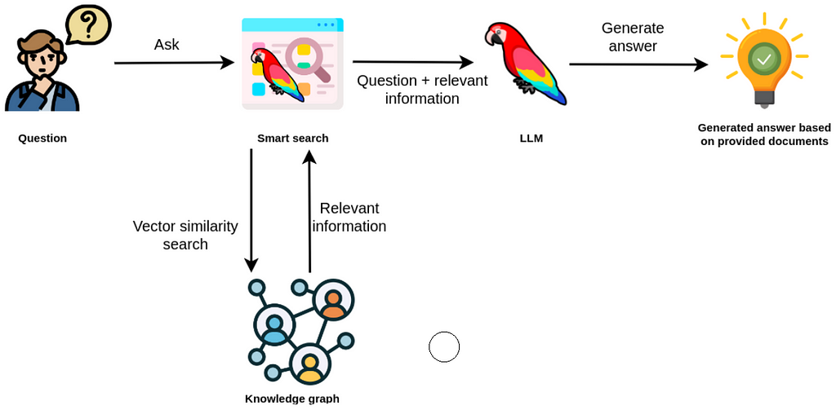
https://neo4j.com/developer-blog/knowledge-graph-rag-application/

Slide 4
https://www.53ai.com/news/qianyanjishu/326.html

