Slide 2
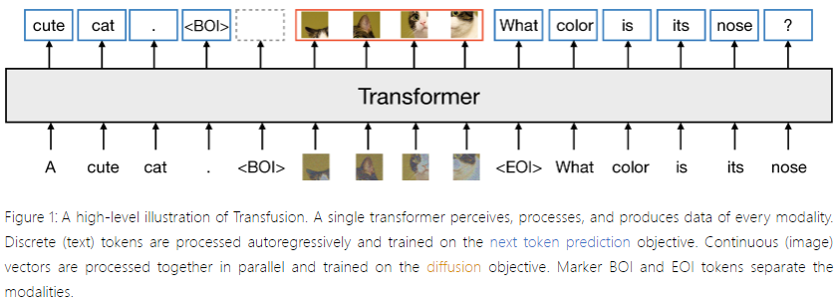
https://arxiv.org/html/2408.11039

Slide 3
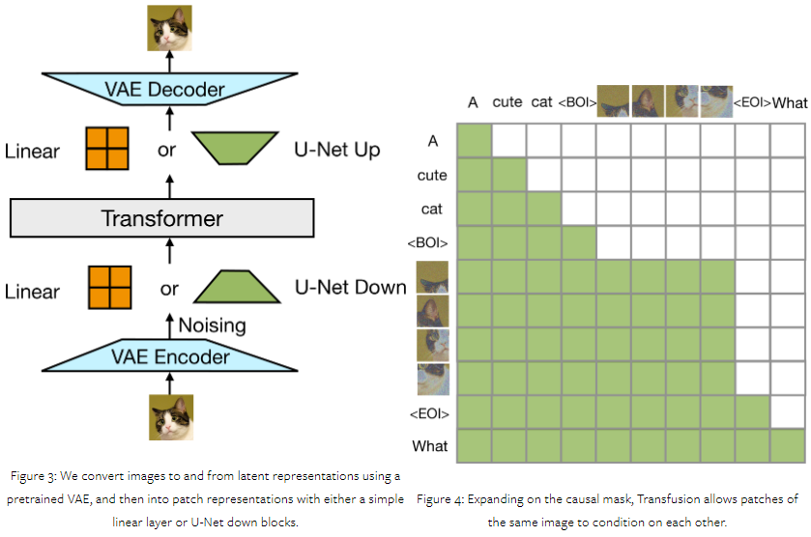
https://arxiv.org/html/2408.11039
https://arxiv.org/html/2408.11039

Slide 4
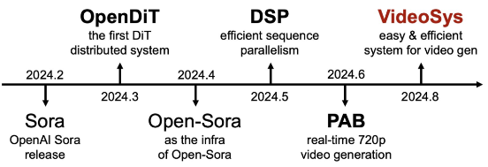
https://www.jiqizhixin.com/articles/2024-08-26-3
https://github.com/NUS-HPC-AI-Lab/VideoSys

