Slide 1
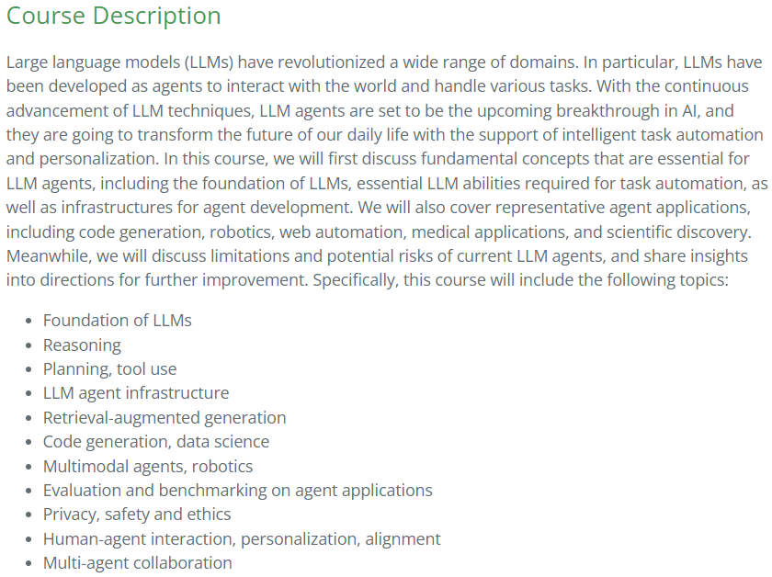
https://llmagents-learning.org/f24

