Slide 1
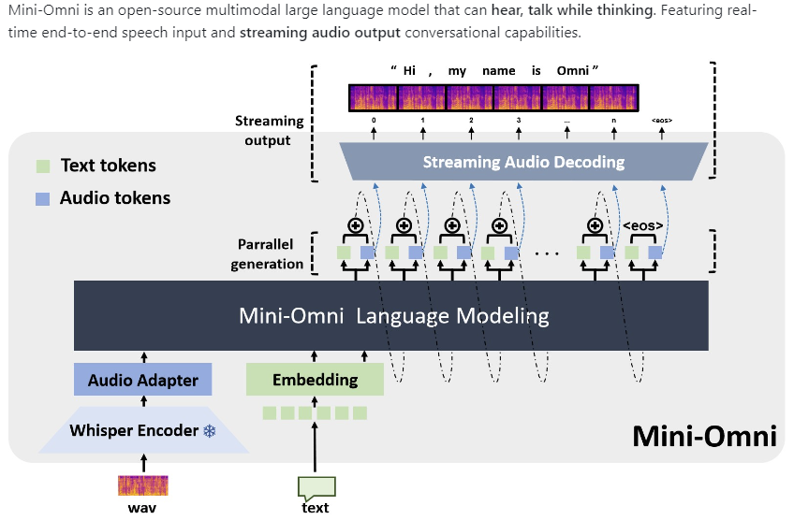
https://github.com/gpt-omni/mini-omni

Slide 2
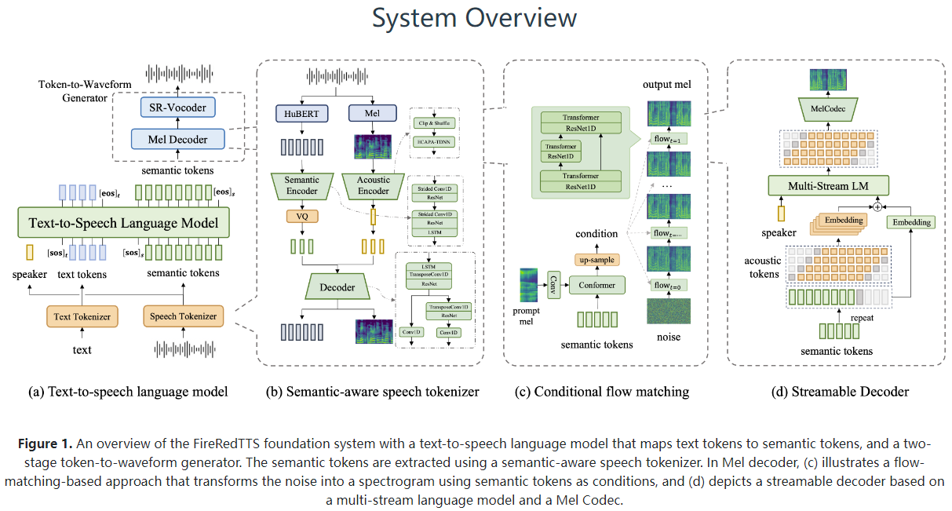
https://fireredteam.github.io/demos/firered_tts/

