Slide 1
SLACK AGENT BUILDER CHALLENGE 2026
Veritype
A Slack-native fact-checker that renders chart-rich verdict cards.
Track 1 : New Slack Agent · TypeScript Coded Agent · MCP + Real-Time Search
Tim Dries · Biztory · May 2026
github.com/timdries/veritype

Slide 2
01 THE PROBLEM
Misinformation moves faster
than the team can Google.
Stats and half-truths land in channel, get three emoji reacts, and become 'fact' by lunch.
The person who pushes back has to do their homework alone, in a side tab, and disrupt the thread.
How it goes today
· Claim drops in #general at 09:47.
· Three reactions, no challenge.
· Someone tries to push back at 10:30, has to Google for ten minutes.
· Source debate derails the channel for the rest of the morning.
Veritype : Slack Agent Builder Challenge 2026
2 / 9

Slide 3
02 WHAT WE BUILT
Veritype offers a one-tap verification, in thread, in seconds.
Listen
Verify
Render
A Haiku 4.5 classifier reads every channel message and decides what is a verifiable, public-interest claim.
Opus 4.7 with web_search fans out, reads primary sources, and produces a JSON verdict with confidence and citations.
We paint the verdict as a Datatype-font card. Plain text like {b:20,45,70} renders as a real bar chart.
step 1
step 2
step 3
Veritype : Slack Agent Builder Challenge 2026
3 / 9

Slide 4
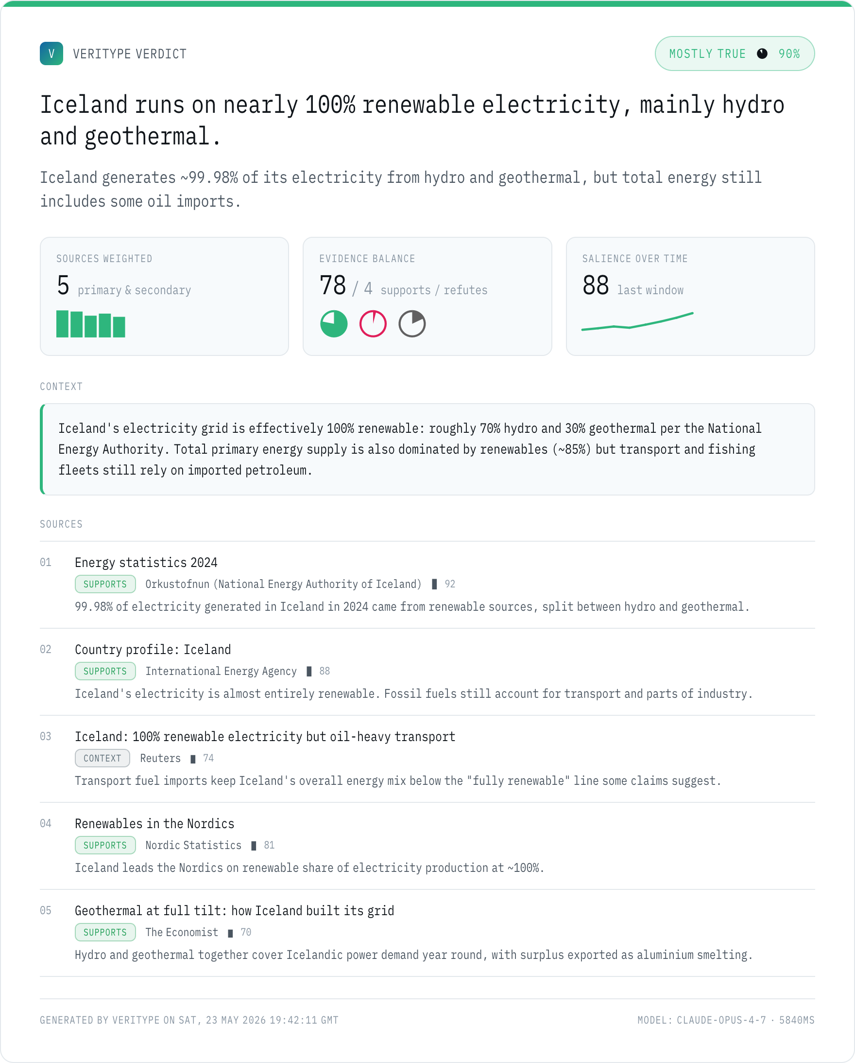
03 THE VERDICT CARD
Datatype turns plain text into inline charts.
Reading the card
MOSTLY TRUE pill
verdict + confidence as {p:98} pie + percentage
Source weights
{b:92,88,74,81,70}: primary docs sit taller than blogs
Evidence balance
three pies for supports / refutes / context
Salience sparkline
{l:22,28,35,30,42,55,70,88}: how often the claim is showing up
Citations
every source has stance, weight, publisher, excerpt
Veritype : Slack Agent Builder Challenge 2026
4 / 9

Slide 5
04 ARCHITECTURE
One brain, three surfaces.
The Slack bot, the MCP server, and the CLI/dashboard all call the same core module.
Slack Bolt app
MCP server
CLI / Dashboard
Socket Mode, /verify, message events, button handlers
stdio transport, 3 tools, plug into any MCP client
render cards offline, demo + admin UI
src/core : screen → research → render
Haiku 4.5 (screener) · Opus 4.7 + web_search (research) · Puppeteer + Datatype font (PNG card)
Veritype : Slack Agent Builder Challenge 2026
5 / 9

Slide 6
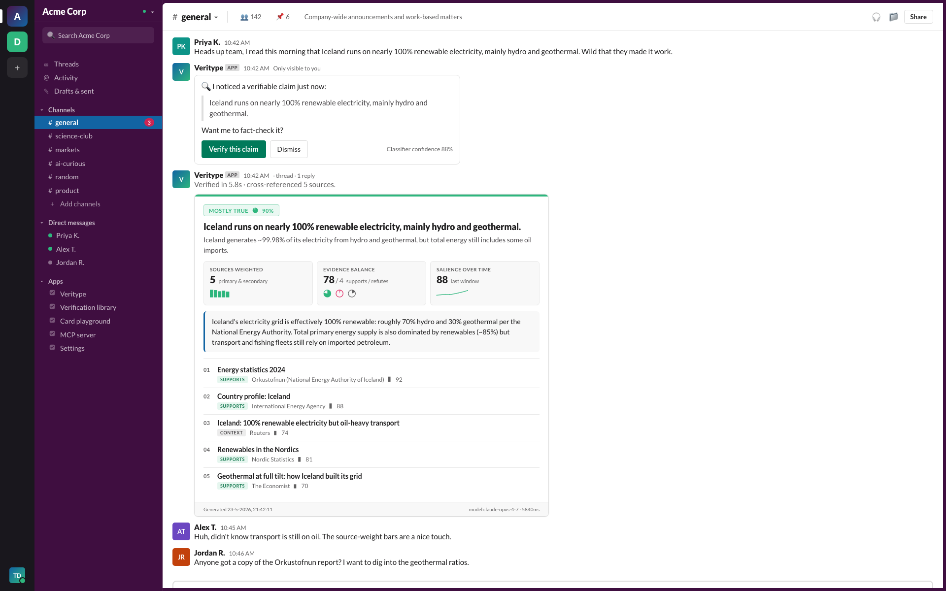
05 IN-CHANNEL UX
It feels native because it is native.
Ephemeral offer, threaded verdict, Block Kit mrkdwn fallback for accessibility.
Veritype : Slack Agent Builder Challenge 2026
6 / 9

Slide 7
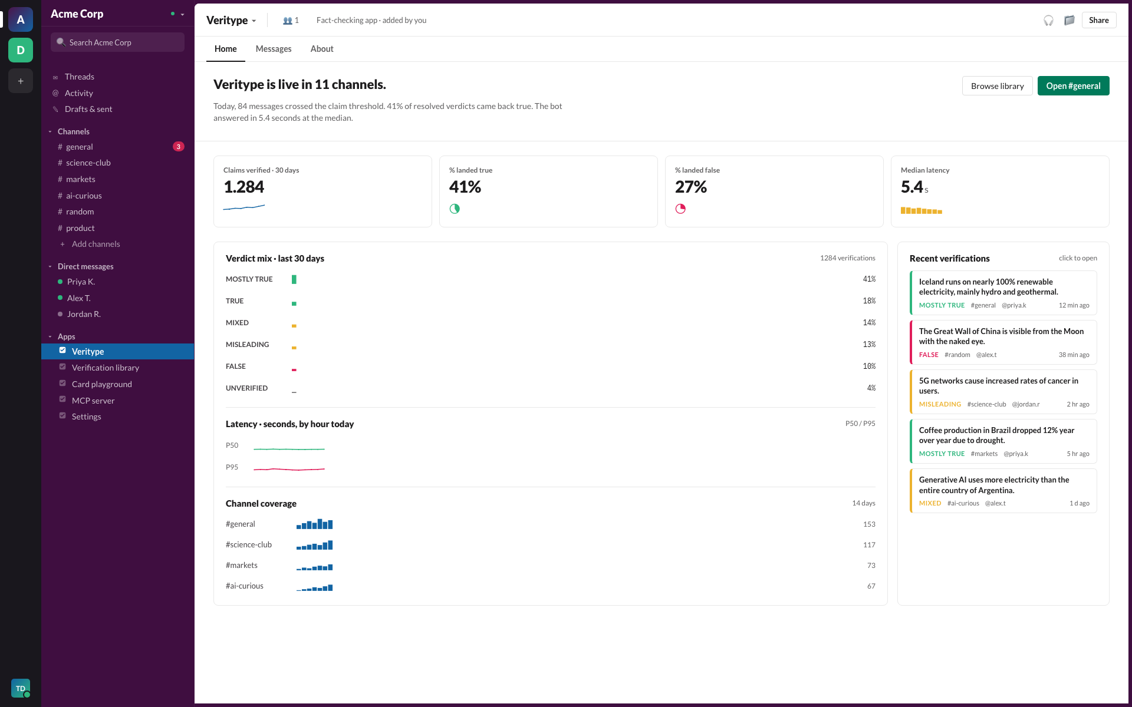
06 WORKSPACE HOME
Admins get a Slack-style dashboard.
Live KPIs in Datatype charts. Verdict distribution, latency, channel coverage, library.
Veritype : Slack Agent Builder Challenge 2026
7 / 9

Slide 8
07 WHY IT WINS
We score on every judging axis.
Tech implementation
Coded Agent in TypeScript. Haiku 4.5 + Opus 4.7 + web_search. MCP server reuse. Puppeteer pipeline.
Design
Fully Slack-skinned. Aubergine sidebar, workspace rail, Block Kit verdict, Datatype charts.
Idea quality
Nobody else is rendering charts via a font in Slack. The proactive ephemeral offer is novel UX.
Impact
Misinformation friction inside Slack maps directly to trust at every team using it.
Required pillars
Hits MCP + Real-Time Search. Two of three checked off, not just one.
Veritype : Slack Agent Builder Challenge 2026
8 / 9

Slide 9
THANK YOU.
Try Veritype yourself.
Live workspace : acme-corp.slack.com · Repo : github.com/timdries/veritype
MCP config : drop into Claude Desktop and the same brain is yours.
Slack-native fact-checking, with charts that ride inside type.
9 / 9

