Slide 1


THE MEDIA CUSTOMS
An AI crew that clears your commercial for 15 markets
and re-renders what fails.
AGENTIC CINEMA 2026 / GRAFANA LABS TRACK / GEMINI + ADK + GRAFANA

Slide 2
01 / THE PROBLEM
One spot, dozens of markets,
and the public as your QA team.
REGULATED
France bans TV alcohol ads (Loi Evin). Quebec bans ads to under-13s. The UK pre-clears every TV ad through Clearcast. Nigeria requires ARCON vetting. Each miss carries an invoice.
UNREGULATED
Pepsi and Kendall Jenner. Dolce & Gabbana in China. H&M's hoodie. Burger King's chopsticks. Caught by the public, at a cost measured in tens of millions.
TODAY'S DEFENCE
A cultural consultant, a focus group, and luck. Nobody has an instrument for this.

Slide 3
02 / THE INSTRUMENT
Load a commercial. Watch it clear
customs in real time.
Fifteen market tiles flip from pending to cleared, at risk or blocked as adjudicators return. Every finding cites the statute. The output is a decision (can this air here, on what evidence) and a localized master (the version that can).
FR
SA
US
UK
DE
JP
BLOCKED
BLOCKED
CLEARED
AT RISK
CLEARED
CLEARED
“Cleared for launch in 9 of 15 markets” is a go or no-go, not a report.

Slide 4
03 / THE CREW
Seven agents, one closed loop.
INGEST
ffmpeg shots, keyframes, audio; Gemini transcription and OCR
ANALYST
watches once; neutral timecoded observations, 18 dimensions, no verdicts
ADJUDICATORS
one per market, in parallel; observations x rulebook, Google Search grounding
GUARD
a rule layer, not a model; blocks protected-basis remediation, cannot be prompted away
PUBLISHER
builds the Grafana surface over MCP; metrics, logs, annotations, alert rules
REMEDIATOR
woken by a Grafana alert; re-letters, re-props, re-voices the failing shot
VERIFIER
re-runs the same instrument on the changed shots; only it may resolve a finding
The Verifier closing back onto the Analyst is what makes this a crew rather than a pipeline.

Slide 5
04 / THE ARCHITECTURE
Observe once. Judge per market.
ONE MULTIMODAL PASS
The Analyst emits facts, never verdicts:
“A glass of red wine sits on the table in front of the left-hand actor.” t=12.4s, conf 0.91
No market. No severity. No opinion.
FIFTEEN CHEAP JUDGES
Every finding is a join:
observation x market rule x citation
The expensive pass runs once, not per market. When a brand disputes a finding, “is the fact wrong” and “is the rule wrong” are separable questions.
Unsourced citations cap severity at 40 and never trigger remediation. 15 packs, 114 rules, every rule naming its statute or code.

Slide 6
05 / THE GUARD
Some findings are not edits.
They are decisions.
SA-LGBT-01 / LEGAL / SEVERITY 90 / SOURCED
The test ad shows a same-sex couple holding hands. Saudi Arabia's GAM media standards prohibit it. The Guard marks it remediation_blocked: the system names the problem, cites the regulation, and hands it to a human.
The Media Customs will tell you that you cannot ship into a market without censoring who appears in your ad. It will not do that for you.
The Guard reads only market-pack rule metadata, never model output, so it cannot be argued out of by a prompt. Offence-class findings are never auto-remediated either.

Slide 7
06 / GRAFANA AS PARTICIPANT
The crew builds its own instrument panel.
THE CREW WRITES IN
The Publisher provisions six dashboards and the alert rules over the Grafana MCP server, pushes customs_risk to Mimir over OTLP, findings to Loki, and writes every finding as an annotation.
GRAFANA TRIGGERS THE CREW
An alert rule fires a webhook into Cloud Run and wakes the Remediator. Grafana sits upstream of the work, not in a report after it.
THE CREW READS BACK
Before remediating, the Remediator queries campaign history over MCP: has this brand tripped this rule before, and what was done.
When the Verifier confirms a fix, the metric drops and Grafana resolves the alert on its own. That resolution is the demo's closing beat.

Slide 8
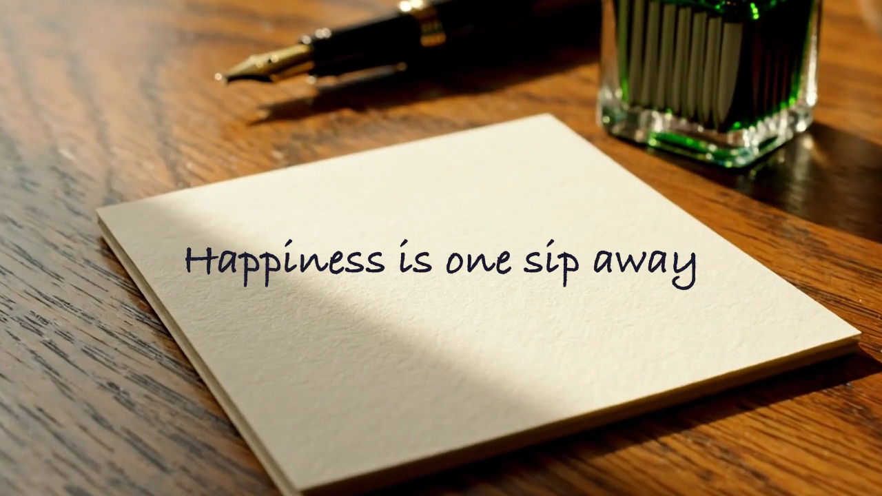
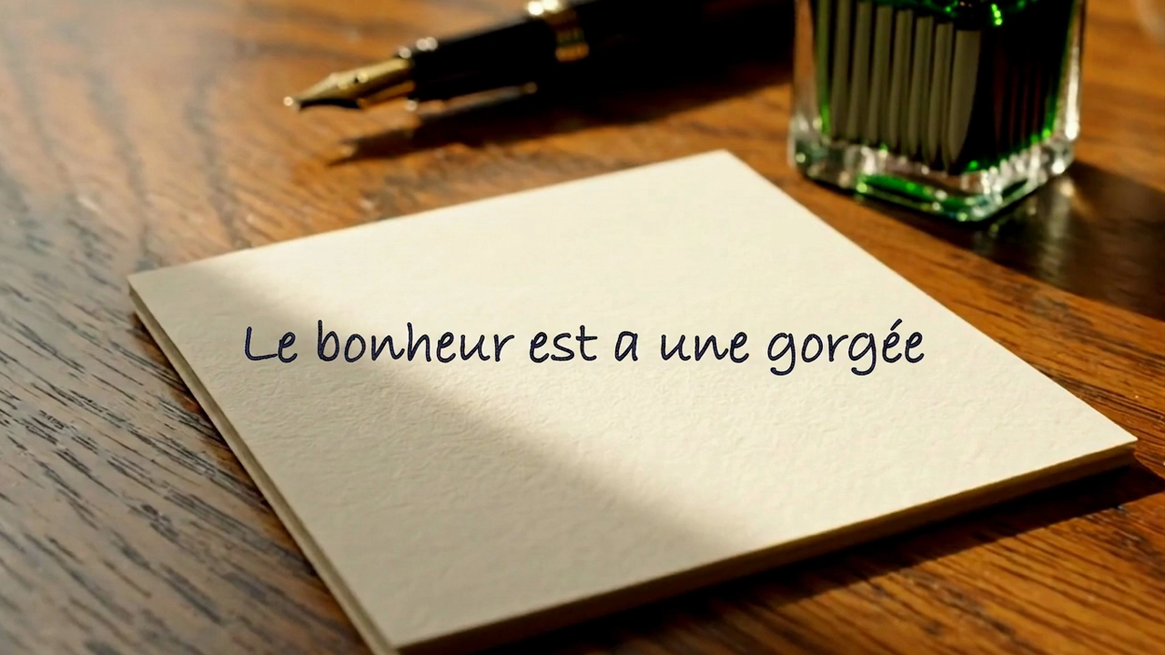
07 / HYPER-LOCALIZATION
The Remediator re-renders what fails.
BEFORE / FR-LANG-01, Loi Toubon: English-only on-screen text
AFTER / re-lettered in context by Gemini image editing
Same paper, same light, same focus; only the words changed. Alert fired, Remediator edited, Verifier re-observed the shot, the finding resolved, the alert closed. Re-lettering, prop substitution and TTS re-voicing all ship in the loop.

Slide 9
08 / WHERE IT STANDS
Built, measured, deployed.
15
market packs, spanning distinct regulatory regimes
114
rules, every one naming its statute or code
18
observation dimensions in the fixed taxonomy
5/6
planted landmines caught at the milestone gate
339
offline tests green; live suite hits Gemini and Grafana
1
Cloud Run service; SQLite; no build step on the console

Slide 10
09 / WHAT'S NEXT
From instrument to pre-flight standard.
MORE MARKETS
the pack format is the extension point; a market is a YAML file, not code
VEO SHOT REGENERATION
full shot re-render for the market, on top of re-letter, re-prop, re-voice
CLEARANCE HISTORY
campaign memory across assets: has this brand tripped this rule before
HUMAN WORKFLOW
route Guard decisions to legal review with the statute attached
github.com/tdries/devpost-hackathon-agentic-cinema
customs-app-akap4ao72a-ew.a.run.app / Grafana Labs track / Apache-2.0

