Slide 1






T H E M E D I A C U S T O M S
An agentic ad-clearance crew. It watches your commercial once, judges it against every market in parallel, and re-renders the shots that fail.
Google Cloud
Agent Builder
Gemini Omni
Veo 3.1
Grafana
Agentic Cinema hackathon · Grafana Labs track · Tim Dries
Notes:
The Media Customs. One asset, every market, before it ships.

Slide 2




THE PROBLEM
One master, twenty markets, six of them checked
A commercial is cut once and shipped everywhere. The regulated half already carries an invoice, and the unregulated half costs more, because nobody checks it until the public does.
Alcohol on screen
France will not broadcast it. Loi Evin, Code de la sante publique L3323-2.
A thumbs up
Reads as an insult across the Gulf and parts of West Africa.
Every one of those is fine somewhere and illegal somewhere else. Finding out means a lawyer per market, a broadcaster's reviewer, and luck.
A claim on the pack
Comparative advertising has to be substantiated to air in France.

Slide 3
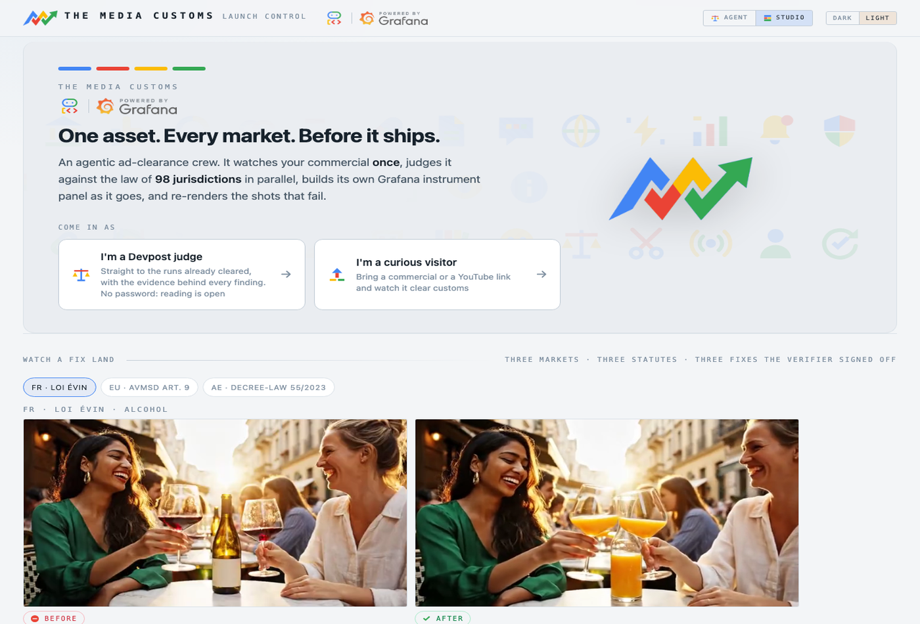
WHAT IT IS
You hand it a master. It hands back a decision, and a version that can air.
98
jurisdictions judged in parallel, on one fact sheet
128
rules, every one naming a real statute or code
5
ways to fix a failing shot, each priced before it runs
3
alert rules the agent writes itself in Grafana

Slide 4
THE CORE IDEA
Observe once, judge many
Looking at the film is the expensive part. Opinions about what was seen are cheap. So the two never mix.
One commercial
The analyst
Neutral observations
98 adjudicators
Findings
»
»
»
»
a file, or a link
watches each shot ONCE, Gemini vision
timecoded, boxed, no verdicts, 18 dimensions
one per jurisdiction, in parallel, own rulebook
observation x rule x a citation that resolves
The analyst is forbidden an opinion. It writes "a woman raises a glass of red wine", never "this violates French law". Ninety-eight adjudicators then argue about that one sentence, simultaneously, each holding a different rulebook. Which is what makes "is this fact wrong?" and "is this rule wrong?" separable questions.
A finding is always a join. Break any leg of it and the finding is not made.

Slide 5
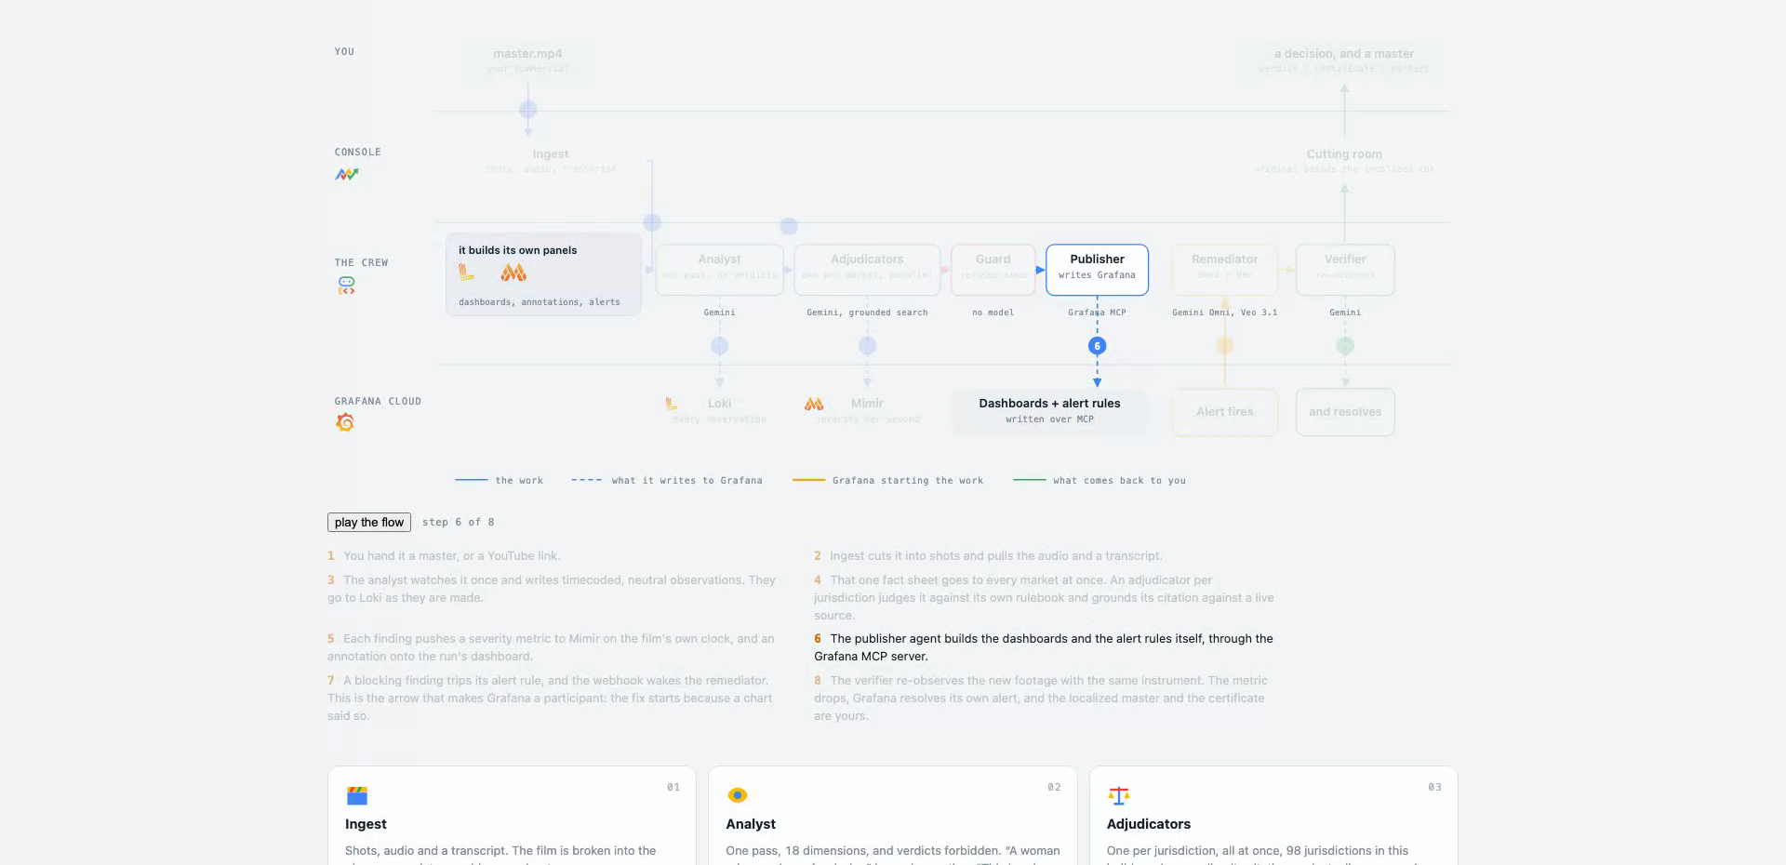
THE WHOLE LOOP
What happens between the upload and the master
1
You hand it a master.
2
Ingest cuts it into shots and pulls the audio and a transcript.
3
The analyst watches once and writes timecoded, neutral observations, into Loki as they are made.
4
That one fact sheet goes to every market at once, each judged against its own rulebook with a grounded citation.
5
Each finding pushes a severity metric to Mimir on the film's own clock, and an annotation onto the dashboard.
6
The publisher agent builds the dashboards and the alert rules itself, through the Grafana MCP server.
7
A blocking finding trips its rule and the webhook wakes the remediator. The fix starts because a chart said so.
The diagram is a screen in the product, and it plays itself.
8
The verifier re-observes with the same instrument. The metric drops and Grafana resolves its own alert.

Slide 6
THE MARKET MODEL
A ladder, not a list
A market inherits from the one above it. Pick a Belgian broadcaster and you get twelve rules nobody wrote in one place.
GLOBAL
1 baseline
what almost every market agrees on
21
market packs on disk
CONTINENTAL
1, the EU
the AVMSD, on top of the baseline
98
NATIONAL
16 countries
the law of the land, and its regulator
selectable jurisdictions
128
CHANNEL
80 broadcasters
a channel's own acceptance rules, on top of its country
rules, all cited
A market is a YAML file, not code. Adding one is writing its rules down.

Slide 7















THE VOCABULARY
Eighteen dimensions, and nothing outside them
The analyst may only emit these, and every one of the 128 rules is written against one of them. That is what makes the join between a fact and a market's opinion a lookup rather than an argument.
Alcohol, tobacco, drugs
Religious symbols
Modesty and dress
Gesture
Food and animals
Gender portrayal
Orientation, gender id
Children and minors
National symbols
Health claims
Gambling and finance
Violence and weapons
Language and idiom
Humour and satire
Superstition, colour
Photosensitivity
On-screen text
Comparative claims

Slide 8
01
PART ONE
The console, screen by screen
Fifteen screens, each one a way of asking the same question at a different distance: what is in this film, and who objects to it?

Slide 9
01 /
The front door
Two doors: read everything with no password, or bring a commercial and spend.
The strip underneath is a fix that already landed, rotating through three markets.
The ring on the tour door is the working light the whole product uses.
Reading is never gated. Only spending is.

Slide 10
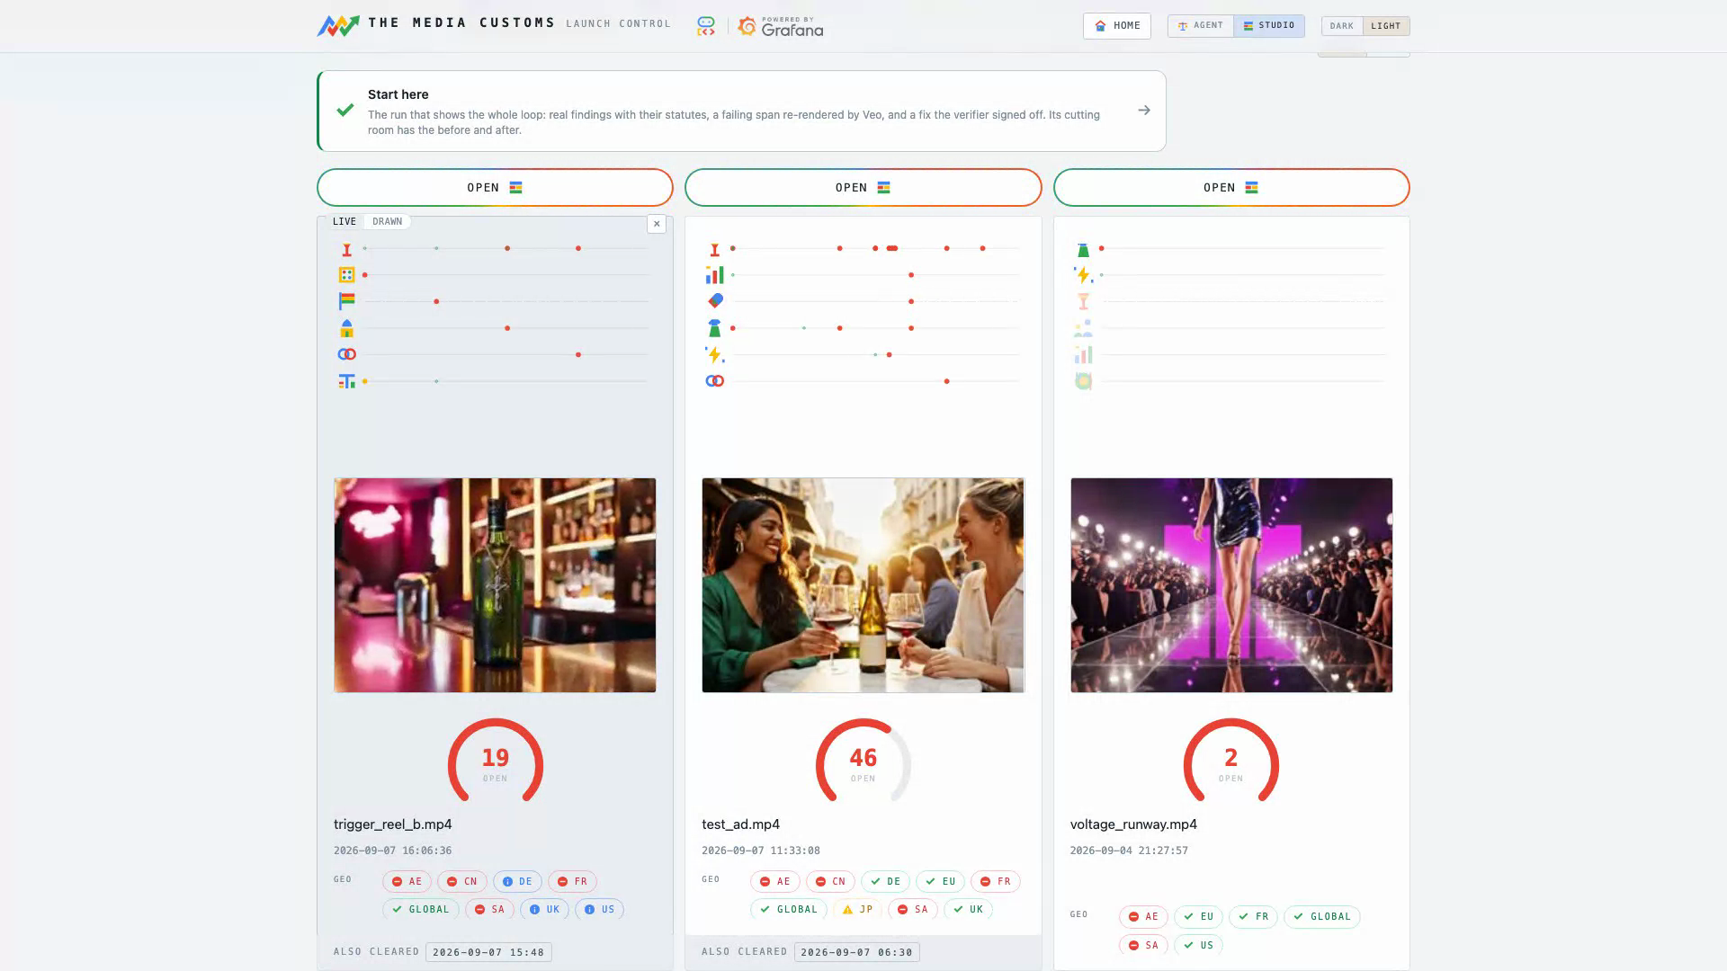
02 /RUNS
Archive
Every clearance this instance has performed, newest first.
Hover a card and the whole commercial plays as a five second timelapse.
Under it, one lane per category and a mark wherever something was found.
Each card's lanes are a live Grafana panel.

Slide 11
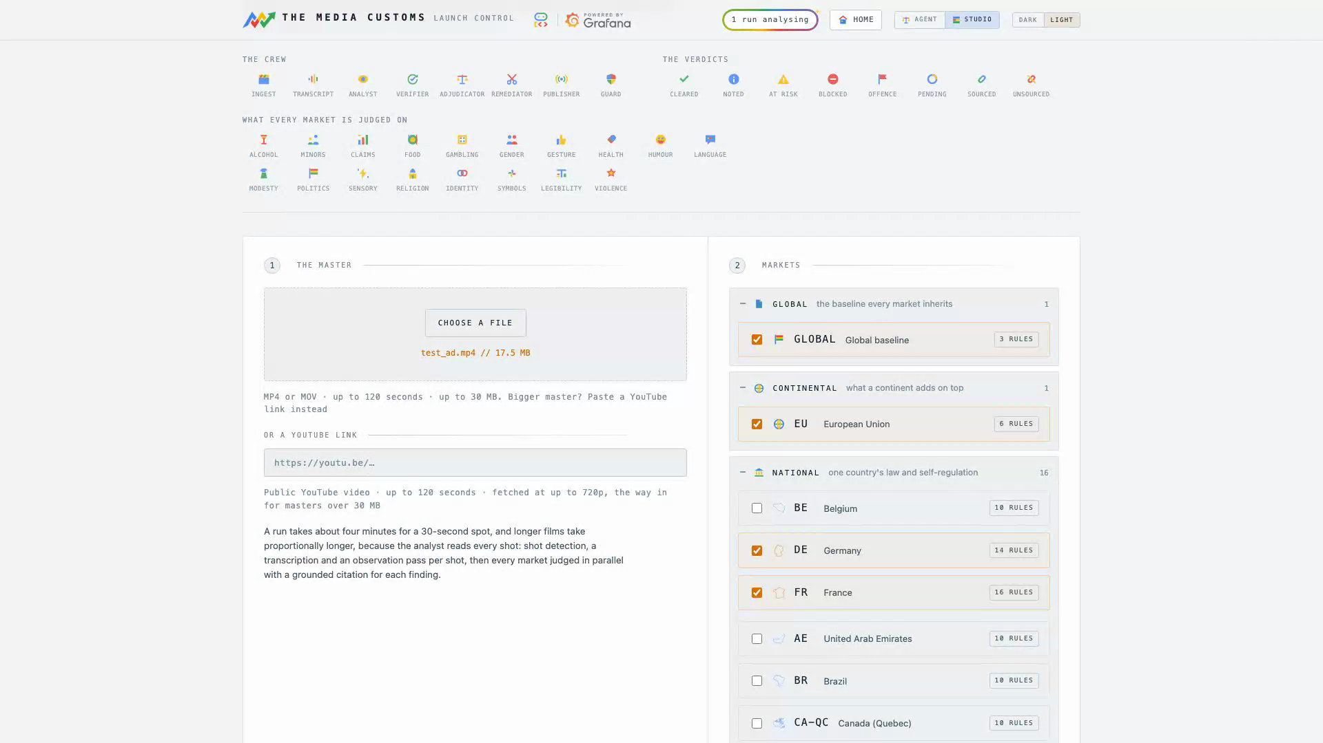
03 /NEW
New clearance
Hand it a file, pick the markets, and watch it clear customs live.
The ladder is the picker: baseline, continent, country, broadcaster.
Every run is priced against the day's budget before it starts.
A 30 second spot takes about four minutes.

Slide 12
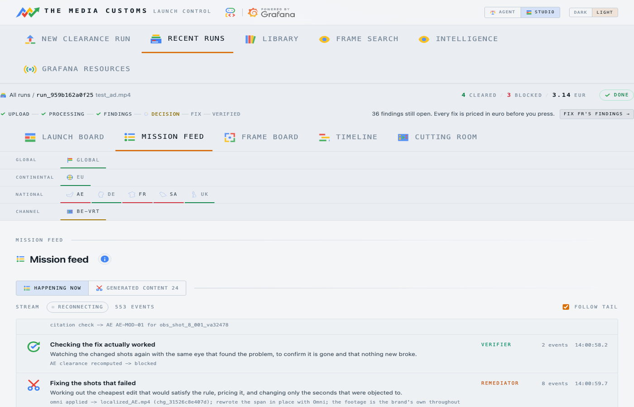
04 /RUNS/{ID}/MISSION
Mission feed
Every move the crew made, in the order it made them.
Each stage says in plain words what it is doing, with its own shorthand underneath.
Server-sent events, so it is the run happening rather than a log you refresh.
The flow diagram, actually running.

Slide 13
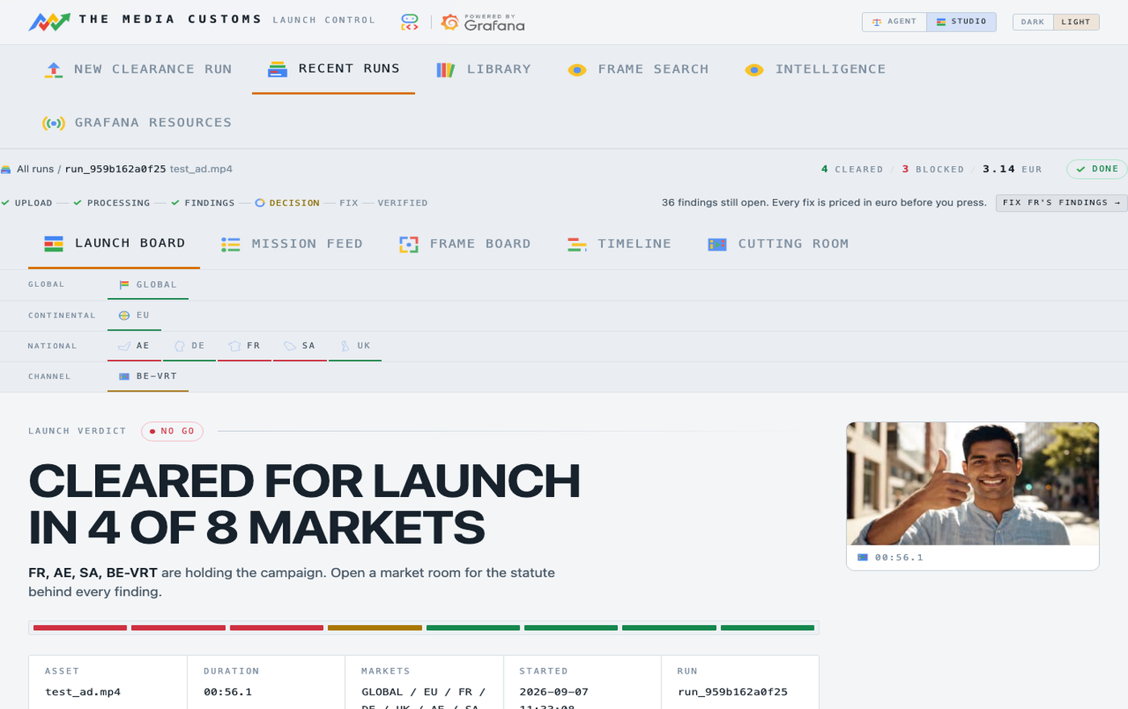
05 /RUNS/{ID}
Launch board
The verdict, market by market, flipping in place as each adjudicator returns.
Cleared, at risk or blocked, with the worst finding on the face of the tile.
Underneath, the crew's own lanes dashboard, live and clickable.
Four markets clear, France and China block.

Slide 14
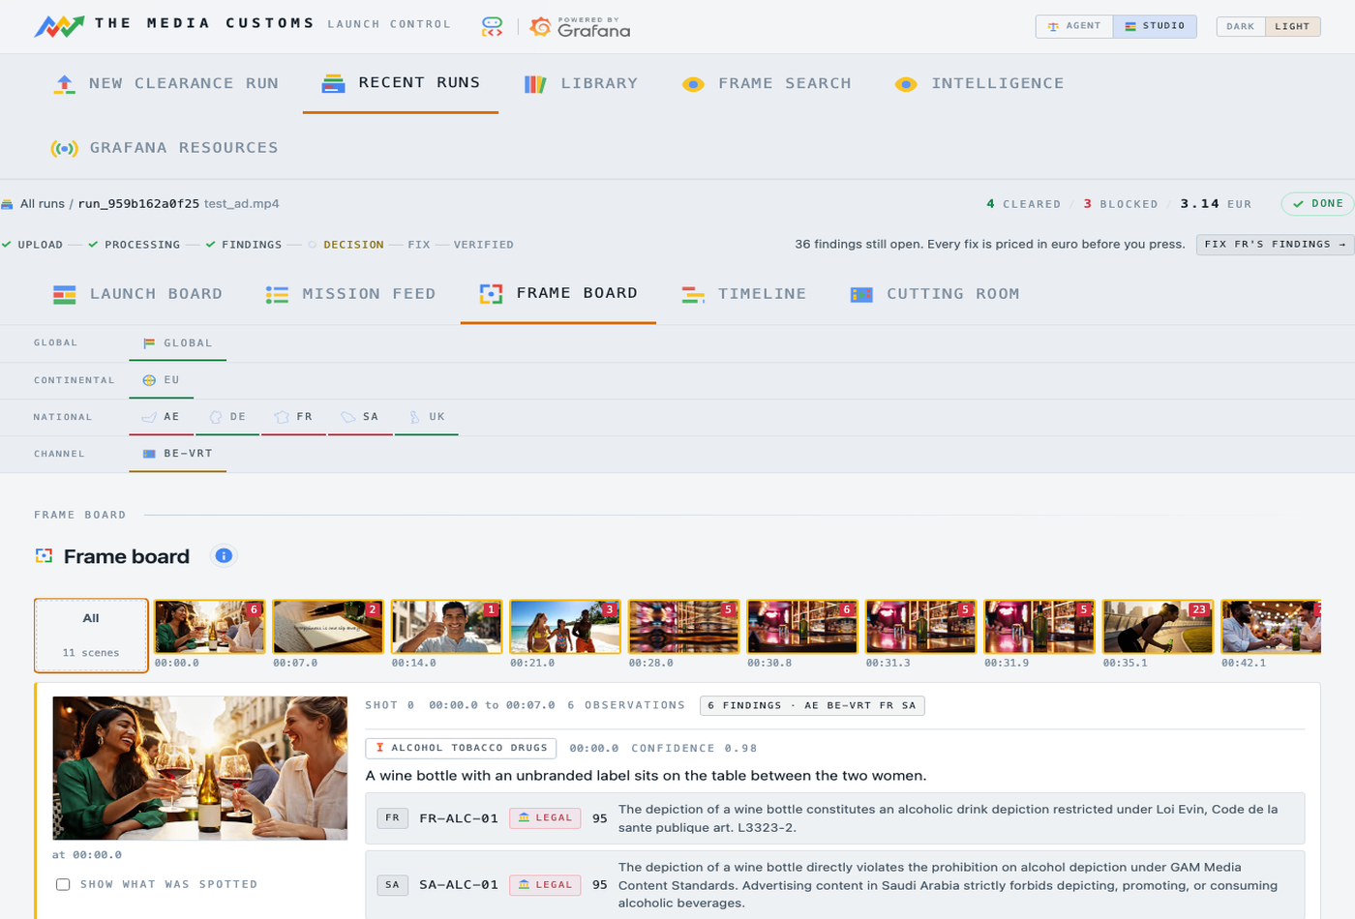
06 /RUNS/{ID}/FRAMES
Frame board
Every scene the crew looked at, how it opens and how it closes.
The neutral sentences the analyst wrote, before any market saw them.
This is the fact sheet all 98 adjudicators are arguing about.
Facts here. Opinions elsewhere.

Slide 15
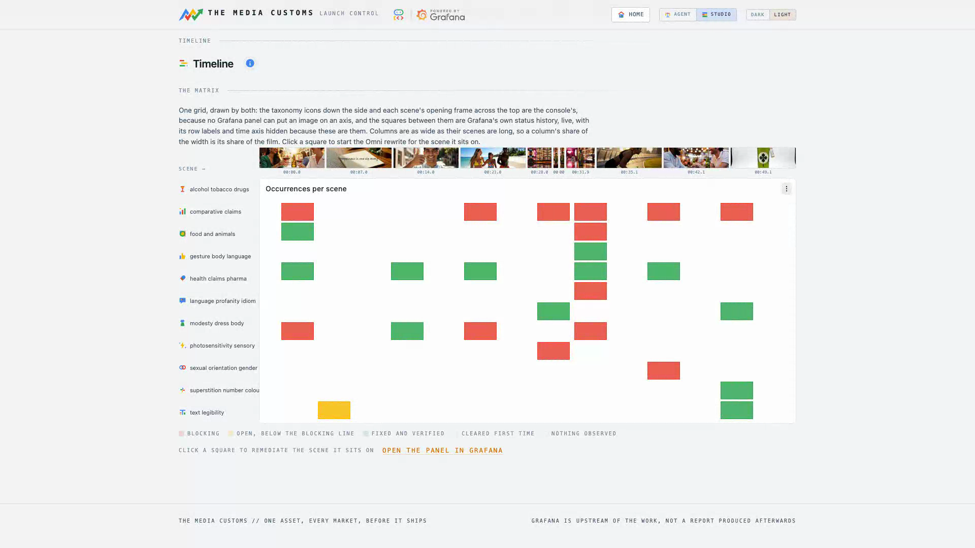
07 /RUNS/{ID}/TIMELINE
Timeline
One grid drawn by two systems: our icons and scene thumbnails as the axes.
The squares between them are Grafana's own status history panel, live.
Click a square and it starts a priced fix on the scene under it.
A column's width is its share of the film.

Slide 16
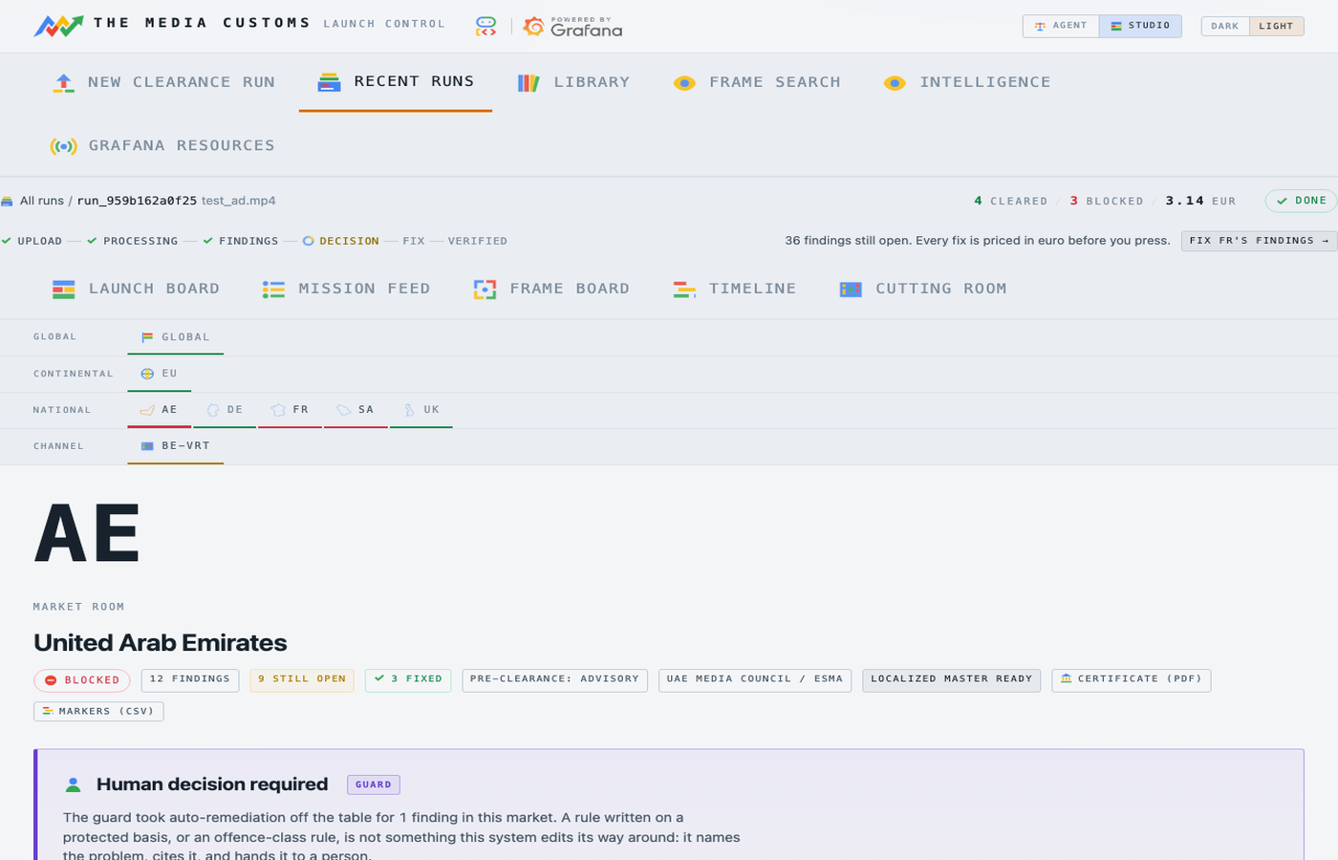
08 /RUNS/{ID}/MARKETS/FR
Market room
One panel per scene, with every finding written against it.
The triggering frame, the rule id, the class, the severity and the window.
The statute in the regulator's own words, and the citation resolved at judging time.
Not a summary. Evidence.

Slide 17
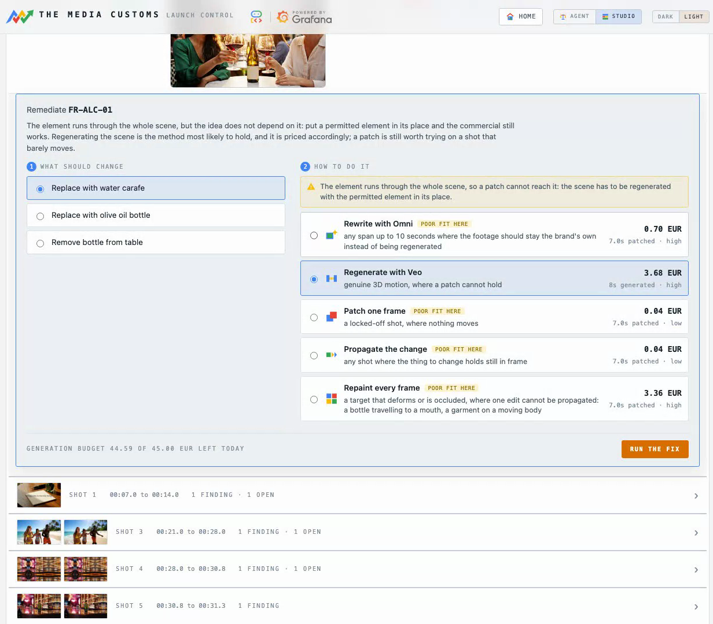
09 INSIDE THE MARKET ROOM
The fix panel
Two questions: what should change, and how it should be done.
Five methods, each priced in euro, each saying where it is a poor fit.
When a patch cannot reach the violation, it says so and offers Veo instead.
Nothing is spent until you press.

Slide 18
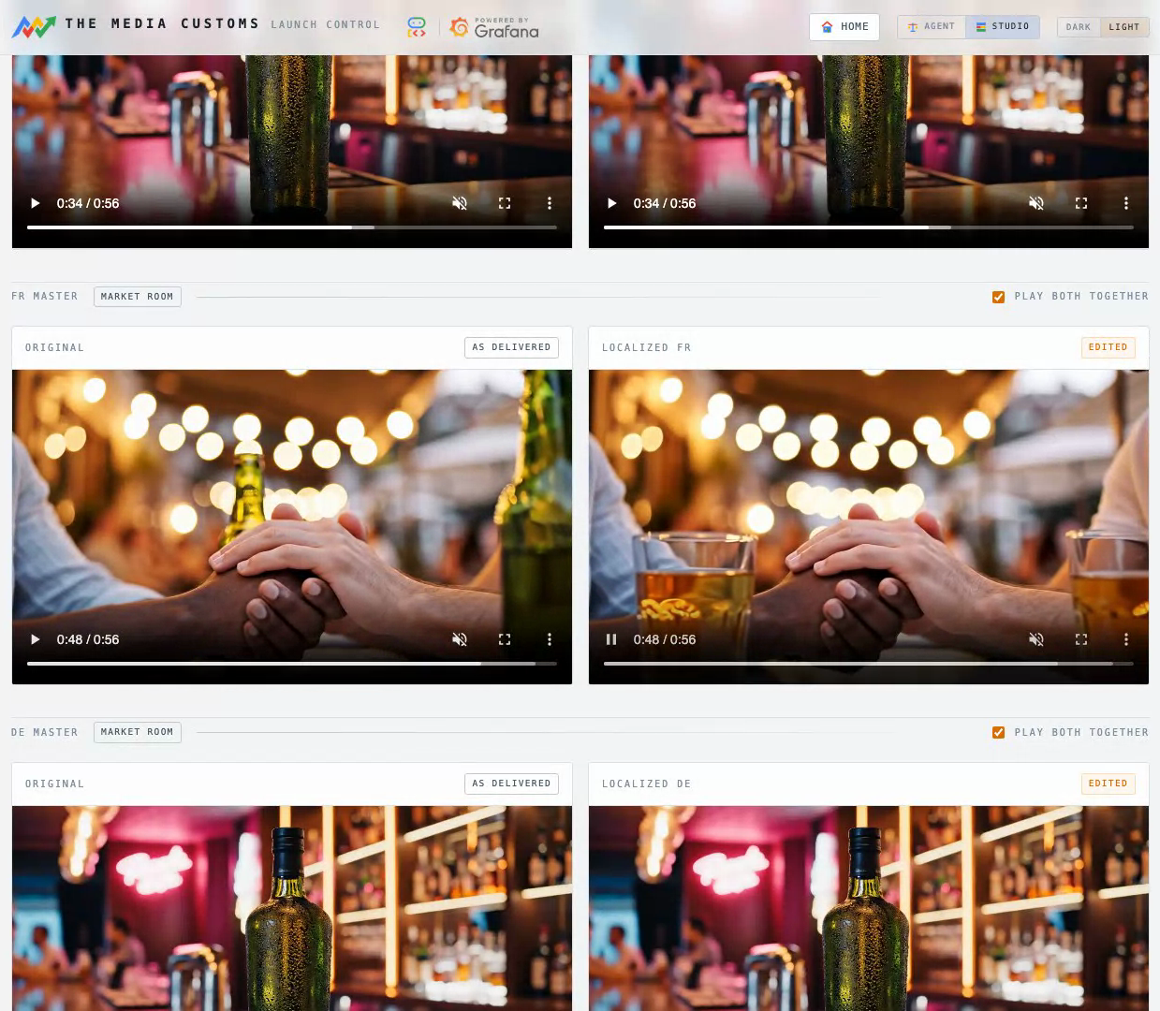
10 /RUNS/{ID}/CUTTING
Cutting room
The original and the localized master, playing in lockstep.
Both players open on the second that changed.
One edited master per market, written by the remediator, signed off by the verifier.
Same terrace, same people. Only the drink changed.

Slide 19
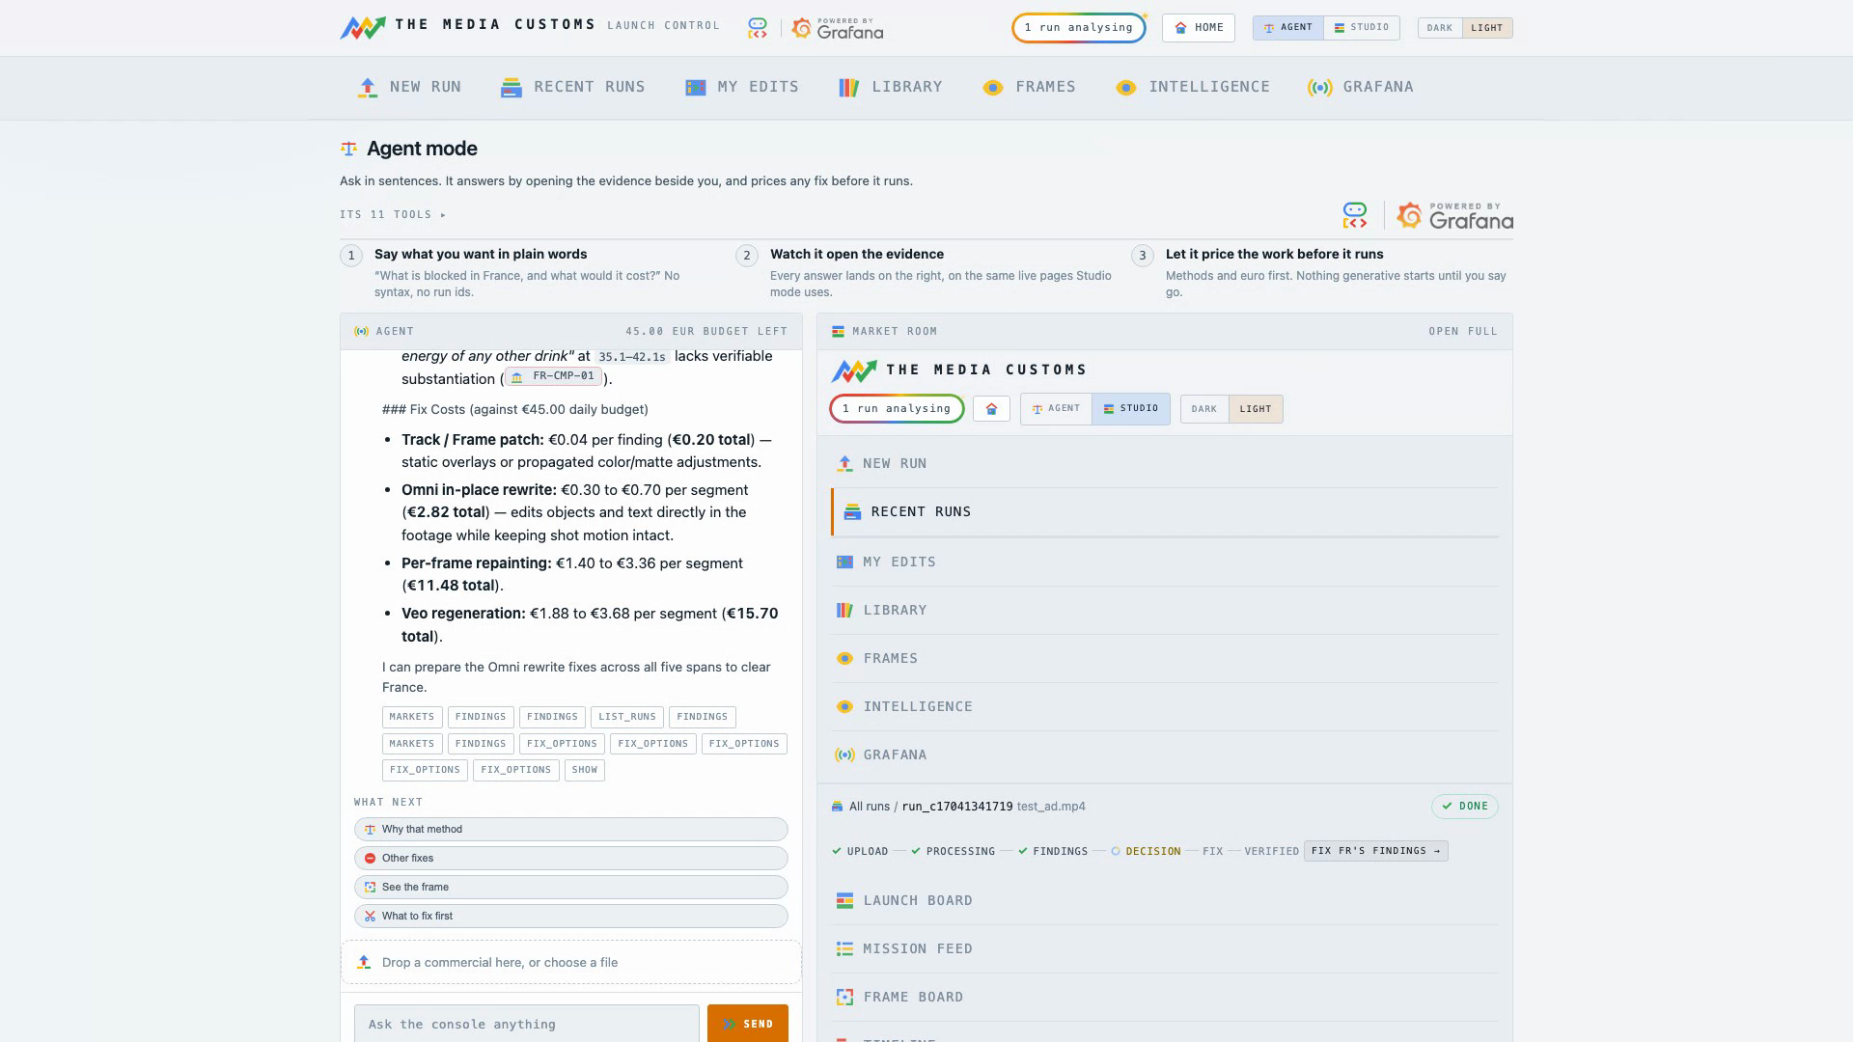
11 /AGENT
Agent mode
A second ADK surface: one agent with ten tools.
Ask in sentences and it opens the evidence beside you.
It prices any fix before it runs, and refuses to spend past the day's ceiling.
Ten tools, and the whole console as its canvas.

Slide 20
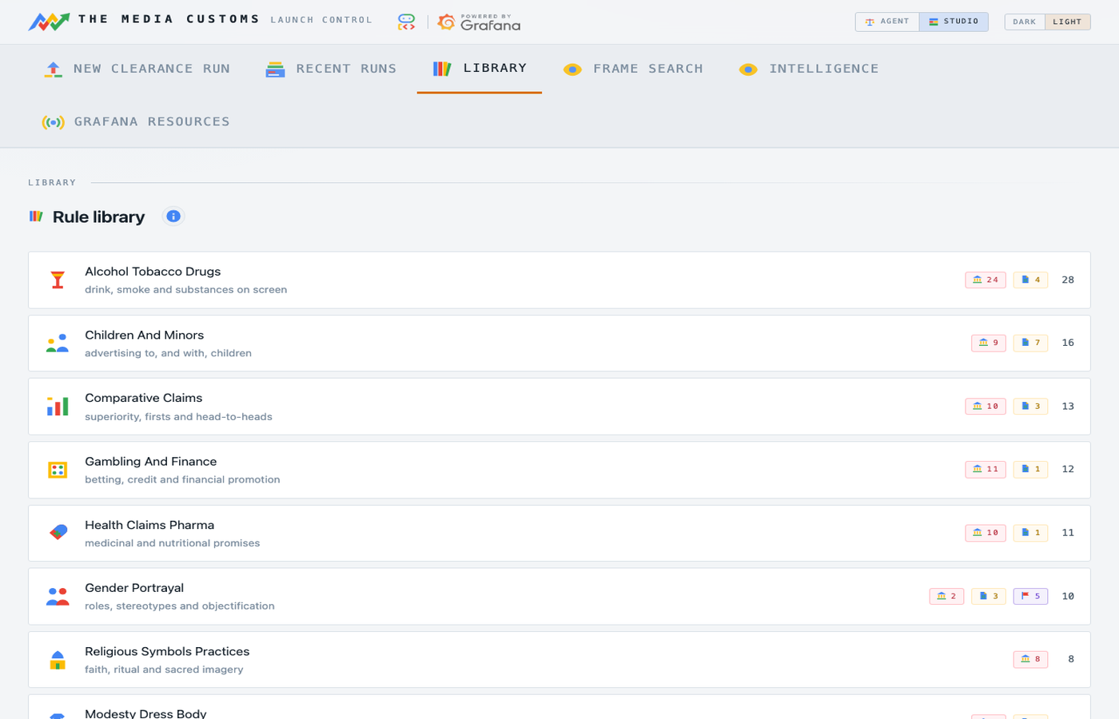
12 /LIBRARY
Rule library
Every rule, filed under the observation that can trigger it.
The statute text, the market that holds it, and whether it blocks or advises.
Two rules carry a protected basis, and the Guard reads only that field.
128 rules, 18 dimensions, 21 packs.

Slide 21
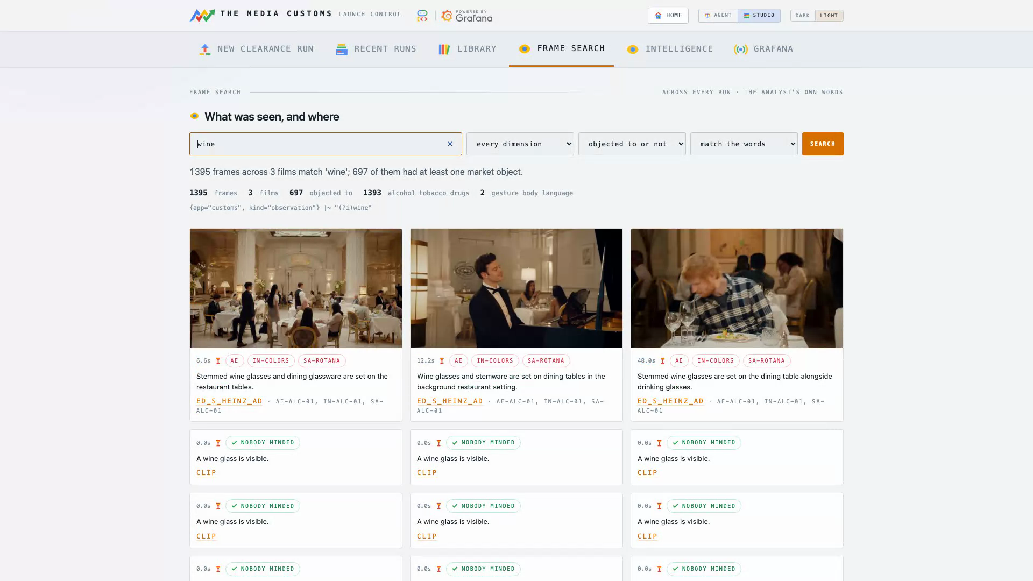
13 /SEARCH
Frame search
Every caption the analyst ever wrote is a Loki line.
So "which frames show wine" is a question, not a feature somebody anticipated.
The match is semantic: question and captions go to Gemini together.
Across every run this instance has done.

Slide 22
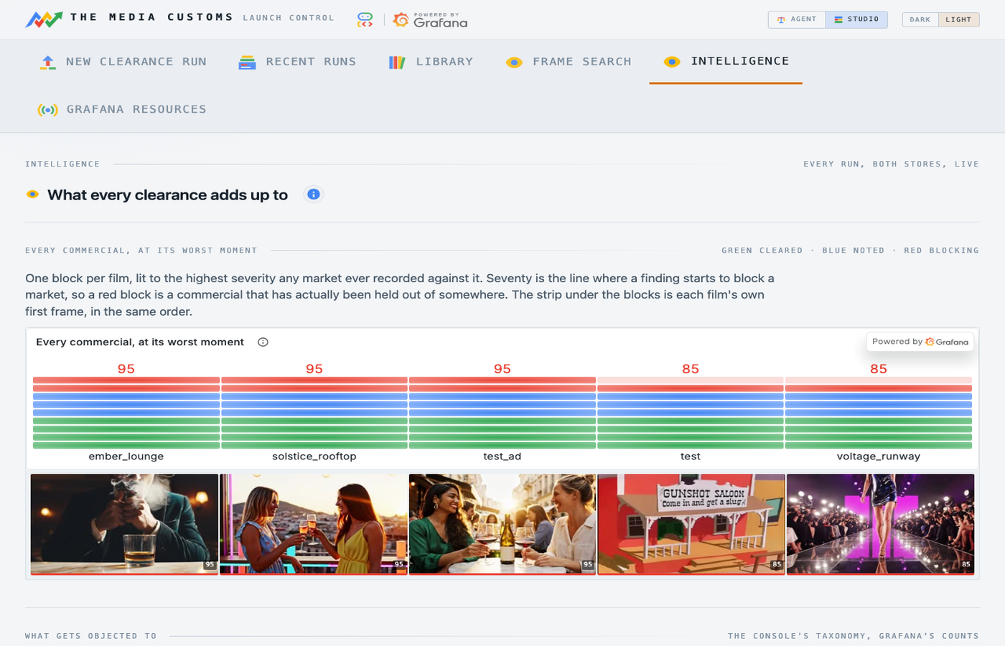
14 /INSIGHT
Intelligence
Every other screen answers a question about one commercial. This one reads across all of them.
17 panels and 8 kinds of chart, out of the same two stores the crew wrote during those runs.
Which subject your creative keeps tripping over, and which jurisdictions are actually hard.
The console draws the axes. Grafana charts the data.

Slide 23
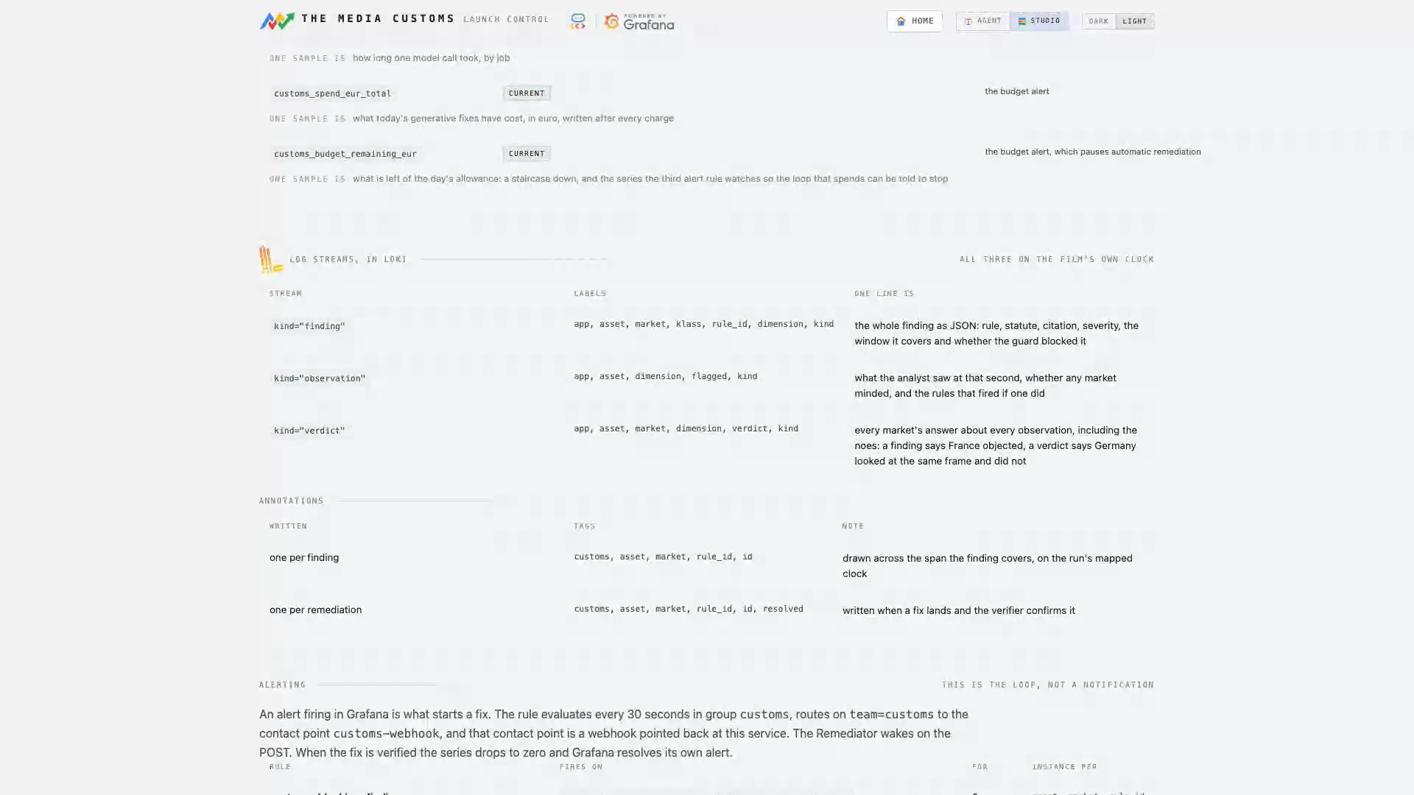
15 /GRAFANA
Grafana resources
The whole Grafana surface on one page, read from the definitions the agent provisions from.
9 dashboards and every panel, 9 metric series, 3 log streams, 3 alert rules.
Every write operation, with the MCP tool it uses or the REST call it falls back to.
So it cannot drift into describing a stack nobody has.

Slide 24
02
PART TWO
Fixing what it blocked
A finding that only says no is a report. The loop that closes is what makes this a product: edit the seconds that fail, then prove the edit worked.

Slide 25





REMEDIATION
Five ways to fix a shot, priced before you press
Rewrite with Omni
Gemini Omni rewrites the whole span as video to video
0.10 EUR per second
up to 10s
Regenerate with Veo
both ends of the span edited, Veo 3.1 generates the motion between
1.88 to 3.68 EUR
genuine 3D motion
Patch one frame
one Gemini image edit, held over the span
0.04 EUR
a locked-off shot
Propagate the change
the same edit, its lighting divided out and multiplied into every live frame
0.04 EUR
the thing holds still
Repaint every frame
a repaint of every frame in the span
0.04 EUR per frame
a target that deforms
The planner chooses among the patch methods by the observation's own dimension, and it is a pure function with no model call. Veo is never chosen automatically: it regenerates pixels and costs real money, so it only ever runs because a person picked it.

Slide 26


WHAT A FIX LOOKS LIKE
The wine goes. Everything else stays.
ORIGINAL, AS DELIVERED
LOCALIZED FOR FRANCE
Gemini Omni rewrote the shot as video to video. Same terrace, same people, same motion, and the beer is now a soft drink. The verifier then re-watched the new footage with the same analyst that failed it, and only then did the finding close.

Slide 27
THE SAFETY LOOP
Nothing is trusted because a model says so
1
Grafana
an alert rule crosses its threshold and posts to the webhook
Two things it refuses to do
It does not ask the model whether the edit worked.
The verifier re-runs the real analyst pass over the changed shots and asks the same instrument that found the problem whether it still sees it. Then it answers the second half: did anything new break?
It does not keep an edit that damaged the film.
The craft gate measures length, resolution, soundtrack and collateral drift inside the span. A staged file that fails is discarded and the finding goes back to open, with the master untouched.
2
Remediator
plans, prices, edits the span, one edit per shot
3
Craft gate
length, resolution, audio and drift, or the file is discarded
4
Verifier
re-runs the REAL analyst on the changed shots
5
Resolved
the metric drops and Grafana clears its own alert
An edit that removes a bottle can also remove the finding next to it, or introduce one.

Slide 28
THE GUARD
When the honest answer is not an edit
When a rule is written on a protected characteristic, editing the ad is not the product working. Naming the problem and handing it to a person is.
HUMAN DECISION REQUIRED
"rule basis targets a protected characteristic; human decision required"
Reads exactly two things
the pack rule matched by rule id, and the finding's own class
The console shows the statute beside the refusal, and offers a person three ways out: approve a manual edit, send it to legal review, or accept the risk. Whichever they choose is recorded on the run and printed on the certificate.
Never reads model output
not the rationale, not the severity, not any generated field
Never calls a model
it is a pure function, so it cannot be talked around
Guardrails belong in rule layers, not prompts. Anything a prompt grants, a prompt can take away.
Enforced twice
at adjudication, and again before a single frame is touched

Slide 29
THE MONEY
The loop that spends is the one that needs a brake
Fixing a finding by generating video is the one path that can empty a day's allowance while nobody is watching. So the budget is not a config value, it is a metric with an alert on it.
Priced before it runs
Every charge is a series
Every method shows its euro cost in the picker, and the agent quotes a fix before it starts one.
customs_spend_eur_total and customs_budget_remaining_eur go to Mimir on the real clock.
The third alert stops the loop
A person can still spend
customs_budget_low fires above the price of the most expensive single fix, and automatic remediation pauses for the rest of the day.
Findings still block, alerts still arrive and are recorded with the reason, and an operator can spend what is left one fix at a time.
The pause is on the path nobody is watching, which is the only one that needed one.

Slide 30
03
PART THREE
Grafana is a participant, not a picture
The crew writes into Grafana, Grafana triggers the crew, and a click on a Grafana panel starts a generative workflow. All three run on the live instance.

Slide 31
THREE DIRECTIONS
What it writes, what wakes it, what a click does
1
2
3
The crew writes into Grafana
Grafana triggers the crew
A click in Grafana generates
9 dashboards and 40 panels, built by the publisher agent during the run
9 metric series to Mimir over OTLP, on the film's own clock
3 log streams to Loki: observation, finding, verdict, with market and rule as labels
One annotation per finding, and the alert rules that will wake the crew later
Two rules evaluate every 30 seconds against customs_blocking
Crossing 70 for an asset, market and rule posts to the customs-webhook contact point
That contact point is a route on this service, and it wakes the remediator
An alert in Grafana is what starts a Veo render. Not a cron, not a queue
The timeline grid is one visual drawn by two systems
The squares are Grafana's own status history panel, live
A data link fires with the click's coordinate, and the console resolves the finding under it
The fix starts because somebody clicked a chart
The MCP server is the official grafana/mcp-grafana v1.1.0, run as a stdio subprocess with a service account token. Seven of its tools are called at runtime: create_folder, update_dashboard, alerting_manage_rules, get_panel_image, query_loki_logs, search_dashboards, get_dashboard_by_uid.

Slide 32
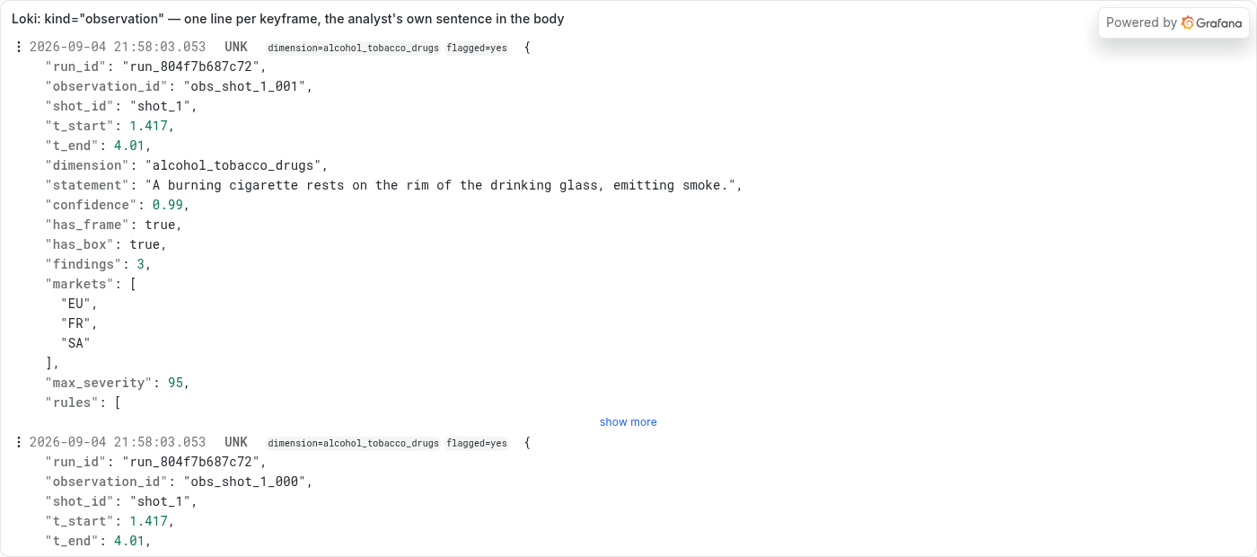
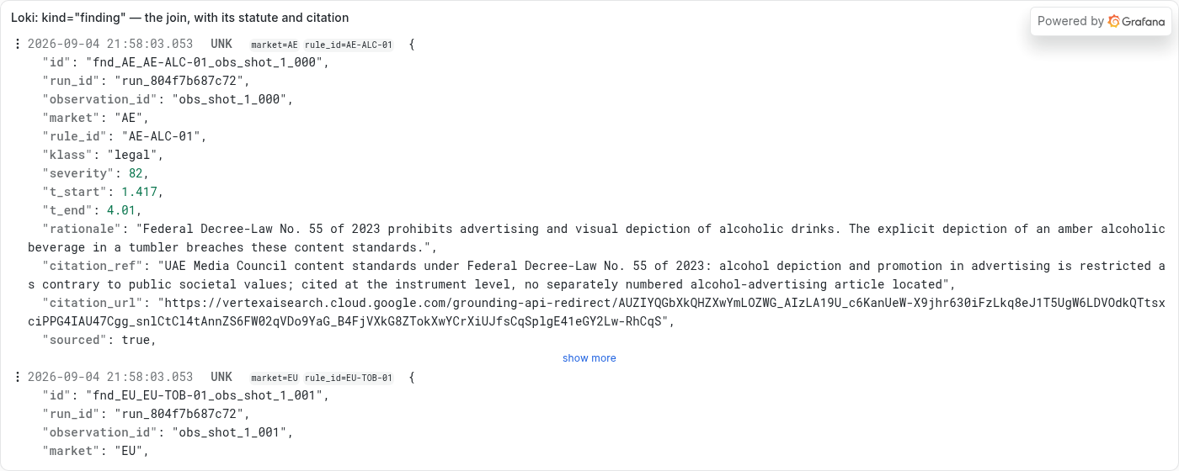
NOT A CLAIM, FOUR RENDERS
What is actually in Loki and Mimir
kind=observation, one line per keyframe. Labels carry app, asset, dimension, flagged and kind; the body carries the analyst's own sentence and which markets objected.
kind=finding, the join with the statute in it. market and rule_id are labels, so a market's findings are a selector rather than a scan, and the citation was resolved at judging time.
Prometheus rejects backdated samples, so each run is mapped onto the wall clock at t0: video second n lands at t0 plus n. The panel range is pinned to the run, so the x axis reads as the timecode because it is the timecode.

Slide 33
WHAT YOU GET OUT
The things a clearance desk actually hands over
A decision per market
A localized master
Cleared, at risk or blocked, with every finding, its statute and a citation that resolves. The evidence, not a summary.
One edited file per market, only the failing seconds touched, checked by the craft gate and signed off by the verifier.
A clearance certificate
Timeline markers
A PDF per market: every finding worst first, the rule, the seconds, the statute, the fix and the verifier's own sentence.
CSV and CMX3600 EDL, so an editor sees the findings on their own Resolve or Premiere timeline, coloured by what they mean.
Colour on the markers is what the finding does rather than how it feels: red where a legal finding is at or over the blocking line, green where the verifier signed a fix off, yellow for the rest, and HUMAN DECISION REQUIRED in the note where the Guard refused.

Slide 34
UNDER IT
One ADK crew, one console, two stores
crew.py
the ADK SequentialAgent: ingest, analyst, adjudicators, guard, publisher
THE NUMBERS
analyst.py
one Gemini vision call per shot, 18 dimension taxonomy, no verdicts
21
market packs
adjudicate.py
the join: observation x rule x grounded citation, severity decided in code
guard.py
un-promptable refusal, reads rule metadata only
98
jurisdictions
remediate.py
five methods, priced, group aware, guarded twice
128
rules
verify.py
re-runs the real analyst on the changed shots, rules on bystanders
media.py
ffmpeg: shots, flashes, spans, craft gate, thumbnails, previews
18
dimensions
grafana_ops.py
MCP first, REST where mcp-grafana 1.1.0 has no write tool
9
dashboards, 40 panels
telemetry.py
Mimir over OTLP on the film's own clock, Loki lines, annotations
600+
offline tests
app.py
FastAPI console: server-sent events, 21 templates, no build step
Python · FastAPI · Google Cloud Agent Builder (ADK) · Gemini vision, text, TTS and image · Gemini Omni · Veo 3.1 · Vertex AI · Grafana Cloud with Mimir, Loki and MCP · ffmpeg · SQLite · Cloud Run

Slide 35
HONEST LIMITS
Known, deliberate, and worth saying out loud
The channel rung is thin
The corpus is deliberately small
Three Belgian broadcasters have pack files of their own. The other 77 inherit their country and add nothing yet.
The archive shows the commercials this project generated with Veo, because they are the ones it holds the rights to.
Omni refuses third-party footage
Veo has a celebrity filter
Gemini Omni declines to edit recognisable third-party content. The refusal is quoted verbatim and nothing is charged.
A bridge over a shot it reads as a public figure is refused. Never charged, and a retry cannot help: the footage is the refusal.
Grafana Cloud cannot be framed
One Cloud Run instance
Fourteen URL forms were probed and every one enforces frame-ancestors none, so live panels come from a self-hosted viewer over the same data.
SQLite plus one writer thread is the concurrency model. Two concurrent multi-market clearances is too much for one instance.
A hackathon build says what it cannot do. Everything above is in the README, in these words.

Slide 36
T H E M E D I A C U S T O M S
One asset, every market, before it ships.
Live, and nothing is gated for reading
customs-app-akap4ao72a-ew.a.run.app
Code
github.com/tdries/devpost-hackathon-agentic-cinema
Built on Google Cloud and Grafana · Tim Dries

