Slide 1
Tamareddtchy
Your Reddit soul, raised as a living 3D pet.
Reddit's Games with a Hook . Devvit Web

Slide 2
THE PROBLEM
Reddit games die on day three.
Nothing pulls you back. Nothing connects you to anyone else. You lurk the same three subreddits and a game post gets played once and scrolled past.
Today
Engagement is an abstract number.
Winning is a score nobody remembers.
You never leave your bubble.
With Tamareddtchy
Engagement is food that shapes a pet you love.
Winning is a mutated lineage you built with others.
Your best move is to find your opposite.

Slide 3
WHAT IT DOES
A pet whose body IS your Reddit personality.
Hatch
Feed
Grow
Breed
Pick the corners of Reddit you live in. Your creature is born looking like you.
Read, comment, post. Every action pushes points into a gene and reshapes the 3D body.
It breathes, blinks, and droops when neglected. Egg to adult across days of nurture.
Find your opposite and mate. Good genetics come from crossing distant gene pools.

Slide 4
THE MECHANIC
12 genes. 6 opposite pairs. One body, grown live.
The creature is never stored as a picture. It is rebuilt in 3D every frame from twelve numbers. Each body slot maps to one opposite pair.
Knowledge / Vitality . head
Tech / Heart . eyes
Craft / Mayhem . torso
Pulse / Lore . arms
Inner / Social . legs
Earth / Fiction . aura

Slide 5
THE HOOK: A BREEDING ECONOMY
Opposites win. Twins make a busted, viral mess.
Pairing produces and the strategy is
Gen-1 x Gen-1
a plain Gen-2
cheap starter, breed wide
Gen-3 x Gen-3
a strong Gen-4
both want the kid, hard-fought deal
Gen-5 x Gen-1
an advanced Gen-6
the Gen-5 holder has the leverage
Cost to mate: a big hunger hit plus a multi-day cooldown. Win metric: lineage score = depth x genetics quality + offspring count.

Slide 6
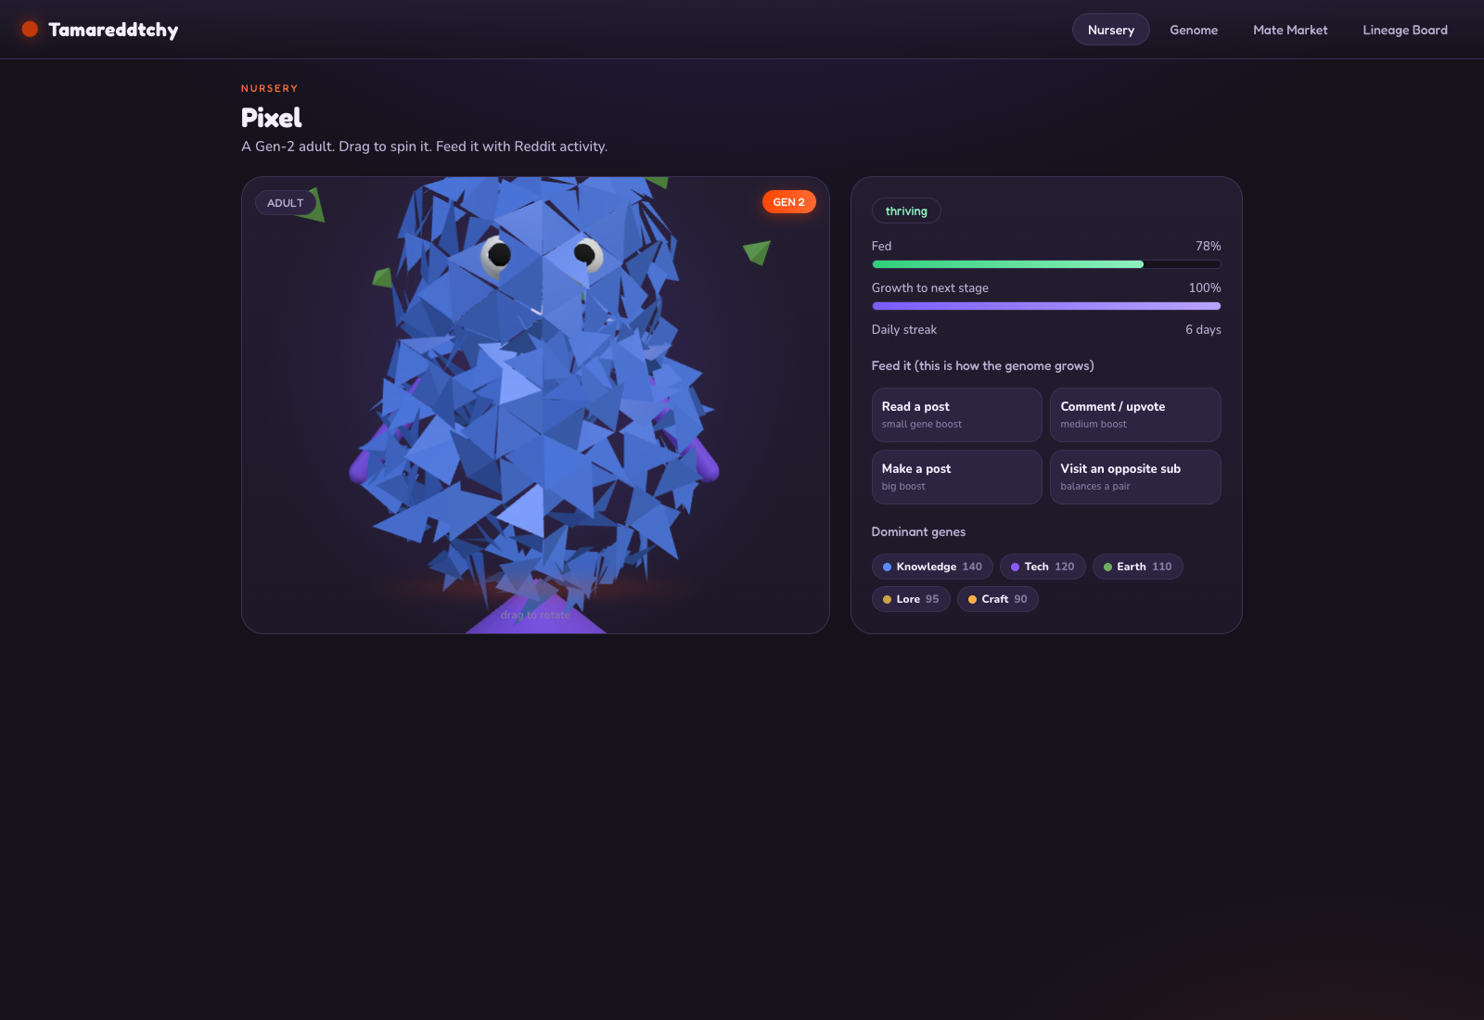
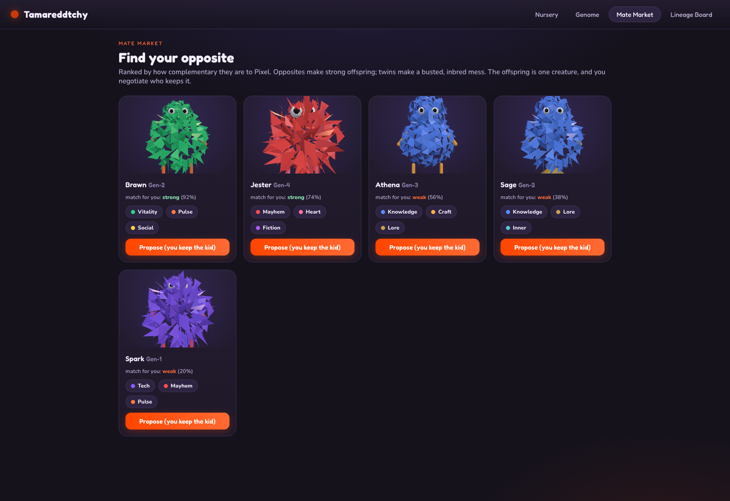
SEE IT
Every genome grows a different body.
The nursery: a living 3D pet.
The mate market: five genomes, five bodies.

Slide 7
HOW IT IS BUILT
One Devvit Web app. Shared rules. No model files.
Procedural 3D
Shared logic
Three.js geometry grown from the genome. No assets to download, infinite variety.
Genome, scoring, and breeding live in one module imported by client, server, and tests.
Devvit Web
Plays anywhere
A web view post backed by Redis and the Reddit API. Milestones post themselves.
An in-memory mock makes the whole game playable with zero Reddit auth, for judges.

Slide 8
Leave your bubble.
Raise something only the whole of Reddit could make.
github.com/tdries/tamareddtchy

