Slide 1
Nice Ride in Minneapolis
2010 - 2018
Patterns in Bike Sharing
Justin Co
Tyler Rygg
Matt Garcia
Chou Moua
Nimo Osman
Dave Rodriguez

Slide 2
Eau Claire is ready for a bike share:
The Eau Claire City Council wants to learn from NiceRide in Minneapolis
A small group of data minded students is tasked to glean insights from nine years of NiceRide rider data.
https://volumeone.org/articles/2019/03/21/28625_sharing_their_wheels

Slide 3
What can changes in NiceRide ridership tell us about how to best grow a bike share program?
How has the number of trips changed over time?
What age groups use NiceRide them most?
What can changes in subscribership reveal about about how to structure fees
Do electric scooter programs impact bike share ridership?

Slide 4
Trends in Overall Nice Ride Usage
Over the course of a typical riding season, how many rides occur?
When does peak ridership occur during the year? Any surprises?
Can we expect rapid adoption of our bikeshare program?

Slide 5
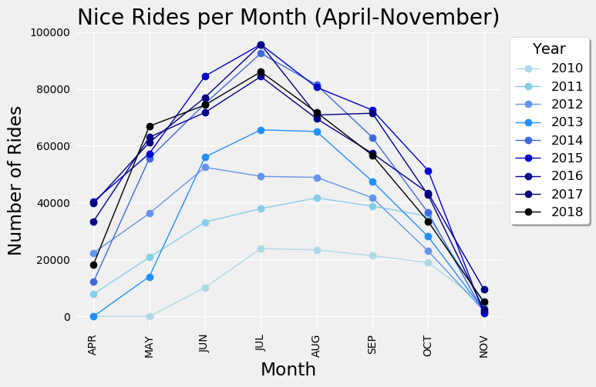
What doe
Explosive growth in first five years!
Season and temperature play a role.
Slow or negative growth in the last four years. Why?
We can expect similar trends here in Eau Claire.

Slide 6
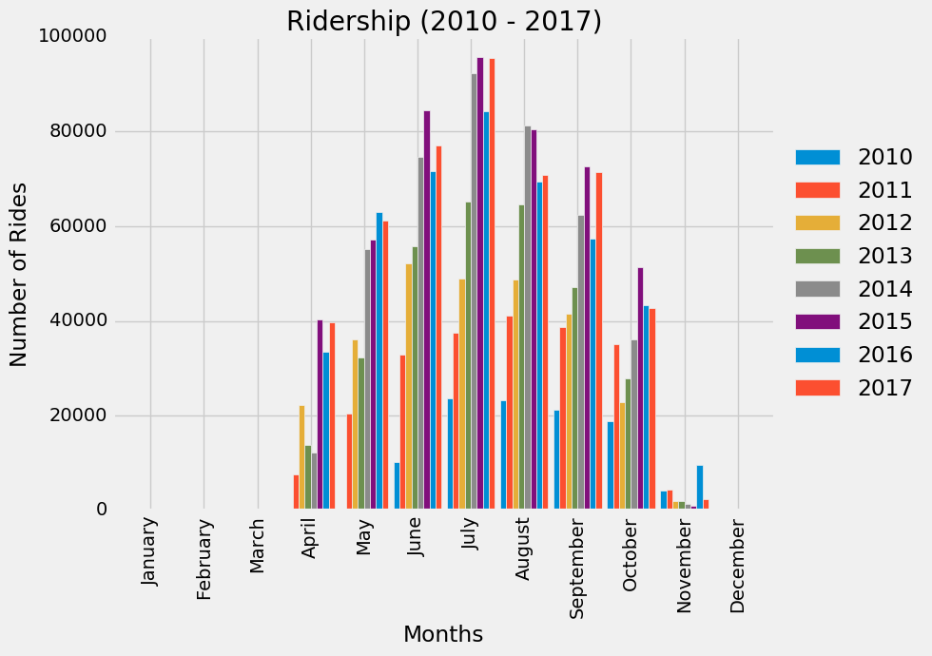
Rides Over Time
Notes:
Nimo

Slide 7
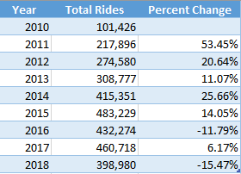
Ridership Over Time
Nice rides experienced strong growth and increased ridership for 5 consecutive years.
In the launch year of 2010, Nice Rides had just over 100,000 rides. From 2010 - 2011, ridership more than doubled.
In the peak year of 2015, there were nearly half a million rides taken.
Notes:
Nimo

Slide 8
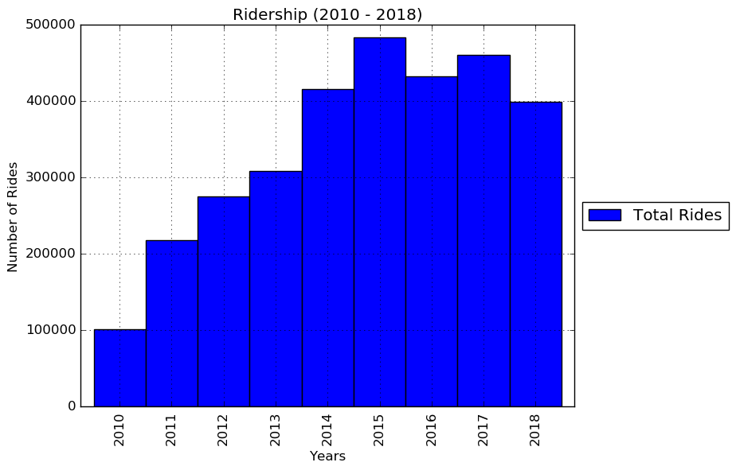
Rides Over Time
What happened in 2018?
Notes:
Nimo
In 2016 and 2018 there was a decrease in ridership however.
2015 was such a big year for the program that it is understandable that there was a slight decrease the following year as a natural correction.
In 2018, Nice Ride was competing with the scooter program being piloted in Minneapolis.
“From August to November of 2018, the City of Minneapolis permitted a scooter pilot with up to 400 scooters available for shared use throughout Minneapolis. Almost 75,000 people took over 225,000 trips during the 4-month pilot period.” (http://www.minneapolismn.gov/publicworks/trans/WCMSP-212816)
Although competition in the market has somewhat slowed growth, that was to be expected. Nice Ride is not only making dominating the market, they are enhancing the quality of life for each and every rider.

Slide 9
2018 eScooter Pilot Impact to Ride Totals?
Compared total rides by month between 2017 and 2018.
2017 month average rides were slightly higher than 2018.
Data is relatively normally distributed.
Samples are independent.
T-test (statistic=0.41649997186076, pvalue=0.6833606911535794)
Cannot reject null hypothesis.
Notes:
eScooter Pilot Impact to 2018 NiceRide Trips
Question: In July of 2018, the city of Minneapolis piloted an eScooter program from August through November 2018. Did the introduction of this program have an impact on NiceRide ridership?
Sought two measures of ridership: Total rides and trip duration
Total rides is an indicator for demand for NiceRide bikes
Due to the fee structure, longer rides will cost a user more potentially providing extra revenue to the organizations.
Compared two 2018 time periods: April through July and August through November.
Conducted t-test for each ridership measure.
Conclusion 1:
The average of monthly total trips was higher than 2017 then in 2018. However, when conducting a independent t-test on this metric, the result was (statistic=0.41649997186076, pvalue=0.6833606911535794). From this we failed to reject the null hypothesis the means are not statistically different. This was a useful test as the data was relatively normally distributed and the samples were independent.
Conclusion 2:
The median of trip duration was slightly higher in 2018 than in 2017. When conducting an independent t-test on this metric, the result was (statistic=-9.902631940092293, pvalue=4.0718420819885724e-23). At first glance, it appears we can reject thenull hypothesis the means are not statistically different. However, upon closer inspection of the data, it is not normally distributed so the independent t-test was not an appropriate measure of statistical significance.
Discusion:
I attempted several methods to test the normality of the distrbution for the trip duration data.
Reviewed descriptive statistics to understand averages and standard deviations. This was my first hint the data was highly skewed.
Q-Q plot to help visualize the distribution. From my understanding, using the Q-Q plot, if the data is normally distributed, the ploted points will follow a 45 degree line from bottom left to upper right corner. In this case, the data was far from this and sketched a straight line with a sharp incline at the far right.
The data in it's raw form was not condusive to visualizing distribution in a histogram.
I tried to normalize the data and ultimately calcuated the inter-quartile range to find upper and lower bounds. Then I filtered the data to only include observations within that bounded range. After removing the outliers in this way, I was able to vizualize the data using a simple histogram which showed the data was skewed to the right.

Slide 10
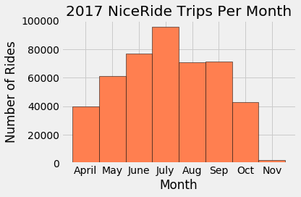
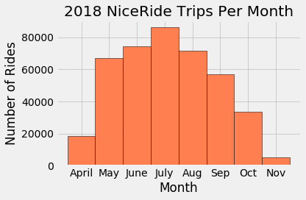
2018 eScooter Pilot Impact to Ride Totals?

Slide 11
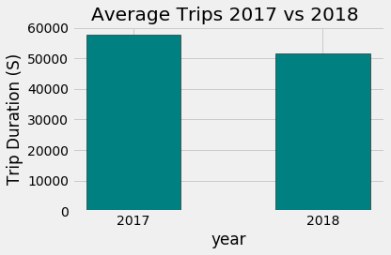
2018 eScooter Pilot Impact to Ride Totals?

Slide 12
2018 eScooter Pilot Impact to Trip Duration?
Compared monthly median trip duration.
2018 median ride duration was higher than 2017.
Data was not normally distributed even after removing outliers.
Independent t-test is not valid in this case due to the data not being distributed normally.
Cannot make conclusion as to statistically significant differences between 2017 and 2018.

Slide 13
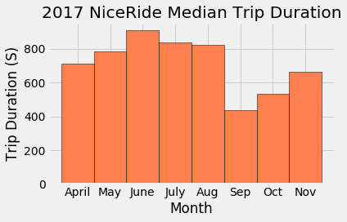
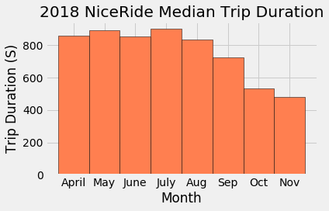
2018 eScooter Pilot Impact - Trip Duration

Slide 14
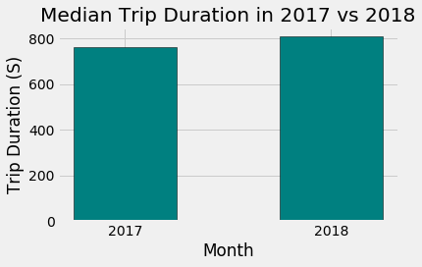
2018 eScooter Pilot Impact to Trip Duration?

Slide 15
Trends in Nice Ride Demographics
What is the age distribution of Nice Ride users in Minneapolis?
How does this compare with the total population of Minneapolis?
How does the population of Minneapolis compare with Eau Claire?
What can we expect from a bike share program in Eau Claire based on the demographic usage in Minneapolis?
Notes:
We used the answers to these questions to determine what age groups were using Nice Ride most frequently. When looking at Minneapolis riders as compared to the total population we can estimate Eau Claire riders based on the known population of Eau Claire. We look at each cities populace and Nice Rides in each 5 year age group.

Slide 16
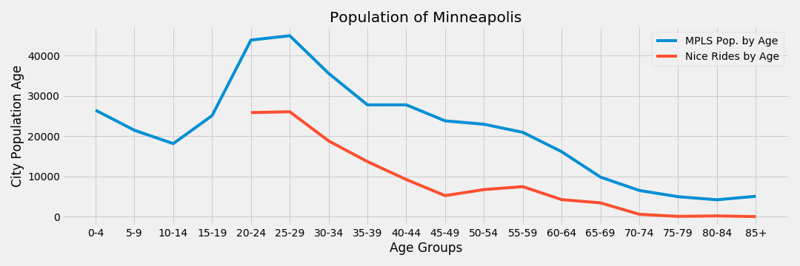
Population of Minneapolis compared with number of Nice Rides by Age
Notes:
Chou
In another effort to check feasibility of duplicating nice ride in Eau Claire, we have taken a high-level look at basic demographics of age between the two cities.
This not only show similarities between populations between the cities but also can hint at potential markets in EauClaire.
A major difference between Minneapolis and Eau Claire is that the latter has a younger population and smaller total population over all.
This works in Eau Claire’s favor as the most frequent users of Nice Ride are between the ages of 18 and 30.

Slide 17
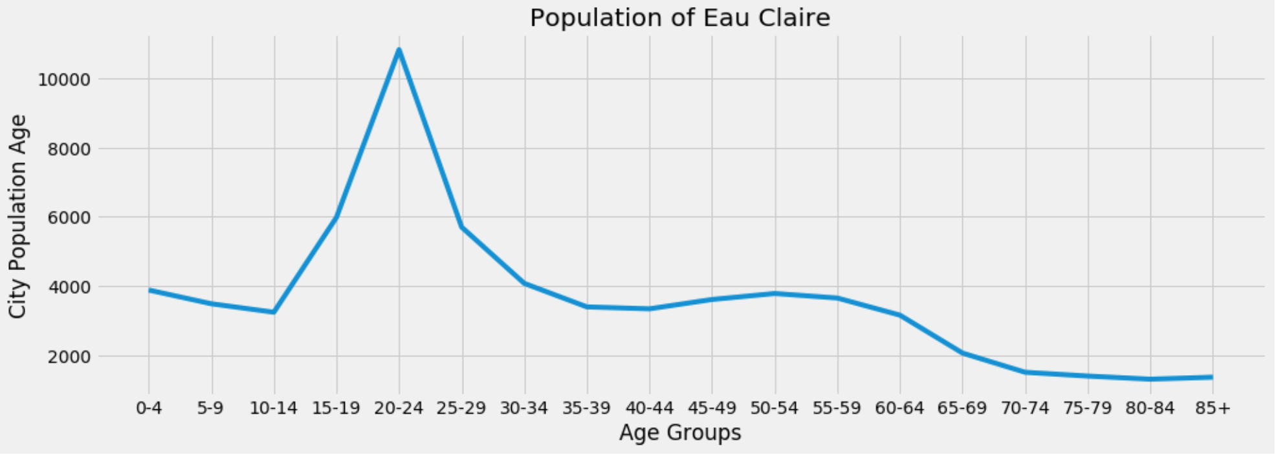
Population Comparisons: Eau Claire
Notes:
Age demographics in Eau Claire are promising for a bike share program. Eau Claire has a significant number of 18-30 year olds which happen to be Nice Ride’s most frequent riders. There is also a consistent population of 30-60 years olds, around 3800 for each five year age group. Nice Ride has many users in this age range and sees a spike in popularity amongst 50-60 year olds of which Eau Claire has a growing proportion.
Challenges in retrieving accurate data for city populations include finding accurate data and that census tracts do not always line up with city limits.

Slide 18
Nice Ride Account Type Comparison
How did subscriber ridership change over time?
How do changes in fee structure impact the account type usage?
What account will see the most use by riders?
Notes:
Ridership here is defined total number of rides.
Limitations:
Data does not reflect unique rider preference
Fee structure history was not well documented. Insight into these changes were gleaned from news articles and press release archived on the internet.
Definitions of what defined the Member or Casual account type differed with each year.

Slide 19
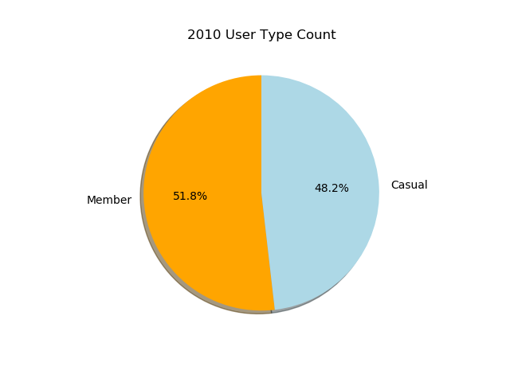
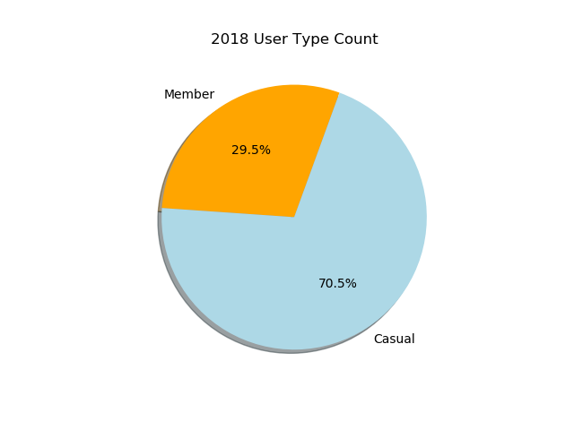
User Type Data Comparison between 2010 and 2018
2010 shows an almost equal distribution between membership and single ride casual riders.
Consecutive years ending in 2018 shows lower proportion of members compared to single ride casual riders.

Slide 20
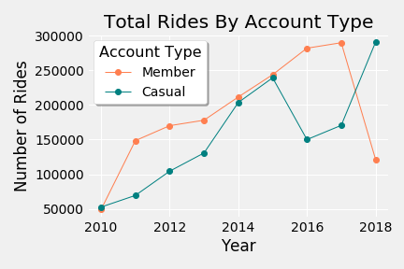
Rides By Account Type
Member account types were popular early.
Starting 2011: Casual riders increased sharply while growth of Member usage slowed.
Account usage will shift based on incentives and fee structure.
Notes:
From 2010-2017: Member account type indicated users who had an account with NiceRide. For the same time period, Casual account type indicated users who walked up and bought a pass at the station.
2018: Member account type indicated users who have a monthly or annual subscription membership with NiceRide. Casual account type indicated users who purchased a single ride or purchased a day pass.
From 2010 to 2014 Member account type members outpaced growth of casual riders.
From 2014-2016, membership growth remained flat and number of riders by account type did not differ greatly as casual rides increased.
2016 saw a large dip in the number of casual riders. At this time, NiceRide offering a discount on single rides for users who create a membership and use the NiceRide app. This could help to explain the reduction in Casual account type riders at this point in time.
By 2018 there the number of member vs casual rides seemingly flipped as member riders steeply declined, and casual riders sharply rose. In 2018 NiceRide began offering a day pass option changing how member vs casual riders were classified.
The day pass popular choice among riders and shifted the distribution of Member and Casual account types. Incentivising usage with discounts or flexible pricing options is effective in driving users to a specific account type.

Slide 21
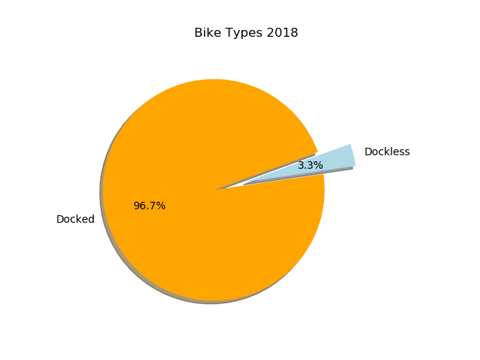
Bike Type Used in 2018
Docking stations need additional overhead/rules (construction/maintenance).
Dockless provides flexibility
Options to focus in reaching/expanding in underserved areas with user growth potential.

Slide 22
Conclusions:
Based on our analysis and the short time the electric scooter pilot program was in 2018, we cannot conclude scooter programs had a statistically significant impact on Nice Ride usership.
Including a day pass option to the typical subscriber/one-time rider fee structure could reduce the number of annual or monthly subscribers as users opt for flexible on-demand payment.
Incentivising usage with discounts or flexible pricing options is effective in driving users to a specific account type.
Other incentive programs (partnerships, employer discounts, insurance) that can boost annual userbase.

