Slide 1

GROUP A · MILESTONE 1
Washbot 🧺
Shared laundry, sorted.
washbot-ten.vercel.app
Notes:
Title

Slide 2

QUICK QUESTION · RAISE YOUR HAND
🙋 Who here is sharing a washer with other people?
Notes:
Question

Slide 3
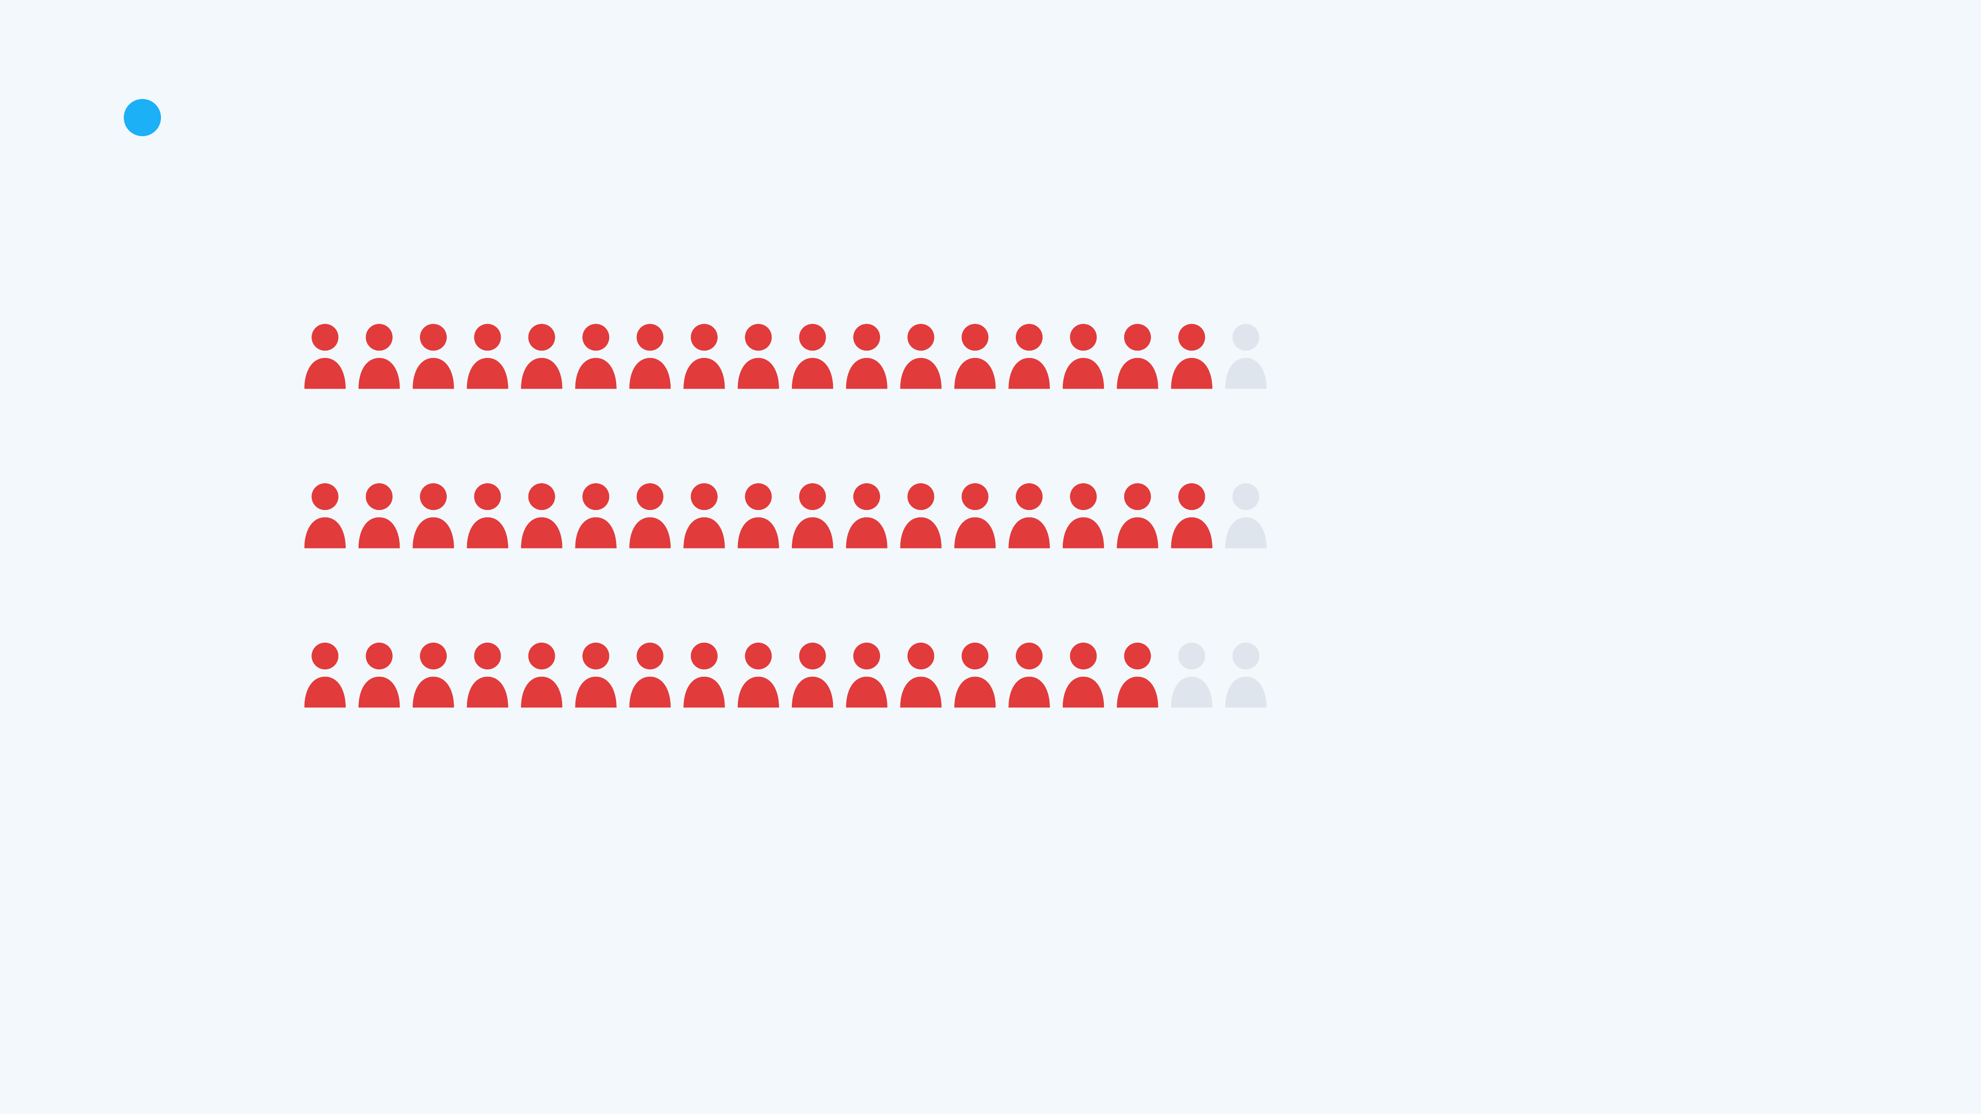
1
PROBLEM & SCOPE
We asked 18 tenants. Last week…
🚪
found the washer busy when they needed it
17
/ 18
🧺
found someone else's laundry still inside
17
/ 18
😬
left their own laundry for 30+ minutes
16
/ 18
Everyone knows this. Nobody has fixed it.
Each figure = one tenant who shares a washer · survey, n = 18
Notes:
The obvious

Slide 4
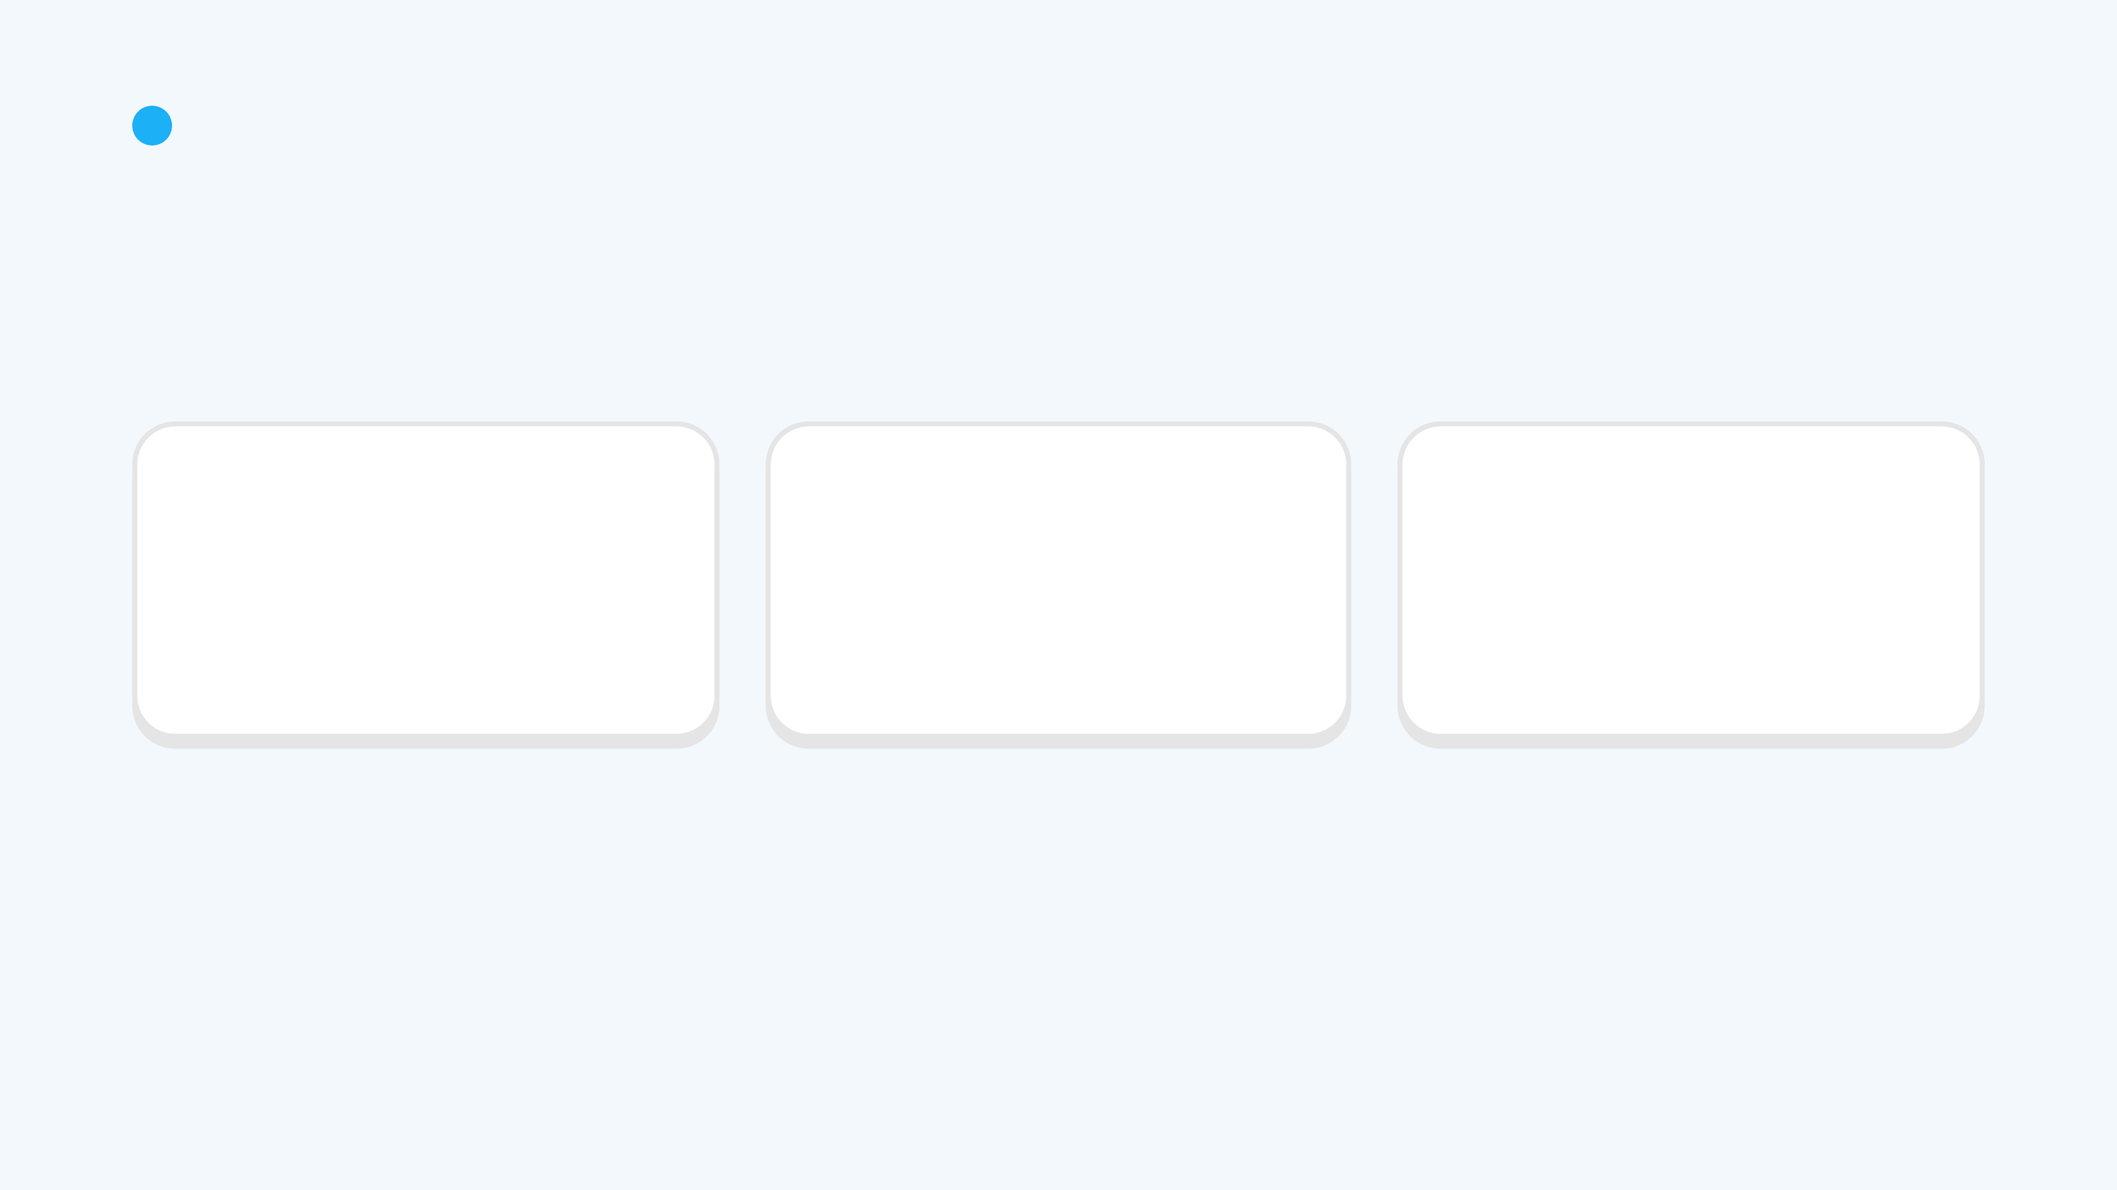
1
THE PROBLEM
Laundry is a basic need.
Shared machines get overloaded.
🏃
👕
🙊
People are busy
Wet clothes can't wait
Housemates don't communicate
And nothing on the market fixes it for shared housing.
Notes:
The problem

Slide 5

1
PROBLEM & SCOPE
How might we help tenants who share one washer or dryer know when it's free, and make sure owners know the moment their load is done, so nobody has to chase anyone?
🎯 Room renters in shared HDB and condo flats, Singapore
One household · one washer
Notes:
How might we

Slide 6
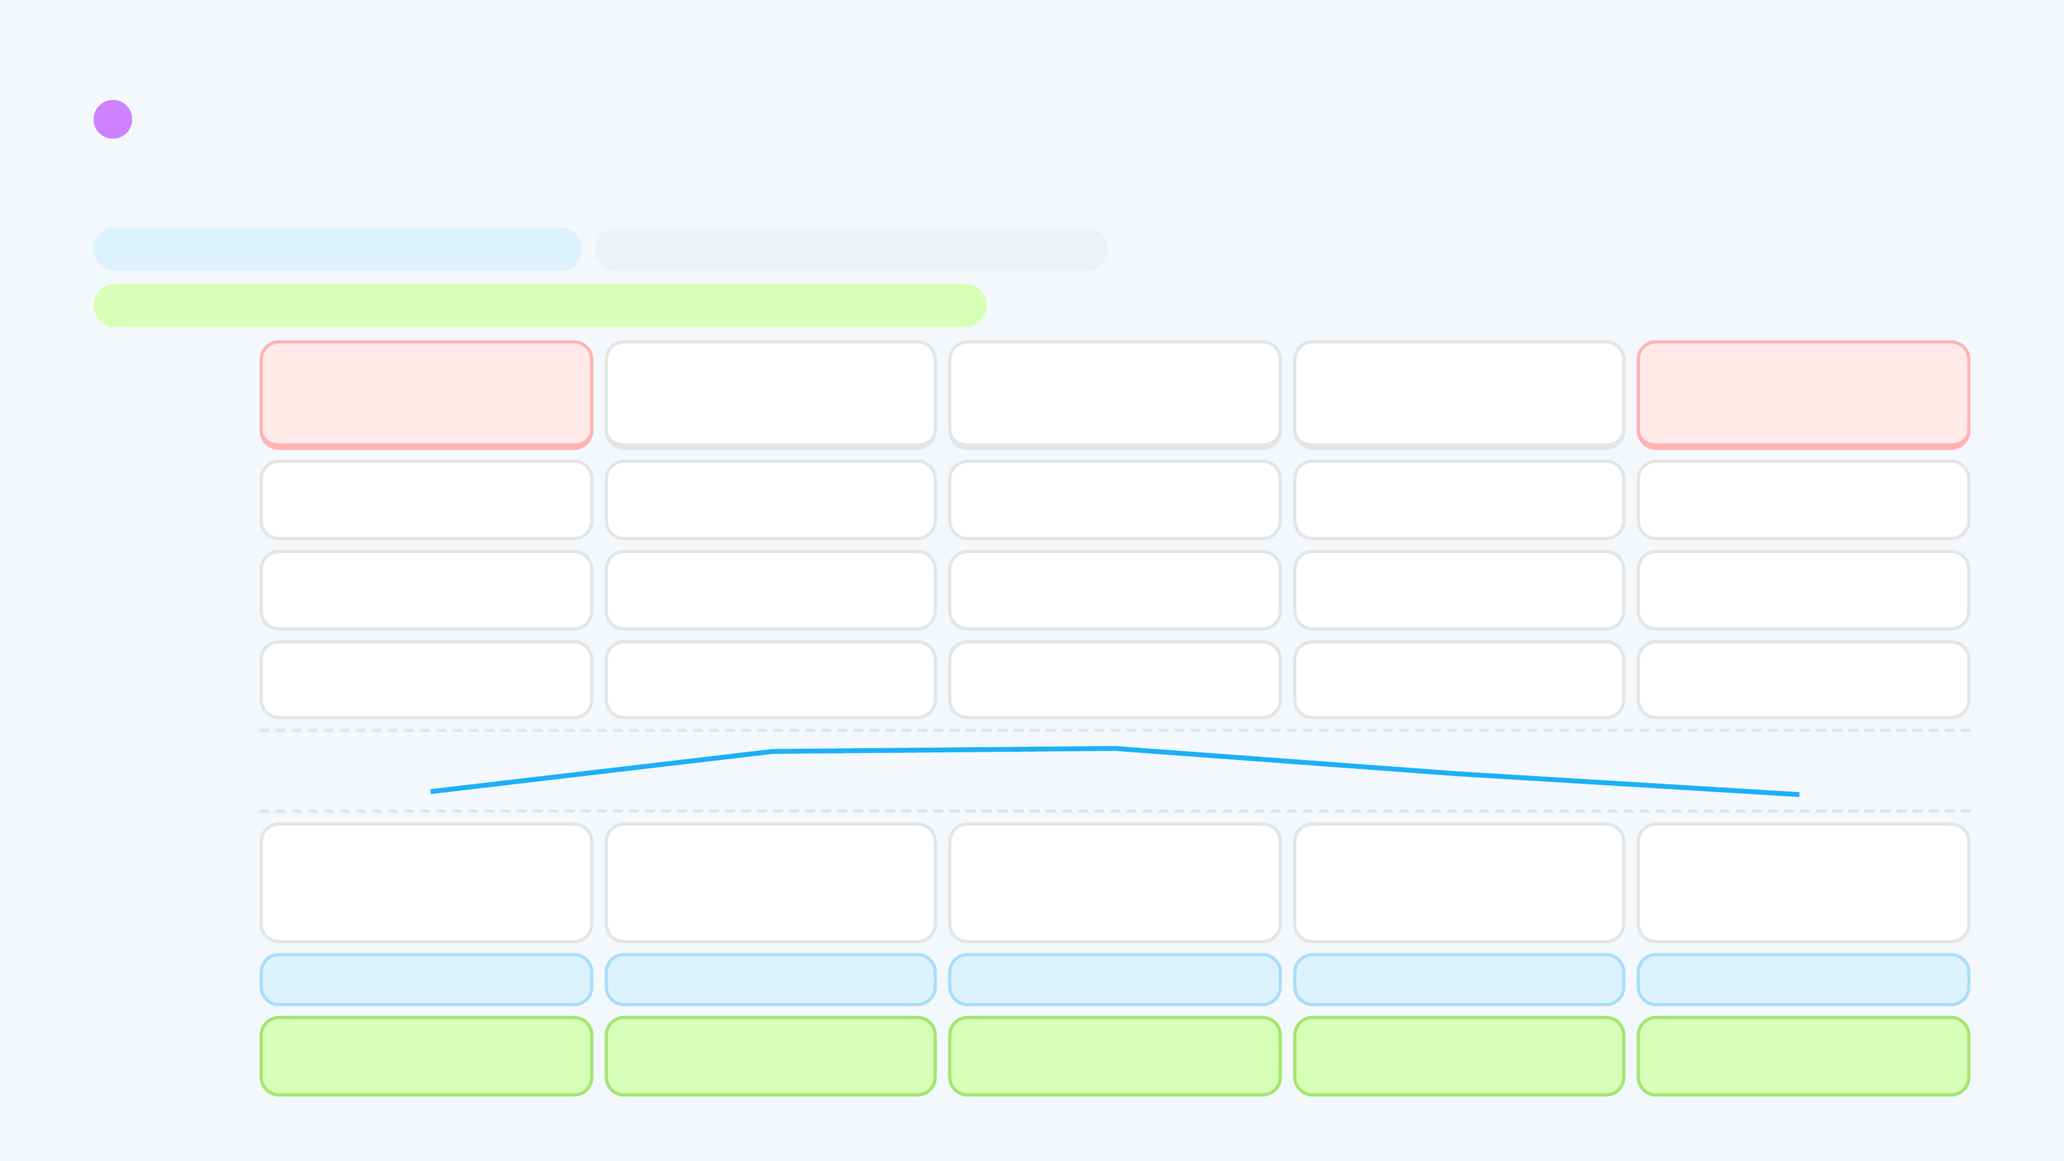
2
USER & STAKEHOLDER RESEARCH
Two moments break a shared laundry day.
Persona: room renter who shares a washer
Scenario: an evening wash, start to handover
Expectation (HMW): know when it's free, owner told when done, nobody chasing
🚶
1 · Check if free
~5 min
🧺
2 · Load and start
~5 min
⏳
3 · Wait
~1 h cycle
🔔
4 · Cycle ends
0–30+ min unnoticed
👕
5 · Next person arrives
minutes to hours
DOING
Walks over to look, or asks the group chat
Loads clothes, presses start, leaves
Back in room, guesses the end time
Busy elsewhere, misses the end
Finds clothes inside, asks around, waits or moves them
CHANNEL
At the machine · house group chat
Washer panel
Washer countdown (on site only) · phone timer
None: nobody is told
At the machine · house group chat
THINKING
“Is it free, or another wasted trip?”
“Done, back to my room.”
“When will it finish?”
(not thinking about laundry)
“Whose clothes are these? Do I touch them?”
🙂
🤔
FEELING
😠
😴
😬
Wasted trip when it's busy
17 of 18 found it busy · 3.3 / 5
Finding 1
Nothing shows whose load
“Don't know whose load” 3.2 / 5
No signal, only guessing
7 of 18 set a phone timer
Owner is never told it's done
16 of 18 left their own 30+ min
Finding 2
Free machine, still blocked
17 of 18 found others' laundry · 10 of 18 ask a chat
Finding 2
PAIN POINTS
WORKS WELL
If free, start at once
Quick, one press
Free time while it runs
—
A group chat already exists
OPPORTUNITY
See if it's free without walking over
Show who is using the machine
Know when it will finish
Tell the owner the moment it ends
Remind the owner, so nobody chases
Survey, n = 18 · Thinking is paraphrased from survey patterns, not quotes · times approximate · red = moment of truth
Notes:
Journey map

Slide 7
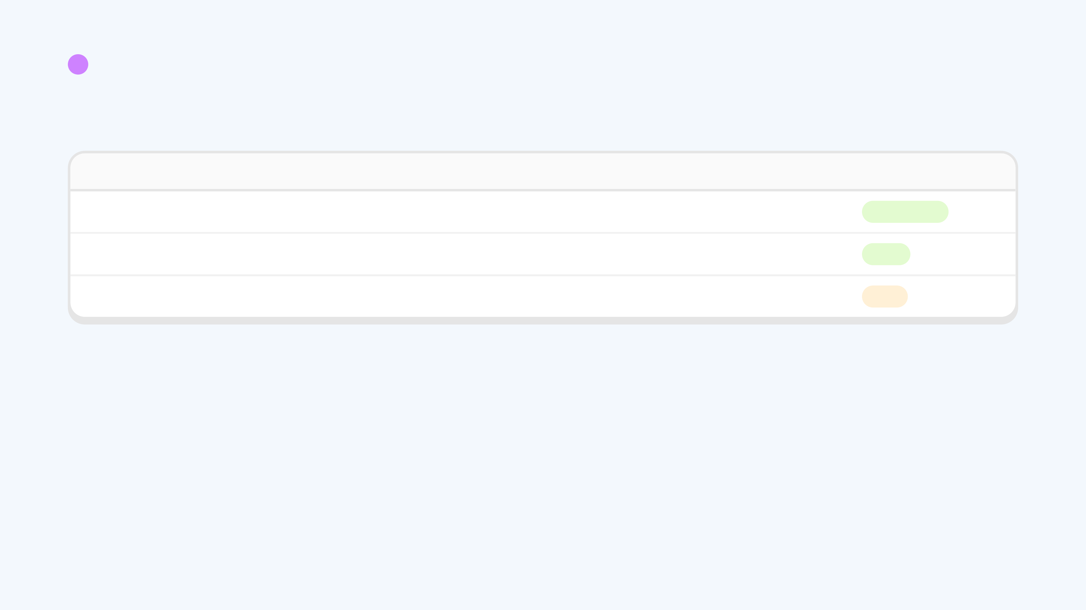
2
USER & STAKEHOLDER RESEARCH
Who we engaged, and who is next.
WHO
HOW
STATUS
Tenants
Survey: 19 responses, 18 answered in full
Done · 1 Oct
Tenants
Interviews, for quotes and depth
Done
Landlords / master tenants
Interviews: price, and who pays
Next
Notes:
Who we engaged

Slide 8
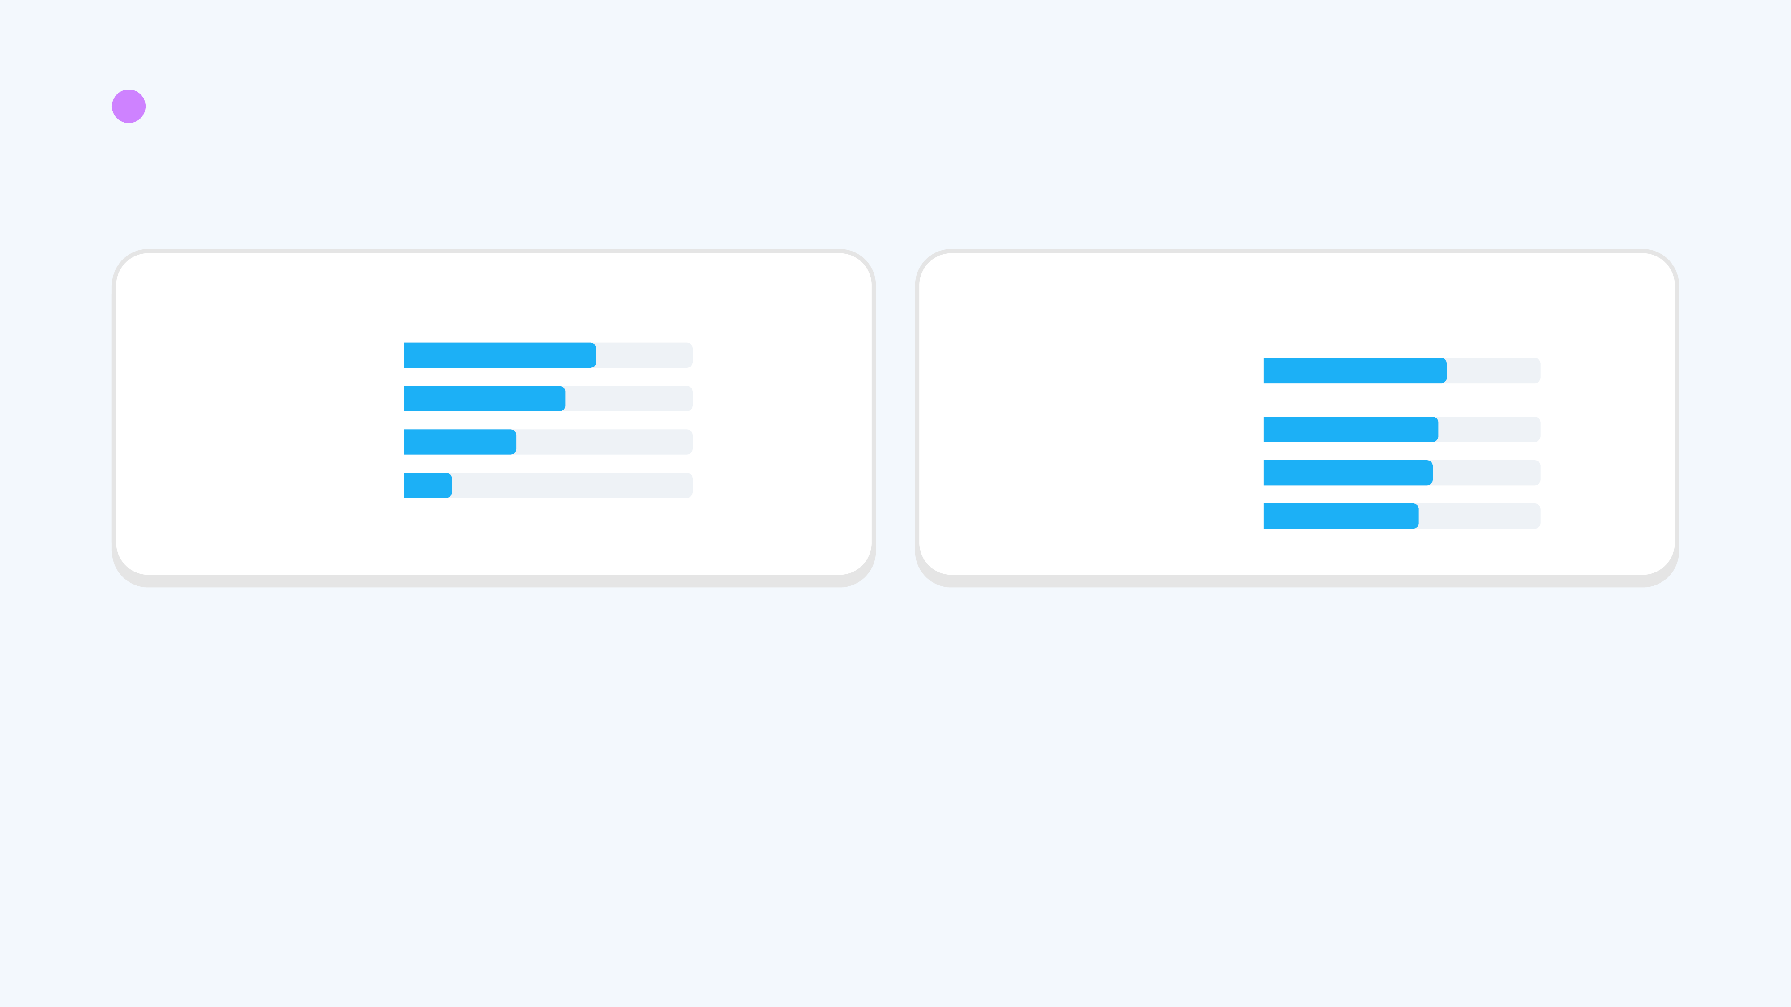
2
USER & STAKEHOLDER RESEARCH
Today's system: walk over and ask around.
How they cope today
How annoying is it?
Walk over and check
12 of 18
Washer busy when I need it
3.3 / 5
Ask in a group chat
10 of 18
Set a phone timer
7 of 18
Don't know whose load
3.2 / 5
Laundry schedule
3 of 18
Others' laundry left
3.1 / 5
I forget my own
2.8 / 5
Survey, n = 18
Notes:
What we learned

Slide 9
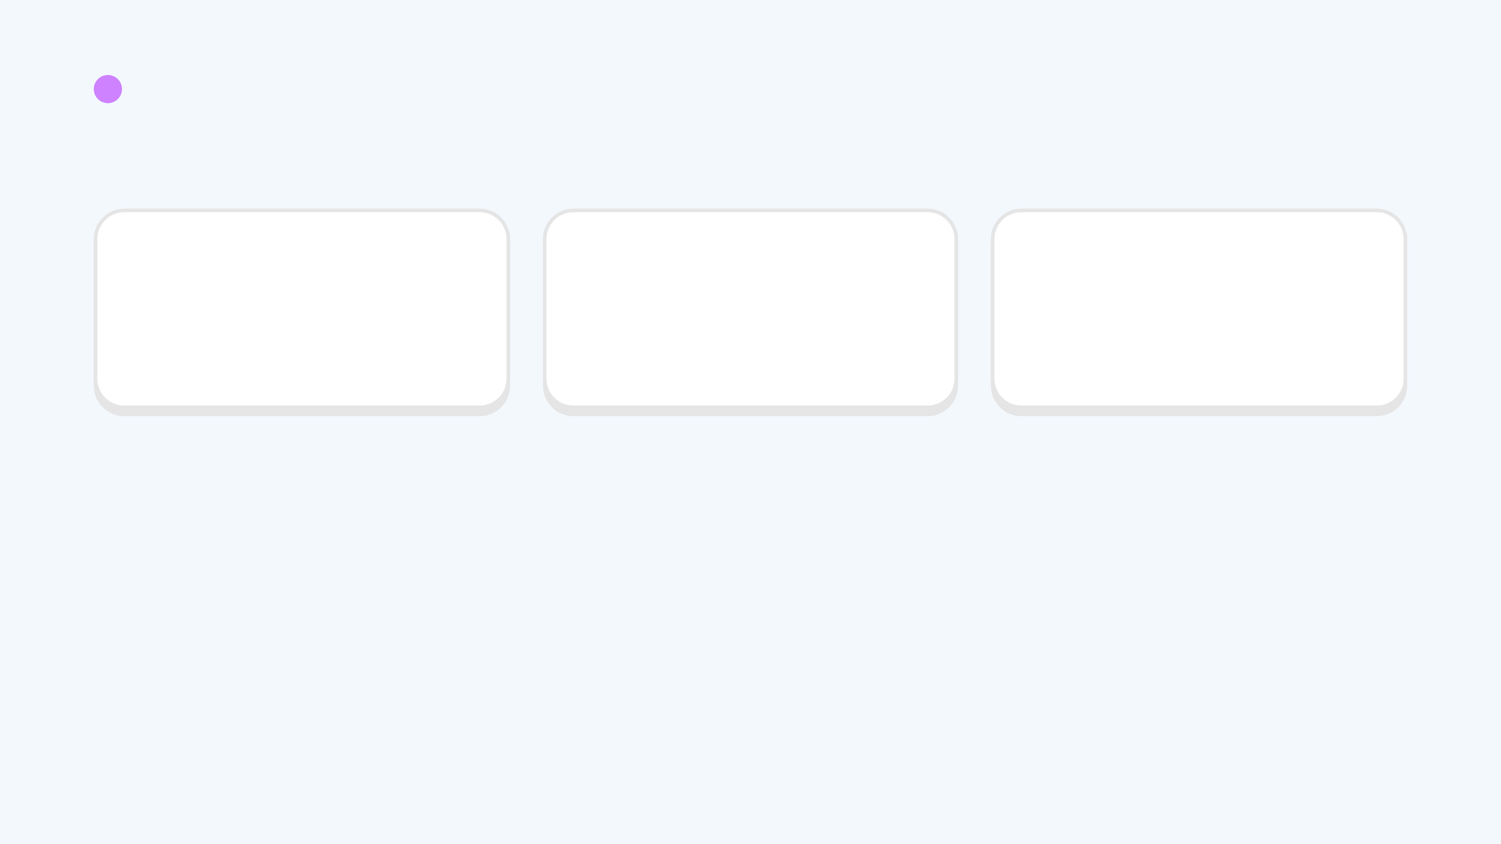
2
USER & STAKEHOLDER RESEARCH
Three findings.
1 · “Is it free?”
2 · Victim and culprit
3 · They cope, they'll pay a little
The machine can't tell anyone its state, so 12 of 18 walk over to check.
17 of 18 found others' laundry. 16 of 18 left their own. Nobody is told when a cycle ends.
13 of 18 willing to pay S$10 or less.
Survey, n = 18
Notes:
Insights

Slide 10
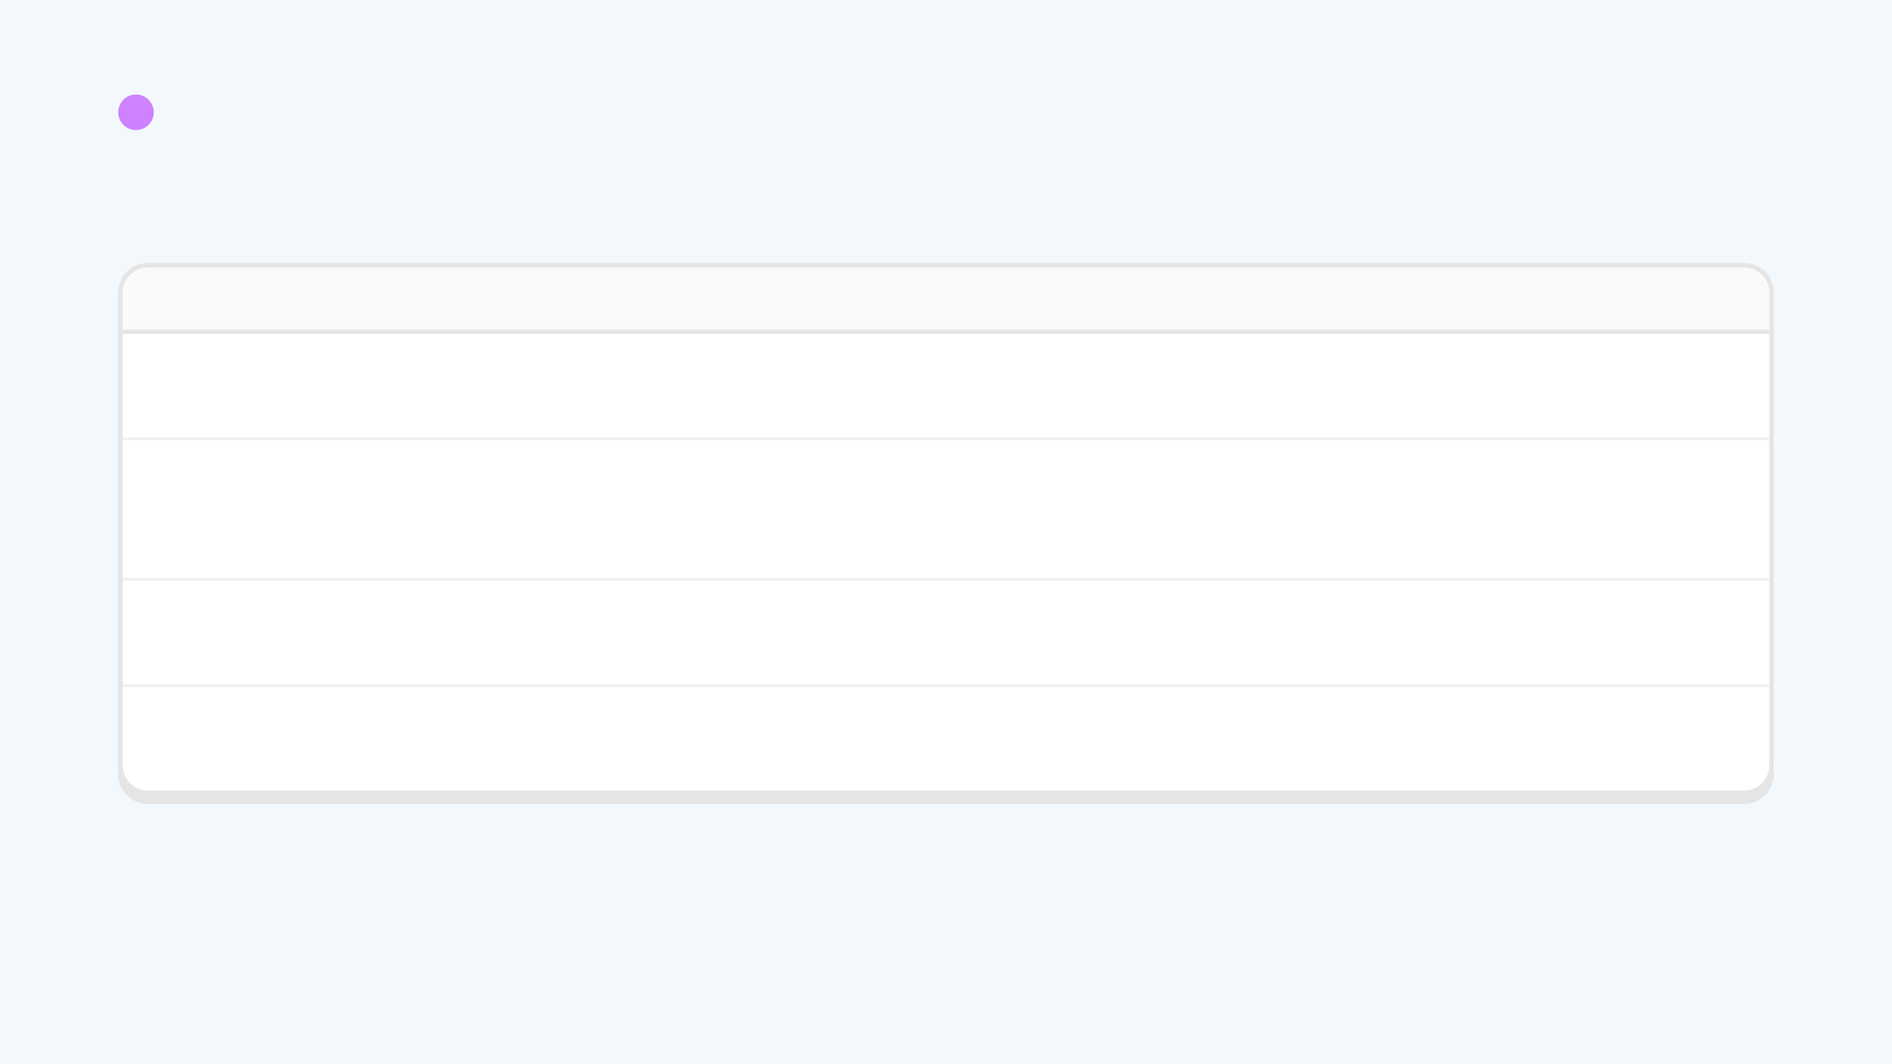
2
USER & STAKEHOLDER RESEARCH
What the evidence changed.
WE ASSUMED
WE FOUND (N = 18)
SO WE NOW…
Tenants would pay a fair price for a laundry tool
13 of 18 would pay S$10 or less, and 7 of those would pay S$0. Only 5 would pay more.
Aim for a product under S$10 per household. Our parts cost has to come down.
Forgotten laundry is the biggest pain
A busy washer is rated most annoying: 3.3 / 5, with 10 of 18 rating it 4–5. Others' left laundry is rated lower (3.1).
Lead with “is it free?” so nobody walks over for nothing. Reminders come second.
One or two forgetful housemates cause it
16 of 18 left their own laundry for 30+ minutes, and 17 of 18 found someone else's.
Design reminders for everyone, not blame for one person.
Everyone is on WhatsApp
13 of 18 use WhatsApp. 5 use another app.
Show status on the machine itself, so it works without any app.
Notes:
What changed

Slide 11
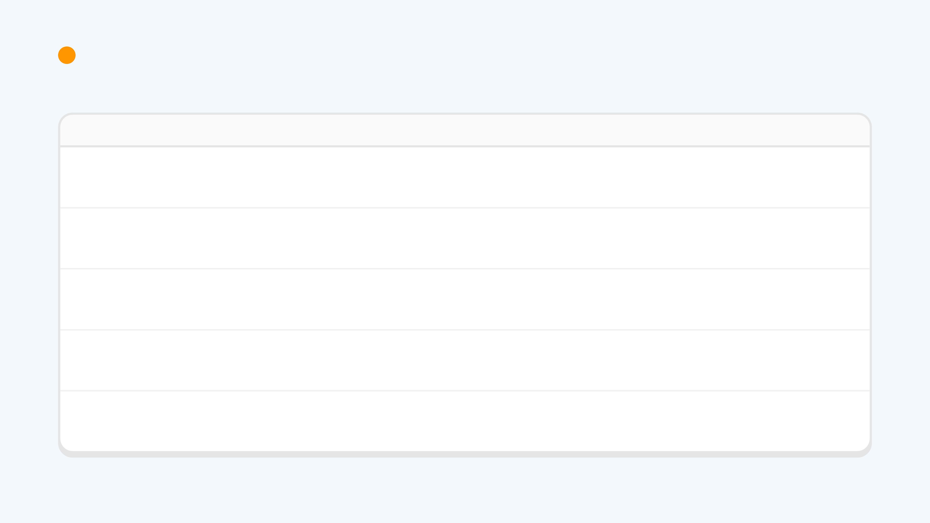
3
EXISTING SOLUTIONS & MARKET LANDSCAPE
Checking the market options.
OPTION
EASE OF USE
COST
PROBLEMS WITH THIS SOLUTION
Tapo P110
2.5 / 5. Install an app, pair the plug, plug the washer into it. Only the account owner sees the data.
≈ S$20 one-off (P110M is S$19.90 on official stores)
Shows power use, not "free or busy". No queue, no names. Above the S$10 target.
smart plug
LaundryView
2.5 / 5. Only in an operator's laundry room. Find your room on a website, then check it or set an email alert per machine.
Free to residents. CSC pays for the install.
Needs the operator's networked machines, so a rented flat can't add it. Shows status, not a queue.
CSC ServiceWorks
Smart washer
3.5 / 5. The brand's app shows status and says when the cycle ends. Only people added to the account get it.
S$1,000+: buy a new washer
The washer belongs to the landlord, so tenants can't swap it. No queue, no names.
SmartThings / ThinQ
WashQ
3 / 5. Web app, no sign-up, but a code for every wash, and every housemate must use it.
Free (no price found)
A prototype: only 1 of its 15 demo machines has a live sensor. Play Store listing not verified.
queue app
Our product
4.5 / 5 (hypothesis). Scan a QR in WhatsApp; the tag shows status on the machine.
≈ S$35–55 parts today. Target under S$10.
Too costly today. The hardware has to get much cheaper.
to be tested
Scores are our assessment from public information, on a 1–5 scale. Not yet rated by tenants.
Notes:
Competitor check

Slide 12
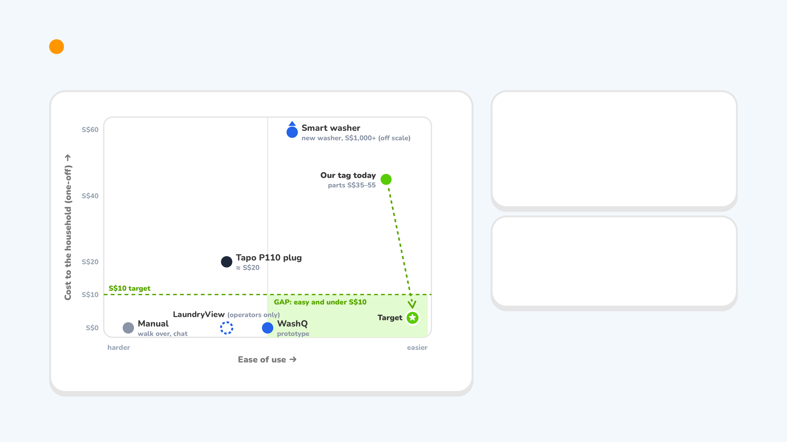
3
EXISTING SOLUTIONS & MARKET LANDSCAPE
Ease of use against cost.
How we built it
1. Ease of use: tenants rely on free workarounds that need no setup (walk over: 12 of 18).
2. Cost: 13 of 18 would pay S$10 or less.
3. Cost is the real one-off price to a household. Ease is our 1–5 assessment.
4. Pending: tenants rate each option 1–5.
Read it
● Manual ● Indirect ● Direct
The free options are all a hassle, and the easy one (smart washer) costs S$1,000+. Our tag is easy but too costly today. The job is to get under S$10.
Sources: tp-link.com (Tapo, S$19.90) · cscsw.com (LaundryView) · WashQ project page · retail listings (smart washers). Ease is our assessment.
Notes:
Competition map

Slide 13
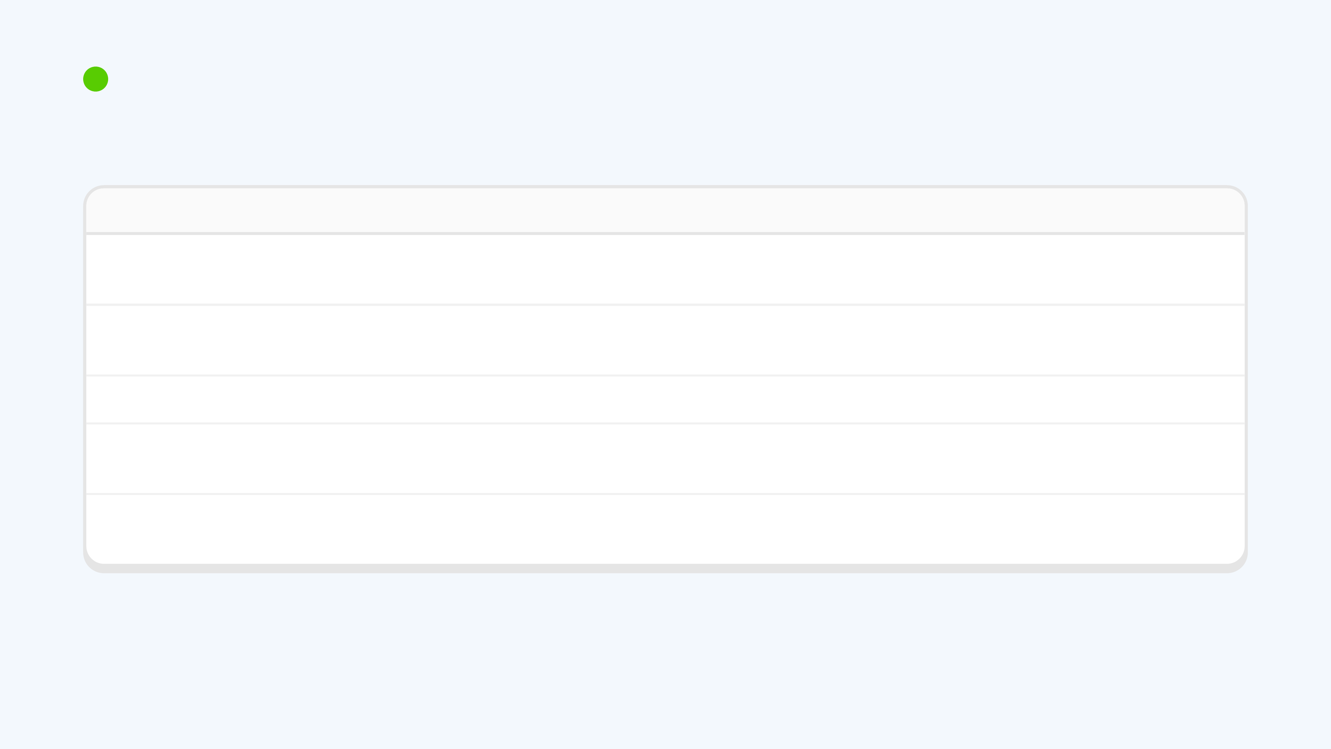
4
NEEDS, REQUIREMENTS & VENTURE HYPOTHESIS
From what they told us to what we must build.
NEED
EVIDENCE (N = 18)
REQUIREMENT
MEASURE
Know if it's free
17 found it busy; 12 walk over
Status visible from anywhere, and on the machine
Wasted trips per week
Laundry gets collected
17 found others' laundry; 16 left their own
Owner told when the cycle ends, then reminded
Minutes from end to collection
Know whose load
8 rate it 4–5 out of 5
Machine shows the current user's name
Loads with a named owner
Nothing new to install
10 already ask a group chat
Works in the chat app they already use
Household using it in week 1
Cheap enough to say yes
13 would pay S$10 or less
One-off cost under S$10 per household
Tenants who accept the price
Notes:
Requirements

Slide 14
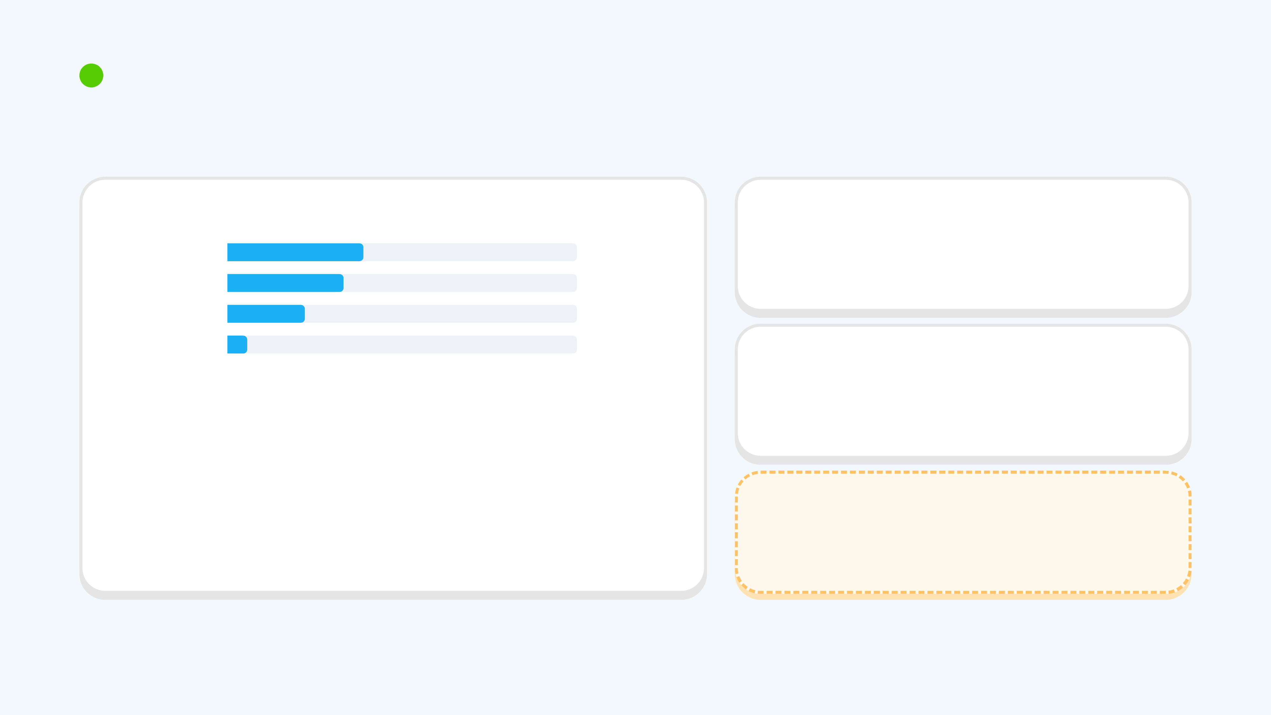
4
NEEDS, REQUIREMENTS & VENTURE HYPOTHESIS
Tenants will pay a little. Aim: under S$10.
Most a household would pay, once
Early adopter
S$0
7 of 18
Tenants who share a washer and already ask around in a group chat.
Up to S$10
6 of 18
S$11–30
4 of 18
S$31–50
1 of 18
Value
Survey, n = 18
See if the washer is free and get reminded, for a one-off price under S$10 per household.
Challenge: our rough parts estimate (S$35–55 per tag) is far above S$10. The hardware has to get much simpler, or be shared more widely.
Notes:
Who pays

Slide 15
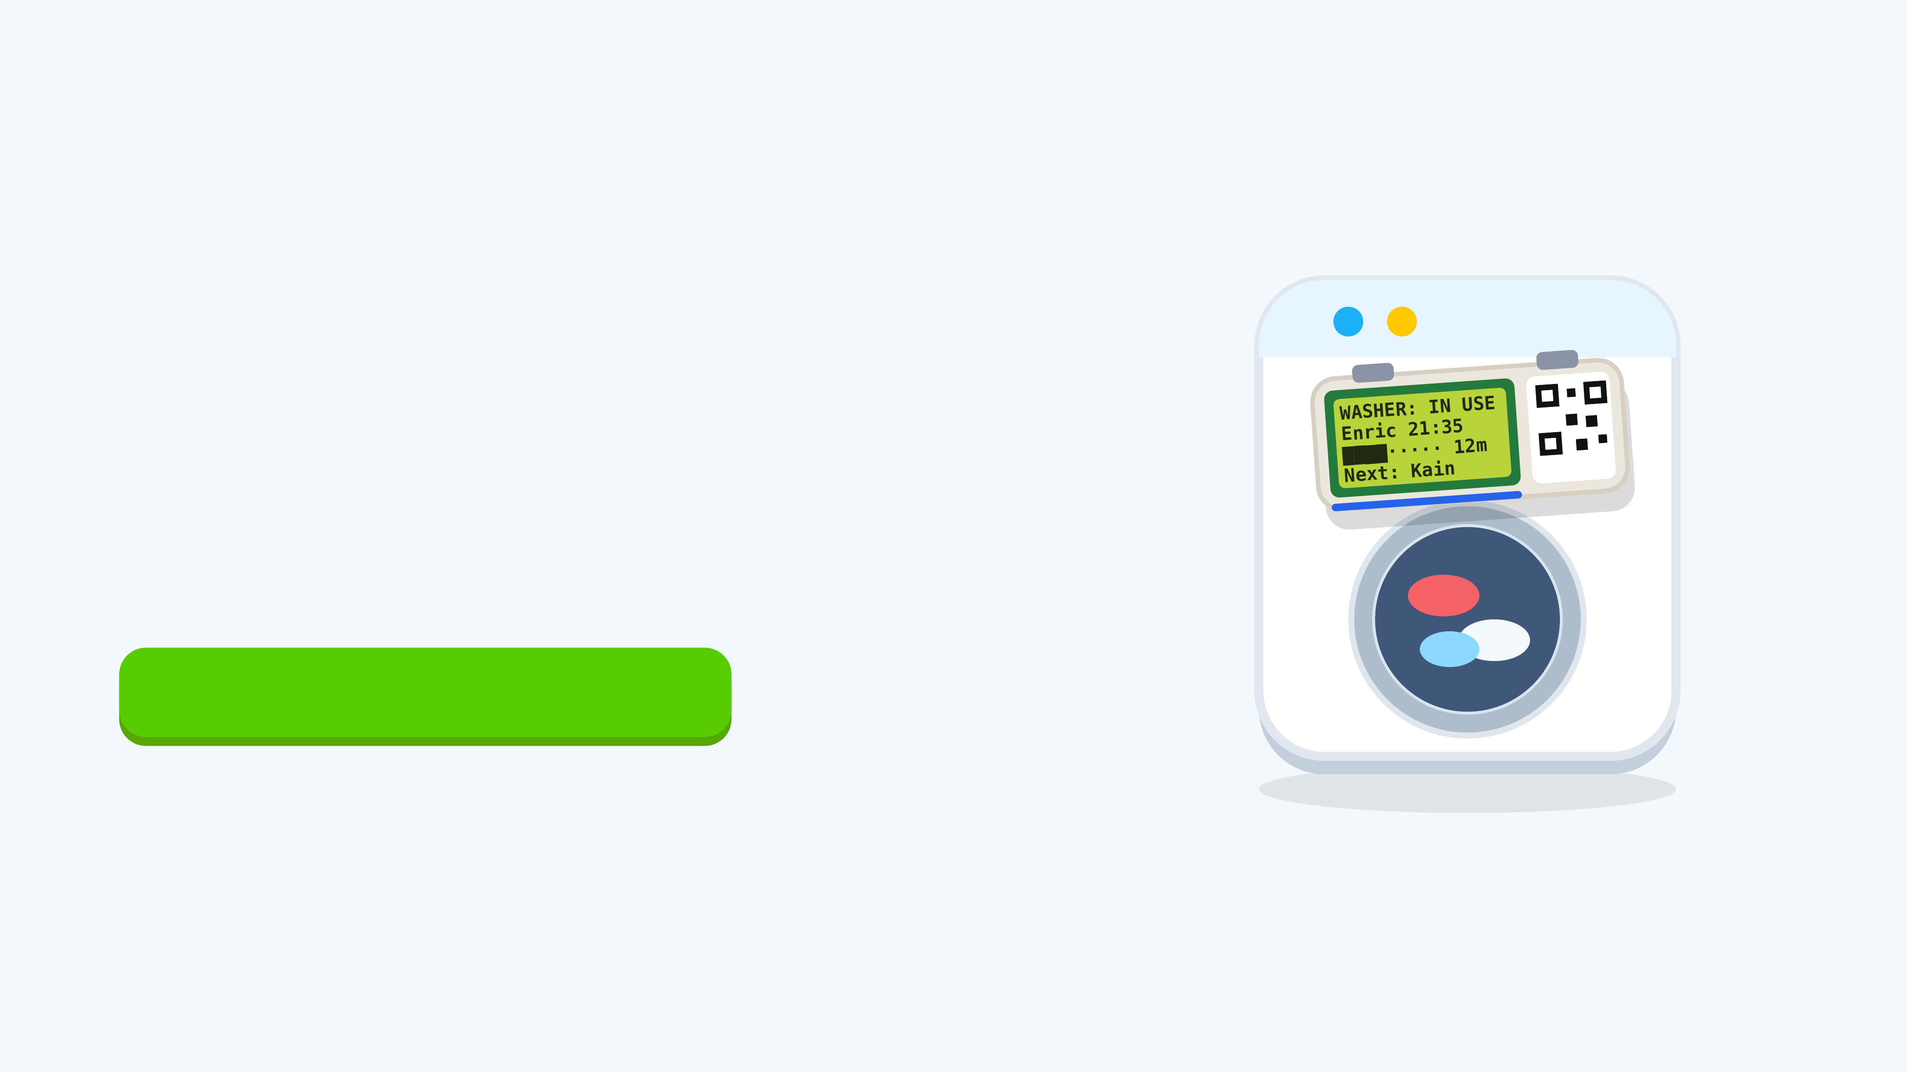
OUR CONCEPT, TO BE TESTED
One idea: Washbot.
A stick-on tag on the washer + a WhatsApp bot. Scan. Queue. Get pinged.
▶ Try it live · washbot-ten.vercel.app
Notes:
Concept

Slide 16
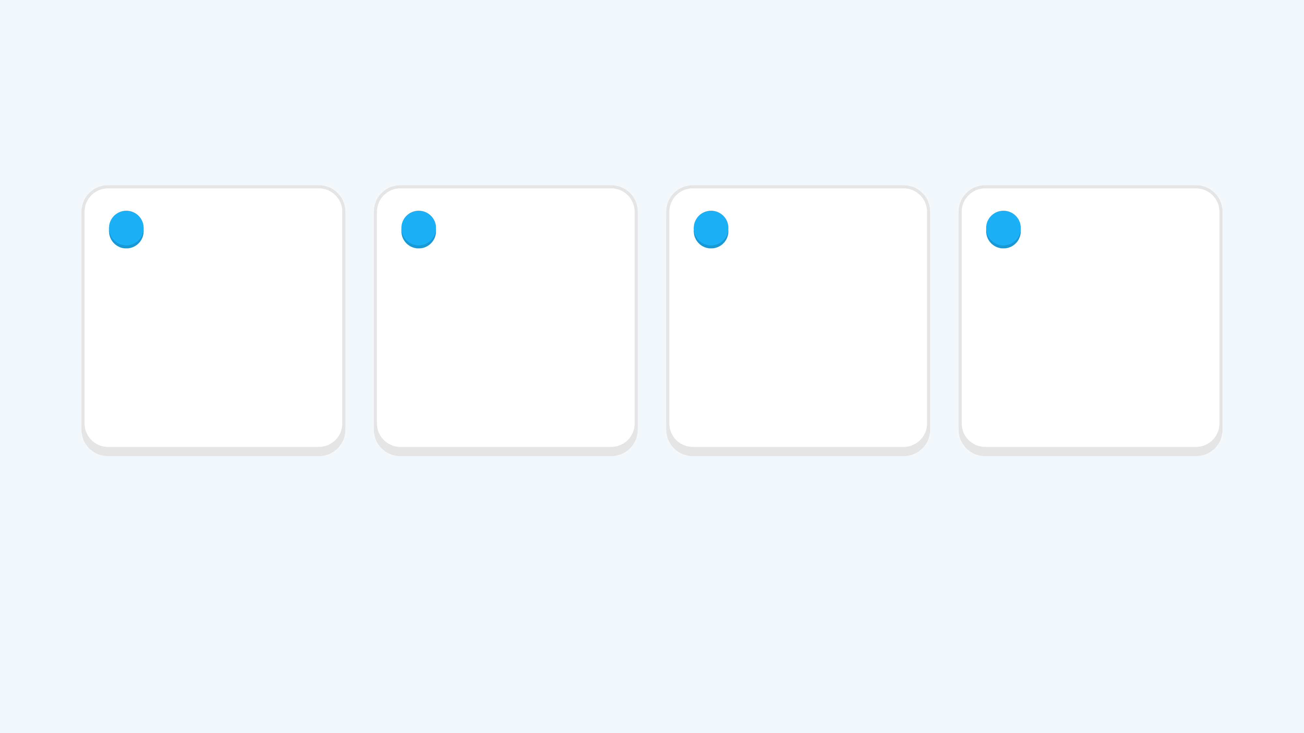
APPENDIX · HOW IT WORKS
How the concept works.
1
2
3
4
Scan the tag
Use it or queue
Get reminded
Collect and hand over
Scan the QR on the machine with a phone camera. WhatsApp opens with the message ready to send.
If the washer is free, it is yours. If not, the bot shows the expected wait and books a place in line.
A message arrives 5 minutes before your turn and again when the washer is free.
Reply DONE after taking your clothes out. The next person is told it is their turn.
Notes:
How it works

Slide 17
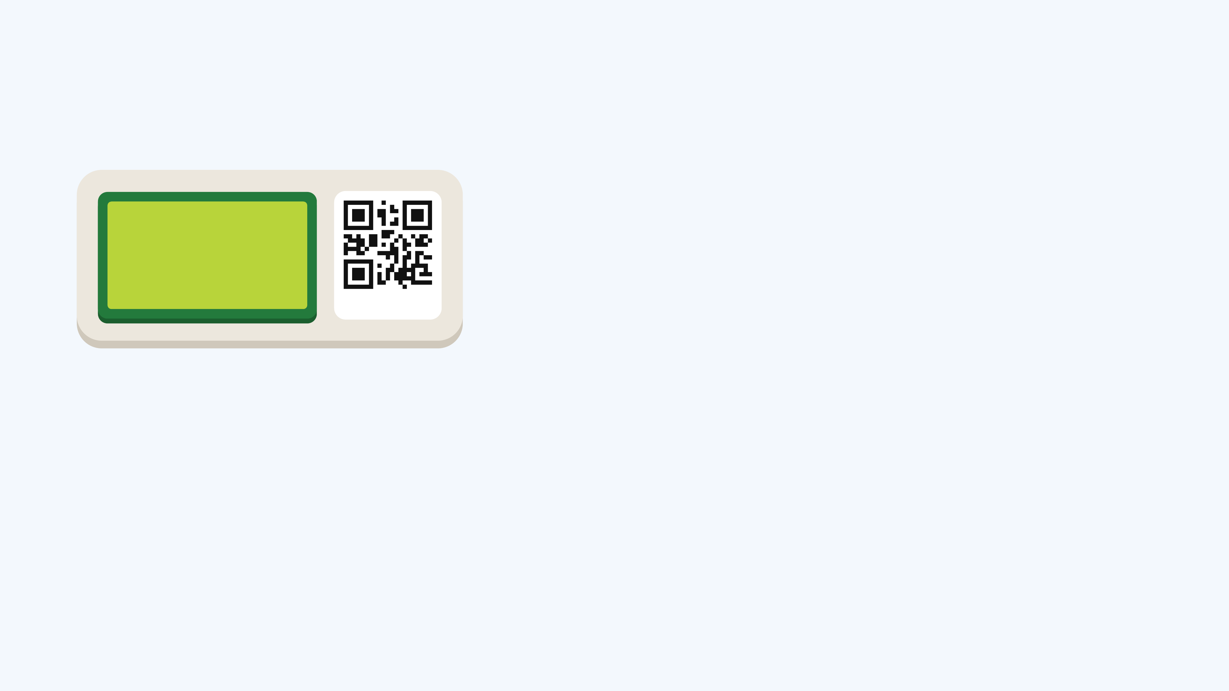
APPENDIX · THE HARDWARE
A tag that sticks on any machine.
📟 20×4 LCD: status, who, when, who's next
WASHER: IN USE
Enric done 21:35
████······ 12 min
Next: Kain ~21:40
🟢 RGB light bar: colour at a glance
🫨 Vibration sensor: knows when it really starts & ends
SCAN ME
🔊 Buzzer: alarm if someone skips the queue
🧲 Magnets + USB power: installs in a minute
Notes:
The tag

Slide 18
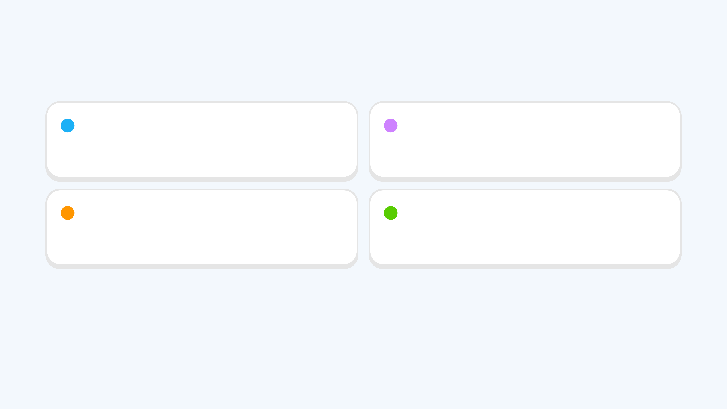
WHAT WE DO NEXT
Next steps.
1
Opportunity
2
Research
Add a sourced figure for how many people rent rooms in Singapore.
Interview tenants and landlords, then go back to the same people in Round 2.
3
Landscape
4
Venture
Compare price, effort and time for each alternative with real numbers.
Bring the cost under S$10 and test the price with tenants.
Notes:
Next

Slide 19
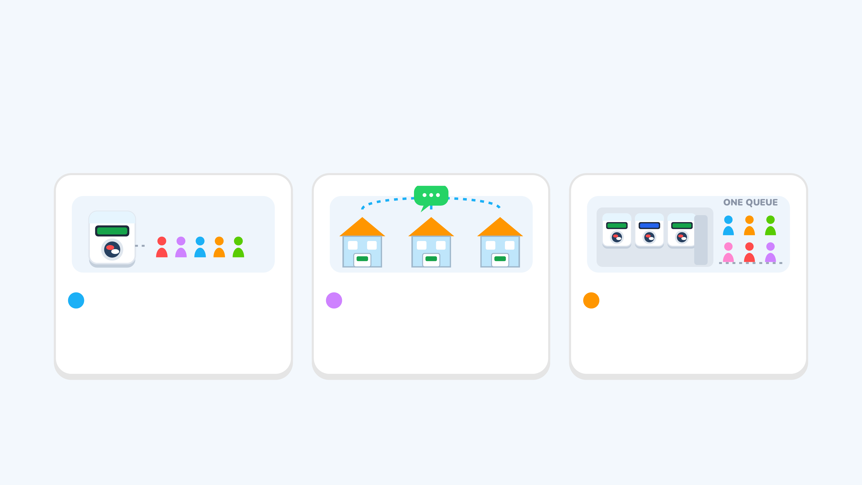
THINKING AHEAD
Where it can grow (hypotheses)
1
Shared rooms
2
Many flats
3
Dorms and co-living
Now. One flat, one shared washer. Where our research is.
The same tag in many rented flats and condo units. One bot, one WhatsApp number.
A laundry room with several machines. One queue for the next free washer.
Notes:
Scalability

Slide 20

WASHBOT · GROUP A
Thank you.
Questions? 🙋
Try it: washbot-ten.vercel.app
Notes:
Thank you

Slide 21
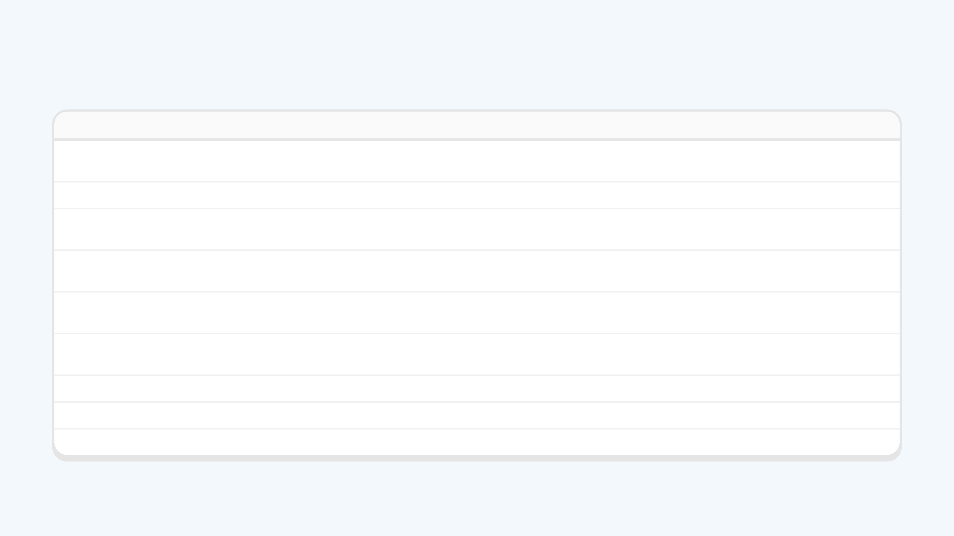
AFTER THE PRESENTATION
Questions raised in the Q&A.
TOPIC
QUESTION FROM THE AUDIENCE
Privacy and PDPA
What data do we collect, how long do we keep it, and how do we protect it under Singapore's PDPA? How do we pay for storing and protecting it with a S$10 product?
Getting tenants to use it
How do we make sure tenants use the solution, or convince them to?
Tenants who won't use it
What if some housemates don't want to use it, or just don't care? How do we handle non-users and enforce it? Who exactly is the target customer?
Wi-Fi as a penalty
Could it link to the house Wi-Fi and switch it off for people who don't collect their clothes? Suggested for families with children.
Weekday and weekend demand
More people wash at weekends. How is the queue kept fair (first come, first served)? Feedback: suggest the quiet weekday slots.
No internet
If the phone or the machine's tag loses its connection, can people still check the status or book? Should the tag join the house Wi-Fi?
Different cycle lengths
Cycles vary with load size and mode, for example 30 minutes or 60. How do booking and the queue adjust?
Washer and dryer in one round
Today it takes two rounds: one for the washer, one for the dryer. Can the product help do both in one?
Business model
What is the business model, and how do we make a profit from a product that costs only S$10?
Recorded at the Milestone 1 presentation. Open questions for us to work through next.
Notes:
Q&A questions

