Slide 1
DataSentics Home Task
Tomas Bouma

Slide 2
Previous Solution
Review:
https://github.com/tdtom167/dataSenticsHomeTask/pull/2/files
Many mistakes

Slide 3
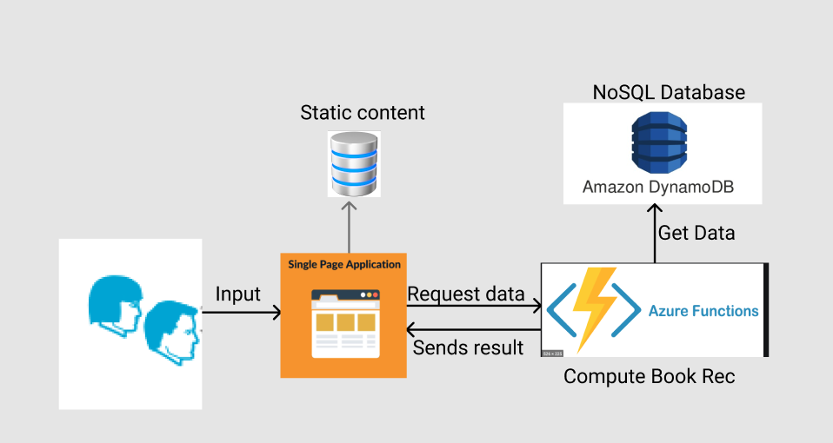
Architecture
Cloud based
Serverless
SaaS

Slide 4
Current Solution
The code written is not ready for azure app function
ML algorithm for book recommendation missing
Code for UI is missing
Database needs to be deployed, currently runs locally

Slide 5

