Slide 1
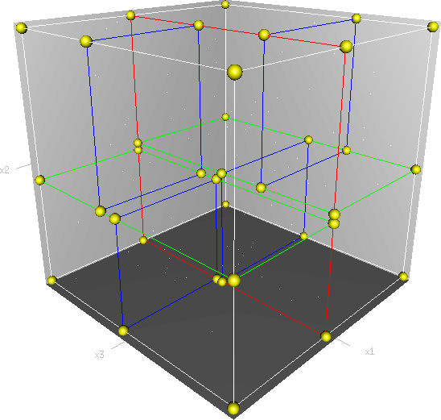
KD Tree
CS523.N21.KHCL
K-Dimetional Tree

Slide 2
KD Tree
Introduction
CS523.N21.KHCL

Slide 3
KD Tree
CS523.N21.KHCL
KD tree is a binary tree.
Being used to organize points in K-dimensional space.
Very efficient searches of points in multidimensional space, including nearest-neighbor searches and range searches.

Slide 4
KD Tree
What are KD Tree
CS523.N21.KHCL

Slide 5
KD Tree
CS523.N21.KHCL
Each node represents a k-dimensional point.
Every non-leaf node in the tree acts as a hyperplane, dividing the space into two partitions.
Very efficient searches of points in multidimensional space, including nearest-neighbor searches and range searches.

Slide 6
KD Tree
Insertion
CS523.N21.KHCL

Slide 7
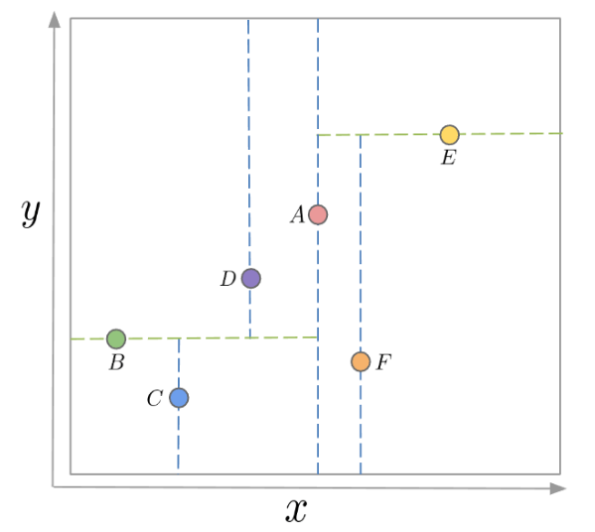
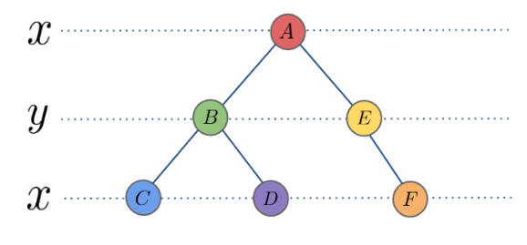
KD Tree
CS523.N21.KHCL
the most common strategy for choosing an axis when dividing would be to cycle through each of the K dimensions repeatedly and select a midpoint along it to divide the space.

Slide 8
KD Tree
CS523.N21.KHCL
(7,2)
(5,4)
(2,3)
(9,6)
(4,7)
(6,10)
(8,8)
7,2
x
5,4
9,6
y
2,3
4,7
8,8
x
6,10
y

Slide 9
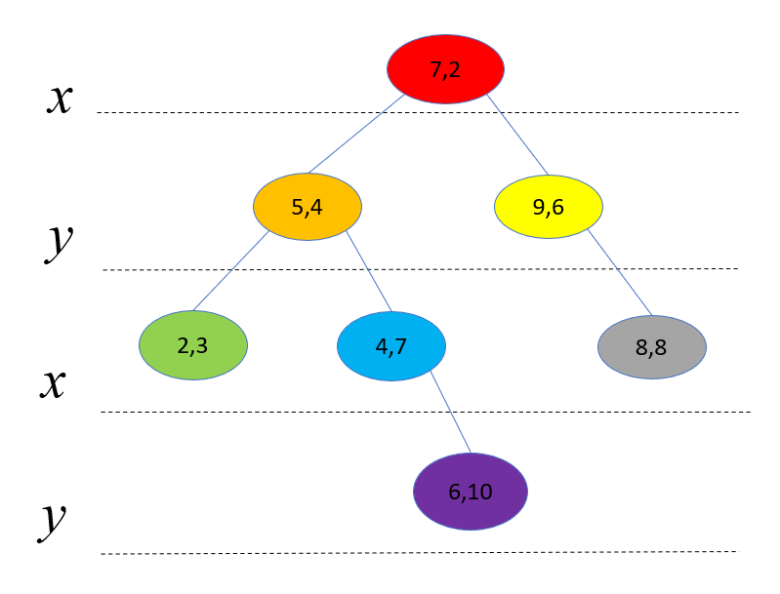
KD Tree
CS523.N21.KHCL
y
x

Slide 10
KD Tree
Search
CS523.N21.KHCL

Slide 11
KD Tree
CS523.N21.KHCL
Searching (2,3), comparing X:2 to X:7
7,2
x
5,4
9,6
y
2,3
4,7
8,8
x
6,10
y

Slide 12
KD Tree
CS523.N21.KHCL
Searching (2,3), comparing Y:3 to Y:4
7,2
x
5,4
9,6
y
2,3
4,7
8,8
x
6,10
y

Slide 13
KD Tree
CS523.N21.KHCL
Searching (2,3), comparing X:2 to X:2, Y:3 to Y:3
Return True
7,2
x
5,4
9,6
y
2,3
4,7
8,8
x
6,10
y

Slide 14
KD Tree
CS523.N21.KHCL
Searching (10,10), comparing X:10 to X:7
7,2
x
5,4
9,6
y
2,3
4,7
8,8
x
6,10
y

Slide 15
KD Tree
CS523.N21.KHCL
Searching (10,10), comparing Y:10 to Y:6
7,2
x
5,4
9,6
y
2,3
4,7
8,8
x
6,10
y

Slide 16
KD Tree
CS523.N21.KHCL
Searching (10,10), comparing X:10 to X:8
Searching (10,10), comparing Y:10 to Y:NULL
Return False
7,2
x
5,4
9,6
y
2,3
4,7
8,8
x
6,10
y

Slide 17
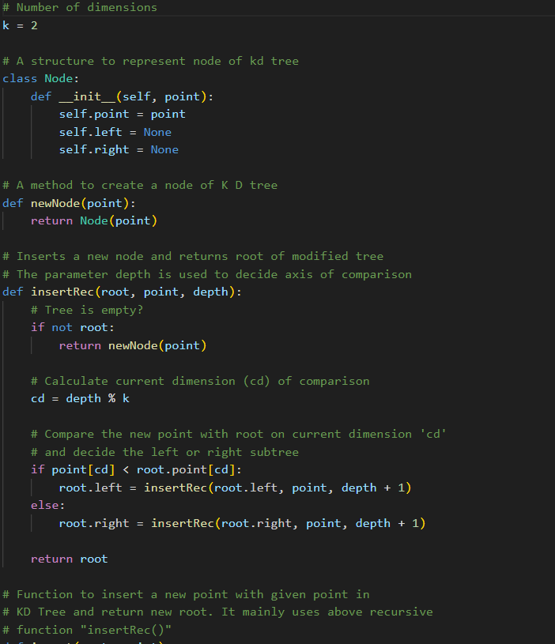
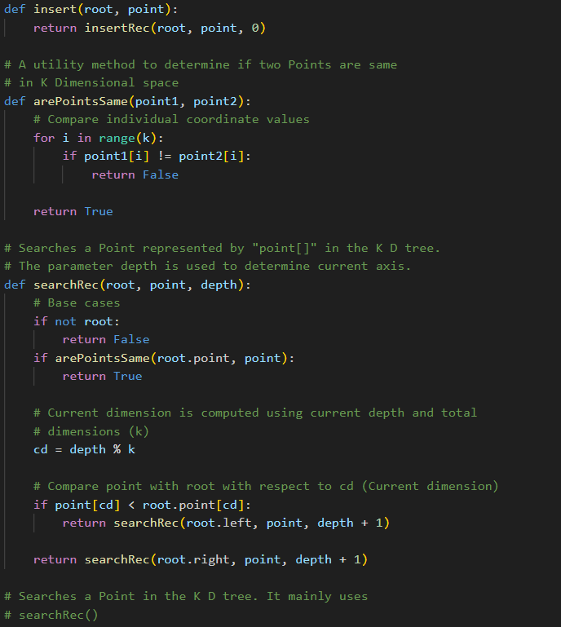
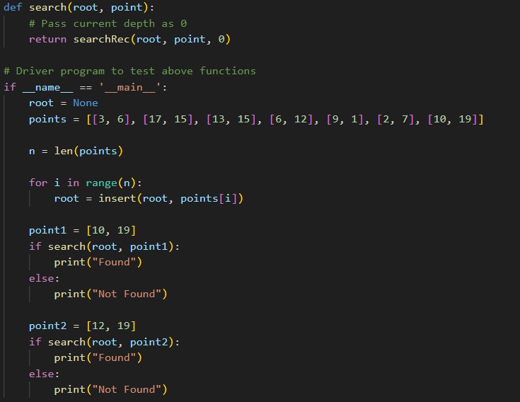
KD Tree
CS523.N21.KHCL

Slide 18
KD Tree
Find minimum
CS523.N21.KHCL

Slide 19
KD Tree
CS523.N21.KHCL
Minimum of X dimention
7,2
x
5,4
9,6
y
2,3
4,7
8,8
x
6,10
y

Slide 20
KD Tree
CS523.N21.KHCL
Minimum of X dimention
7,2
x
5,4
9,6
y
2,3
4,7
8,8
x
6,10
y

Slide 21
KD Tree
CS523.N21.KHCL
Minimum of X dimention
7,2
x
5,4
9,6
y
2,3
4,7
8,8
x
6,10
y

Slide 22
KD Tree
CS523.N21.KHCL
Minimum of X dimention
7,2
x
5,4
9,6
y
2,3
4,7
8,8
x
6,10
y

Slide 23
KD Tree
CS523.N21.KHCL
Minimum of Y dimention
7,2
x
5,4
9,6
y
2,3
4,7
8,8
x
6,10
y

Slide 24
KD Tree
CS523.N21.KHCL
Minimum of Y dimention
7,2
x
5,4
9,6
y
2,3
4,7
8,8
x
6,10
y

Slide 25
KD Tree
CS523.N21.KHCL
Minimum of Y dimention
7,2
x
5,4
9,6
y
2,3
4,7
8,8
x
6,10
y

Slide 26
KD Tree
CS523.N21.KHCL
Minimum of Y dimention
7,2
x
5,4
9,6
y
2,3
4,7
8,8
x
6,10
y

Slide 27
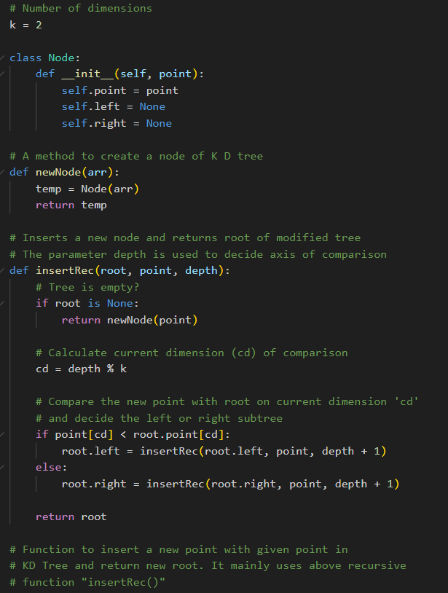
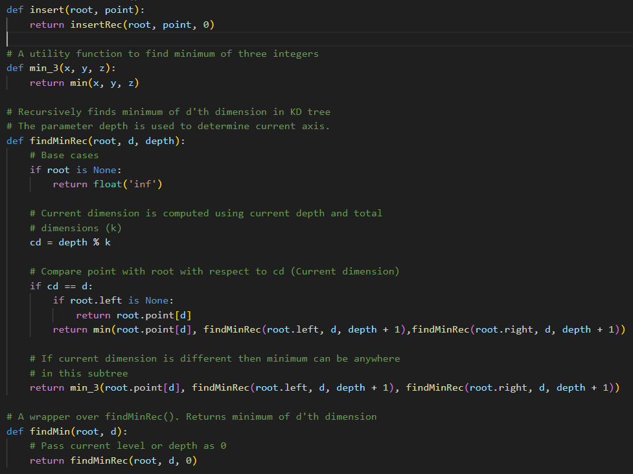
KD Tree
CS523.N21.KHCL

Slide 28
KD Tree
Deletion
CS523.N21.KHCL

Slide 29
KD Tree
CS523.N21.KHCL
If node to be deleted is a leaf node, simply delete it
If node to be deleted has right child as not NULL
Find minimum of current node’s dimension in right subtree.
Replace the node with above found minimum and recursively delete minimum in right subtree.
Else If node to be deleted has left child as not NULL
Find minimum of current node’s dimension in left subtree.
Replace the node with above found minimum and recursively delete minimum in left subtree.
Make new left subtree as right child of current node.

Slide 30
KD Tree
CS523.N21.KHCL
Delete (6,10)
7,2
x
5,4
9,6
y
2,3
4,7
8,8
x
6,10
y

Slide 31
KD Tree
CS523.N21.KHCL
Delete (6,10)
7,2
x
5,4
9,6
y
2,3
4,7
8,8
x
y

Slide 32
KD Tree
CS523.N21.KHCL
Delete (7,2)
7,2
x
5,4
9,6
y
2,3
4,7
8,8
x
y

Slide 33
KD Tree
CS523.N21.KHCL
Delete (7,2)
7,2
x
5,4
9,6
y
2,3
4,7
8,8
x
y

Slide 34
KD Tree
CS523.N21.KHCL
Delete (7,2)
8,8
x
5,4
9,6
y
2,3
4,7
x
y

Slide 35
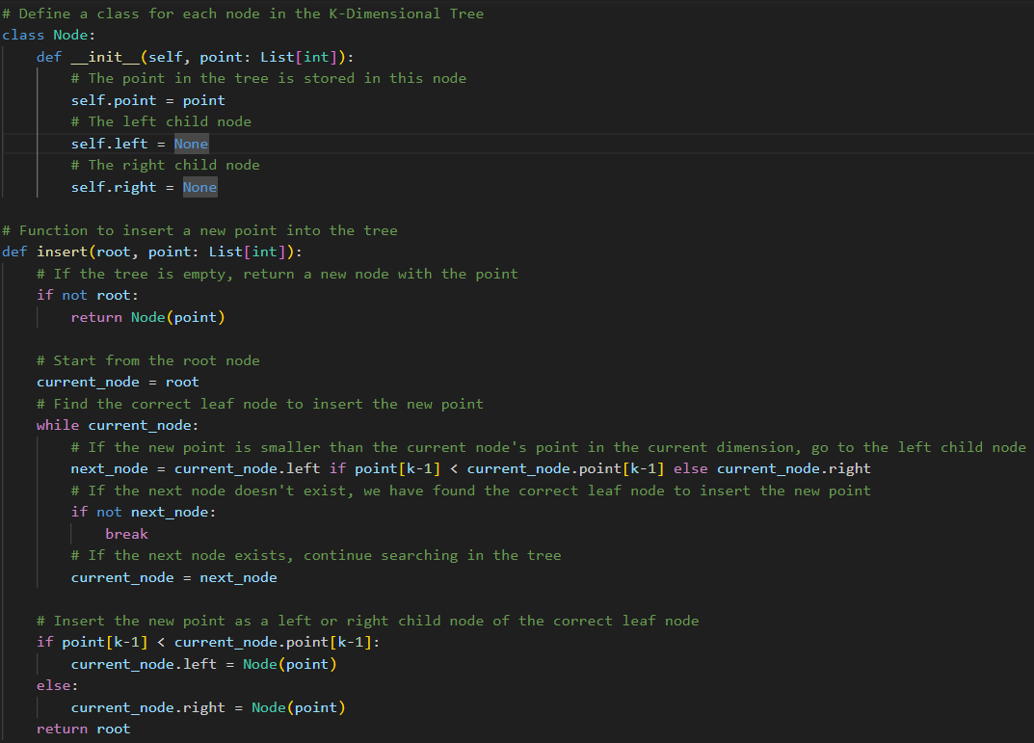
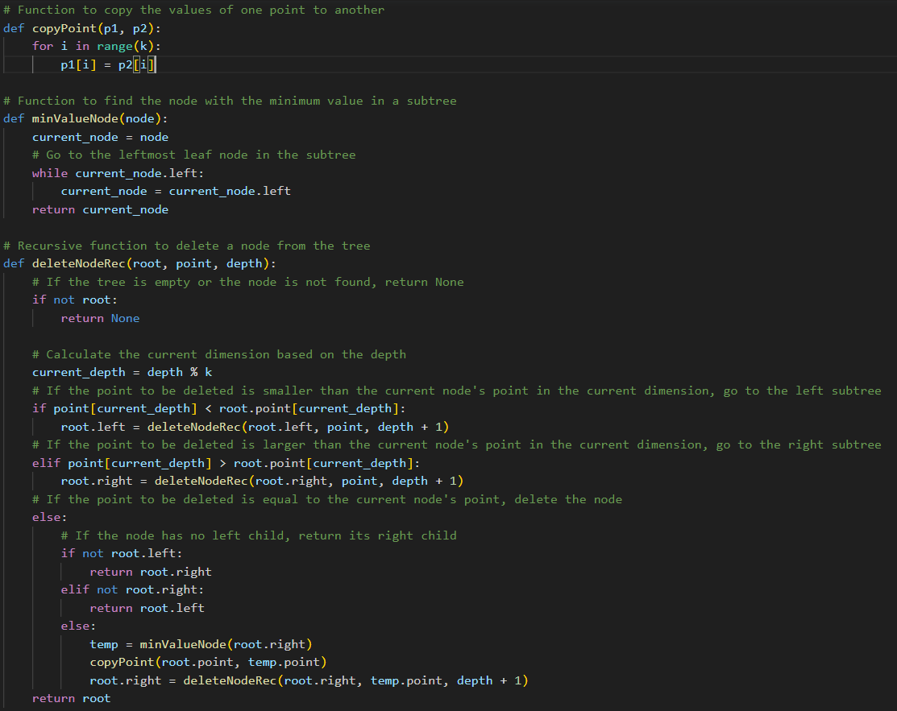
KD Tree
CS523.N21.KHCL

Slide 36
KD Tree
Nearest Neighbour Search
CS523.N21.KHCL

Slide 37
KD Tree
CS523.N21.KHCL
1,4
7,2
x
5,4
9,6
y
y
2,3
4,7
8,8
x
6,10
y
x

Slide 38
KD Tree
CS523.N21.KHCL
1,4
7,2
x
5,4
9,6
y
y
2,3
4,7
8,8
x
6,10
y
x

Slide 39
KD Tree
CS523.N21.KHCL
1,4
7,2
x
5,4
9,6
y
y
2,3
4,7
8,8
x
6,10
y
x

Slide 40
KD Tree
CS523.N21.KHCL
1,4
7,2
x
5,4
9,6
y
y
r
2,3
4,7
8,8
r’
x
6,10
y
x

Slide 41
KD Tree
CS523.N21.KHCL
1,4
7,2
x
5,4
9,6
y
y
r
2,3
4,7
8,8
r’
x
6,10
y
x

Slide 42
KD Tree
CS523.N21.KHCL
1,4
7,2
x
5,4
9,6
y
y
2,3
4,7
8,8
r
x
6,10
y
x

Slide 43
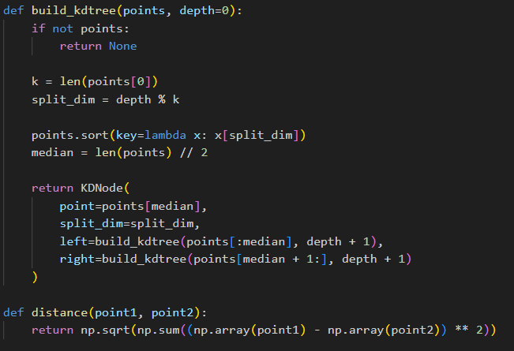
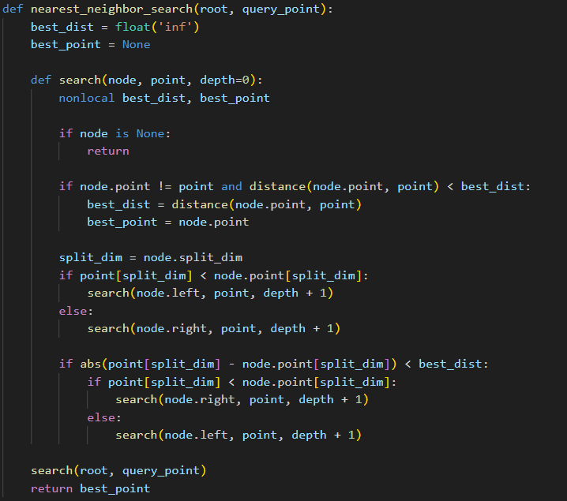
KD Tree
CS523.N21.KHCL

Slide 44
KD Tree
Complexity
CS523.N21.KHCL

Slide 45
KD Tree
CS523.N21.KHCL
If the tree is binary, the number of levels in the tree is O(log n). Therefore, the total time complexity of building the K-D tree is O(n log n). However, in the worst case, the construction time can be O(n^2), which can occur if the tree is very unbalanced.
Insertion | Search | Deletion | Nearest Neighbour Search
O(log n) | O(log n) | O(log n) | O(log n)
O(n) | O(n) | O(n) | O(n)

Slide 46
KD Tree
Pros and cons
CS523.N21.KHCL

Slide 47
KD Tree
CS523.N21.KHCL
Advantages
Disadvantages
Efficient Search
Handling High-Dimensional Space
Diverse Applications
High Performance with Large Data Sets
Construction complexity.
Space dimensionality.
Imbalance.

Slide 48
KD Tree
Application
CS523.N21.KHCL

Slide 49
KD Tree
CS523.N21.KHCL
01
04
Audio Processing
Positioning System
03
Clustering Data
02
05
Image Processing
Routing Optimization

