Slide 1



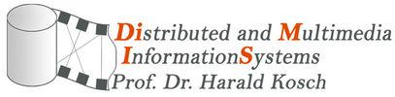
Collaborative(ly) Personalized PageRank
September 2014
Théo Dubourg - theo.dubourg@insa-lyon.fr
This presentation must not be redistributed without express consent of the author.
1
Notes:
Notes: Video proj resolution => 1440x900, output “HDMI1”

Slide 2
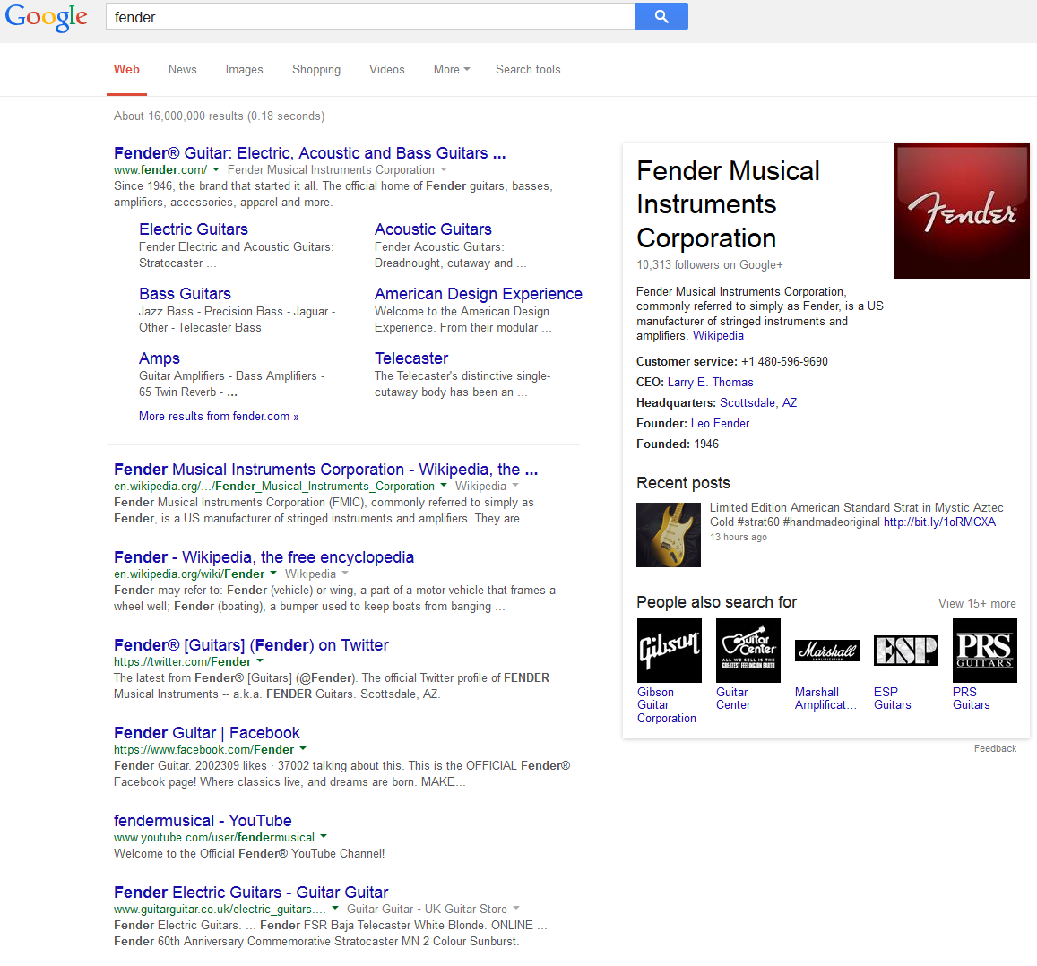
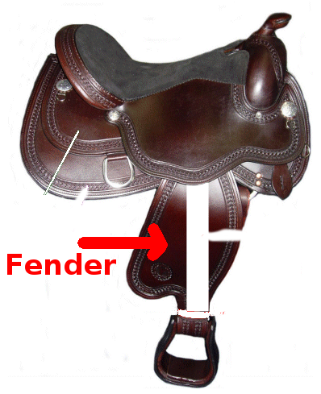
Now’s when I am convincing you (“3’ to convince”(INSA))
2
Notes:
0 -> 3
I think everyone agrees with the fact that we now live a world where everything has to be the most efficient possible. If you can do a given task in one minute, there is no reasons for you to spend two minutes on this very task.
Indeed, you could doing something else during this minute. Something like making science or humanity go forward, for instance.
This is the philosopher’s utopy: A life where people are freed from their low levels tasks that usually require all their time and can instead spend time on doing philosophy and improving humankind.
Well, a task that many people currently do several times a day is web search. In web search, for instance if you’re searching for “fender”, which a part of horse saddle, and you just type “fender” on Google, here are the results that you obtain. But you do not want guitars, you just want horse saddle fenders.
But the fact is, the web search engine does not that you meant “horse saddle fender” when you typed “fender”. This is because you have a context, but the web search engine does not know about your context. This is where computer scientists introduced what we call “context aware systems”.
In web search, one specific way to make a context-aware and solve this issue is to use what we call “web search personalization” techniques.
My project is about working on web search personalization and more specifically, combine existing techniques with Web Graph Analysis techniques. Web Graph analysis techniques, are also made to improve web search results. The most renowned of them is probably PageRank. PageRank gives an absolute importance score to every page of the web by analysis its relationships with other pages through hyperlinks analysis. My goal in this project is to implicitly and automatically personalize the PageRank so that you spend less time using Google and more doing, let’s say, philosophy, for instance.
In order to achieve this, I will be using web search engine logs and extract information about how and what users clicked in order to personalize their results or the results of similar users when they will make this query in the future.

Slide 3
Slides Aren’t Mandatory
Hey ! I am a slide.
I am projected, shiny, I’m quite big, but it is not mandatory to read me.
Listening is enough, if needed to look at me, the guy over there will tell you.
3
Notes:
3 -> 3
The last time I did a presentation, I thought people would figure it out by themselves but they did not, so this time I am expliciting it:So, do not be confused if you do not have the time to read the slides: It is in purpose. I am going to speak and everything needed will be said by me. Slides are here so that if you stop listening for any reason, you can jump back into the presentation by seeing what we are currently talking about.
Some slides will need to be read or looked at, but in those special cases, I will be showing things on the slides anyway so I will tell it, do not worry.
That’s the way I make presentations, I hope this is not illegal =] .

Slide 4
Context: Web Search, IR Limits
Only use the text/document
Not aware of the “environment”
Human beings are not really compatible with IR: They do not express themselves the right way. “Human beings do not know how to search” - Someone
4
Notes:
3.5 -> 5
Web Search was historically based on information retrieval.
However, information retrieval for the web has several limits.
First, it only uses the text of the document.
As a consequence, it is not aware of the “environment of a document”. A web page is not only some text, it is also a node in the web graph.
Two documents with similar contents will be ranked similarly by the IR engine but if they are in very different places of the web graph, they might not have the same meaning at all.
The other important problem is that human beings to not express themselves the right way for information retrieval techniques to work well.
Someone I could not find the name again, but that had spent a couple of years studying users behaviours on web search engine said as one of his CCL that “human beings do not know how to search”, as a reference to the fact that users are not using web search engine the optimal way.

Slide 5
Context: Web Search, Some Solutions
Use the environment/specificities of the web:
Linking information: PageRank
Techniques that Google commonly calls “antispam”: filters, rules, to prune the set of results and filter out the majority that is of low quality and keep the minority of higher quality
Anchor analysis
Other graph-based approaches: TrustRank, etc. ...
5
Notes:
5 -> 6.5
The first attempts to address the limits of Information Retrieval were for instance to analyze the environment, or the specifities of the web.
One of probably the first ones and very famous one is PageRank. PageRank analyses the “linking” information of web pages. Indeed, as the web is graph, there are links between documents, called hyperlinks and PageRank uses them in order to provide with an “importance” that will break ties for instance between similar documents.
Then there is a set of techniques that Google commonly calls “antispam”. Such techniques are basically filters, or post-processes that will prune the majority of low quality results and try to only keep the minority or higher quality results using predefined rules or heuristics.
Anchor analysis has also be used a lot. The anchor is the text of the hyperlink. Studying anchors of hyperlinks pointing to a given web allow you to get additional information about the web page.
Many other filters or techniques have also been developed, like TrustRank, that is the evolved version PageRank that Google is using that defines the “trust” one can put into a given page.

Slide 6
Context: Web Search Personalization
Ideas coming from Recommender Systems:
Tailoring the system’s output to the current user.
Making “recommendations” of certain items vs. others to the user.
Set of items = all items returned by the IR engine
Recommended items = items that should be ranked higher / rank-merging with the IR score
Can be seen as another type of “filter”
Content-based filtering: based on user profile + item profile
Collaborative filtering: based on collaboratively collected info
6
Notes:
6.5 -> 8.5
Another way to improve significantly the quality of the web search results is to use “web search personalization”.
Web search perso is coming from Recommender Systems. Ideas of RS are that: you should tailor the system’s output to the current user.
and you recommend some items compared to other of the current. It is like saying “eh my friend, I know you well, and I think theses items would fit you better compared to those ones.”
In web search the, the set of items is all the results returned by the IR engine.
The recommended items are results that should either be ranked higher, or have “grade” that will be used together with the IR score using rank-merging techniques.
Such techniques can once more be seen as filters. They will filter out some items and only keep the rest.
The two main approaches are content-filtering and collaborative filtering.
In content filtering we use your profile and the item’s profile in order to estimate how much we should recommend the item to you.
But in CF, instead of just using your profile, we use the profiles of users that are similar to you. This is like saying “hey my friend, we’ve seen many other people like you before, we think you would probably prefer this, based on we we observed with your colleagues.”.

Slide 7

My Proposal: Original Idea
Link/Graph Analysis vs Recommender Systems
7
Notes:
Both set of techniques having their advantages, I thought why should we not use both of them?

Slide 8
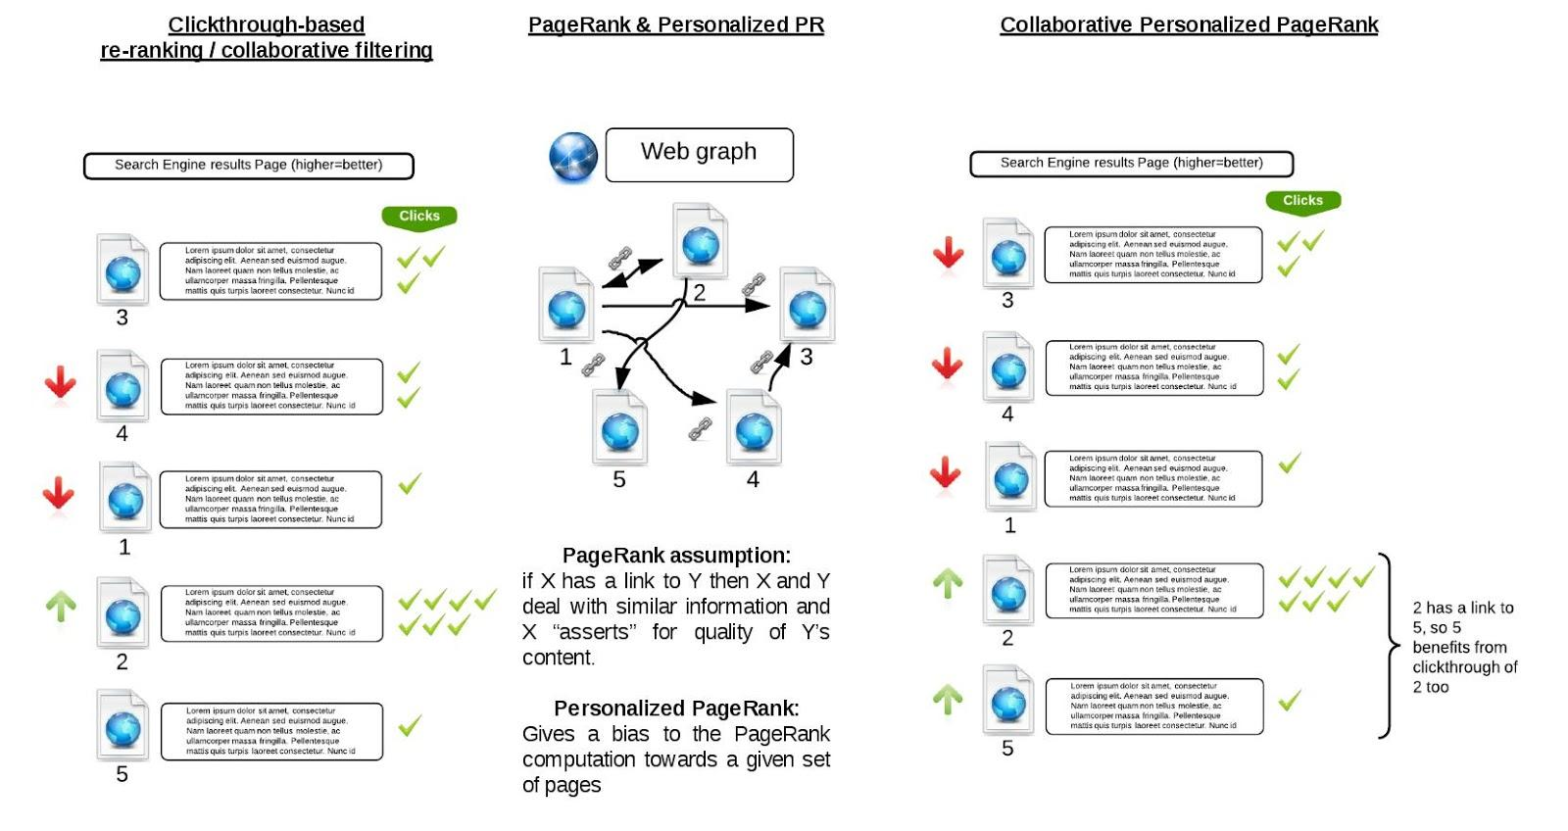
My Proposal: Previous Works Basis
“A Large Scale Evaluation of Personalized Search Strategies”, Dou, 2007
“Topic-Sensitive PageRank”, Haveliwala, 2002
8
Notes:
8.5 -> 10.5
More specifically, my proposal is based on the way “A large scale…” has implemented collaborative filtering techniques in order to achieve web search perso. based on clicks extracted from web search engine logs
and on “Topic Sensitive PageRank” that has achieved improvement of web search results quality by personalizing the PageRank so that it is biased towards a set of page with stronger relationship with the query.
The global behaviour of the system can be imagined has on this diagram. People similar to you click on some results.
In normal CF techniques, such results are ranked higher. In my collaboratively personalized pagerank, such results are given more importance when computing PageRank. And as a consequence, they also bring more importance to pages linked from them, as the assumption of PageRank is that linking to a page means that you “asserts” for quality of this web page, or it is in relationship with what your page is talking about.

Slide 9
Project Definition
Features we want to achieve:
Web search personalization: Results depending on the user
Collaborative approach: results depending on users similar to current user
Usage-based approach: the system adapts to what you do
Implicit and automated: As a user, you do not need to do anything for the personalization to take place
Data we have: AOL Search Logs (2006), Internet-connection-reachable data
9
Notes:
10.5 -> 11.5
Now, more formally, here is the list of features we want to achieve with our system.

Slide 10
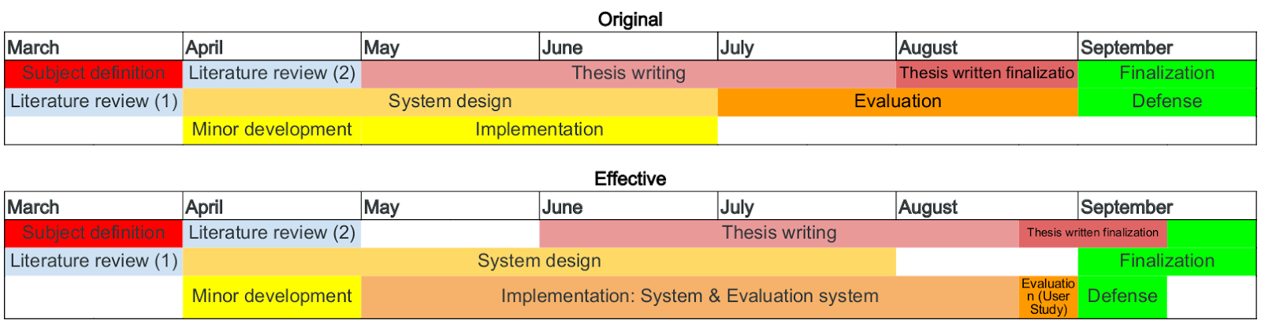
Project Schedule(s)
10
Notes:
11.5 -> 13.5
Here is a overview of the schedule of the project.
The original schedule had …
The effective scheduled, shifted a little bit but is actually pretty close to the original one. The main difference is that I originally planned for sequentials tasks: implementing the system first, and the evaluating it.
But in fact, design and implementation have been affected all the way by how we would do the evaluation. And thus, I was basically always working in parallel on how to do the system and how to evaluate it.

Slide 11
Project Main Tasks
User Model Definition
Usage Extraction
Collaboration
Web Graph Personalized Scoring
PageRank Personalization
SERP Personalization
11
Notes:
13.5 -> 14.5
Now before jumping into the details of the system. Here are the main tasks we need to go through in order to design/implement the system.
We need to define a user model…
…. how to extract the usage information
… how to achieve collaboration between users
… how to score the web graph differently for every user, effectively providing web graph personalized scoring
… how to perso. the PR
… how to perso. the final SERP
Sounds easy? I hope not, because it isn’t

Slide 12
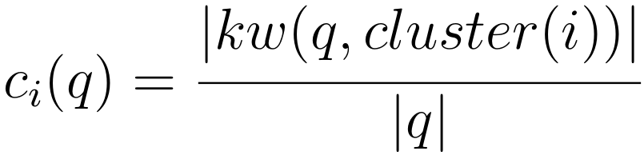
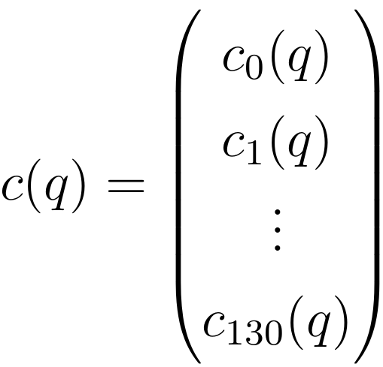
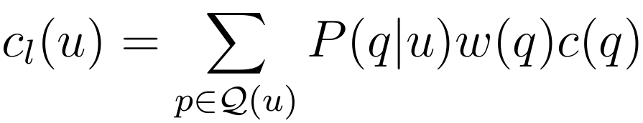
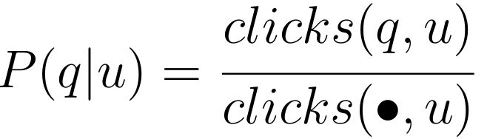
Usage Extraction
Queries clustering
User profile
Implementation: Runs fast enough. Using Numpy vectors.
12
Notes:
14.5 -> 16
So let’s talk about the usage extraction.
The 1st we do is that we reuse a previous clustering of our dataset that had clustered semantically all keywords founds in the logs.
For every query, we generate a clustering vector that is made of coefficient as seen here (formula). This is the number of common keywords between the query string and the cluster, normalized by the query string length.
Then, the user profile is compiled out of both its usage, which is related to queries and clicks, and indirectly out of semantic concepts by multiplying the usage coefficient for every query, by the query clustering vector over the semantics clusters.
In terms of implementation, in this part, there is not much to be said, it’s translating maths into Python. We parse the logs to

Slide 13
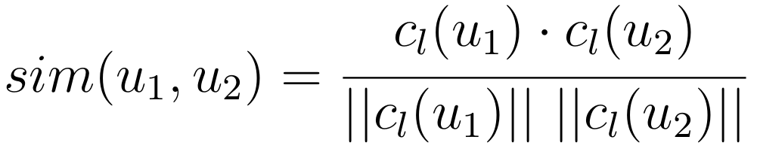
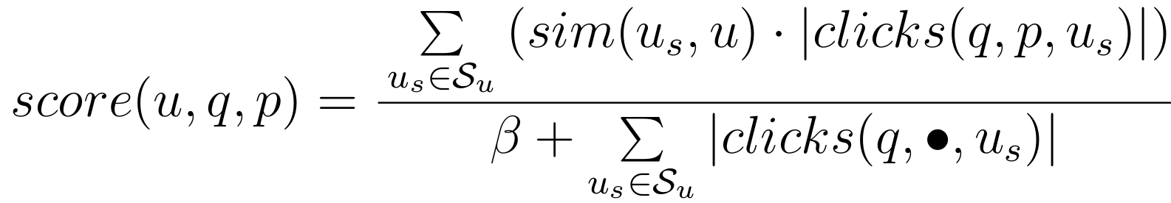
Personalization
User-to-user similarity
Top 100 similar users (excluding sim = 1.0 ones)
Scoring using similar users (collaboration) :
3 implementations of the scoring:
Straightforward: store in DB, retrieve from DB when needed, with caching → Hugely² slow
DB accesses grouped: download & DB accesses by batches + caching → Hugely slow
Store in RAM, process in-RAM (no cache needed) → Quite OK
Multiprocessed in-RAM computation → Viable solution (~ 1 day) (10e-7s/sim)
Could be scaled using more CPUs / servers
13
Notes:
16 -> 19
Now let’s dig into the personalization itself.
As we said we wanted to perform collaborative-filtering-like personalization, the 1st thing to define is the user-to-user similarity.
Here we use the standard cosine similarity between two vectors as the user profiles are defined as vectors. Note that as the coefficients represent the probabilities to belong to a given semantic cluster, this similarity can be seen in some way as behaving inversely to the the semantic distance between two users. Except it is not a exactly distance as it does not respect the triangle inequality for instance.
Once the similarity is defined, we generate the group of the top 100 most similar users to the current user. Excluding users with exactly the same profile (sim=1.0)
Then we define a scoring function, that will give us, for every web graph node, or web page, and every user and query, a personalized score, using the group of most similar users and their clicks.
This formula is directly taken from “a Large scale…”
In terms of implementation here, there is a little more to say. We had to implement the user similarity top-100 user group generation three times…. (+ say what’s on the slide)

Slide 14

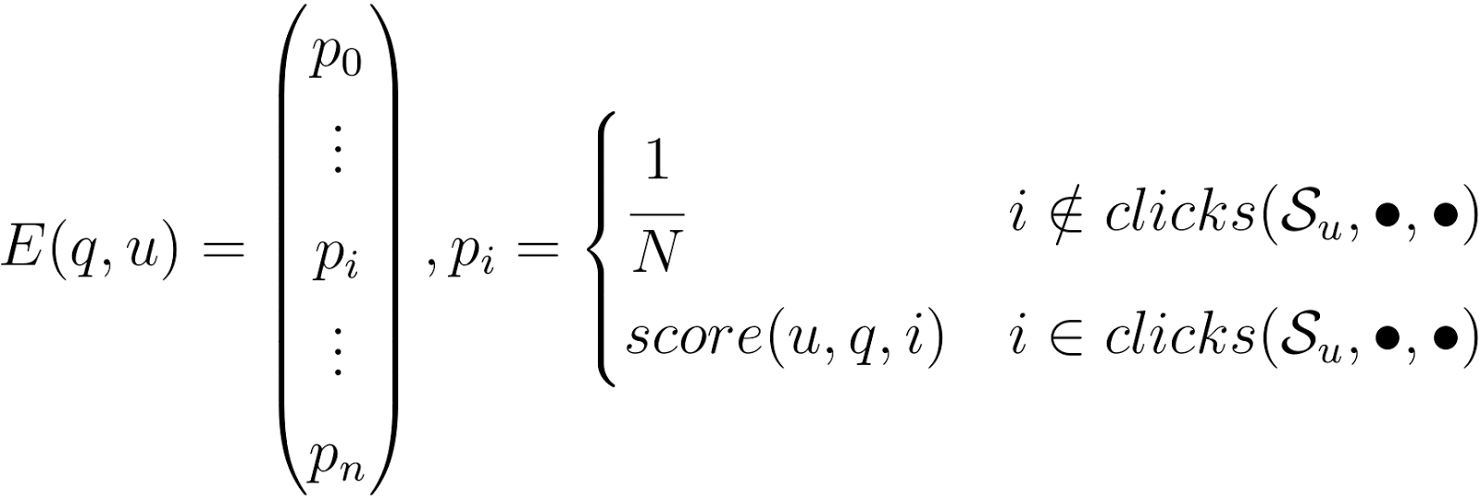
PageRank Personalization
Recall: Standard PageRank →
Our personalization vector:
CPPR formula →
14
Notes:
19 -> 20.7
Finally, we personalize the PageRank computation by integrating such scores into the Perso. Vector.
As a recall, here is the PR original formula. R is the PR vector, M is the “linking matrix”, which contains the information on what page links to what other page and E is the “perso. vector”.
The “perso vector” has a coefficient for every web page in the graph, that defines the probability that the “random surfer” will jump to this page instead of following a hyperlink. In the “normal” PR vector, all coefficients are equal to 1/N
In our case, coefficients are equal to the personalized score for the current user and the current query.
The PageRank formula could thus be rewritten as shown here, in the case of the CPPR vector.

Slide 15
AOL Re-Query / Web Crawl / Indexation
AOL Re-Querying System
Loads keywords & related logs entries
Loads the SERP
Analyses SERP vs. logs to decide if we keep this SERP
Anti-bots protections workarounds: proxies, delays, tor, etc. ...
Web Crawl
7/3 other domains/same domain links following strategy
Web Crawl Indexation
ElasticSearch with BM25
Several processing servers committing → central ElasticSearch Server
15
Notes:
20.7 -> 22.7
In our experimental setup, three additional steps are necessary to be able to perform the evaluation.
In short, we need to build a web search engine in order to then issues a specific list of queries on it, and evaluate on this set of queries.
The first thing we need is to enrich the dataset, that only contains domains and not full URLs. We issue the queries again and keep the SERP only if at least one result is the same as before (equal domains). In terms of implementation here we spent quite a lot of time working around the anti-bots protection of AOL…
Then we built a web crawler, in order to crawl the web based on the seed generated from the AOL SERPs. The main settings are the ones showne here: 7/3 links for other domains/same domains strategy. This is in order to have crawl as broad and as representative as possible for the PageRank computation. A total of one million crawled and downloaded web pages. Many more web pages are present in the final generated web graph, but we have downloaded 1M of them.
Then we index them in ElasticSearch using BM25 and after post-processing their HTML in order to obtain a plain-text usable/indexable document. This process is quite slow and as a consequence we had to run it on several parallel servers all committing to a central ElasticSearch. We also had issues with ElasticSearch needing a lot of memory… but I do not have the time to get into details, unfortunately.

Slide 16
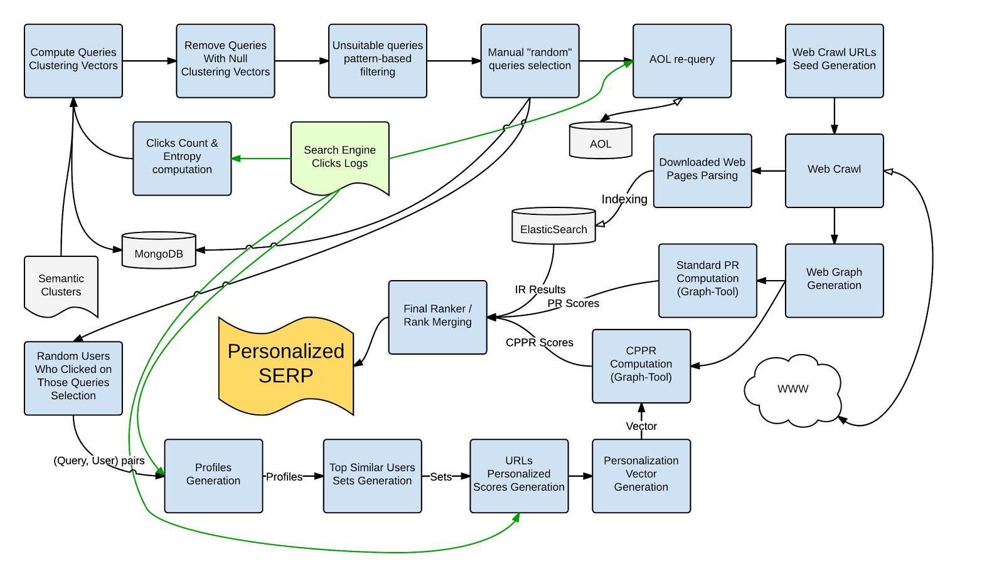
All Together
16
Notes:
22.7 -> 23.7
Here is a global pictures of the overall experimental setup.
I do not have the time to describe all processes in details but the most important is to see that:
We go from the logs, through queries selection and processing, then query AOL again, create the web crawl and web graph and feed the CPPR and IR engines with them.
At the same time, we also generate user profiles and web graph nodes personalized scores, that we ultimately map onto the web graph and feed the personalized PageRank engine with.
Then all of this is used for the personalization of the final SERP.

Slide 17
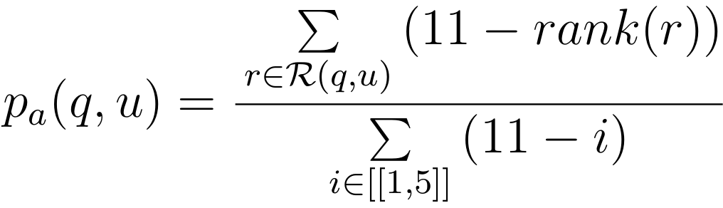
User Study
5 queries
5 contexts (user + history)
11 volunteers
Asked which preferred ranking
Asked to select “at most 5 relevant links” for every ranking
Precision metric:
17
Notes:
23.7 -> 25.7
Once we have a set of personalized SERP. We build an online platform that allows us to run a user study with 11 volunteers.
After reading the instructions, volunteers are shown 5 pages. On every page, they first have the context of the “current user”, with a summary of topics he or she previously queried and links clicked by users similar to him (at most 3).
Then, two rankings are shown: the baseline one (normal PageRank score) and the personalized one.
Such rankings are randomly swapped left/right position on every page load, and thus the volunteer has no idea which is what.
They are asked to select at most 5 results that they consider “relevant”, with no minimum. They are also asked to select which ranking they think is the best, overall.
Using the “relevancy judgments”, we define the “precision” of a ranking as follows: the score of the ranking divided by the maximum possible score (if all 5 relevant results are the top 5) possible.

Slide 18

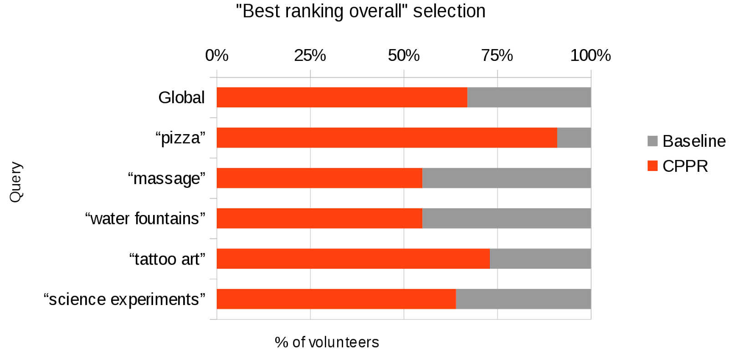
Results (1)
Preferred ranking: CPPR
18
Notes:
26.4 -> 27.1
And the results are not bad! For all queries, a majority of users preferred our ranking compared to the baseline one. Which is I think a first success.
This proves that users have the impression that the ranking is better, overall. And user satisfaction is what industries system generally seek to improve

Slide 19
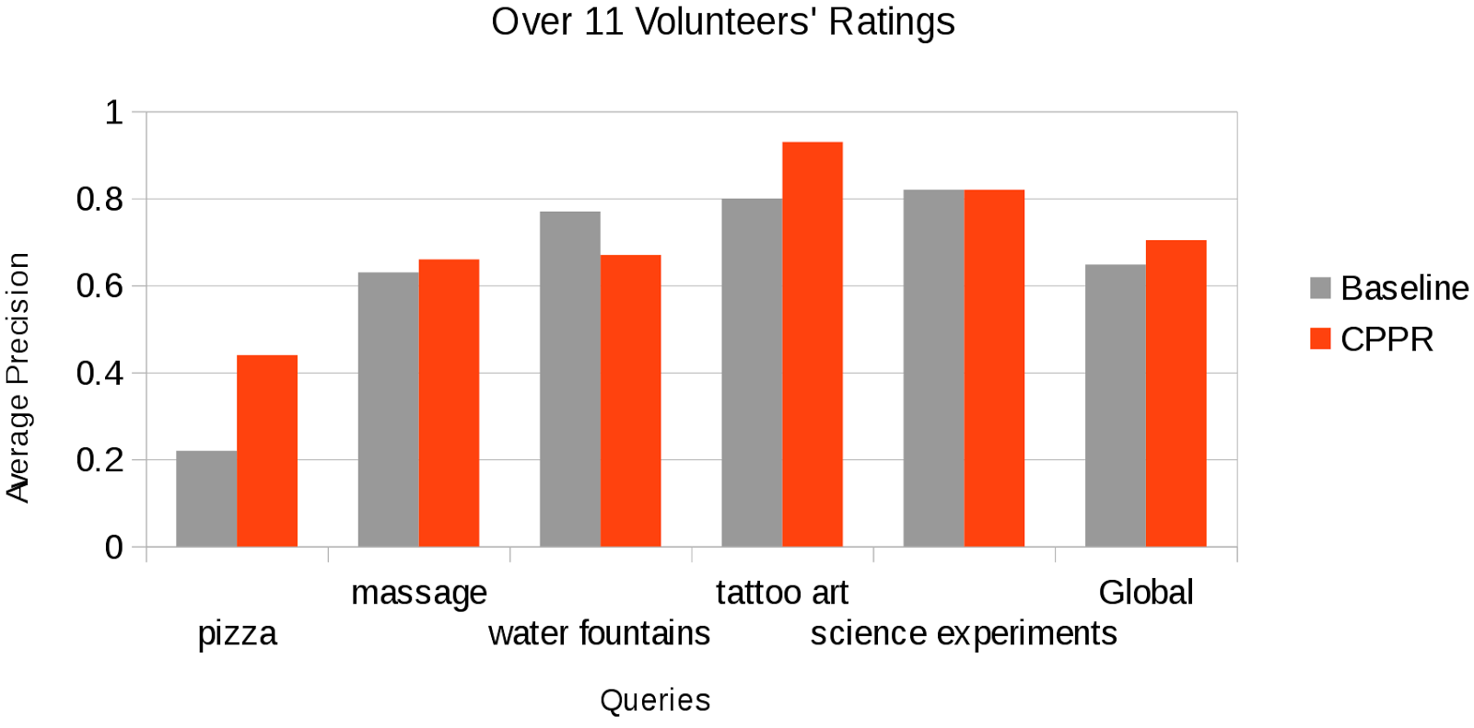
Results (2)
Average precision gain: 21.6%
19
Notes:
25.7 -> 26.4
In terms of precision, it is not bad either. We have a measurable improvement over the baseline for most of the queries. In one case, though, the precision decreases, even though user still mostly preferred the CPPR ranking…
In one other case, scores are the same. But in two cases the precision is greatly improved. And in average, the precision difference, computed on a volunteer-per-volunteer basis, is a 21.6% for the personalized ranking.

Slide 20
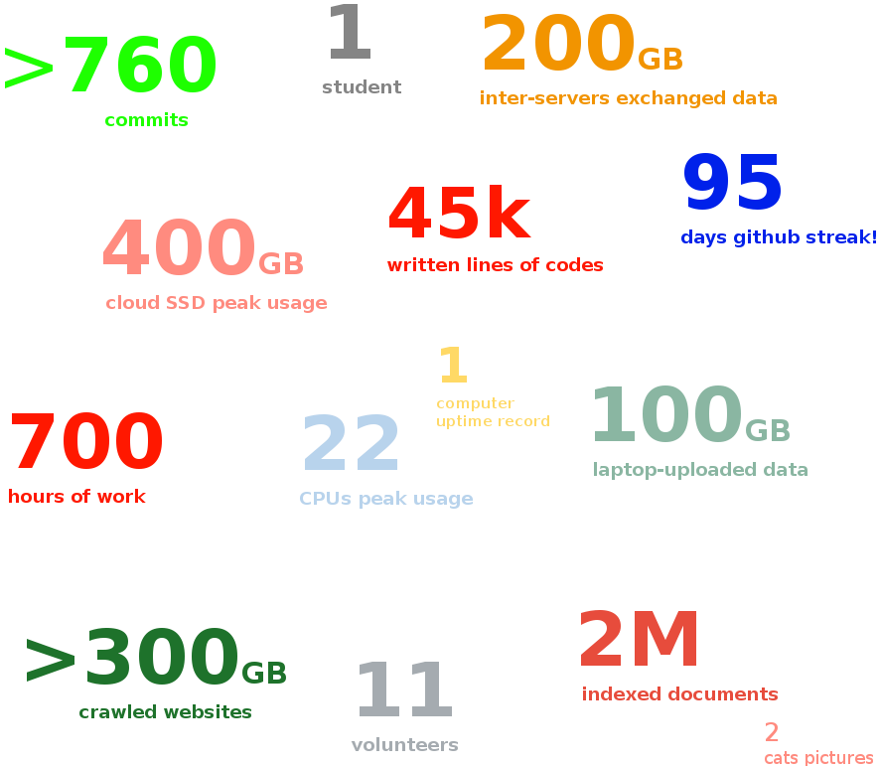
Retrospective/Figures/Taking a look behind…
some figures might have been ceiled :)
20
Notes:
27.1 -> 28.1
To summarize it all, this was a great project I think!
In retrospective, I thought I would gather a couple of figures about the project, to help quantify the work done.
This definitely is the biggest university-related project I’ve ever done.
And is also is the biggest project I’ve done from end-to-end. I made myself a couple of records, including number of commits and commit streak. And probably also lines of codes.

Slide 21
Technologies Used (that I already knew)
Docker! (LXC) (now part of the “developer survival kit”)
CentOS, Fedora, Ubuntu, Debian
Data Crunching: Python (http://python.org)
Web Crawl: Scrapy (http://scrapy.org)
21
Notes:
Short note about the technologies I used in the project, here is the set of technologies I used that I already knew

Slide 22
Technologies Used (never used before) & learnt
Written work: Multimarkdown
User Study Online Platform: Express.js (http://expressjs.com)
PageRank computation: Graph­Tool (http://graph­tool.skewed.de/)
HTML Parsing / Web Crawl Post­Processing:
Chardet (https://github.com/chardet/chardet)
BeautifoulSoup4 (http://www.crummy.com/software/BeautifulSoup/)
IR/BM25 indexation & search: ElasticSearch (http://elasticsearch.org)
Database: MongoDB (http://mongodb.org)
Heavy computation: Google Compute Engine (http://cloud.google.com/products/compute­engine/)
Python modules: MultiProcessing, GZip, Pickle, JSON
22
Notes:
Now here’s a set of technologies I had not used before.

Slide 23
References / Bibliography
Please see the bibliography of the written thesis.
23

Slide 24
The End
THE END
Thanks for your attention. Any questions?
24
Notes:
The last time I did a presentation, I thought people would figure it out by themselves but they did not, so this time I am expliciting it: You do not need to read the slides. I am going to speak and everything needed will be said by me. Slides are here so that if you stop listening for any reason, you can get back in the move by seeing what we are currently talking about.
Some slides will need to be read or looked at, but in those special cases, I will be showing things on the slides anyway so I will tell it, do not worry.
So, do not be confused if you do not have the time to read the slides: It is in purpose, I’m the information source, not the slide. That’s the way I make presentations, I hope this is not illegal =] .

Slide 25
Web Crawl & Indexation (optional slide, for questions)
Web Crawler based on Scrapy framework
Follows links:
3 links to same domain
7 links to different domains
< 255chars
Some patterns excluded
Pictures, css, js, etc., excluded
Trials with several different settings
~1M docs in <1d with “nice” settings (not hitting server too heavily)
Indexation is another story: ~1.6 page/sec
Need for a several servers to get it to one day
Indexation process not built to be ran in parallel: most processes doing work that has already been done…
Separating data chunks by hand in the end...
25

Slide 26
AOL Re-Query (optional slide, for questions)
Web scraper
Loads keywords & related logs entries
Loads the SERP
Analyses SERP vs. logs to decide if we keep this SERP
Anti-bots protections workarounds:
slow down → too slow, or banned
proxies → all banned
tor → banned
tor + slow down → too slow, or banned
proxies + slow down → tricky to add to the framework, but works OK
26

