Slide 1
Security Case Study
with the Downsizing Game
Théo Dubourg Real Life Security Seminar - 2014
1

Slide 2
Goal of the Work
We want to study a security protocol
Implementation-oriented work / software engineering exercise
Case Study: The Downsizing Game
Study how secure we can implement the game
Use the case study to learn and point to security issues that arise throughout implementation
Comparison of the implementation against coding security guidelines
2

Slide 3
The Downsizing GameSimplified
A group of players (for us: 3)
1M money given at the beginning
Maximize their profit
Vote for other players
Winner if the highest score
At the end, give back the starting money
A judging party or game master controls the game
3

Slide 4
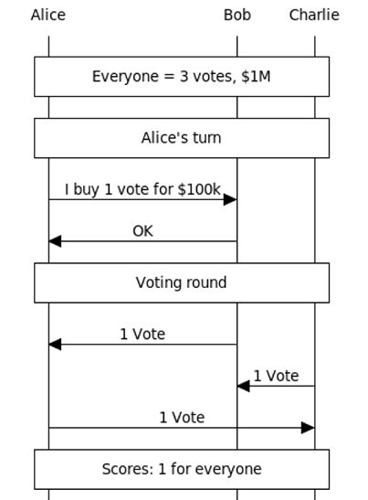
The Downsizing GameGame Example 1/4
- 3 players
- 6 rounds
- 3 voting rounds
4
Notes:
title Game Example (1/3)
participant Alice as 1
participant Bob as 2
participant Charlie as 3
note over 1, 2, 3: Everyone = 3 votes, $1M
note over 1, 2, 3: Alice's turn
1->2: I buy 1 vote for $100k
2->1: OK
note over 1, 2, 3: Voting round
2->1: 1 Vote
3->2: 1 Vote
1->3: 1 Vote
note over 1, 2, 3: Scores: 1 for everyone

Slide 5
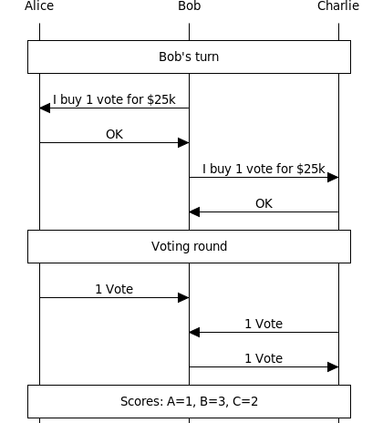
The Downsizing GameGame Example 2/4
5
Notes:
title Game Example (2/3)
participant Alice as 1
participant Bob as 2
participant Charlie as 3
note over 1, 2, 3: Bob's turn
2->1: I buy 1 vote for $25k
1->2: OK
2->3: I buy 1 vote for $25k
3->2: OK
note over 1, 2, 3: Voting round
1->2: 1 Vote
3->2: 1 Vote
2->3: 1 Vote
note over 1, 2, 3: Scores: A=1, B=3, C=2

Slide 6
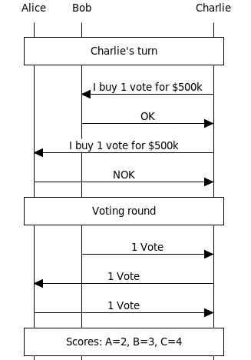
The Downsizing GameGame Example 3/4
6
Notes:
title Game Example (2/3)
participant Alice as 1
participant Bob as 2
participant Charlie as 3
note over 1, 2, 3: Charlie's turn
3->2: I buy 1 vote for $500k
2->3: OK
3->1: I buy 1 vote for $500k
1->3: NOK
note over 1, 2, 3: Voting round
2->3: 1 Vote
3->1: 1 Vote
1->3: 1 Vote
note over 1, 2, 3: Scores: A=2, B=3, C=4

Slide 7
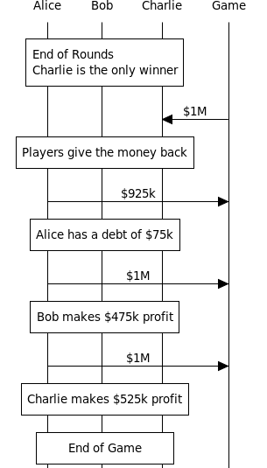
The Downsizing GameGame Example 4/4
7
Notes:
title Game Example (2/3)
participant Alice as 1
participant Bob as 2
participant Charlie as 3
participant Game as g
note over 1, 2, 3:
End of Rounds
Charlie is the only winner
end note
g->3: $1M
note over 1, 2, 3: Players give the money back
1->g: $925k
note over 1, 2, 3: Alice has a debt of $75k
1->g: $1M
note over 1, 2, 3: Bob makes $475k profit
1->g: $1M
note over 1, 2, 3: Charlie makes $525k profit
note over 1, 2, 3: End of Game

Slide 8
The Downsizing GameOur Instance’s Rules
Fixed length of 1,000 rounds
3 players
Participating only once (cannot purge debt using the game again)
Tradable resources: votes, score and dollars
At start: $1M (to be returned at the end), 10 votes
Starting score = 0
Remainder of the money can be kept
Cannot give back the money = debt contracted
Two players can trade resources using transactions
A judging party
enforces the game's rules (cheating prevention)
manages transactions (validity, cheating prevention)
8

Slide 9
The Downsizing GameOur Instance’s Rules (continued)
10 voting rounds (every 100 rounds)
All players must vote on voting rounds
Players must cast exactly 1 vote at every voting round
Players can not vote for themselves
1 vote received = scored increased by 1
Highest score at the end = winner = $1M prize
If a player is banned (cheating), starting money must be returned
9

Slide 10
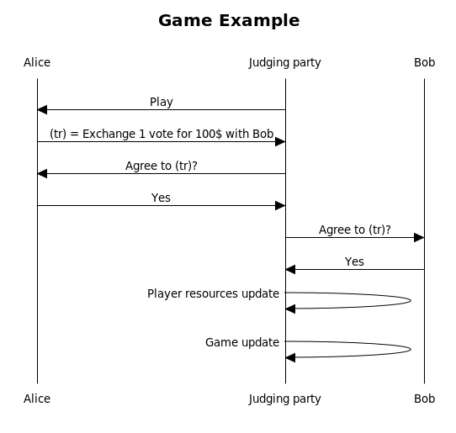
The Downsizing GameOur Instance’s Security Protocol
10
Notes:
Diagram code: title Game Example
participant Alice as a
participant Judging party as j
participant Bob as c
j->a: Play
a->j: (tr) = Exchange 1 vote for 100$ with Bob
j->a: Agree to (tr)?
a->j: Yes
j->c: Agree to (tr)?
c->j: Yes
j->j: Player resources update
j->j: Game update

Slide 11
Functional Requirements & Definitions:
Rounds
Players play turn-by-turn
Current player allowed to contact judging party
Round passes when
Transaction applied
Changing current player
Applying the result of a voting round
11
Notes:
Current player is the player that can perform action. We give it some CPU time and it is allowed to use the judging party’s interface. If a player managed to get some CPU time but it’s not its turn, the judging party will refuse to communicate with it.
Round passing advantage:
- Every action that changes the state of the game passes a round, allowing for uniquely idenditying every state of the game
- If the player submits no transactions, a round will be passed when we change player
- If the player submits multiple transactions but those are refused, he can still submit some (up to a given limit), and no rounds have passed. When a transaction is finally applied, a round passes.
- Thanks to the round number, players have a hint about whether a lot happened or not since the last time they played (their last turn)

Slide 12
Functional Requirements & Definitions:
Transactions
Unidirectional vs. Bidirectional
Immediate vs. Scheduled (“delayed”)
Fixed amount
Transactions history log
12

Slide 13
Functional Requirements & Definitions:
Transactions Validation
Immediate transactions
Immediate validation or refusal
Scheduled transaction
Pre-validation / acceptance
On deadline: transactions history log analysis to check for fulfilment of the agreed amount to have been transferred
Subtransactions with “parent transaction” id
Not fulfilled: Cheating attempt (ban)
13

Slide 14
Functional Requirements & Definitions:
Voting rounds
Each player casts exactly 1 vote
Valid votes are registered as special transactions
Those transactions can only be instantiated and applied by the judging party, not players
14

Slide 15
Functional Requirements & Definitions:
Voting Promises Transactions
Scheduled transaction
Fulfilment checked as normal for scheduled transactions, using “voting transactions”
15

Slide 16
Security Requirements & Definitions:
Game & Judging party protection
Judging party should only execute actions from the current player, no other players.
We need to authenticate players
Judging party neutrality
Game state alteration
Resources accounting protection
16
Notes:
The judging party should only execute action of the current player…← In order to ensure that all players can play
Authentication: Random password passed to players at the beginning of the game.
Judging neutrality: you cannot force it to treat a player differently from the other ones. You cannot tamper with it
Game state & resources accounting: They should only be modifiable by the Judging party. No one else should be able to modify them directly.

Slide 17
Security Requirements & Definitions:
Transactions
Immediate transactions should be atomic
Scheduled transactions should be completed before the deadline
Transactions should only be approved if both players, authenticated, agreed on it.
17
Notes:
This means that no other actions that modify the game’s state should happen between the validation of an immediate transaction and full application.
When the deadline is met, when the round used as the deadline, is happening, then we should be ensured that the transactions that had this deadline have been either completed or the cheater was banned.
We should explicitly ask players for their agreement and ask them to authenticate when they answer.

Slide 18
Other related issues
Players that are banned might owe some resources (pending scheduled transactions)
Divide the remaining resources of the banned player proportionally to what it owed to you
Balances are not accessible at all by players, they know their initial balance and then have to track it themselves → Avoid protection mechanism on the balances.
Some input validation is needed for transactions (negative amounts, banned players as the other trader, invalid deadlines…)
18

Slide 19
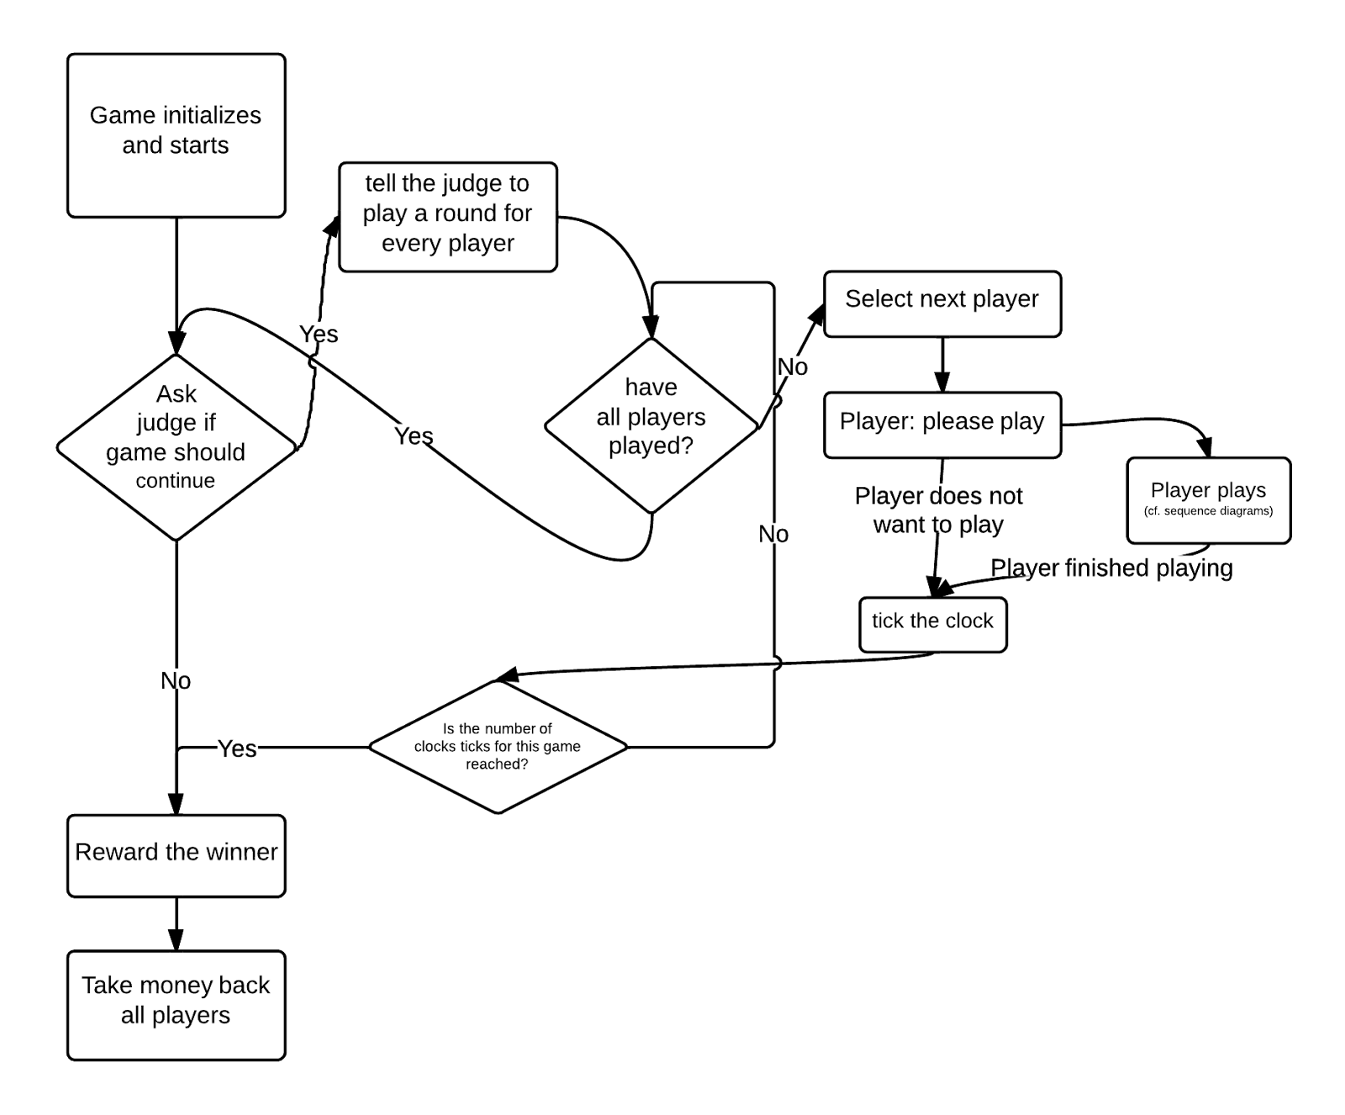
Game System Overview
19

Slide 20
THE END

Slide 21
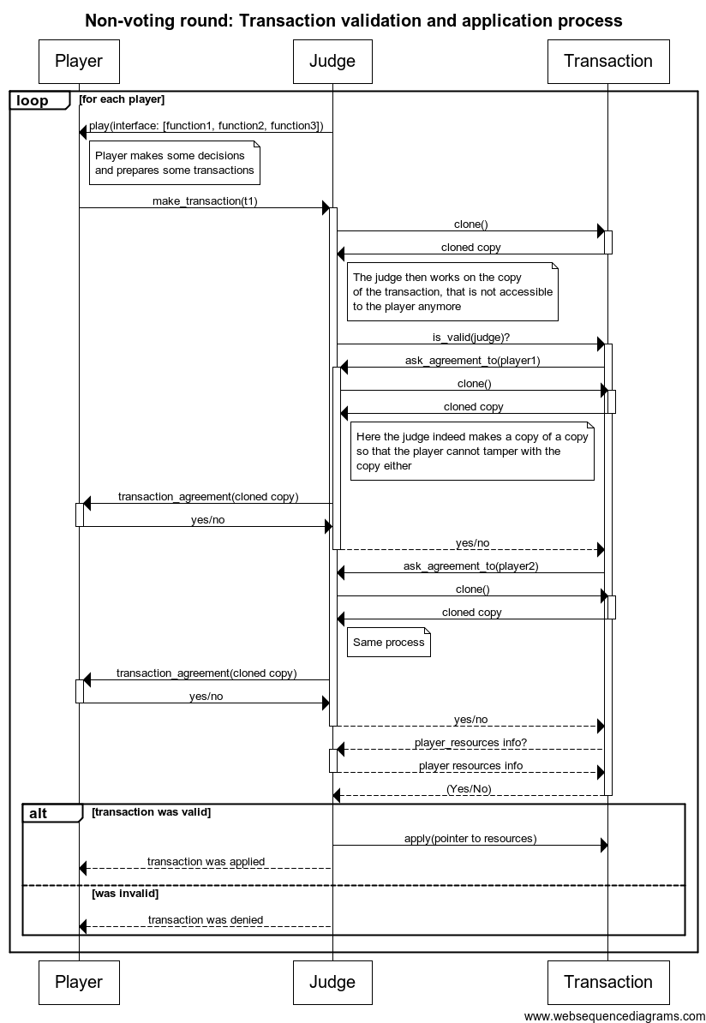

Slide 22
