Slide 1

Observational versus experimental Studies
Tracey Dudding

Slide 2

Observational studies
A measurement of a group of people without manipulating any variables or affecting any people.
No treatment or random assignment into groups.
Sometimes, the only way to explore certain questions.
This Photo by Unknown Author is licensed under CC BY-SA-NC
Notes:
Only a dependent variable is measured in observational studies. That is, the response that is measured, such as the amount of people in Walmart on Sundays for two years.
There are no independent variables, variables that are manipulated, in an observational study.
Only way to explore certain questions… For example, it would be unethical to design a randomized controlled trial deliberately exposing workers to a potentially harmful situation

Slide 3

Experimental studies
A study where you randomly assign treatment(s) to a group(s) to draw a conclusion on any cause and affect relationships.
This Photo by Unknown Author is licensed under CC BY-NC
Notes:
An independent variable is the variable that is manipulated or varied by the researcher.
A dependent variable is the response that is measured.

Slide 4
Experimental studies
Factor(s) variables and treatment(s) Variables
The factor(s)
An explanatory variable manipulated by the experimenter.
Each factor has two or more levels.
The Treatment(s): A variable(s) that is manipulated.
Treatment | GPA | Gender
A | 2.9 | MALE
… | 3.4 | FEMALE
B | 3.01 | MALE
… | 2.9 | FEMALE
C | 2.0 | MALE
… | 3.5 | FEMALE
Notes:
Consider the following:
We take a random sample of students from Virginia Tech.
We hypothesis that female students maintain a higher GPA than male students when put into three different environments.

Slide 5
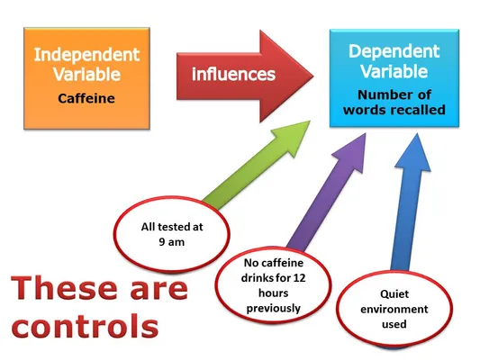
Experimental studies
control(s) variables
Control Variables:
An independent variable that is held constant in order to rule out other variables which may be influencing the results of an experiment.
https://www.simplypsychology.org/controlled-experiment4.jpg?ezimgfmt=rs:553x404/rscb30/ng:webp/ngcb30
Notes:
To bring everything full circle:
Control Group:
Do not receive treatment
Experimental Group:
Receives treatments
For example
Testing fertilizer with crops. There can be a crop that receives no fertilizer… that can be an entire group being constrained against the treatment of fertilizer.

Slide 6
Check your understanding
1) A study took a random sample of students at Radford University and asked them about their nightly habits. The data showed that freshman through sophomore students were more likely to stay up late than junior and senior students.
Notes:
Observational Study. We are asking and not assigning students randomly to groups and controlling any variables.

Slide 7
Check your understanding
2) Another study took a different group of students from Radford University and randomly divided them into three groups. The first group was told to drink five cups of coffee, the second group was told to drink five cups of tea, and the third group was told not to drink coffee or tea. The researcher then compared when each group fell asleep.
Notes:
Experimental Study. We have assigned students to groups and manipulated variables.

Slide 8
Check your understanding
3) A different study took a group of students from Virginia Tech and asked them to complete a survey on their social media habits. Each person in the group could classify their social media use as none, a little, or a lot. The researcher then compared which groups of students tended to be happier.
Notes:
Observational Study. We have asked for a survey and have not manipulated any variables that could influence their answers. Assuming the survey was written properly to avoid bias.

Slide 9
Resources & Further topics To explore
Strengths and weaknesses of observational versus experimental studies.
Another overview and examples of experimental and observational studies.
An article covering more on control groups.
Khan Academy: Experimental versus Observational Studies Lecture Series
Looking at Treatments and Factors
All other content : Exploring the Practices of Statistics (Moor, McCabe, Craig)

