Slide 1

Experimental bias, the placebo effect and how to combat them
Tracey Dudding

Slide 2
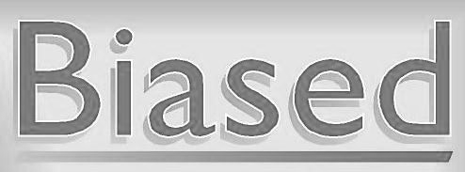
Experimental bias
Favoring certain outcomes over others.
Avoid this by using control variables or groups!
This Photo by Unknown Author is licensed under CC BY
Notes:
Famous example of experimental bias:
Rosenthal and Fode Experiment
Robert Rosenthal and Kermit Fode in 1963.
Rosenthal and Kermit asked two groups of psychology students to assess the ability of rats to navigate a maze.
One group was told their rats were “bright”.
The other group was convinced that they were assigned “dull” rats.
In reality, the rats were chosen randomly and there was no significant difference between them.
Interestingly, the students who were told that their rats were maze-bright reported faster running times than the group who was not expecting their rodents to perform well.
In other words, the students’ expectations directly influenced the obtained results.
Rosenthal and Fode’s experiment shows how the outcomes of a study can be modified as a consequence of the interaction between the experimenter and the subject.

Slide 3
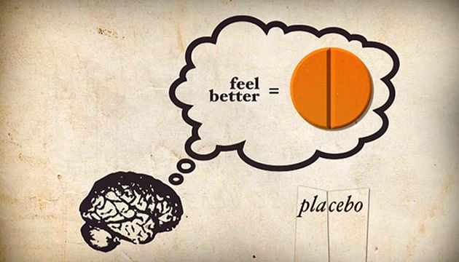
Placebo effect
Many patients are confident that a treatment will positively affect them. Hence, they react to a placebo which has no physical affect at all.
This Photo by Unknown Author is licensed under CC BY-SA-NC
Notes:
Why do we include placebos then?
In order evaluate the difference between the placebo effect and the actual effect of the treatment you should always have the placebo and actual treatment, along with other controlling variables if needed.
Note: A placebo is NOT a substitute for a control group.

Slide 4
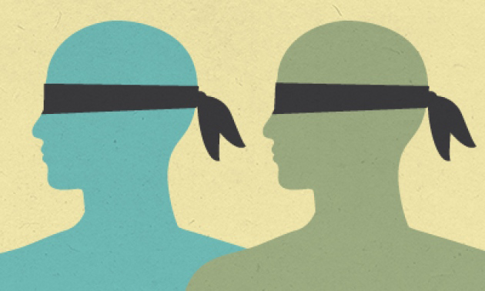
Double blind experiments
The subjects and researchers are unaware of the subjects' group status.
Another way to avoid a placebo effect and experimental bias.
This Photo by Unknown Author is licensed under CC BY
Notes:
Double blind experiments aid in avoiding
bias by ensuring the researcher does not already have any idea of what results may be seen by a group.
the placebo effect by ensuring the researcher can not clue in the subjects as to which group they are in.

Slide 5
Resources & Further topics To explore
Types of Experimenter Bias and the famous example of it.
Overview and example of Experimenter Bias, Placebo Effect, and Double-Blind Studies. (*start at the control section)
All other content : Exploring the Practices of Statistics (Moor, McCabe, Craig)

