Slide 1
Severity Car Accident
Capstone

Slide 2
Problem: Many people in general are unaware about the "Impact of traffic" on the accident rate and the severity of those accidents, thereby making them vulnerable to such accidents. When someone ventures out on a road , he / she should be fully aware of the risks, challenges instead of going with assumptions.
Hence this project is intended to generate Supervised ML models to predict the "severity" of the accident based on different predictor variables/attributes.
Audience: Driving population in general, who can gain value by being aware on the potential risks while driving to a particular location on certain road, light , weather conditions, car speeding etc. This would enable them to take informed decisions and choose the route / direction accordingly. More so, these insights shall facilitate the people to be able to plan out their journey and tasks effectively thereby being able to achieve the intended agenda. Rather than being stuck up in an accident site and miss out on the opportunities.

Slide 3
Approach
"Severity" classified as "Injury Collision" or "Property Damage Only Collision".
Feature set : Location, Weather Condition, Light conditions, Road conditions, Junction, People Count, Vehicle count.
Build and train Supervised Machine Learning models for Car Accident severity prediction and its accuracy.

Slide 4
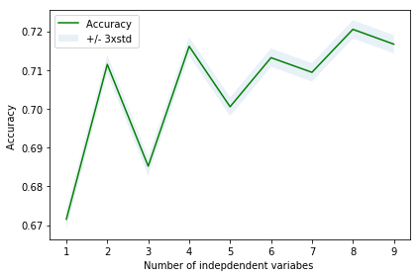
In this case the highest prediction accuracy is 0.72 .

Slide 5
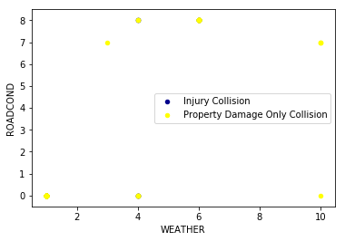
Using SVM
F1 score (accuracy) 0.6455598376907591
Jaccard Index for accuracy 0.7086116281616117

Slide 6
Conclusion
According to the results, the Decision Tree Algorithm is most effective in predicting the accuracy of a car accident with highest severity. The K-NN and SVM models are stable too and point in the same direction with a similar error ratio as for Decision Tree. Hence the results are rationally approaching the actual value of the target.
It is recommended to deploy the Decision tree model for this specific case of Predictive analysis.

