Slide 1
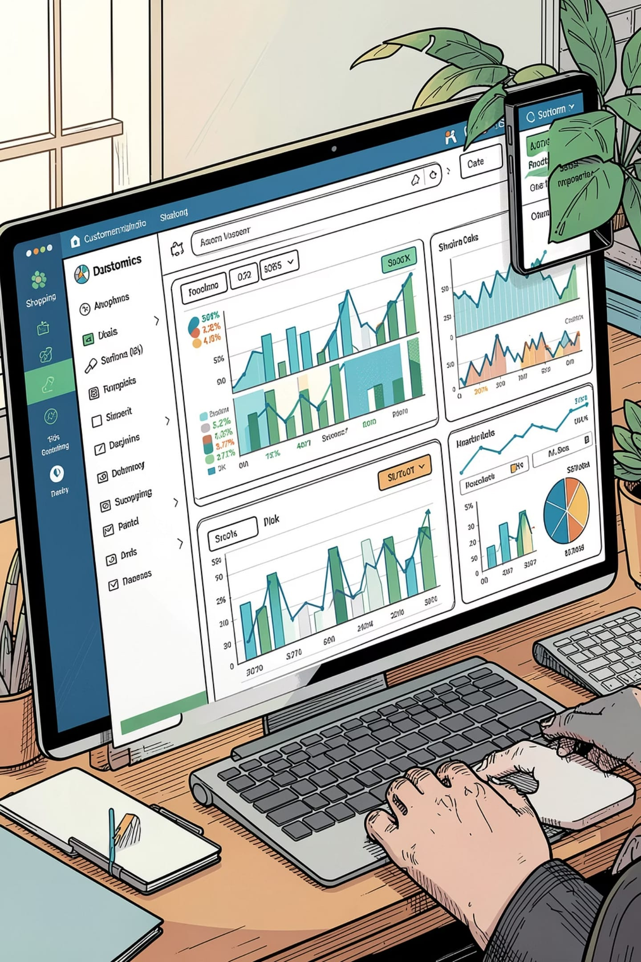
Customer Shopping Behavior Analysis
Uncovering spending patterns, customer segments, and product preferences from 3,900 transactions

Slide 2
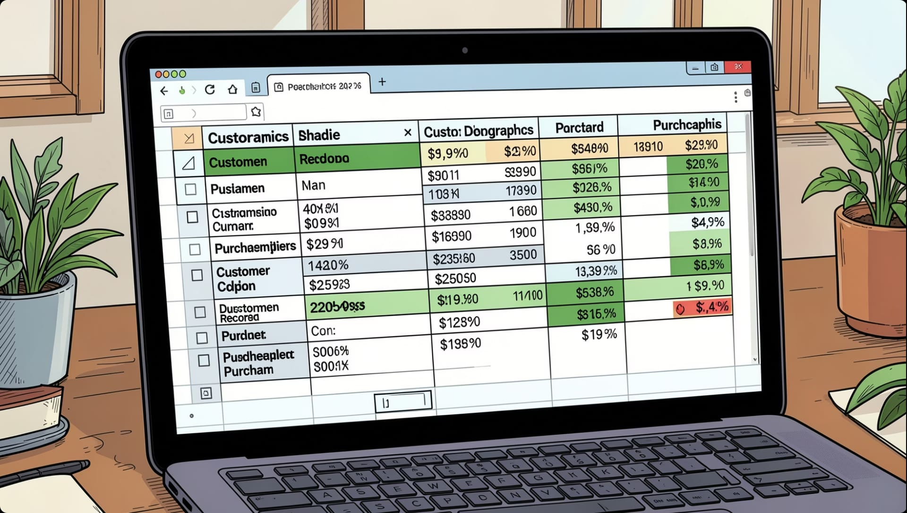
Dataset at a Glance
3,900
18
37
Purchases
Columns
Missing Values
Review Rating only
Key Features
Demographics: Age, Gender, Location, Subscription
Purchases: Category, Amount, Season, Size, Color
Behavior: Discount, Frequency, Review Rating, Shipping

Slide 3

Data Preparation in Python
01
Load & Explore
Imported via pandas; df.info() & describe()
02
Clean Missing Data
Imputed Review Rating using median per category
03
Feature Engineering
Created age_group bins & purchase_frequency_days
04
Database Integration
Loaded cleaned DataFrame into PostgreSQL

Slide 4
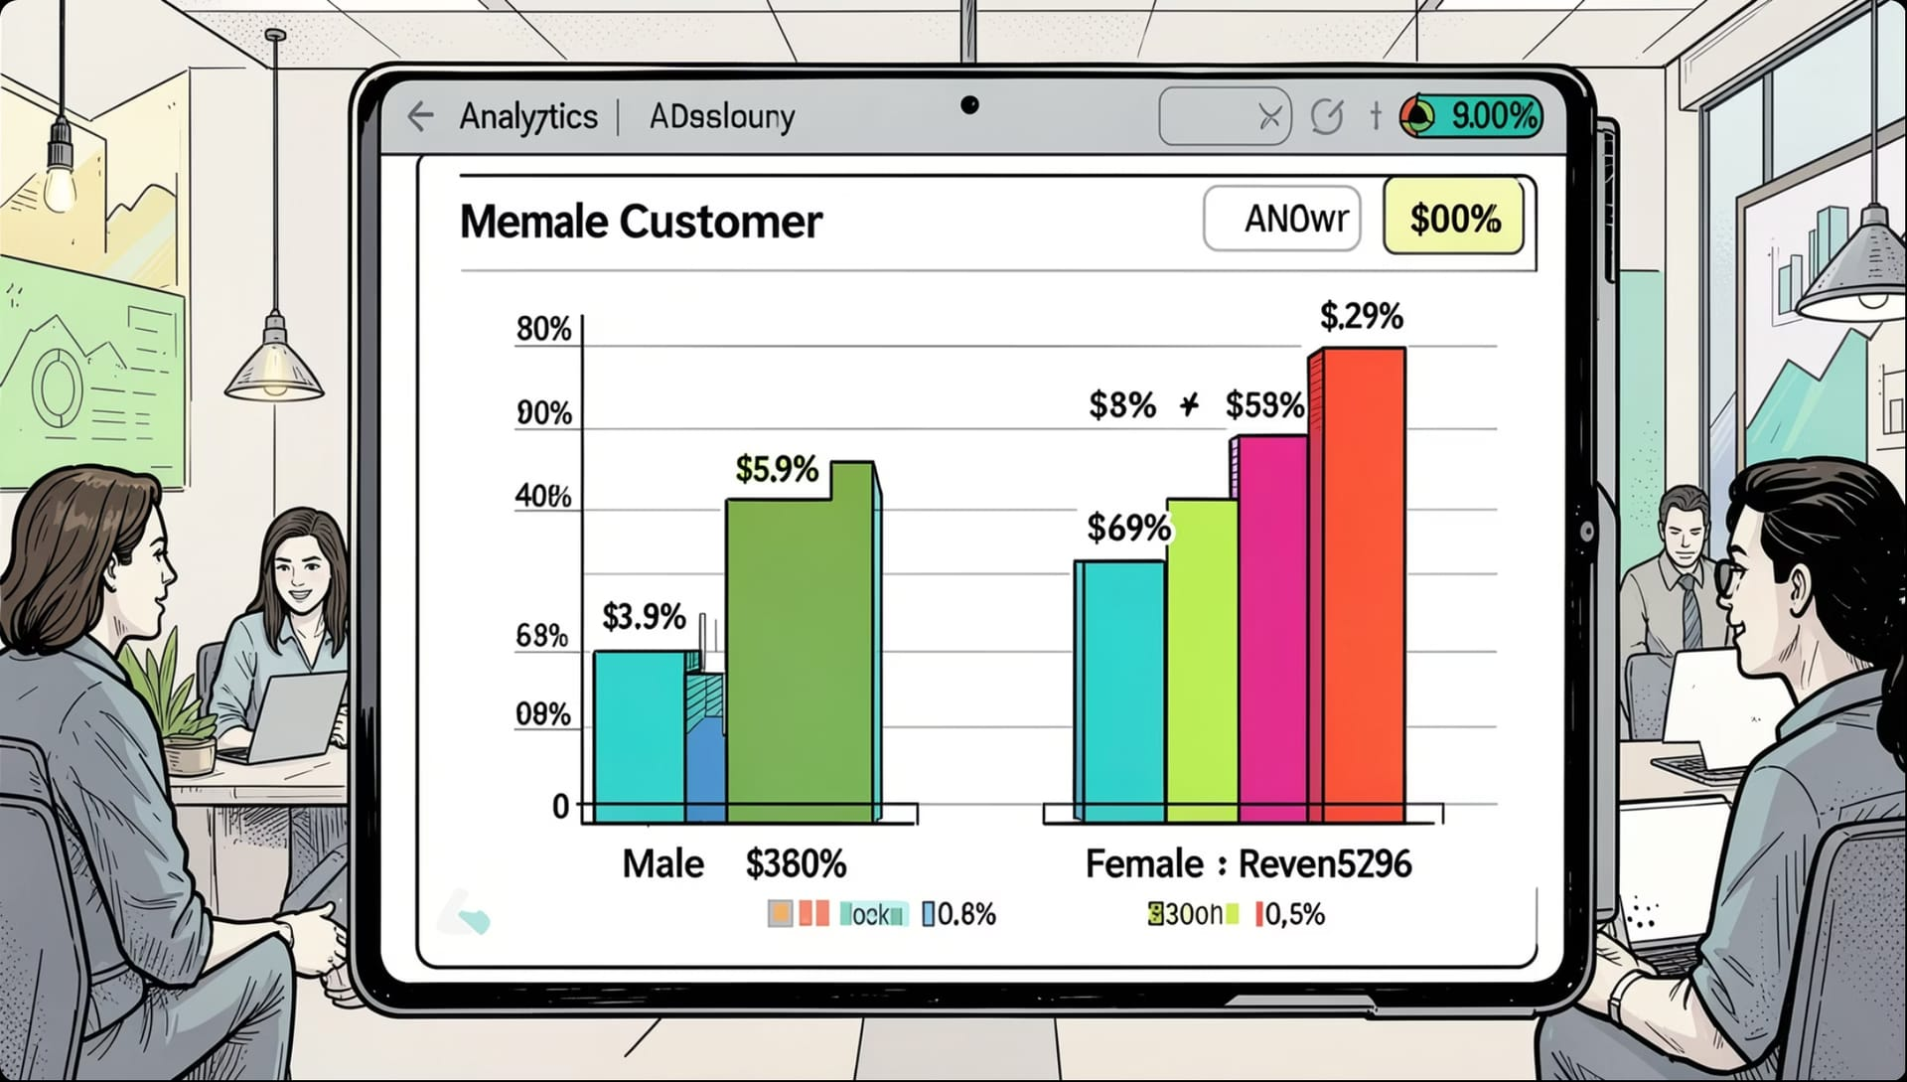
Revenue by Gender
Key Insight
Compared total revenue generated by male vs. female customers to identify which segment drives more spend.

Slide 5
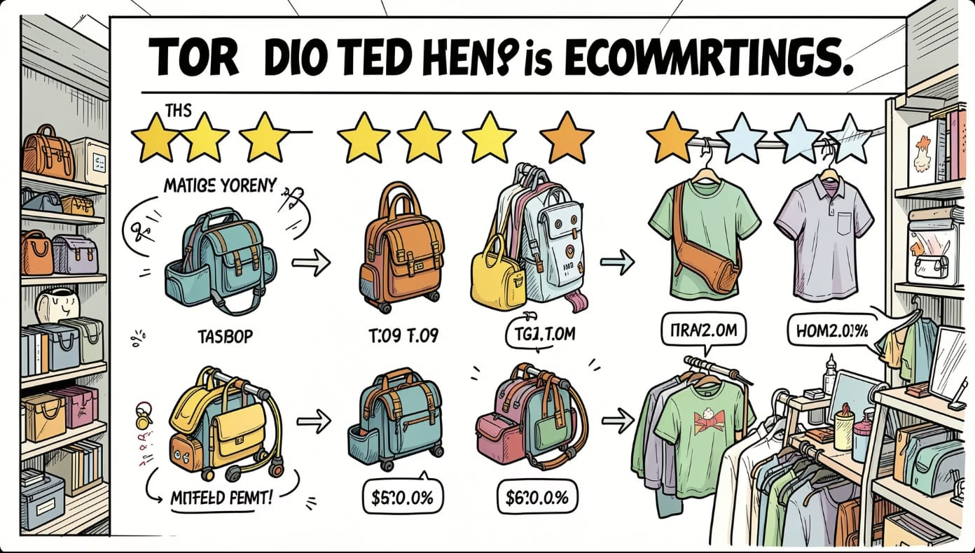
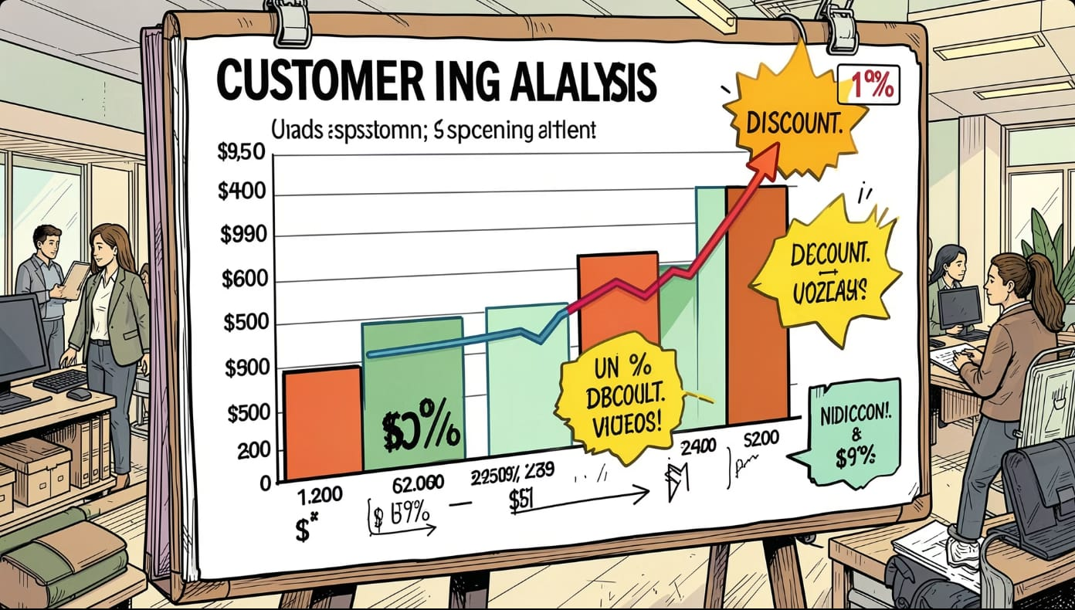
Top Products & Discount Behavior
Top 5 Products by Rating
Found products with the highest average review ratings.
High-Spending Discount Users
Identified customers who used discounts but still spent above the average purchase amount.

Slide 6
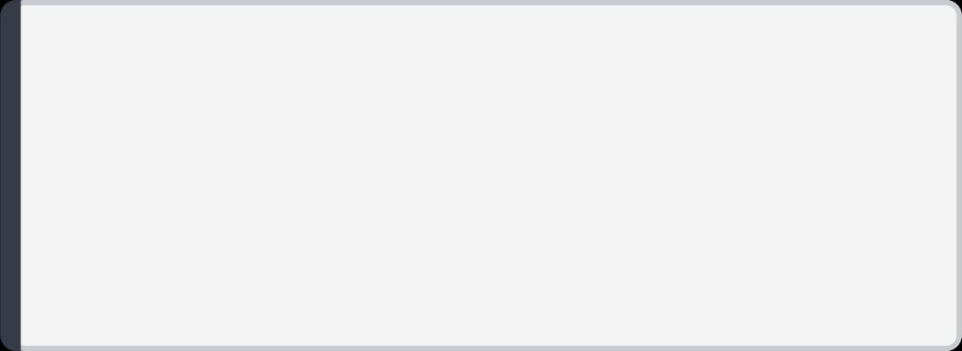
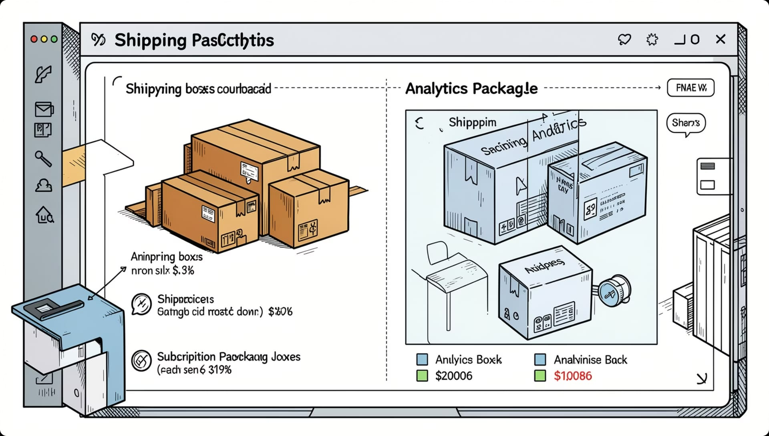
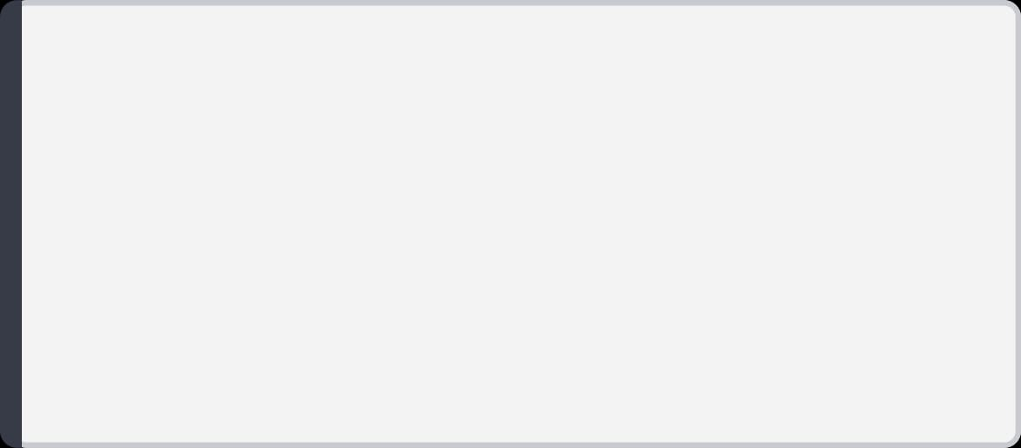
Shipping & Subscription Analysis
Shipping Type
Compared average purchase amounts between Standard and Express shipping.
Subscribers vs. Non-Subscribers
Compared average spend and total revenue across subscription status.
Discount-Dependent Products
Identified 5 products with the highest percentage of discounted purchases.

Slide 7
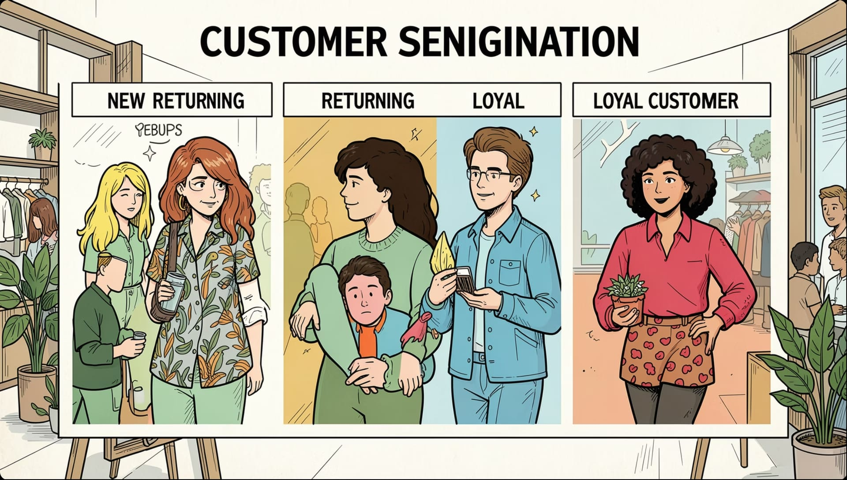
Customer Segmentation
Three Segments
New
Returning
Loyal
Classified customers based on purchase history.

Slide 8
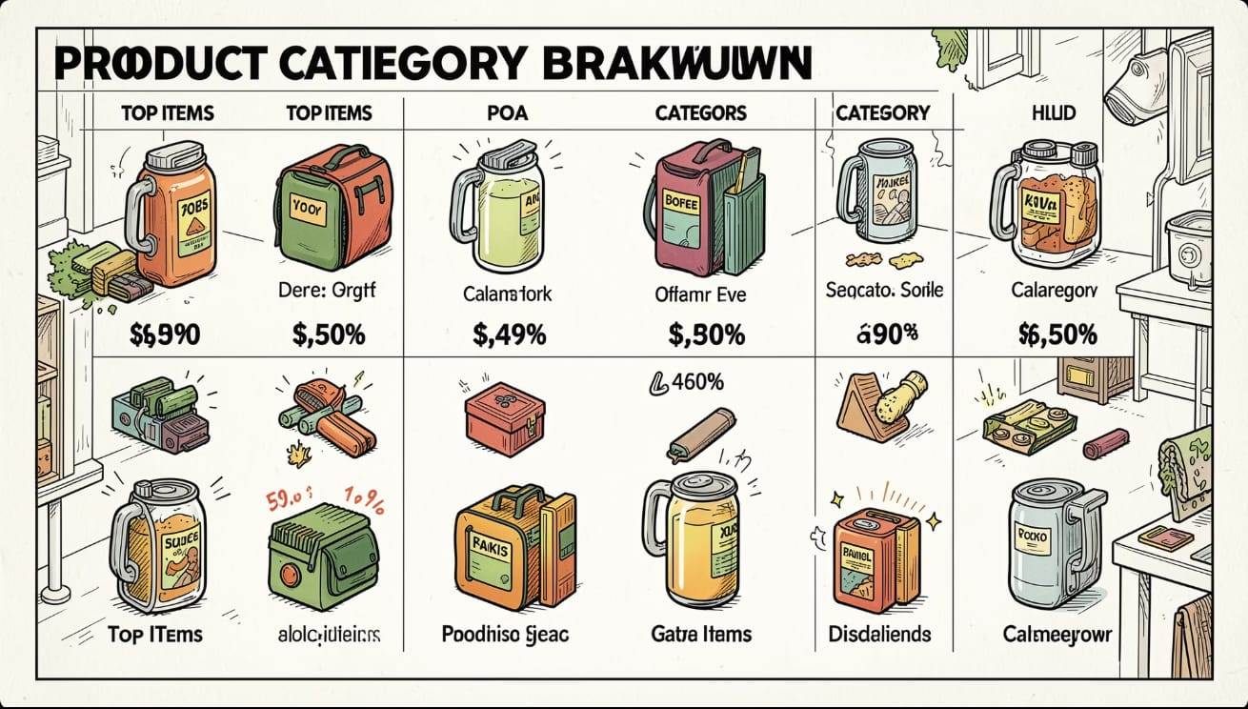
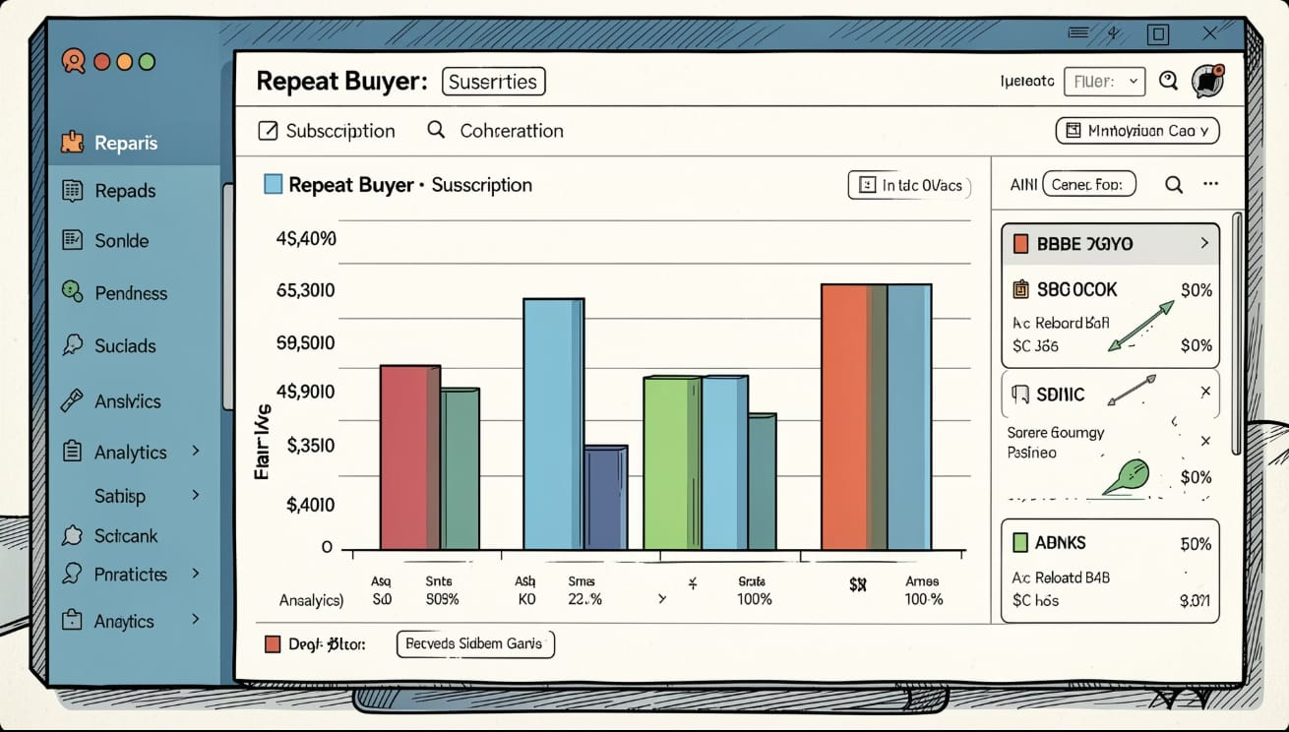
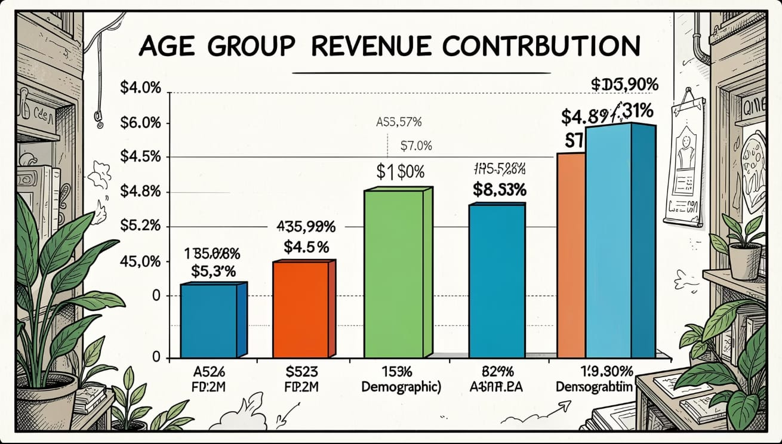
Category & Age Insights
Top 3 Products per Category
Listed the most purchased products within each category.
Repeat Buyers & Subscriptions
Checked whether customers with more than 5 purchases are more likely to subscribe.
Revenue by Age Group
Calculated total revenue contribution of each age group.

Slide 9
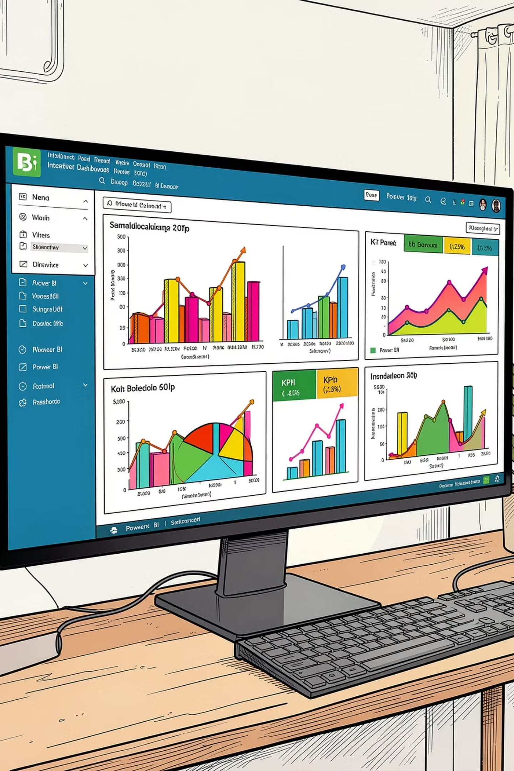
Power BI Dashboard
An interactive dashboard built to present all insights visually — enabling stakeholders to explore revenue, segmentation, and product performance at a glance.

Slide 10





Business Recommendations
Boost Subscriptions
Loyalty Programs
Review Discount Policy
Promote exclusive subscriber benefits
Reward repeat buyers to reach "Loyal" segment
Balance sales boosts with margin control
Product Positioning
Targeted Marketing
Highlight top-rated & best-selling products
Focus on high-revenue age groups & express-shipping users

