Slide 1
ICT221 Software Development 1
Lecture 9
Objects and Classes

Slide 2
Assignment Timeline
Week | Tasks that should be completed
21 Jul | Create a Java UserInterface class for the assignment containing a main method that outputs a message
28 Jul | Design the algorithms to be used within the program
4 Aug | Add input to program, but without code to check whether values are valid, make decisions or loops Add output to program so that input values are reported
11 Aug | Add input validation – this needs only to generate error messages Add code to determine if a vehicle is category V1, V2 or V3 based on its family (motorbike/car/truck), number of axles and trailer Add code to output all required management information – at the moment the values output can all be zeros, apart from the machine/staff cost of the lanes and the total time per vehicle to process vehicles in each of the 3 lane types
18 Aug | Modify validation code so that when invalid input is received the user is given an error message and re-prompted until input is valid Add code that can determine the lane type for a vehicle, based on its cash value and vehicle type (V1/V2/V3)

Slide 3
Assignment Timeline
Week | Tasks that should be completed
25 Aug | Create a JBuilder project for the application and move the UserInterface class into it Modify validation code so that when invalid input is received the user is given an error message and re-prompted until input is valid Create code that can convert a price from cents (eg 225 cents) to dollars and cents (eg $2.25)
1 Sep | Devise test plan and data Test and debug
8 Sept | Construct methods to: Construct an empty two dimensional array of ints Construct a two dimensional array of ints in the format defined in the Traffic class – use the same data as in the example file, and the array can again be named vehicleList Obtain the number of rows in vehicleList Obtain the number of rows in vehicleList that are a specified type (V1, V2 or V3 vehicles) Also construct all other methods in the Traffic class that use vehicleList

Slide 4
Assignment Timeline
Week | Tasks that should be completed
15 Sept | Create the Traffic class, containing all required properties, getters, setters & methods; methods will contain no code yet, but their assignment descriptions should be inserted as comments. Add the constructor with the String parameter to the Traffic class Use visibility modifiers so that the visibilities of properties and methods match those in the UML diagram. Implement the first three methods in the Traffic class Modify the main method in the UserInterface class so that: The filename obtained from the user is used as a parameter when calling the constructor to create a new Traffic object. It stores all information input by the user in the Traffic object and then uses the appropriate methods from the Traffic object to output this information.
22 Sept | Modify your UserInterface code so all its management information is generated using methods from the Traffic object – this will mean that many of the report items are output as zero values Implement the processingTimePerVehicle method

Slide 5
Assignment Timeline
Week | Tasks that should be completed
29 Sept | Implement the vehiclesInList methods Implement the vehiclesInLaneType methods
6 Oct | Implement the processingTimePerLaneType Implement the revenuePerLaneType methods
13 Oct | Implement the costPerLaneType methods Implement the netIncomePerLaneType methods
20 Oct | Complete any further functionality that you have not yet implemented, and ensure that all required results are output

Slide 6
Summary
When software is developed, the Systems Development Life Cycle is followed
  Systems planning
  Systems analysis
  Systems design
  Systems implementation, which we will be covering in this course
  Systems operation and support

Slide 7
Summary
We will develop software which has already been divided into modules
For each module, we will develop program code by
  Using pseudocode (with flowcharts for complex code) to develop an algorithm design
  Creating the module and inserting the pseudocode as comments
  Following each comment with the necessary lines of code to undertake the required operations

Slide 8
Summary
We have seen how the fundamental concepts upon which pseudocode is based are simply
  Processing of input and output data, which is stored in variables, constants and literals
  Control structures, determining execution order, which can be
    Sequence, where lines of code are executed from top to bottom
    Selection, where one of several different courses of action can be taken according to circumstances
    Repetition, where lines of code can be repeated
We have examined data, control structures, testing, debugging, methods and arrays in Java
Today we will examine classes and objects

Slide 9
Object-Oriented Programming
So far, although we have worked with existing classes and objects, we have not developed new examples
Our code has therefore been essentially similar to that which could be produced in procedural languages such as C
We will now examine how and why we should build and use classes and objects

Slide 10
Object-Oriented Concepts
Procedural programming languages keep data (variables) and operations on the data (methods) separate
This means that data must be sent to methods, as we have seen
Object-oriented (OO) languages such as Java allow related variables and methods to be combined into a class
This can make program code more clear, flexible, modular and reusable

Slide 11
Object-Oriented Concepts
Every object can have
  Data
    Known as properties
    Implemented using variables
    Describes the state of an object, such as its
      Account balance
      Interest rate
  Behaviour
    Known as methods
    Implemented using methods
    Defines what an object does, such as
      Deposit money
      Withdraw money

Slide 12
Object-Oriented Concepts
OO languages work as a collection of cooperating objects
This matches the real world much more closely
For example, consider an ICT department within a business
Each member can be considered an object with
  Properties such as
    Projects that they are currently working on
  Methods that they may undertake such as
    Designing a web application
    Writing program code

Slide 13
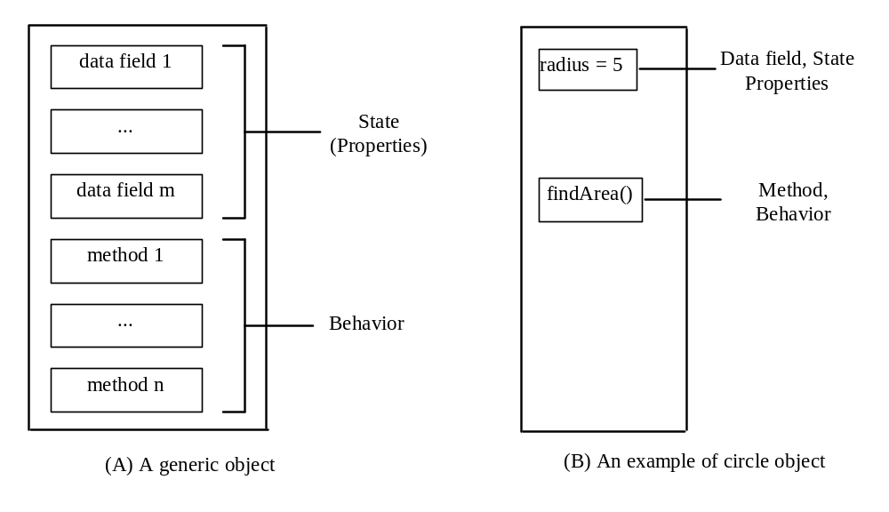
Objects

Slide 14
Classes
A class is a design for an object, defining its properties and methods
The class also provides special methods, called constructors, that create an instance of an object from the class
A class is analogous to a cookie cutter and an object to a cookie
A constructor is analogous to using the cookie cutter to cut a cookie from some pastry

Slide 15
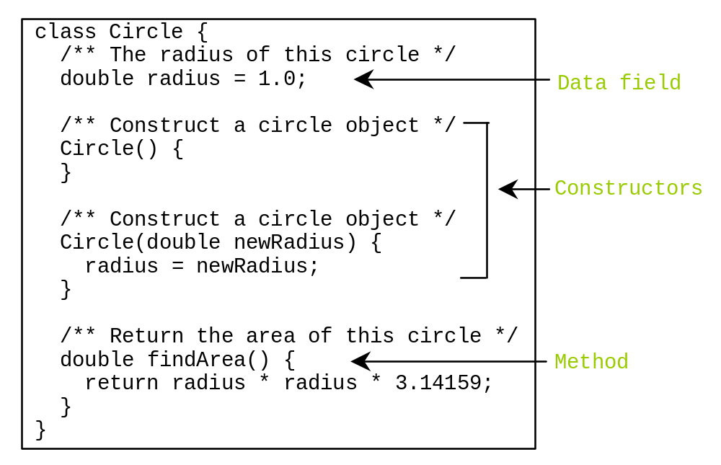
Classes

Slide 16
Classes
All the classes we have seen so far contain a main method
This tells Java where program execution must begin when the program is run
Any class that does not contain a main method, such as on the previous slide, cannot be run, since Java would not know where to begin execution
Such classes can only be used to declare and create objects

Slide 17
Classes
More than one class can be put into a single file, provided
  Only one class in the file is public
  The public class has the same name as the file name

Slide 18
Constructors
Constructors must have the same name as the class itself
Constructors do not have a return type—not even void
Constructors are invoked using the new operator when an object is created
Constructors play the role of initializing objects
Constructors can be overloaded, making several different construction methods available

Slide 19
Default Constructors
A constructor with no parameters is a default constructor
If no constructor is defined then a default constructor is implicitly defined
However, if one or more constructors is defined then the default constructor must also be created if it is to be used

Slide 20
Using Constructors
A constructor is called in the same way as a standard method, except that it is preceded by 'new'
For example, the following creates an object of the class ClassName using its default constructor
new ClassName();

Slide 21
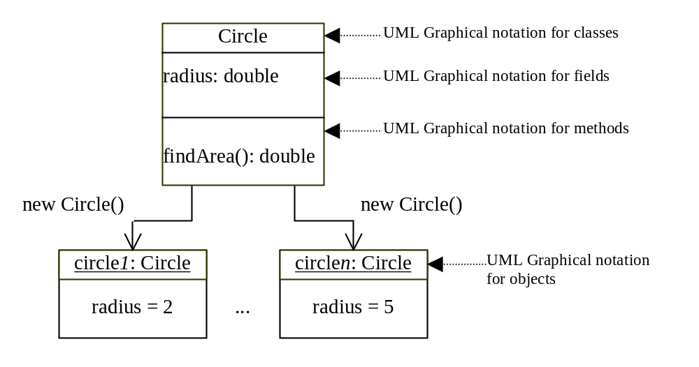
Constructing Objects

Slide 22
Using Objects
To use an object, a reference to its location in memory can be stored in a variable
The variable is called an object reference variable
Arrays are implemented as objects in Java, so you have already used this approach

Slide 23
Using Reference Variables
A reference variable objectRefVar to store an object that is an instance of the class ClassName can be declared using the syntax
  ClassName objectRefVar;
An instance of the class ClassName can then be stored in the variable using the syntax
  objectRefVar = new ClassName();
These operations can also be performed in a single step using the syntax
  ClassName objectRefVar = new ClassName();

Slide 24
Accessing Reference Variables
A reference variable objectRefVar that is storing an object that is an instance of the class ClassName can have a property named exampleData accessed using the syntax
  objectRefVar.exampleData;
Or a method named exampleMethod with parameter exampleParameter accessed using the syntax
  objectRefVar.exampleMethod(exampleParameter);

Slide 25
Instance Methods & Variables
Objects are also known as instances
A property that is dependent on a specific instance is known as an instance variable
Similarly, a method that is dependent on a specific instance is known as an instance method
As we will see in the next lecture, variables and methods that apply to the whole class can also be created

Slide 26
Class Example
We will now examine the simple class Person, which illustrates
  Class and Objects
  Constructors
  Reference Variables
  Properties
  Methods

Slide 27
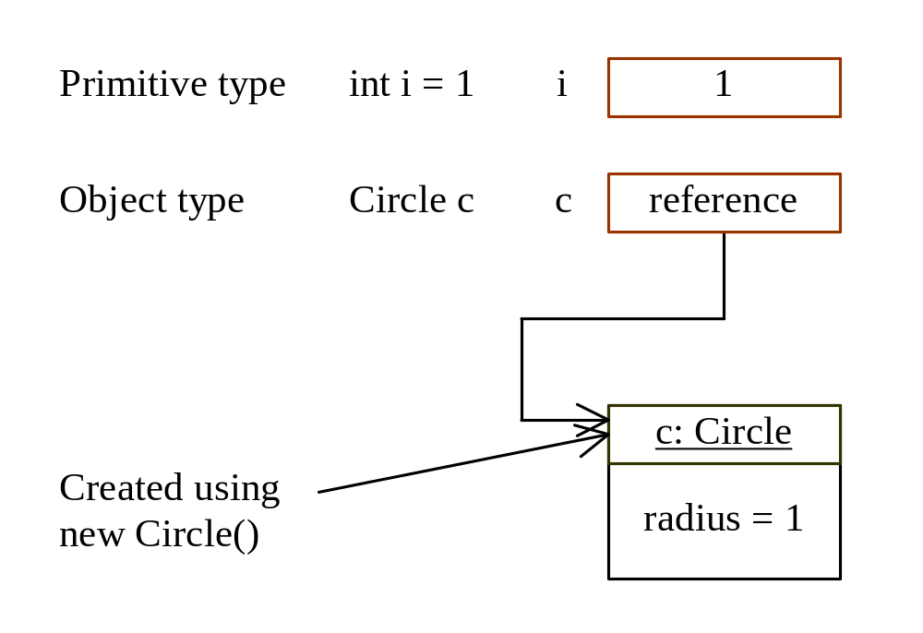
Differences between Variables of
Primitive Data Types and Object Types

Slide 28
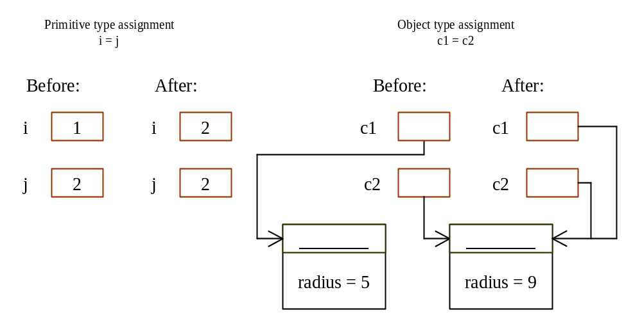
Copying Variables of Primitive Data Types and Object Types

Slide 29
Visibility Modifiers and
Accessor/Mutator Methods
By default, the class, variable, or method can be
accessed by any class in the same package.
public
The class, data, or method is visible to any class in any package.
private
The data or methods can be accessed only by the declaring class.
Get and set methods must be defined to read and modify private properties.

Slide 30
Visibility Modifiers
Visibility modifiers (public or private) are used by placing them at the start of classes, methods or properties; for example
  public class Circle { …
  public Circle() { …
  private double radius;
If no visibility modifier is used then any class within the same package can access the class, method or property

Slide 31
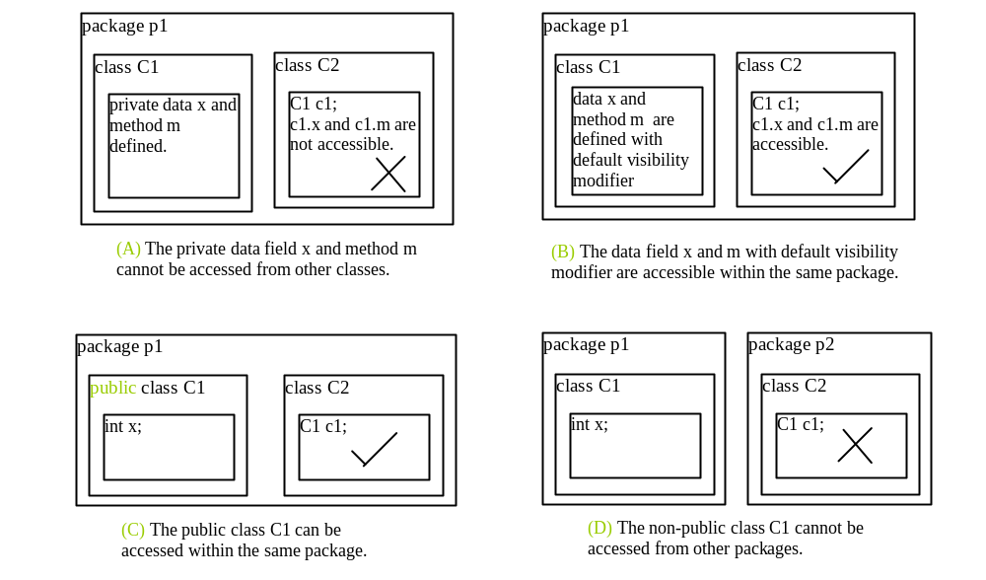

Slide 32
Why Should Data Fields Be private?
To make class easy to maintain
This is called data field encapsulation
You should therefore always make data fields private where possible

Slide 33
Making Data Fields Private
To make a data field named dataField and of type dataType private
  Precede its declaration by 'private'
  If it must be possible to change its value, create a method
    public void setDataField(dataType newDataField) {
      dataField = newDataField;
    }
  If it must be possible to read its value, create a method
  public dataType getDataField() {
      return (dataField);
  }

Slide 34
Class Example
We will examine a modification of the Person class, called PersonEncapsulation
This makes the data fields private, with get and set methods to modify them
This means that the implementation of the data can be changed without affecting software that uses it
For example, the data could be changed to imperial within the class, with the get and set methods performing the necessary conversion
If time permits, we will look ahead to lecture 10

