Slide 1
ICT221 Software Development 1
Lecture 10
Objects and Classes

Slide 2
Assignment Timeline
Week | Tasks that should be completed
21 Jul | Create a Java UserInterface class for the assignment containing a main method that outputs a message
28 Jul | Design the algorithms to be used within the program
4 Aug | Add input to program, but without code to check whether values are valid, make decisions or loops Add output to program so that input values are reported
11 Aug | Add input validation – this needs only to generate error messages Add code to determine if a vehicle is category V1, V2 or V3 based on its family (motorbike/car/truck), number of axles and trailer Add code to output all required management information – at the moment the values output can all be zeros, apart from the machine/staff cost of the lanes and the total time per vehicle to process vehicles in each of the 3 lane types
18 Aug | Modify validation code so that when invalid input is received the user is given an error message and re-prompted until input is valid Add code that can determine the lane type for a vehicle, based on its cash value and vehicle type (V1/V2/V3)

Slide 3
Assignment Timeline
Week | Tasks that should be completed
25 Aug | Create a JBuilder project for the application and move the UserInterface class into it Modify validation code so that when invalid input is received the user is given an error message and re-prompted until input is valid Create code that can convert a price from cents (eg 225 cents) to dollars and cents (eg $2.25)
1 Sep | Devise test plan and data Test and debug
8 Sept | Construct methods to: Construct an empty two dimensional array of ints Construct a two dimensional array of ints in the format defined in the Traffic class – use the same data as in the example file, and the array can again be named vehicleList Obtain the number of rows in vehicleList Obtain the number of rows in vehicleList that are a specified type (V1, V2 or V3 vehicles) Also construct all other methods in the Traffic class that use vehicleList

Slide 4
Assignment Timeline
Week | Tasks that should be completed
15 Sept | Create the Traffic class, containing all required properties, getters, setters & methods; methods will contain no code yet, but their assignment descriptions should be inserted as comments. Add the constructor with the String parameter to the Traffic class Use visibility modifiers so that the visibilities of properties and methods match those in the UML diagram. Implement the first three methods in the Traffic class Modify the main method in the UserInterface class so that: The filename obtained from the user is used as a parameter when calling the constructor to create a new Traffic object. It stores all information input by the user in the Traffic object and then uses the appropriate methods from the Traffic object to output this information.
22 Sept | Modify your UserInterface code so all its management information is generated using methods from the Traffic object – this will mean that many of the report items are output as zero values Implement the processingTimePerVehicle method

Slide 5
Assignment Timeline
Week | Tasks that should be completed
29 Sept | Implement the vehiclesInList methods Implement the vehiclesInLaneType methods
6 Oct | Implement the processingTimePerLaneType Implement the revenuePerLaneType methods
13 Oct | Implement the costPerLaneType methods Implement the netIncomePerLaneType methods
20 Oct | Complete any further functionality that you have not yet implemented, and ensure that all required results are output

Slide 6
Summary
When software is developed, the Systems Development Life Cycle is followed
  Systems planning
  Systems analysis
  Systems design
  Systems implementation, which we will be covering in this course
  Systems operation and support

Slide 7
Summary
We will develop software which has already been divided into modules
For each module, we will develop program code by
  Using pseudocode (with flowcharts for complex code) to develop an algorithm design
  Creating the module and inserting the pseudocode as comments
  Following each comment with the necessary lines of code to undertake the required operations

Slide 8
Summary
We have seen how the fundamental concepts upon which pseudocode is based are simply
  Processing of input and output data, which is stored in variables, constants and literals
  Control structures, determining execution order, which can be
    Sequence, where lines of code are executed from top to bottom
    Selection, where one of several different courses of action can be taken according to circumstances
    Repetition, where lines of code can be repeated
We have examined data, control structures, testing, debugging, methods, arrays, class & objects in Java
Today we will continue to examine classes and objects

Slide 9
Passing Arrays as Parameters
As we have already seen, we can pass primitive data types (integers, floating point numbers, characters and Booleans) as parameters to methods
Primitive data type parameters are passed by value - when a variable is used as a parameter, a copy of its value is used within the method
Any changes to the parameter therefore do not change the value stored within the variable

Slide 10
Passing Arrays as Parameters
As we have seen, when an array is passed as a parameter its value is again used
However, this value is a reference to the array
This means that any changes to the array parameter will change the values stored within the array
Arrays are implemented as objects in Java, so passing objects as parameters will work in the same way
This means that any changes to the object parameter will change the object properties

Slide 11
Instance Methods & Variables
As we have seen, objects are also known as instances
A property that is dependent on a specific instance is known as an instance variable
Similarly, a method that is dependent on a specific instance is known as an instance method
As we will see, variables and methods that apply to the whole class can also be created

Slide 12
Class Variables, Constants & Methods
Class (also known as static)
  Variables are shared by all the instances of the class
  Methods are not tied to a specific object
  Constants are final variables shared by all the instances of the class
The static modifier is used to declare class variables, constants & methods

Slide 13
Why Instance & Class Variables?
Instance variables are used to store data that is specific to each object
Class variables are used to store data that is common to all objects
For example, if an object represents a bank account then
  The account balance must use an instance variable (or every account shares the same balance!)
  The total number of accounts must use a class variable (or every account object stores the total number of accounts, when only a single value needs to be stored for all accounts)

Slide 14
Why Instance & Class Methods?
Instance methods are used to store methods that are specific to each object
Class methods are used to undertake tasks without creating an instance of an object
Using our bank account example again
  A method to calculate account interest must be an instance method (or every account shares the same interest!)
  A method to get the number of accounts must be a class method (so that the total accounts can be determined without having to use an account object)

Slide 15
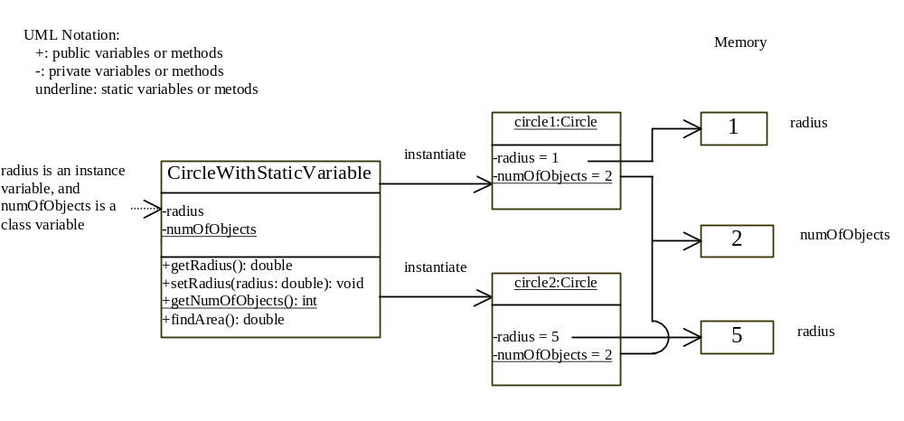
Class Variables, Constants
& Methods

Slide 16
The this Keyword
The keyword this can be used in methods to refer to the object to which the method belongs
This allows us to use the same name for parameters and hidden properties
It also allows us to simplify classes, by implementing multiple constructors by having those with fewer arguments call those with more

Slide 17
The this Keyword
Hidden instance variables can be accessed using the syntax
  this.InstanceVariable
Hidden static variables can be accessed using the syntax
  ClassName.StaticVariable
A constructor of class ClassName can call another constructor of its class using the syntax
  this(ParameterName);
This is illustrated on the following slide

Slide 18
The this Keyword
If a class has multiple constructors then it can be simplified by having those with fewer arguments calling those with more
For example, the default constructor for the Circle class can call the constructor with single parameter and pass it the value 1 in the following way
  this(1);
This is further illustrated on the following slide

Slide 19
The this keyword
Code without this
  public Circle() {
  radius = 1;
  count++;
  }
  public Circle(double newRadius) {
  radius = newRadius;
  count++;
  }
Improved code with this
  public Circle() {
  this(1);
  }
  public Circle(double radius) {
  this.radius = radius;
  Circle.count++;
  }

Slide 20
Code Example
We will now examine the example Account class to illustrate
  Passing objects as parameters
  Instance and class variables and methods
  The this keyword

Slide 21
Variable Scope
The scope of a variable describes where in a program it can be accessed
The scope of
  Instance and static variables is the entire class, regardless of where they have been declared
  A variable declared within a code block (between {..}) is the code block
  Such variables are called local

Slide 22
Variable Scope Example
The scope of
  The class variable number is shown in italic text
  The local variable localNumber is shown in bold
    public class Account {
    private int number;
    public void copyNumber() {
    int localNumber = number;
    System.out.println(localNumber);
    }
    }

Slide 23
Arrays of Objects
A 2 dimensional array is an array of arrays
Each array is an object
This means that arrays of any objects can be created
An array of objects is actually an array of reference variables, as shown on the following slide

Slide 24
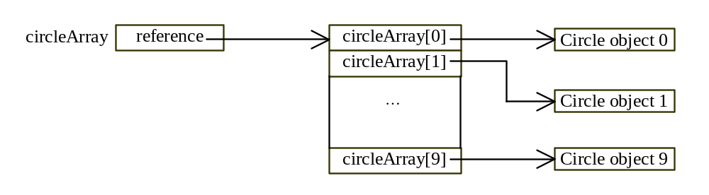
Arrays of Objects
Circle[] circleArray = new Circle[10];

Slide 25
Arrays of Objects
To declare create and create an array
  Containing a maximum index of n
  Named arrayName
  Containing objects belonging to class className
The following syntax is used
  className[] arrayName = new className[n];
This stores the value null at each array location
A reference to an object must be created at each location using a constructor

Slide 26
Arrays of Objects
To store actual objects at each array location instead of null, a reference to an object must be created at each location using a constructor
For example, to use the default constructor to create a reference to every object in arrayName the following can be used
  for (int i=0; i<arrayName.length; i++) {
  arrayName[i] = new className();
  }

Slide 27
Code Example
We will now examine the class AccountArray, which demonstrates
  Variable scope
  Arrays of objects

Slide 28
Class Abstraction
Class abstraction means to separate class implementation from the use of the class
The creator of the class provides a description of the class and lets the user know how the class can be used
The user of the class does not need to know how the class is implemented
The detail of implementation is encapsulated and hidden from the user

Slide 29
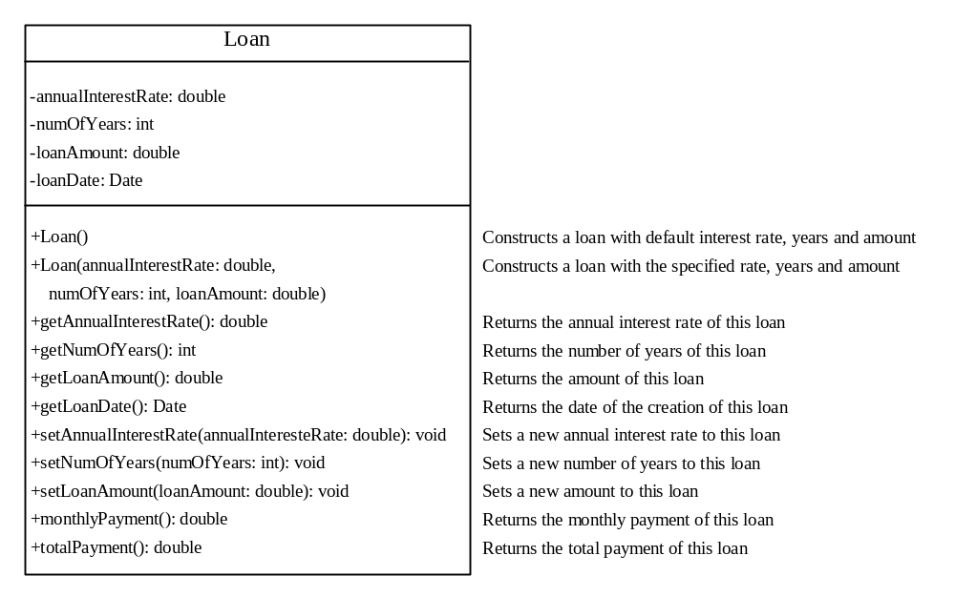
Example 7.15 The Loan Class

Slide 30
Code Example
We will now examine an implementation of the Loan class
Note that we don't need to know how this implementation works if we want to use the class
Indeed, this implementation may change over time and, provided it matches the class definition, can still be used unchanged by other software

