Slide 1
ICT221 Software Development 1
Lecture 11
Strings

Slide 2
Assignment Timeline
Week | Tasks that should be completed
21 Jul | Create a Java UserInterface class for the assignment containing a main method that outputs a message
28 Jul | Design the algorithms to be used within the program
4 Aug | Add input to program, but without code to check whether values are valid, make decisions or loops Add output to program so that input values are reported
11 Aug | Add input validation – this needs only to generate error messages Add code to determine if a vehicle is category V1, V2 or V3 based on its family (motorbike/car/truck), number of axles and trailer Add code to output all required management information – at the moment the values output can all be zeros, apart from the machine/staff cost of the lanes and the total time per vehicle to process vehicles in each of the 3 lane types
18 Aug | Modify validation code so that when invalid input is received the user is given an error message and re-prompted until input is valid Add code that can determine the lane type for a vehicle, based on its cash value and vehicle type (V1/V2/V3)

Slide 3
Assignment Timeline
Week | Tasks that should be completed
25 Aug | Create a JBuilder project for the application and move the UserInterface class into it Modify validation code so that when invalid input is received the user is given an error message and re-prompted until input is valid Create code that can convert a price from cents (eg 225 cents) to dollars and cents (eg $2.25)
1 Sep | Devise test plan and data Test and debug
8 Sept | Construct methods to: Construct an empty two dimensional array of ints Construct a two dimensional array of ints in the format defined in the Traffic class – use the same data as in the example file, and the array can again be named vehicleList Obtain the number of rows in vehicleList Obtain the number of rows in vehicleList that are a specified type (V1, V2 or V3 vehicles) Also construct all other methods in the Traffic class that use vehicleList

Slide 4
Assignment Timeline
Week | Tasks that should be completed
15 Sept | Create the Traffic class, containing all required properties, getters, setters & methods; methods will contain no code yet, but their assignment descriptions should be inserted as comments. Add the constructor with the String parameter to the Traffic class Use visibility modifiers so that the visibilities of properties and methods match those in the UML diagram. Implement the first three methods in the Traffic class Modify the main method in the UserInterface class so that: The filename obtained from the user is used as a parameter when calling the constructor to create a new Traffic object. It stores all information input by the user in the Traffic object and then uses the appropriate methods from the Traffic object to output this information.
22 Sept | Modify your UserInterface code so all its management information is generated using methods from the Traffic object – this will mean that many of the report items are output as zero values Implement the processingTimePerVehicle method

Slide 5
Assignment Timeline
Week | Tasks that should be completed
29 Sept | Implement the vehiclesInList methods Implement the vehiclesInLaneType methods
6 Oct | Implement the processingTimePerLaneType Implement the revenuePerLaneType methods
13 Oct | Implement the costPerLaneType methods Implement the netIncomePerLaneType methods
20 Oct | Complete any further functionality that you have not yet implemented, and ensure that all required results are output

Slide 6
Summary
When software is developed, the Systems Development Life Cycle is followed
  Systems planning
  Systems analysis
  Systems design
  Systems implementation, which we will be covering in this course
  Systems operation and support

Slide 7
Summary
We will develop software which has already been divided into modules
For each module, we will develop program code by
  Using pseudocode (with flowcharts for complex code) to develop an algorithm design
  Creating the module and inserting the pseudocode as comments
  Following each comment with the necessary lines of code to undertake the required operations

Slide 8
Summary
We have seen how the fundamental concepts upon which pseudocode is based are simply
  Processing of input and output data, which is stored in variables, constants and literals
  Control structures, determining execution order, which can be
    Sequence, where lines of code are executed from top to bottom
    Selection, where one of several different courses of action can be taken according to circumstances
    Repetition, where lines of code can be repeated
We have examined data, control structures, testing, debugging, methods, arrays, class & objects in Java
Today we will examine strings, which we have only made limited use of so far

Slide 9
Strings
A string is a sequence of characters, such as "Green" or "Jane"
To store and process strings, Java provides the following classes
  String
    Allows strings to be stored and processed but not modified
    Allows tokens to be extracted from strings using the split method
  StringBuffer
    Allows strings that can be modified to be created

Slide 10
The String Class
The java.lang.String class models a sequence of characters as a string
We have already made use of string literals, such as messages output using the println method
The most frequently used methods of the String class are shown on the next slide

Slide 11
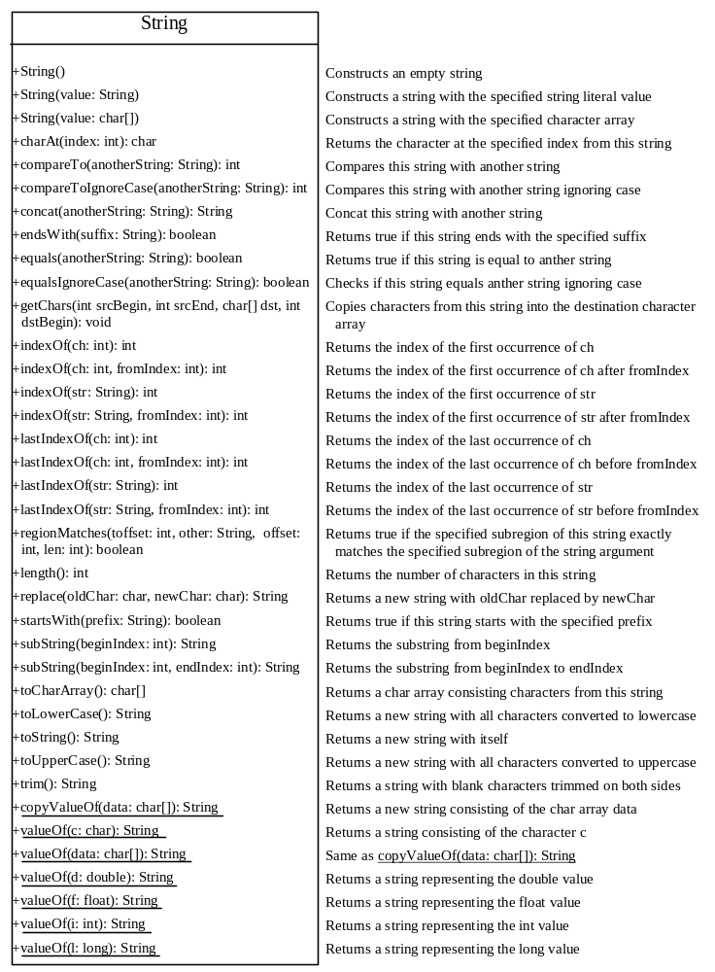

Slide 12
Constructing Strings
So far we have constructed new strings using the syntax
  String newString = stringLiteral;
Where newString is the variable used to store the string and stringLiteral is a string literal, such as in the following example
  String message = "Hello World";

Slide 13
Constructing Strings
The syntax that we have used is actually shorthand notation that Java supports
It is equivalent to
  String newString = new String(stringLiteral);
Our example could be rewritten in this way as
  String message = new String("Hello World");
However, the shorthand notation is simpler and so should normally be used

Slide 14
String Representation
Strings are represented as objects within Java
As we have already seen, to use an object, a reference to its location in memory can be stored in a variable
The variable is called an object reference variable
This has important implications when strings are compared

Slide 15
String Comparison
If two strings are compared using the == operator then they are found to be equal only if they refer to the same object
This is the case for strings created with the same literal value using shorthand notation
Comparing two strings using the == operator that have the same contents but do not share the same object will find them to be unequal

Slide 16
String Comparison
The equals method is used to test whether a pair of strings have the same contents, using the syntax
  s1.equals(s2);
Where s1 and s2 are two strings

Slide 17
String Comparison
The compareTo method is used to compare a pair of strings have the same contents, using the syntax
  s1.compareTo(s2);
Where s1 and s2 are two strings
The value returned is
  0 if s1 is equal to s2
  <0 if s1 is lexographically less than s2
  >0 if s1 is lexographically greater than s2
We will now use the example class TestStringComparison to demonstrate this

Slide 18
String Concatenation
We have already used + to concatenate strings
The concat method can also be used to do this, as in the following example
  s3 = s1.concat(s2);
This is equivalent to the following
  s3 = s1 + s2;

Slide 19
Finding String Length
Finding string length using the length() method:
message = "Welcome to Java";
message.length() (returns 15)

Slide 20
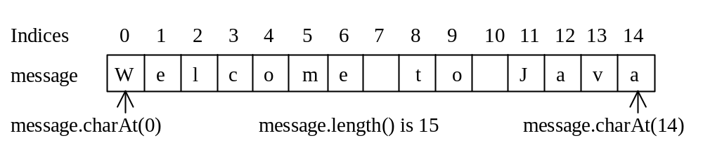
Retrieving Individual Characters in a String
Do not use message[0]
Use message.charAt(index)
Index starts from 0

Slide 21
String Conversions
The contents of a string cannot be changed once the string is created. But you can convert a string to a new string using the following methods:
toLowerCase
toUpperCase
trim
replace(oldChar, newChar)

Slide 22
Finding a Character or a Substring in a String
"Welcome to Java".indexOf('W') returns 0.
"Welcome to Java".indexOf('x') returns -1.
"Welcome to Java".indexOf('o', 5) returns 9.
"Welcome to Java".indexOf("come") returns 3.
"Welcome to Java".indexOf("Java", 5) returns 11.
"Welcome to Java".indexOf("java", 5) returns -1.
"Welcome to Java".lastIndexOf('a') returns 14.

Slide 23
Convert Char & Numbers to Strings
The String class provides several static valueOf methods for converting to strings
  A character
  An array of characters
  Numeric values
These methods have the same name valueOf with different argument types
  char[], double, long, int, and float

Slide 24
Convert Char & Numbers to Strings
For example, to convert a double value to a string, use
  String.valueOf(5.44)
The return value is a string and consists of characters ‘5’, ‘.’, ‘4’, and ‘4’

Slide 25
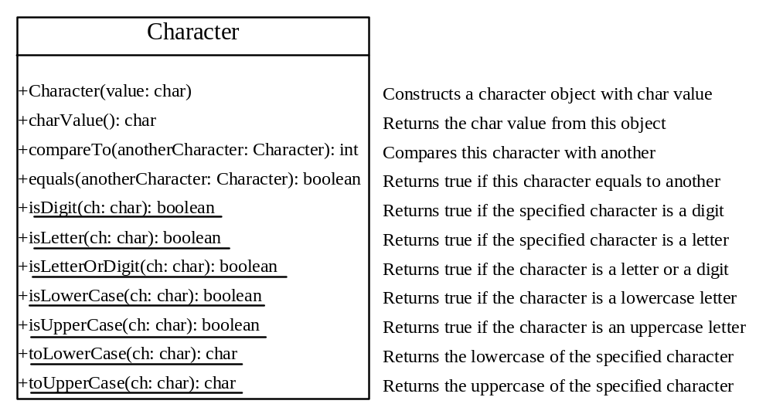
The Character Class

Slide 26
Examples
Character charObject = new Character('b');
charObject.compareTo(new Character('a')) returns 1
charObject.compareTo(new Character('b')) returns 0
charObject.compareTo(new Character('c')) returns -1
charObject.compareTo(new Character('d') returns –2
charObject.equals(new Character('b')) returns true
charObject.equals(new Character('d')) returns false

Slide 27
The StringBuffer Class
The StringBuffer class is an alternative to the String class. In general, a string buffer can be used wherever a string is used.
StringBuffer is more flexible than String. You can add, insert, or append new contents
into a string buffer. However, the value of
a string is fixed once the string is created.

Slide 28
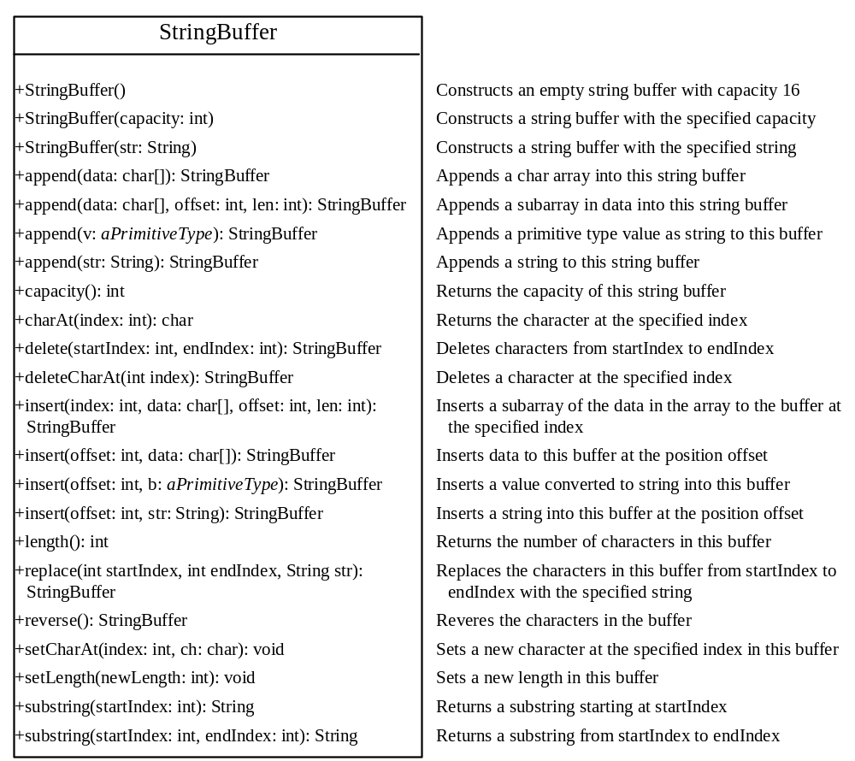

Slide 29
StringBuffer Constructors
public StringBuffer()
No characters, initial capacity 16 characters.
public StringBuffer(int length)
No characters, initial capacity specified by the length argument.
public StringBuffer(String str)
Represents the same sequence of characters
as the string argument. Initial capacity 16
plus the length of the string argument.

Slide 30
Appending New Contents into a String Buffer
StringBuffer strBuf = new StringBuffer();
strBuf.append("Welcome");
strBuf.append(' ');
strBuf.append("to");
strBuf.append(' ');
strBuf.append("Java");

Slide 31
The String split Method
This method is used to break a string into pieces so that they can be processed
For example, a string such as "Tim Jackson" could be broken into a first name and surname

Slide 32
Regular Expressions
The split method in Java makes use of regular expressions – these are used in other methods and languages also, so are very useful to learn
Regular expressions use a sequence of characters to identify a collection of strings – this collection is then used for matching, replacing or splitting
For example, the regular expression “Java” identifies all strings that are “Java”

Slide 33
Regular Expressions
Regular expressions allow more powerful option than just exact matches
For example, regular expressions can match
  Any string starting “Optimise” (“Optimise.*” matches “Optimise Speed”, “Optimise” etc)
  Any string “Optimi” followed by s or z followed by “e” (“Optimi(s|z)e” matches “Optimize” and “Optimise”
More complete details of regular expressions are given in the text

Slide 34
The String split Method
The split method uses the concepts of
  Regular expressions to identify the delimiters between individual words in the string
  Tokens, which are the pieces into which the string is broken
In our previous example
  The delimiter was " "
  The tokens were "Tim" and "Jackson"

Slide 35
The String split Method
The split method is overloaded into:
  split(regex: String): String[]
    This returns an array of strings consisting of the substrings split by the matches
  split(regex: String, limit: int): String[]
    This works above except limit defines how many times the pattern is applied
For example
  “Tim Jackson”.split(“ “) returns an array containing “Tim” and “Jackson” in locations 0 and 1
  “Mr Tim Jackson”.split(“ “, 1) returns an array containing “Mr Tim Jackson” in location 0
  “Mr Tim Jackson”.split(“ “, 2) returns an array containing “Mr” and “Tim Jackson” in locations 0 and 1

Slide 36
The String split Method
We will now use the Validation class to demonstrate the use of Characters StringBuffers and String split methods in a common business application task - validating user input

Slide 37
Running Java Programs From The Command Line
To run a java program named TestProgram from the command line, the following must be input
  java TestProgram
Programs can also have arguments passed to them, in the same way as methods
To do this with arguments arg0 to argn the following must be input
  java TestProgram arg0 arg1 … argn

Slide 38
Running Java Programs From The Command Line
Arguments do not need to be enclosed within double quotes unless they contain spaces
The argument values are passed into the main method of the program when it is executed
This allows programs to modify their operation depending on command line parameter values

Slide 39
Command-Line Arguments
You may have noticed that all main methods have a parameter args of type String[] (ie an array of Strings)
This array contains each of the command line arguments, where
  args[0] corresponds to command line arg0
  args[1] corresponds to command line arg1
  …
  args[n] corresponds to command line argn

Slide 40
Command-Line Arguments
We will now examine the example program InflatePrice
This takes command line arguments defining
  A price
  The number of years ago that the price existed
  The annual inflation rate
And outputs the price in today's terms

