Slide 1
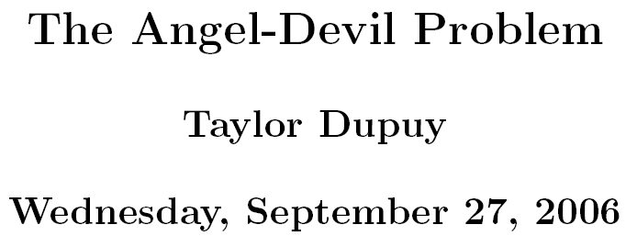

Slide 2
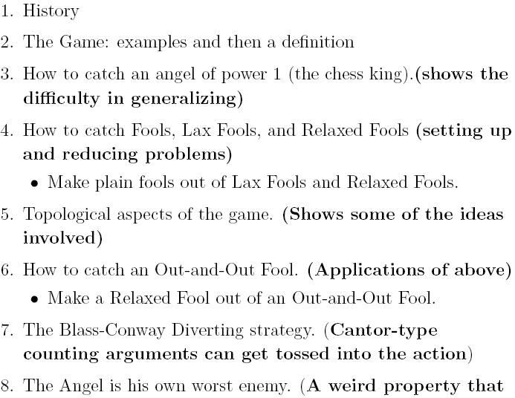


Slide 3
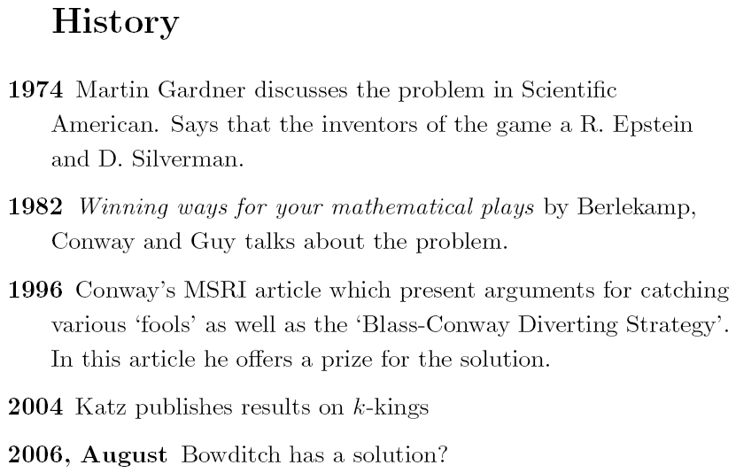

Slide 4
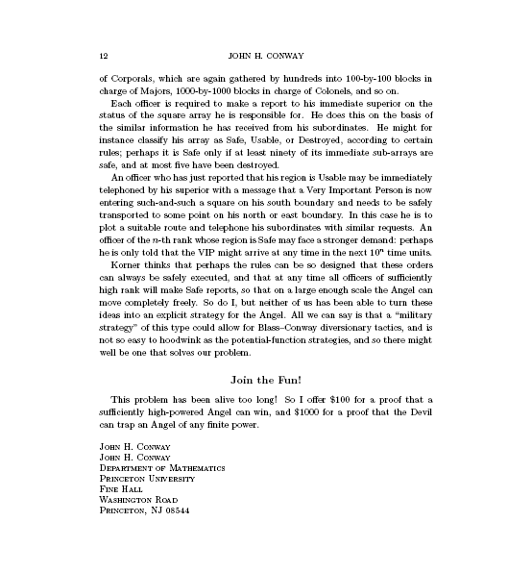
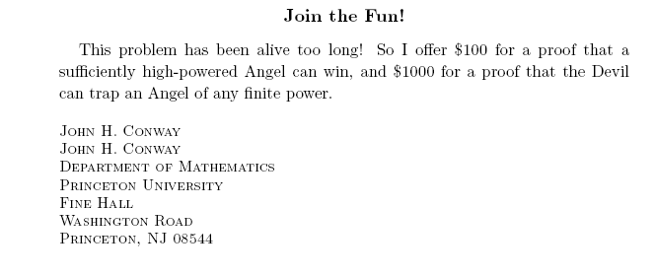

Slide 5

ANGEL:

Slide 20
Power of the Angel
Available Plays (For An Angel of Power 2)

Slide 21
Power of the Angel

Slide 22
Power of the Angel

Slide 23
Power of the Angel

Slide 24
Power of the Angel

Slide 25
Power of the Angel
Angel of Power 3

Slide 26
Power of the Angel

Slide 27
Power of the Angel

Slide 28
Power of the Angel

Slide 29
Trapping the Angel
ANGEL OF POWER TWO

Slide 30
Trapping the Angel

Slide 31
Trapping the Angel
ANGEL OF POWER
THREE

Slide 32
Trapping the Angel

Slide 33
Jumping
Remove this Block

Slide 34
Jumping

Slide 35
Jumping

Slide 36
Jumping

Slide 37
Jumping

Slide 38
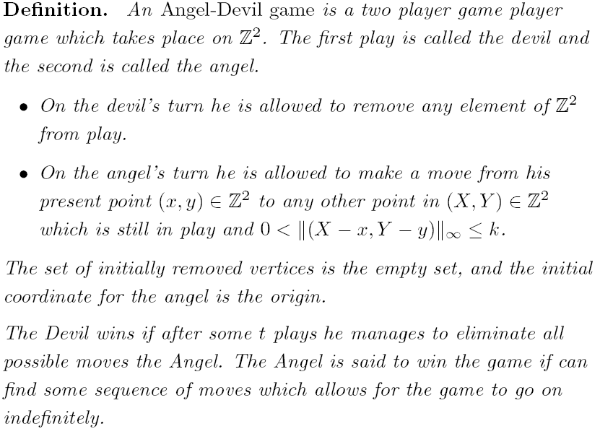

Slide 39


Slide 40
Observe that if we have three blocks in place, we can restrict the king's northern direction by just WALL FOLLOWING

Slide 46
If the devil has 5 spaces to work with, it is sufficient to set up a three square wall in order to block a king's direction

Slide 62
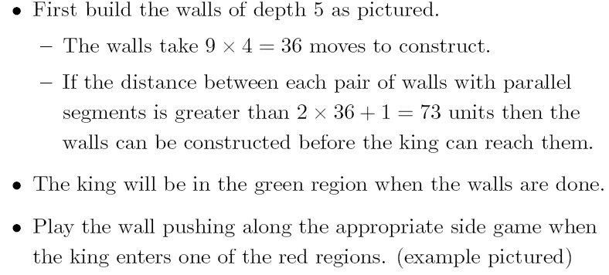
Places the King Could be After the Walls are built
King's Starting Position

Slide 63
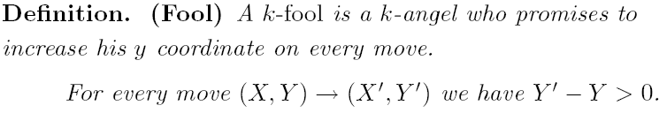

Slide 64
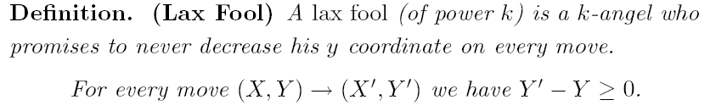

Slide 65
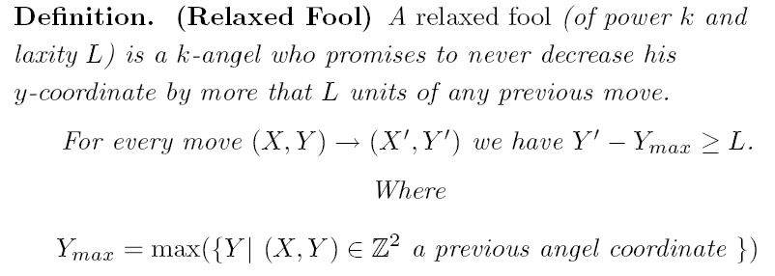

Slide 66








One out of every M have been chomped!
Two out of every M have been chomped!
Possible Paths After Getting Half Way To H, Again
Possible Paths After Getting Half Way To H

Slide 67
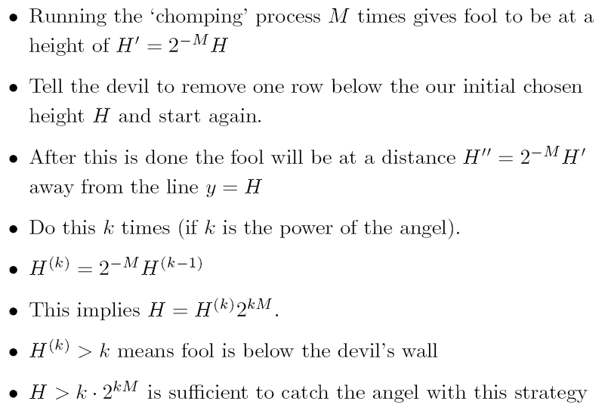

Slide 68
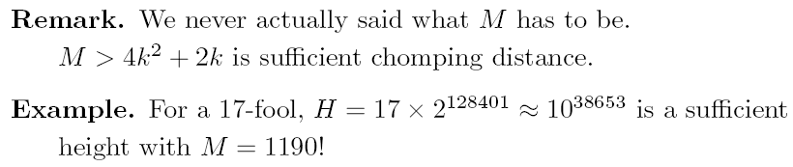
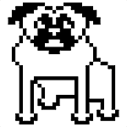
150X150 pixels

Slide 69



Slide 70
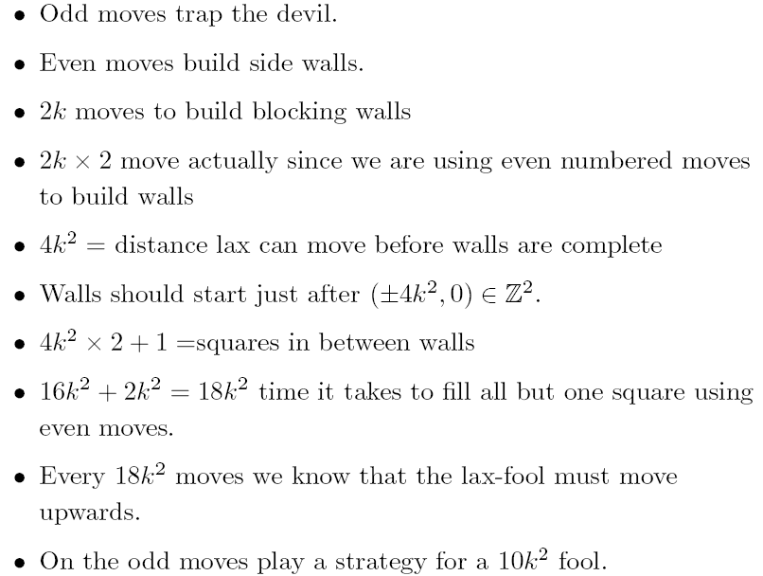

Slide 72
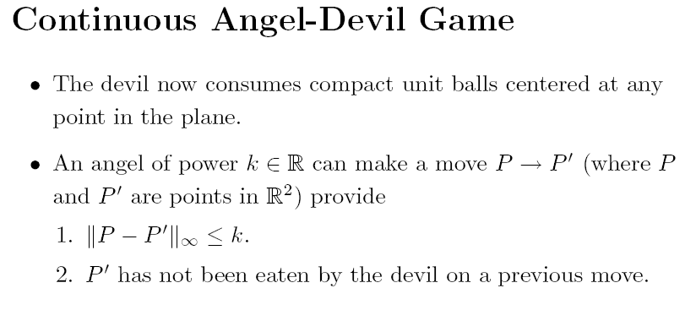

Slide 73
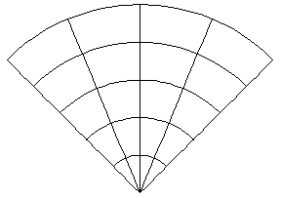
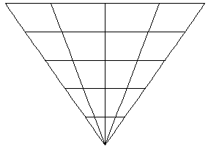
Angel Path
Devil
Strategy
Devil Move

Slide 74
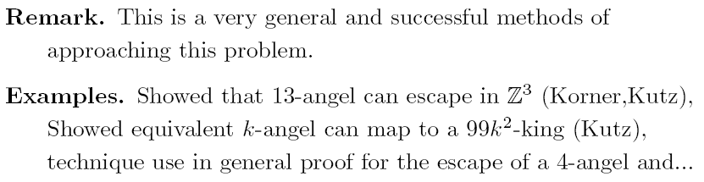

Slide 75
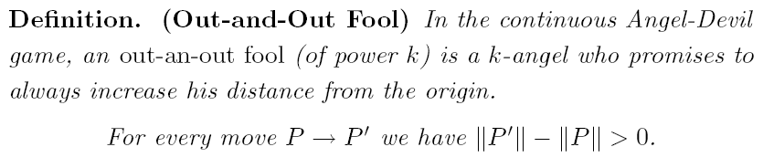

Slide 76
For the first quadrant:
1.Red
2.Green
3.Pink
4.Bordeaux

Slide 77
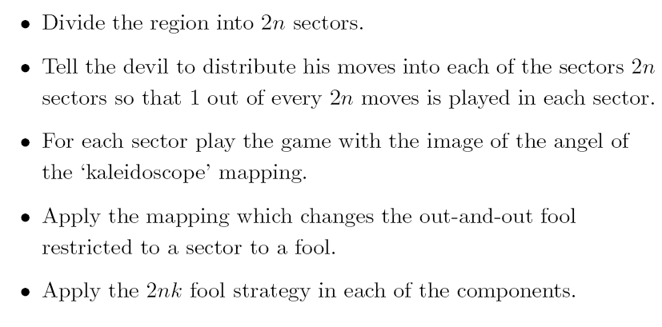
Sector Fool to Plain Fool

Slide 78
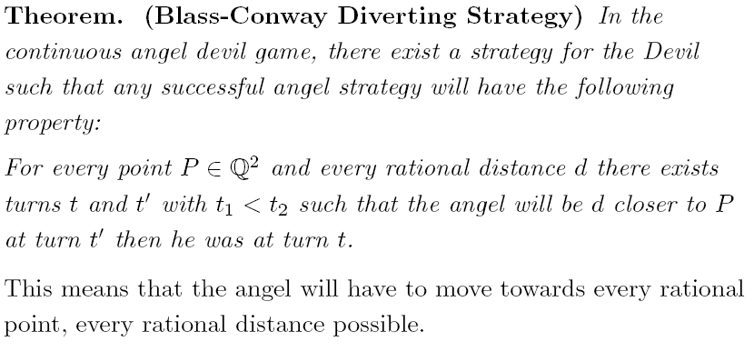

Slide 79
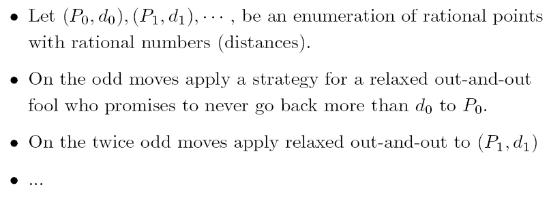
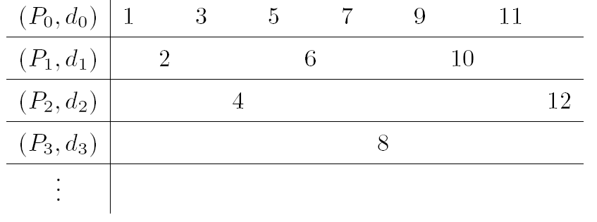

Slide 80
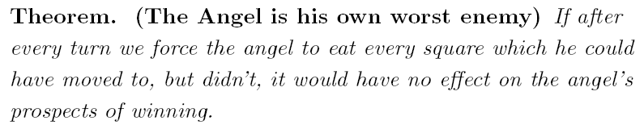
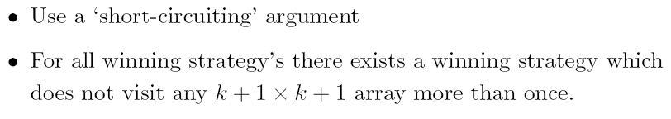

Slide 81
