Slide 1
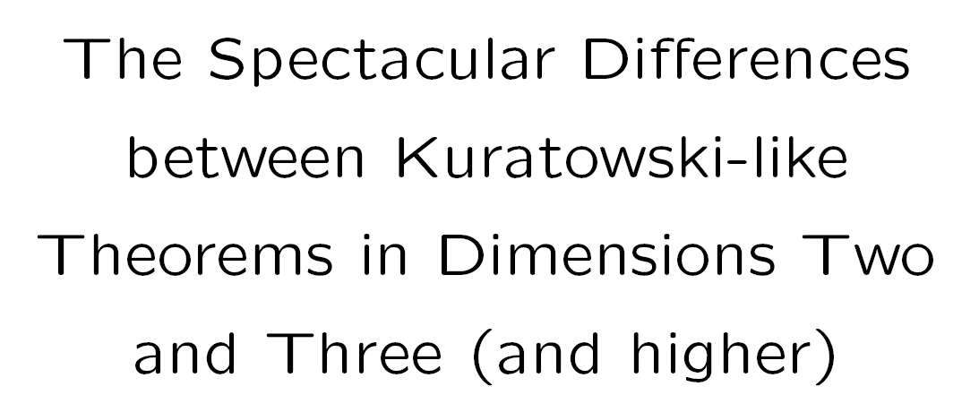
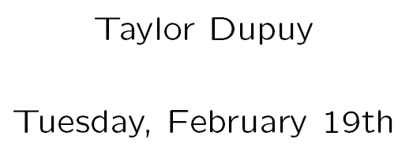

Slide 2
Three Houses-Three Utilities Problem
Connect each house to
each utility...
When drawing, the lines
cannot cross!

Slide 3
Three Houses-Three Utilities Problem

Slide 4
Three Houses-Three Utilities Problem
?

Slide 5
Three Houses-Three Utilities Problem
You Can't Do It!

Slide 6
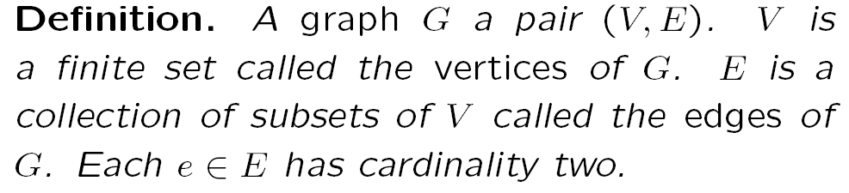
Formalize The Problem: Graphs and Planarity

Slide 7




Formalize The Problem: Graphs and Planarity

Slide 8
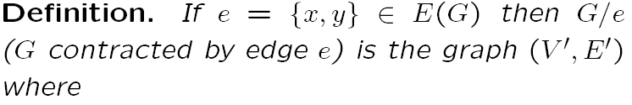


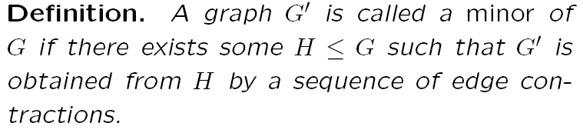
Formalize The Problem: Graphs and Planarity

Slide 9
Formalize The Problem: Graphs and Planarity
is a minor of
Subgraph
Edge to Contract
After Contraction

Slide 10
Another Special Graph...
Can't be drawn in the plane

Slide 11
Makings of a Theorem
Every graph which contains one of theses as a minor is not embeddable.

Slide 12
Makings of a Theorem
Conversely, every graph which not embeddable contains one of these graphs!
If I know this is not
planar...
Then I can find one of these

Slide 13
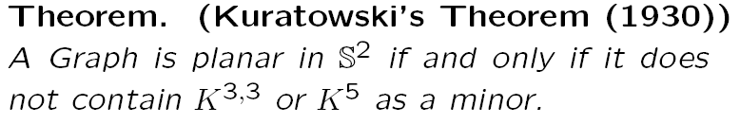
Minors and Kuratowski's Theorem

Slide 14
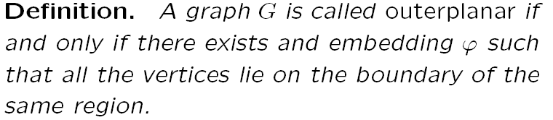
A Relevant Graph Property: Outerplanarity
Outerplanar
Not Outerplanar

Slide 15
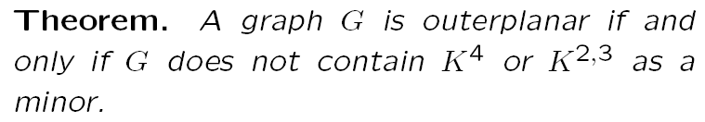
A Relevant Graph Property: Outerplanarity

Slide 16
A Way of Viewing nonplanarity from nonouterplanarity
our nonplanar graphs
(as drawn in most textbooks)
rearrange them
“violations” of our
outerplanar graphs

Slide 17
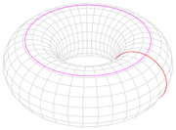
Mixing Things Up: Planarity On Different Manifolds
Fundamental Domain Of Torus:

Slide 18
Mixing Things Up: Planarity On Different Manifolds
Fundamental Domain Of Torus:

Slide 19
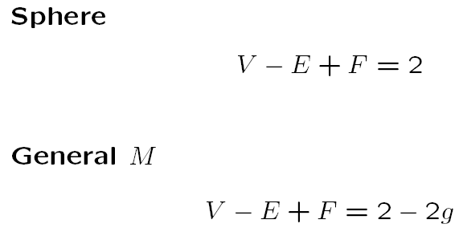
Mixing Things Up: Planarity On Different Manifolds

Slide 20
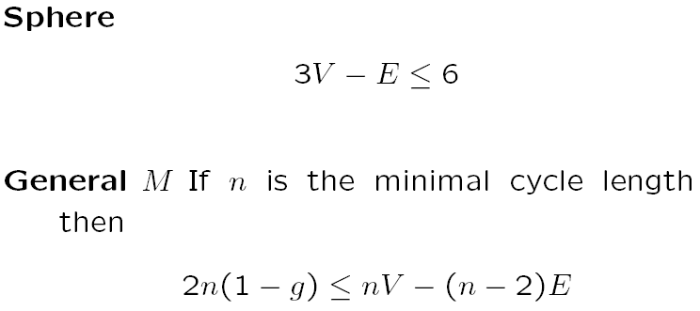
Mixing Things Up: Planarity On Different Manifolds

Slide 21
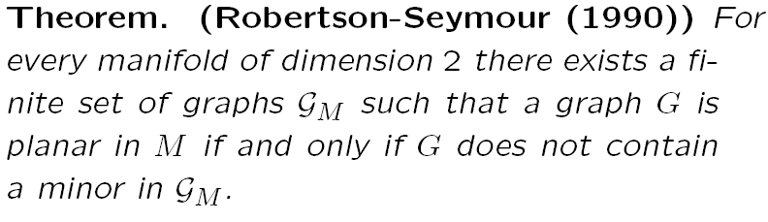
Mixing Things Up: A General Statement and A General Answer

Slide 22
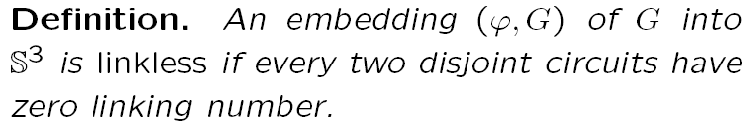
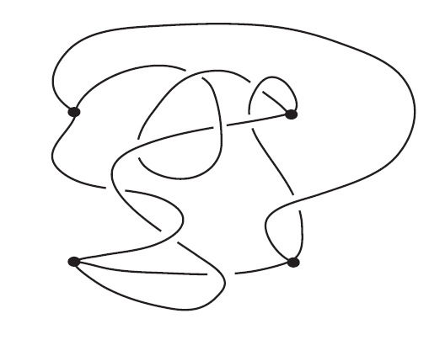
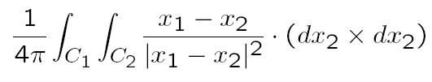
A General Phenomena in Graphs

Slide 23
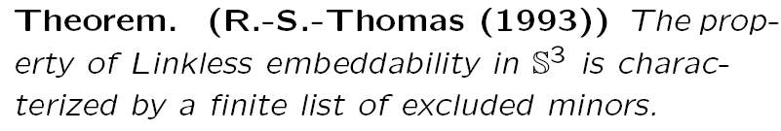
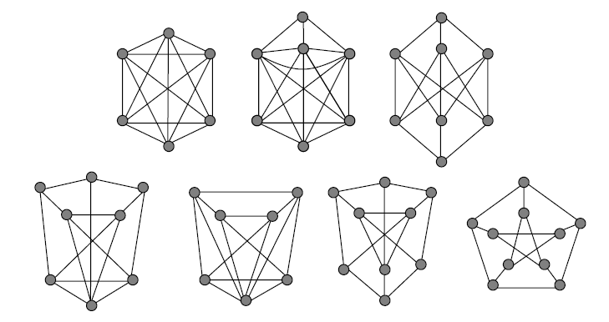
A General Phenomena in Graphs

Slide 24
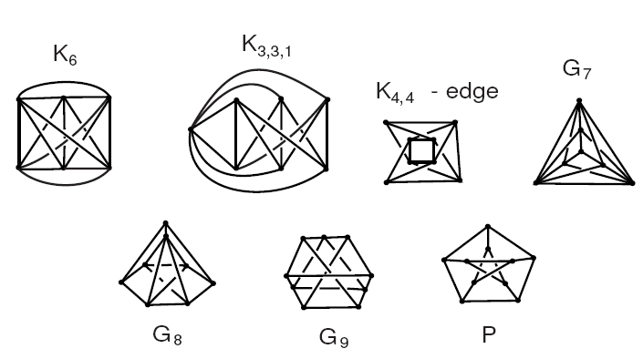
A General Phenomena in Graphs

Slide 25
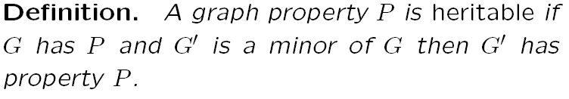
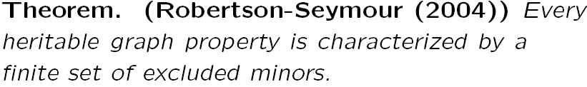
A General Theorem for Graphs!

Slide 26
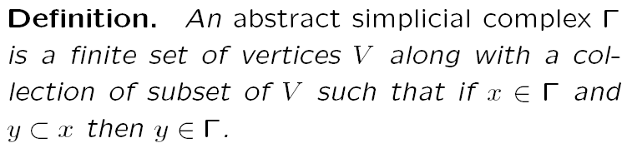
What Next? Abstract Simplicial Complexes

Slide 27
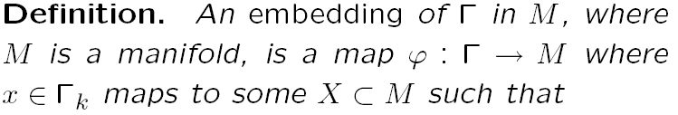
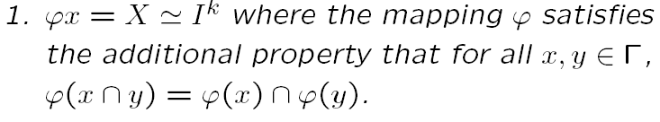

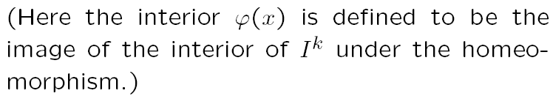
What Next? Abstract Simplicial Complexes

Slide 28
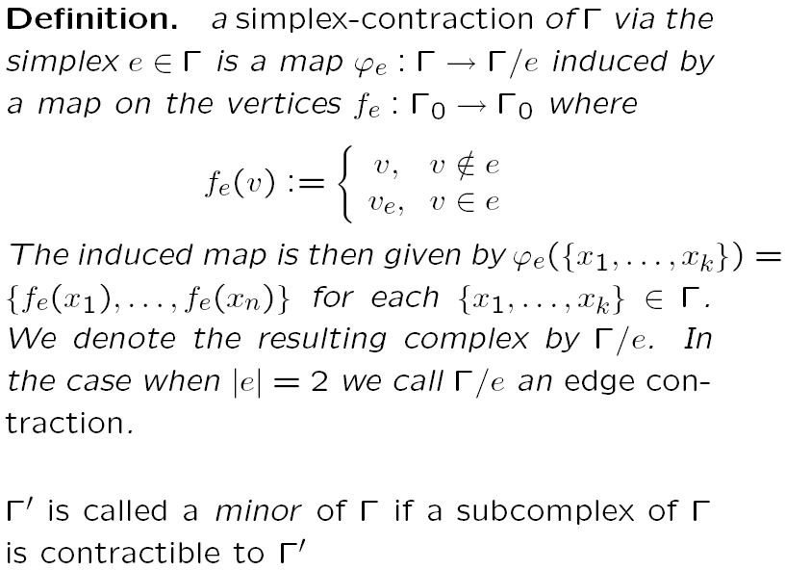

Slide 29

Differences Start To Become Apparent...
We need to change some things up:
Link Condition
Up to an equivalence relation
Piecewise Linearity

Slide 30
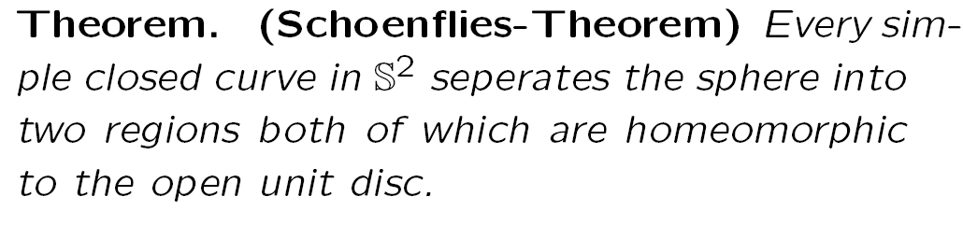
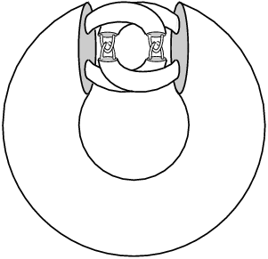
Differences Start To Become Apparent...
Theorem does not hold in higher
dimensions. We will require that our
embeddings be Piecewise-Linear so that
a higher dimensional Schoenflies holds.
Alexander’s Horned
Sphere

Slide 31
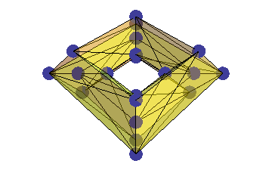
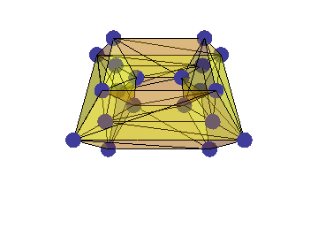
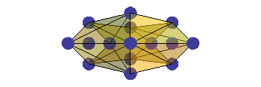
Goal: Get Planarity Criterion via Minors
Try Our First Strategy: Outerplanarity to Planarity
Can we characterize outerplanar complexes?
no... we have problems do to multiply connected regions

Slide 32
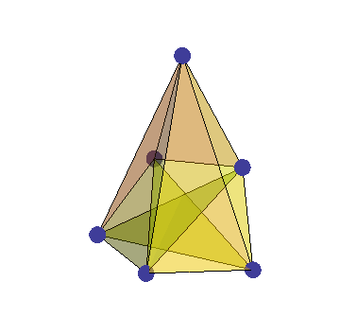
Goal: Get Planarity Criterion via Minors
In addition we have nonorientable complexes: the real projective plane

Slide 33
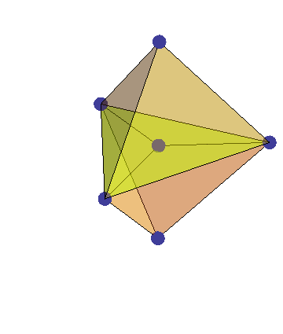
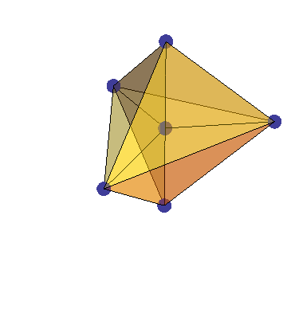
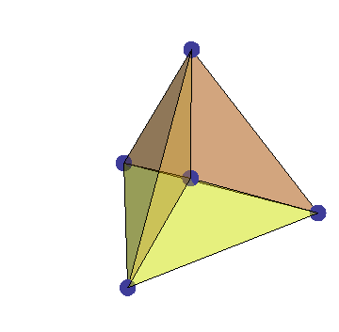
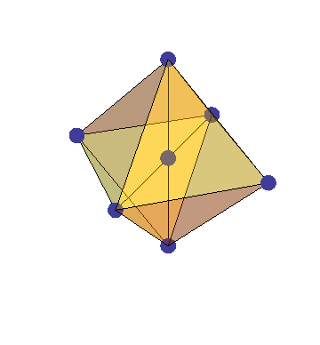
Goal: Get Planarity Criterion via Minors 2.0
Try Our Second Strategy: Outerplanarity to Planarity with modified hypothesis:
All Cycles Are Spheres.
What can we say?
If all the vertices lie in some cycle

Slide 34
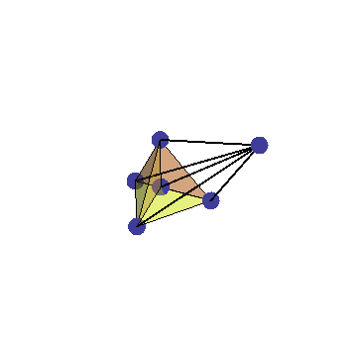
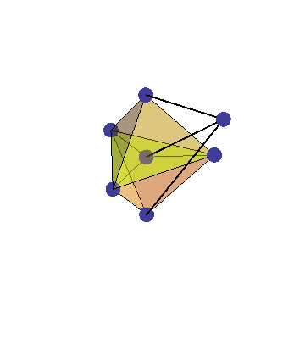
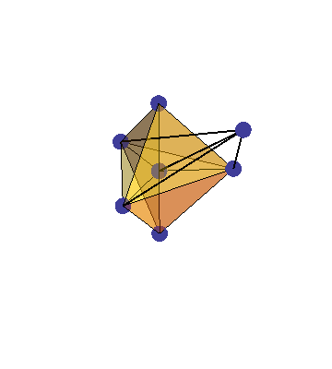
Goal: Get Planarity Criterion via Minors 2.0
What we want to say...
Nonplanar are “violations” of our
outerplanar graphs

Slide 35
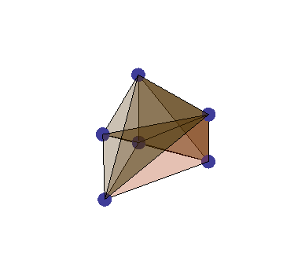
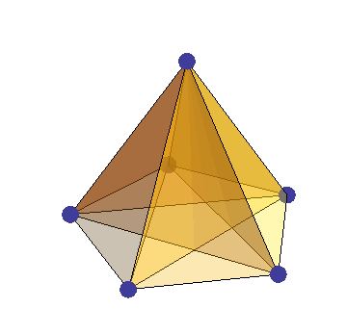
Goal: Get Planarity Criterion via Minors 2.1
Try Our Second Strategy: Outerplanarity to Planarity with modified hypothesis
This is FALSE, there are complexes
which are not planar, but not even
nonouterplanar before they become
outerplanar
coning a nonplanar graph

Slide 36
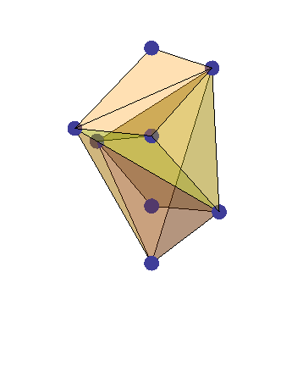
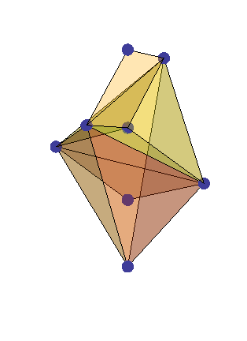
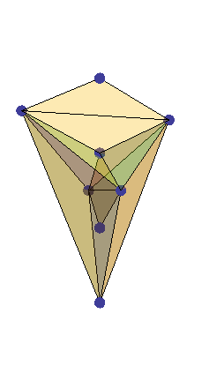
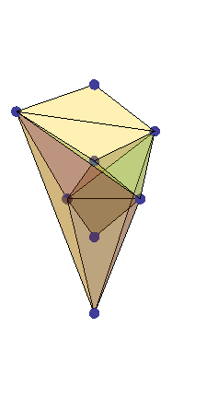
Goal: Get Planarity Criterion via Minors 3.0
Try Our Second Strategy: Outerplanarity to Planarity with modified hypothesis and
demanding that it has an outerplanar subgraph
What we want to say...
That our characterization of outerplanarity is correct.
Can we even restore the hypothesis for cycles to get a characterization
of outerplanarity?
NO... we have a counterexample

Slide 37
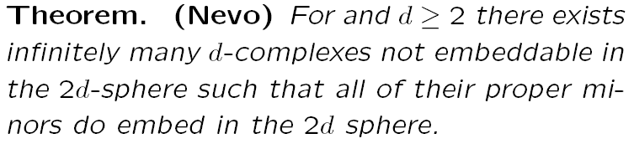
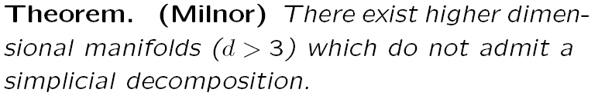
Goal doesn't looks so good...
Note: our inequalities for determining non-planarity go the wrong way in odd dimensions.

Slide 38
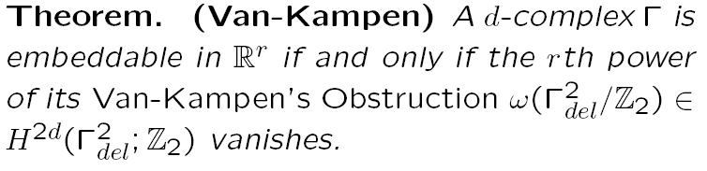
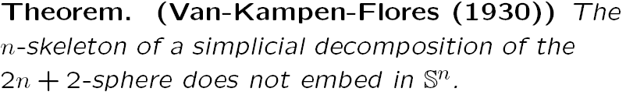
On The Other Hand...
What can we say...

Slide 39


Slide 40
On The Other Hand... Linkless Embeddability
Relationship with Linkless embeddability

