Slide 1
Autonomous cars - who should be held legally accountable in event of an accident?
Katrina, Vera & Tara

Slide 2
outline
Definition of an autonomous car
User Defined
Ethics, Liability & Legislation
Information needed to determine liability
Sources​

Slide 3
Autonomous car DEFINED:
NATIONAL HIGHWAY TRAFFIC SAFETY ADMINISTRATION (NHTSA)
SAE International
Level 0 – no autonomy
Level 1 – vehicle is controlled by the driver, but some assist features may be included.
Level 2 – vehicle has combined automated functions, but the human driver must remain engaged at all times
Level 3 – the vehicle can perform aspects of the driving task simultaneously under some circumstances but the human driver must be ready with notice *Tesla
Level 4 – the vehicle can perform all driving tasks in certain circumstances or only in limited spatial areas.
Level 5 – No human intervention is necessary
"autonomous" or "self-driving" vehicles are those in which the operation of the vehicle occurs without direct driver input to control the steering, acceleration, and braking and are designed so that the driver is not expected to constantly monitor the roadway while operating in self-driving mode.
*No international standard*

Slide 4
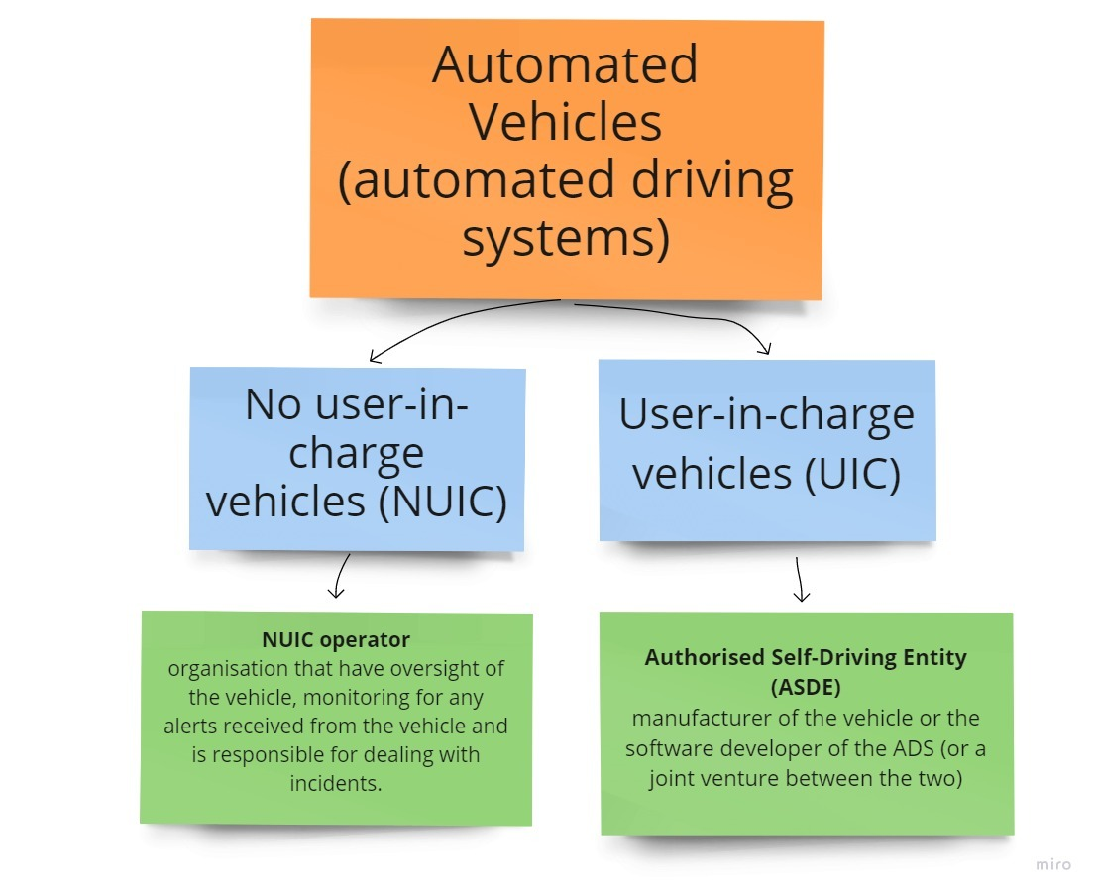
USER Defined
Instead of "owner", more companies and lawyers use a word "user" = autonomous self-driving cars are closer to computers than to cars.
Owner: someone who fully owns the vehicle and can change and modify it as they wish. User: someone who was given right to use the vehicle. This also changes the level of responsibility..
Joint report by the Law Commission of England and Wales and the Scottish Law Commission, January 2022

Slide 5
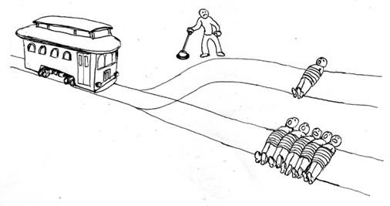
Ethics, Liability and Legislation
USER
users’ responsibility dependant on level of autonomy
responsible for insurance, seatbelts etc
responsible for driving offences if the vehicle has an option for transition of driving controls to the user, and the automated driving system has demanded the transition
responsible not to be under the influence of drugs and so on
MANUFACTURER
‘Manufacturers were not required to report how many vehicles they have on the road that have the systems, nor did they have to report how far those vehicles travelled, or when the systems are in use, NHTSA said. At present, those numbers aren't quantifiable, an agency official said.’
INSURANCE COMPANY
‘Self-driving cars are subject to state insurance requirements just like standard vehicles are.‘ –Progressive Insurance
Onus on user
manufacturers offer their own insurance special rates
AI DEVELOPER
Uber AI case

Slide 6
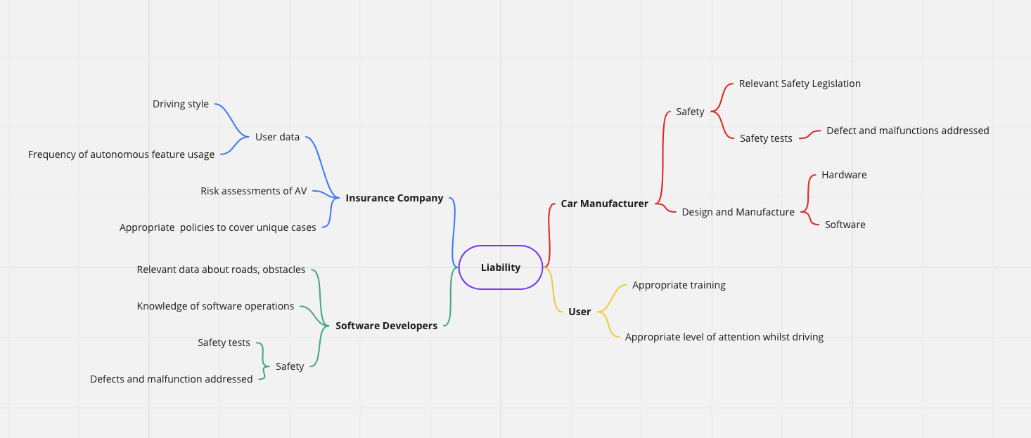
what information each potentially liable party would need to enable them to accept liability?

Slide 7
sources
https://content.naic.org/cipr-topics/autonomous-vehicles#:~:text=According%20to%20the%20National%20Highway,expected%20to%20constantly%20monitor%20theAreas
https://www.sae.org/about/history
https://www.mayerbrown.com/en/perspectives-events/publications/2022/03/new-regulations-to-govern-driverless-cars-in-the-uk
https://www.progressive.com/answers/insurance-for-driverless-cars/
https://www.entrepreneur.com/living/what-happens-when-self-driving-cars-crash-the-rise-of/436942#:~:text=From%20July%202021%20to%20May,least%20partial%20automated%20control%20systems.
https://www.npr.org/2022/06/15/1105252793/nearly-400-car-crashes-in-11-months-involved-automated-tech-companies-tell-regul
https://www.policygenius.com/auto-insurance/car-insurance-for-self-driving-and-autopilot-cars/#:~:text=Some%20car%20makers%20that%20make,all%20offer%20their%20own%20insurance.
https://www.nature.com/articles/s41598-022-19876-0
https://www.forbes.com/sites/naveenjoshi/2022/08/05/5-moral-dilemmas-that-self-driving-cars-face-today/
https://www.mdpi.com/2032-6653/12/2/62/htm
https://www.ntsb.gov/investigations/accidentreports/reports/har1903.pdf

