Slide 1
Application of Deep Learning Frameworks for Classification of Cancer-Related Discussion Posts
Thomas Durkin & Sarah Logan
December 6, 2022

Slide 2
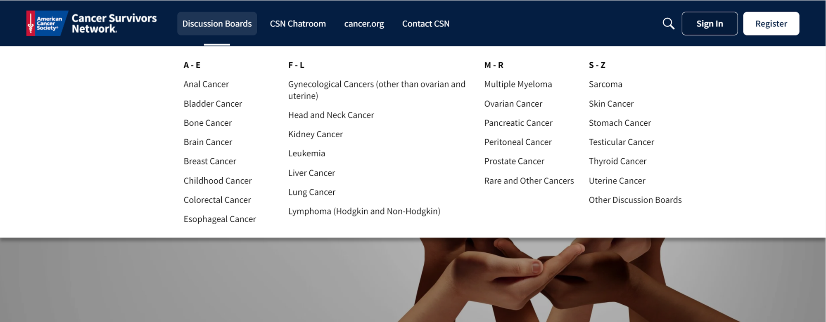
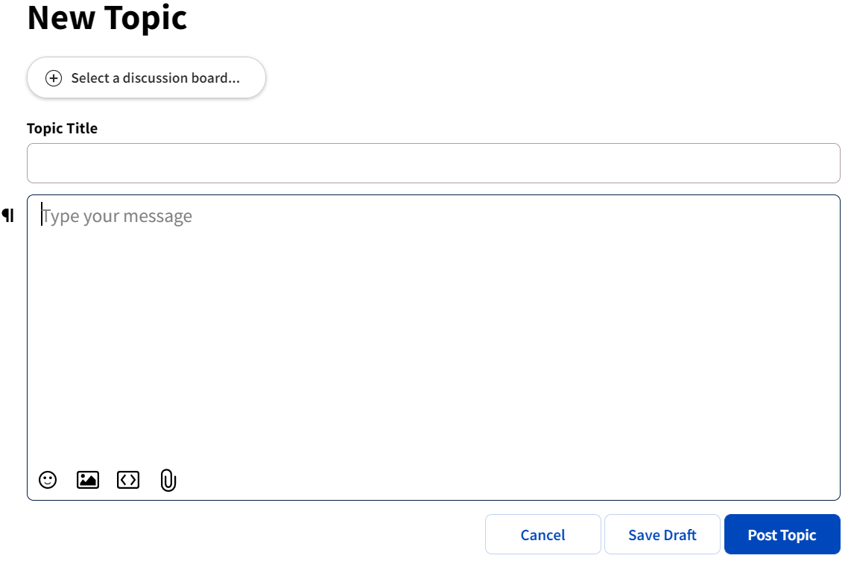
Motivation
Cancer is the second leading cause of death in the United States [1]
Cancer patients seek out support through online discussion forums, such as the American Cancer Society’s Cancer Survivors Network
There are 27 discussion boards
Goal: predict and recommend which discussion board to post to as a user writes their post

Slide 3
Research Questions
Can we utilize discussion posts from CSN and deep learning frameworks to develop a classifier that predicts which discussion board a post should go to with high accuracy?
How does our work and our models compare to other research [2] that has been done on classifying text using deep learning?

Slide 4
Data Collection
Discussion posts were scraped from the Cancer Survivors Network if the thread had a reply between 2018 and 2021
In total, we collected 102,546 posts
Discussion boards with < 1,000 posts were removed from consideration in our classifier
14 categories were kept

Slide 5
Data Cleaning
Emojis were convert to text
All punctuation was removed
Remove stopwords and numbers
Discard all words less than 2 characters

Slide 6
Modeling
Vocab size of 80,000
Test size of 20%
Model | Accuracy
CNN | 63.8%
RNN | 42.7%
Bidirectional LSTM | 69.6%
Transformer | 67.8%

Slide 7
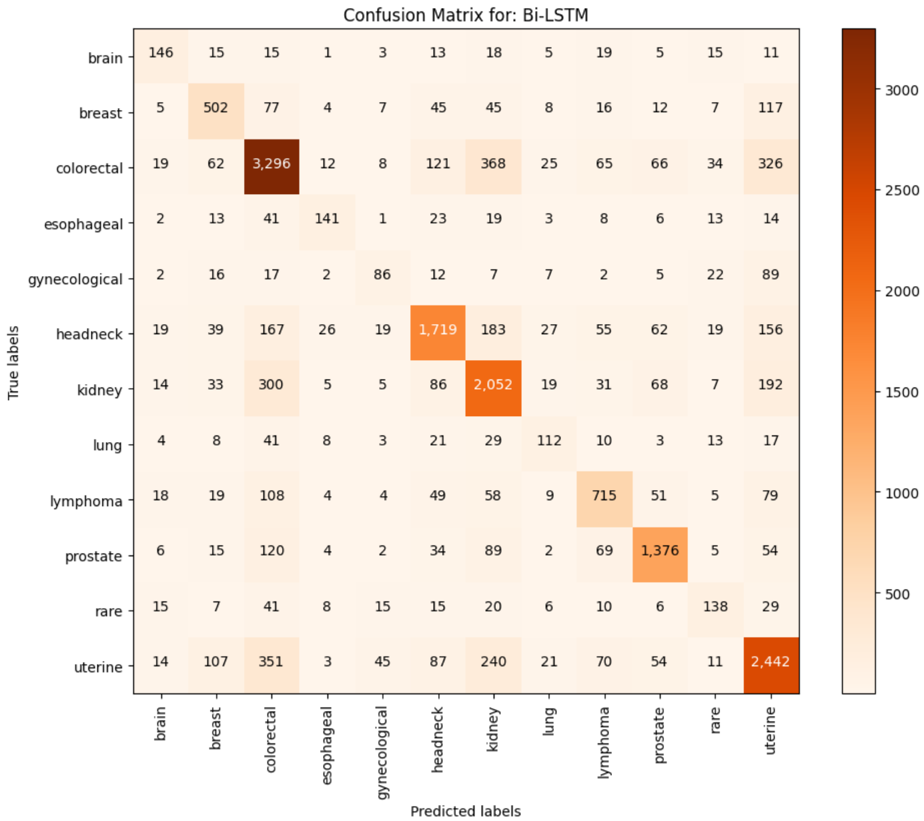
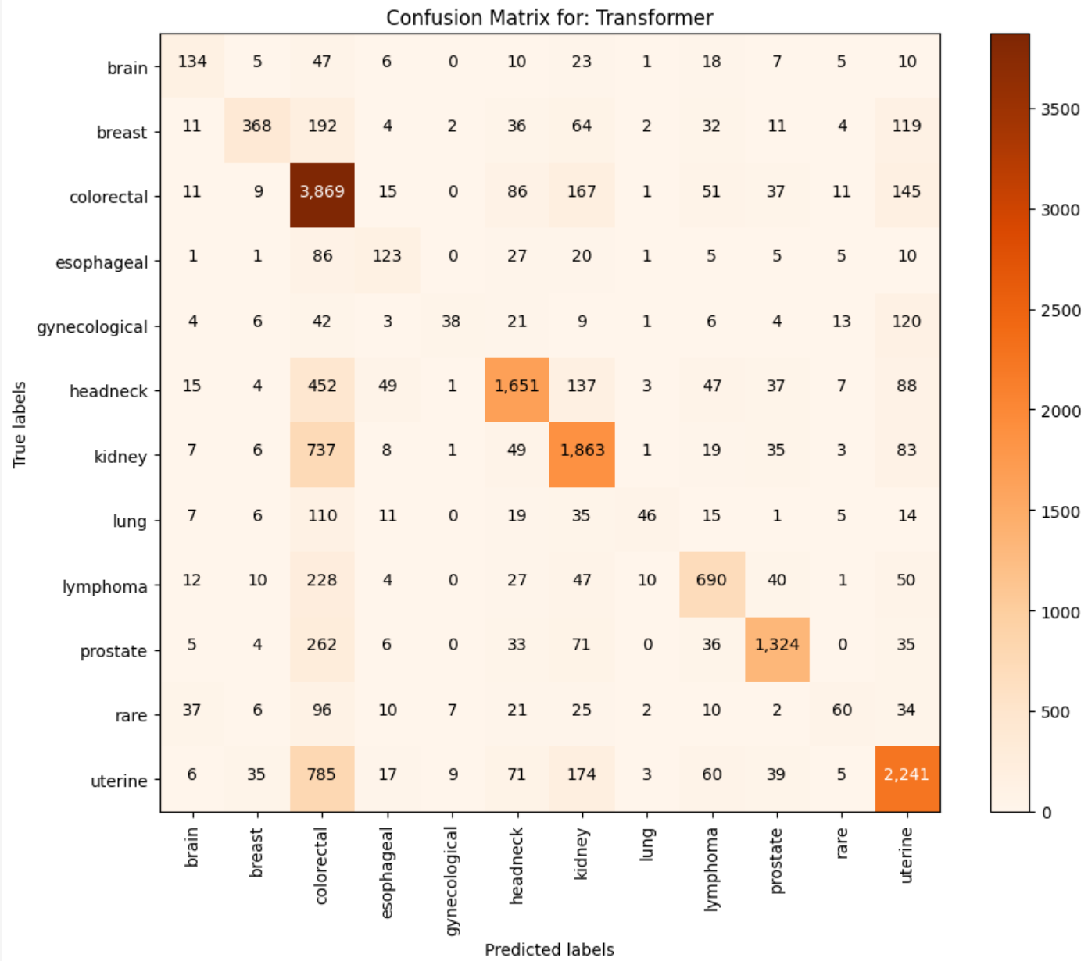
Results of Top 2 Models

Slide 8
Next Steps
What is causing the colorectal and uterine categories to falsely predicted?
Utilize embedding models (GLOVE and SBERT)
Stacking models

Slide 9
References
R. L. Siegel, K. D. Miller, H. E. Fuchs, and A. Jemal, “Cancer statistics, 2022”, CA: A Cancer Journal for Clinicians, 2022.
H. Lu, L. Ehwerhemuepha, and C. Rakovski, “A comparative study on Deep Learning models for text classification of unstructured medical notes with various levels of class imbalance”, BMC Medical Research methodology, 2022.

