Slide 1

Supersize America
Team 11
Harry Heublum, Tom Duszyk, Lena Kim, Jack Phinney

Slide 2
Motivation and Summary
Project Description:
Our project is to uncover patterns and trends between fast food restaurants and census data. We will examine the correlation and relationship between most popular fast food restaurants and demographic data such as professions, poverty rate, and unemployment rate.
Data Sets:
Fast Food America (CSV file , Kaggle)
US Census Data 2017

Slide 3
Questions:
Most popular FFR by state?
Correlation between white collar jobs and FFR?
Correlation between unemployment rate and FFR?
Correlation between income and FFR?

Slide 4
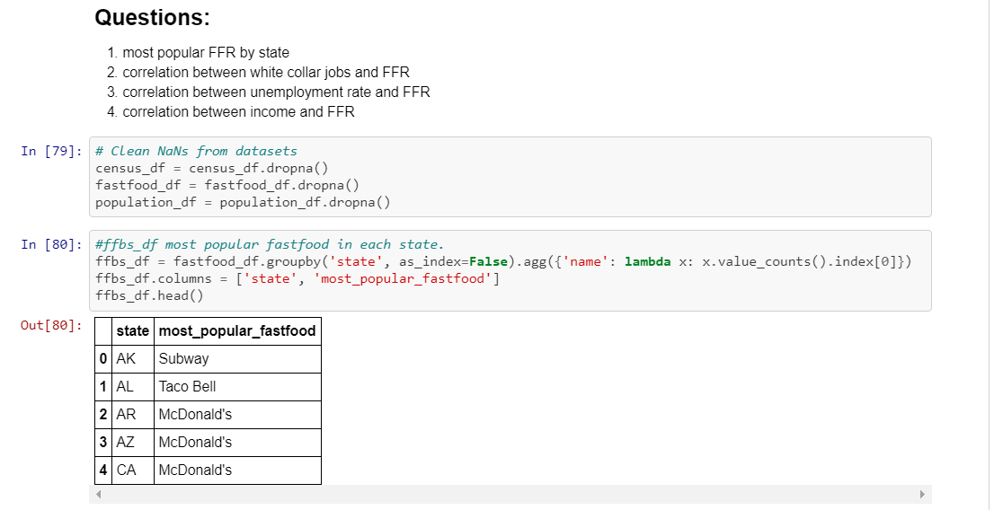
Data cleanup and exploration

Slide 5
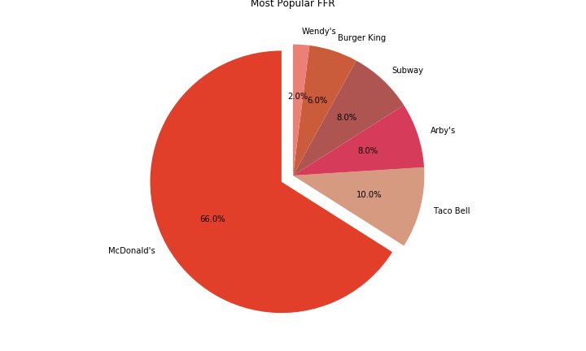

Slide 6
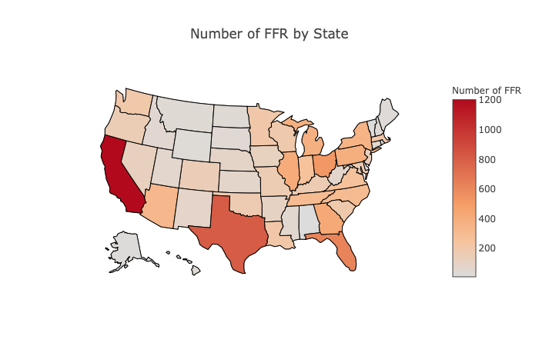
CA has the highest number of FFR.
AK has the lowest number of FFR.

Slide 7
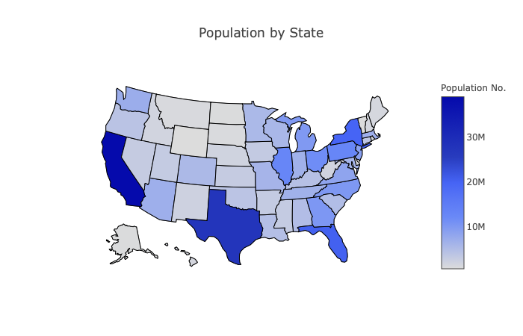
CA has the biggest population
TX is
the second biggest

Slide 8
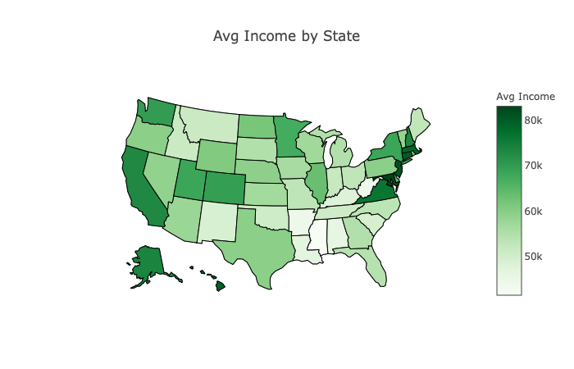
MD is the highest avg income state
MS is the lowest avg income state

Slide 9
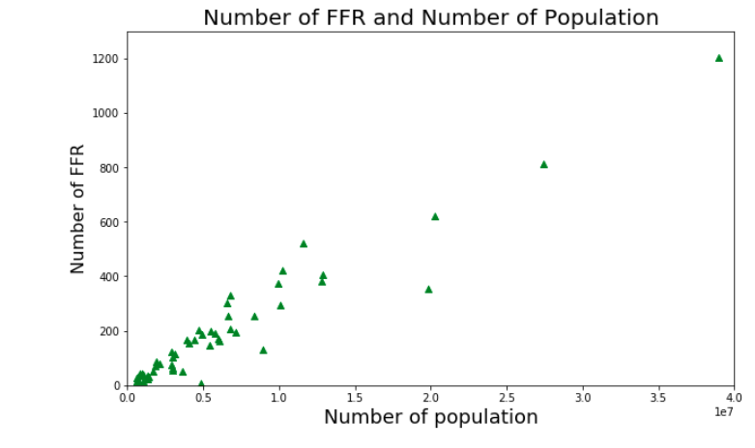
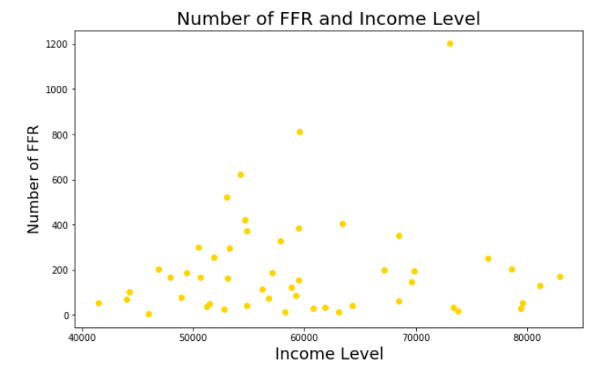
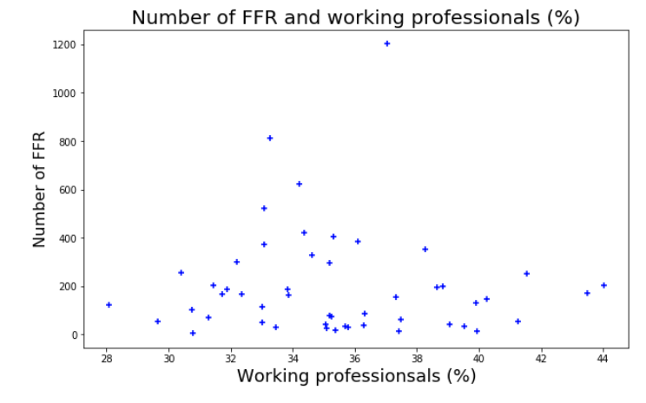
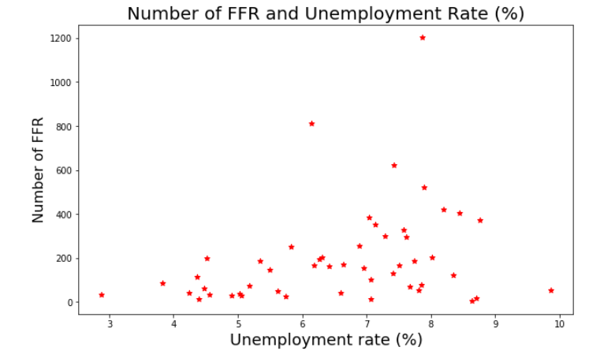
Data Analysis

Slide 10
conclusion
The biggest state by population (California) had the most fast foods and the smallest state by population (Alaska) had one of the least amount of fast foods.
We also found that McDonald’s was the most popular fast food restaurant in the dataset.
This wasn’t that much of a surprise since McDonald’s is so widely known in America. McDonald’s serves the classic American food which appeals to a lot of Americans. McDonald’s is also kid-friendly which grows its popularity.
We found Houston, Texas was the city with most fast food restaurants. This also wasn’t much of a surprise since in our analysis of states, Texas was the second most popular state for fast food.

Slide 11
Post Mortem
Some difficulties that came up were merging the two datasets. We had to convert the Census dataset ‘state name’ to its ‘state abbreviation’. We found someone who converted all state names to state abbreviations so we didn’t have to type this all out in python.
As we expected to see some correlation between people income or profession as well, the datasets didn’t show much of correlation. However, given the fact that the datasets were by states, not by cities, if we dug data into cities, we may find some relevance between variables. And eventually answer to a question like “is there a correlation between the population of a city and the number of FFR?

Slide 12
Questions
Open-floor Q&A with the audience

