Slide 1
An approach for cities clustering
Phuc Tran Duy

Slide 2
Introduction
One of the most concern problems of international companies when entering new market is understanding market’s culture.
They can apply their success case studies of similar market in order to reduce analytic and research effort for new market.
To achieve this, they must have a method to measure how similar one city with others.

Slide 3
Data acquisition and cleaning
Google map API
Foursquare API
US cities dataset

Slide 4
Data acquisition and cleaning
Remove duplicate city name in US cities dataset
Remove missing population information records
Only get top 3 highest population in each state

Slide 5
Feature selection
Feature selection
Select venue categories and assign to them which city they belong to
Category | City
Coffee Shop | Dallas
Bar | San Diego
Park | Los Angeles

Slide 6
EDA
There are 420 unique categories were found in our dataset.
Top 10 most popular venue categories:
Category | Count
Coffee Shop | 677
American Restaurant | 655
Pizza Place | 601
Park | 509
Brewery | 498
Mexican Restaurant | 420
Bar | 358
Grocery Store | 355
Italian Restaurant | 332
Ice Cream Shop | 317

Slide 7
Feature vector
Transform each venue to one-hot encoding vector.
Coffee Shop | Restaurant | Park | … | Grocery Store
1 | 0 | 0 | … | 0
0 | 1 | 0 | … | 0
0 | 0 | 0 | … | 1
Group these vectors by city name, then calculate average of appearance of each venue --> Feature vector
City | Coffee Shop | Restaurant | Park | … | Bar
Miami | 0.2 | 0.1 | 0.05 | … | 0.1
Dallas | 0.15 | 0.08 | 0.03 | … | 0.07

Slide 8
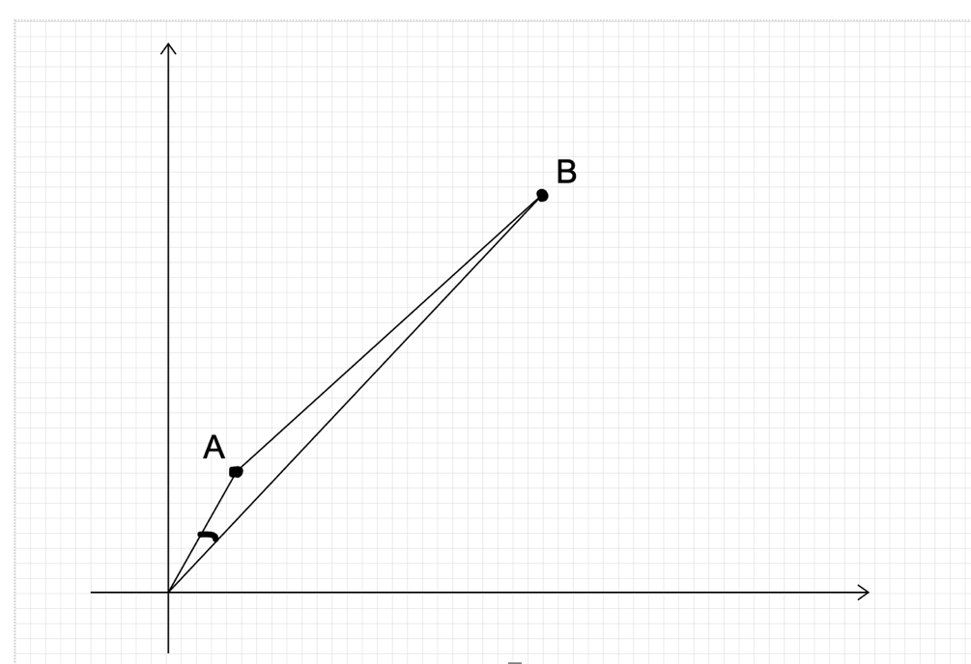
Cosine similarity
Euclidean distance between two point A and B can be long.
The angle which created between them are small.
Euclidean distance doesn’t work well with our frequency vectors, but cosine similarity does.

Slide 9
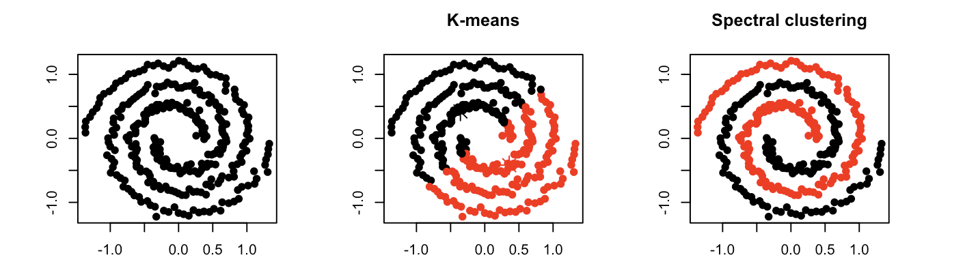
Spectral clustering vs K-Means

Slide 10
Spectral clustering steps
1. Compute a similarity graph
2. Project the data onto a low-dimensional space
3. Create clusters

Slide 11
Example of similarity matrix
 | Dallas | San Diego | Phoenix
Dallas | 1 | c_s(Dallas, San Diego) | c_s(Dallas, Phoenix)
San Diego | c_s(San Diego, Dallas) | 1 | c_s(San Diego, Phoenix)
Phoenix | c_s(Phoenix, Dallas) | c_s(Phoenix, San Diego) | 1
c_s(x, y): cosine similarity function

Slide 12
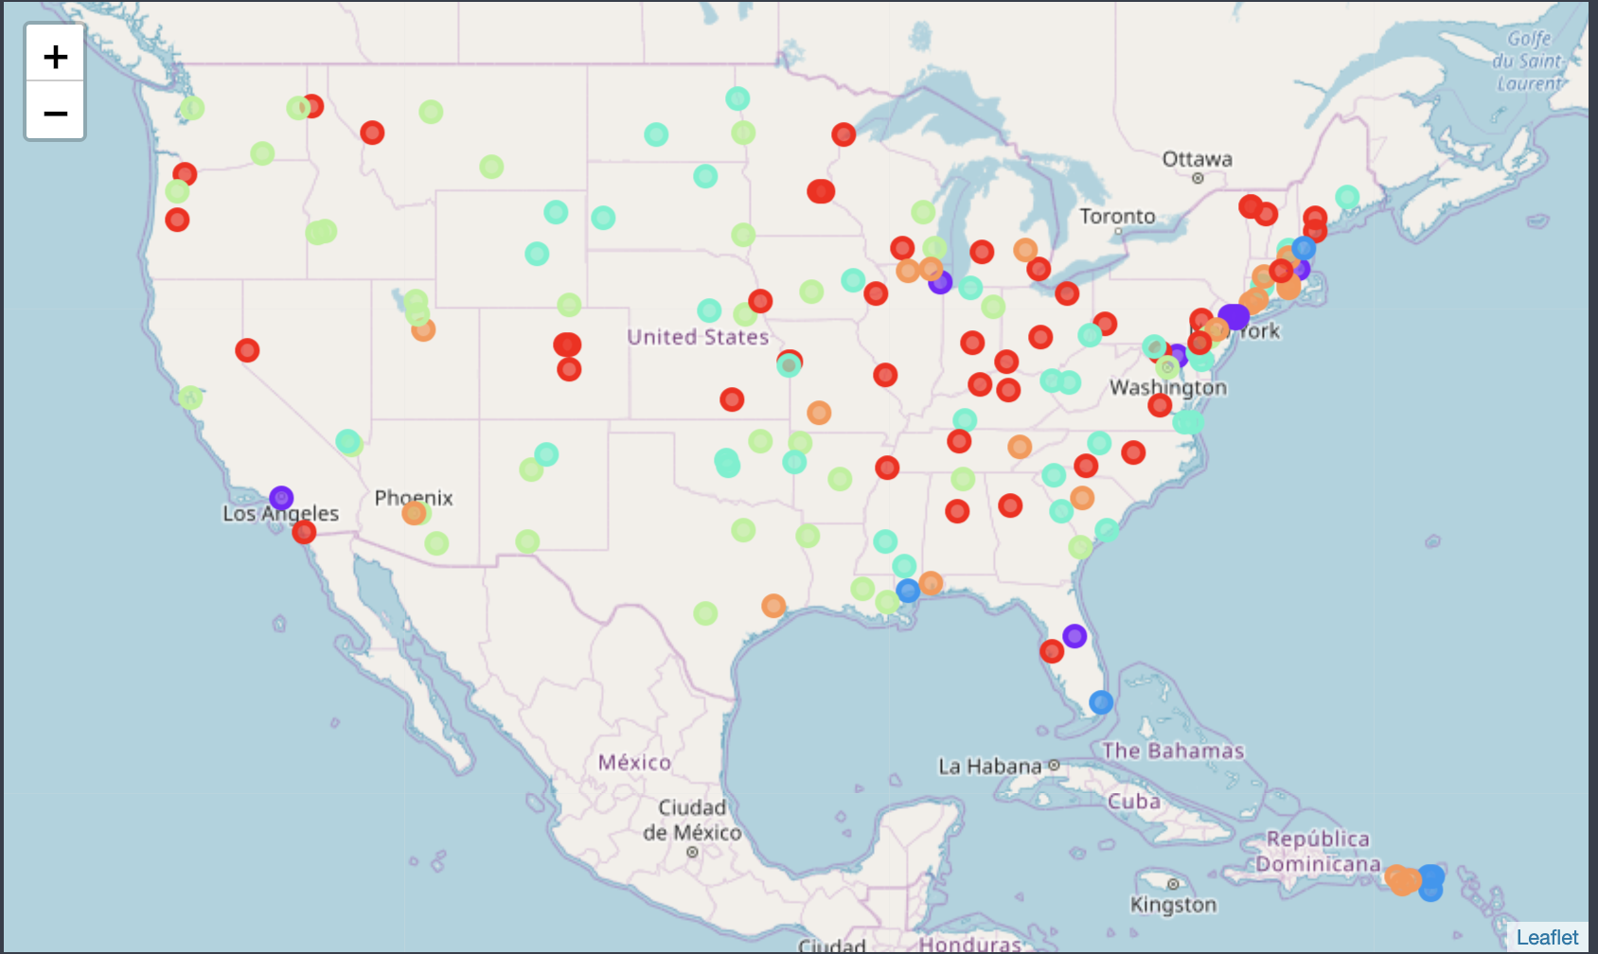
Spectral clustering
Spectral clustering:
n-cluster: 6
Affinity: ‘precompute’
random_state: 0

Slide 13
Conclusion and future directions
Proposed an approach for clustering cities in USA base on their venues.
Point out why cosine similarity is better suite than Euclidean distance for this problem.
Apply for more cities around the world

Slide 14
Reference
https://towardsdatascience.com/spectral-clustering-82d3cff3d3b7
http://ai.stanford.edu/~ang/papers/nips01-spectral.pdf

